Slide 1
Exploring Hydropower

Slide 2
Notes:
Understanding the water cycle is important in order to understand hydropower. The energy driving the water cycle comes from radiant energy released by the sun that heats the water and causes it to evaporate.

Slide 3
Gravitational Energy
Notes:
In addition to the water cycle, hydropower is dependent upon stored gravitational energy. A rock on top of a hill contains potential energy because of its position. If a force pushes the rock, it rolls down the hill because of the force of gravity. Potential energy is then converted to kinetic energy until it reaches the bottom of the hill and stops.

Slide 4
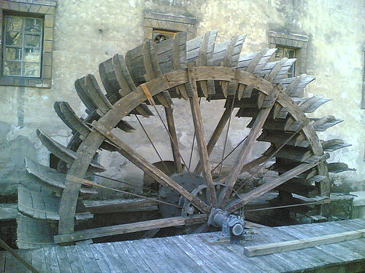
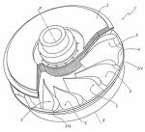
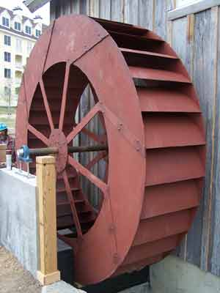
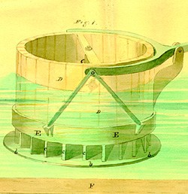
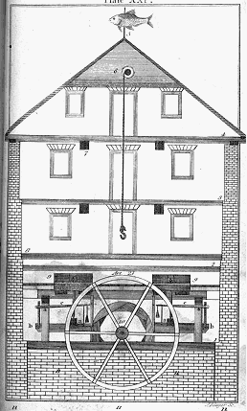
Harnessing Water Power
Notes:
Humans have used the power of moving water for more than 2,000 years. The first references to water mills are found in Greek, Roman, and Chinese texts. They described vertical waterwheels in rivers and streams. These traditional waterwheels turned as the river flowed, turning millstones that ground grains.
In the late 1700s, an American named Oliver Evans designed a mill that combined gears, shafts and conveyors. After grain was ground, it could be transported around the mill. The invention led to waterwheels being the main power source for sawmills, textile mills and forges through the 19th century.
In 1826, a French engineer, Jean Victor Poncolet, designed an even more efficient water wheel. The wheel was enclosed so the water flowed through the wheel instead of around it.

Slide 5
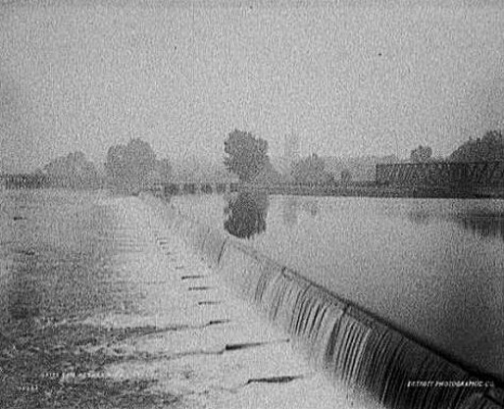
World’s First Hydropower Plant
The dam across Fox River in Appleton, Wisconsin, the site of the first hydroelectric power plant in the world (1882).
CREDIT: “Dam across river, Appleton, Wis.,” 1880-1889. Prints and Photographs Division, Library of Congress. Reproduction Number LC-D4-4783 DLC.
Notes:
In 1880, the Grand Rapids Electric Light and Power Company used a water turbine to generate enough electricity to power 16 lights. Soon after, in 1882, the world’s first hydroelectric power plant began operation on the Fox River in Appleton, WI. The plant, later named the Appleton Edison Light Company, was initiated by Appleton paper manufacturer H.F. Rogers, who had been inspired by Thomas Edison's plans for an electricity-producing station in New York. When you look at rushing waterfalls and rivers, you may not immediately think of electricity but hydroelectric power plants are responsible for lighting many of our homes and neighborhoods.

Slide 6
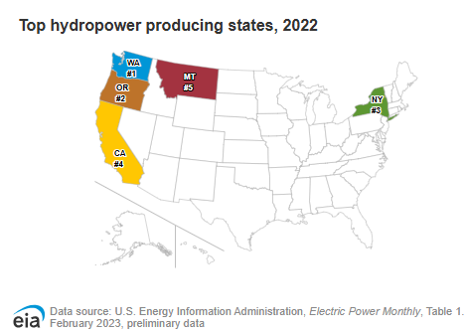
Hydropower Producing States, 2022
The top five states and their percentage shares of U.S. total conventional hydroelectricity generation (not generation capacity) in 2022 were
Washington 27%
California 13%
Oregon 10%
New York 6%
Alabama 4%
Source: EIA
Notes:
About half of U.S. hydroelectricity generation capacity is in Washington, California, and Oregon.
Washington has the most hydroelectric generating capacity of any state and is the site of the Grand Coulee Dam, the largest hydropower facility in the United States. New York has the largest hydroelectricity generation capacity of all states east of the Mississippi River, followed by Alabama.
It is important to note that only a small percentage of all dams in the U.S. produce electricity. Most dams were constructed solely to provide irrigation and flood control.

Slide 7
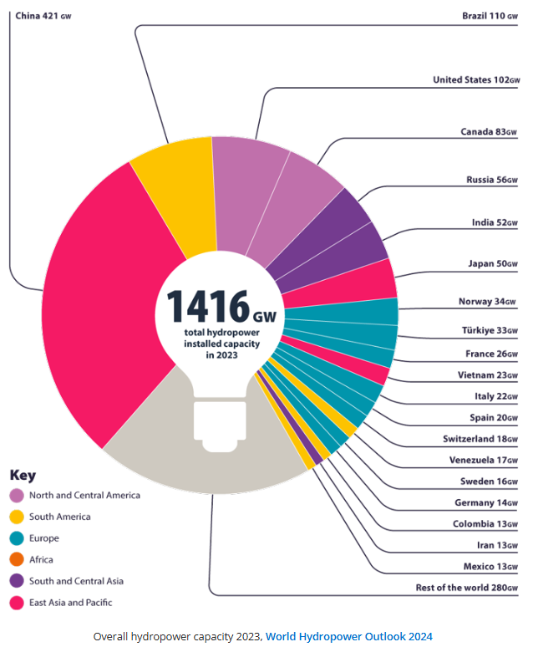
Data: International Hydropower Association
Notes:
China, Brazil, the USA, Canada and India are the largest hydropower producing countries by installed capacity.

Slide 8
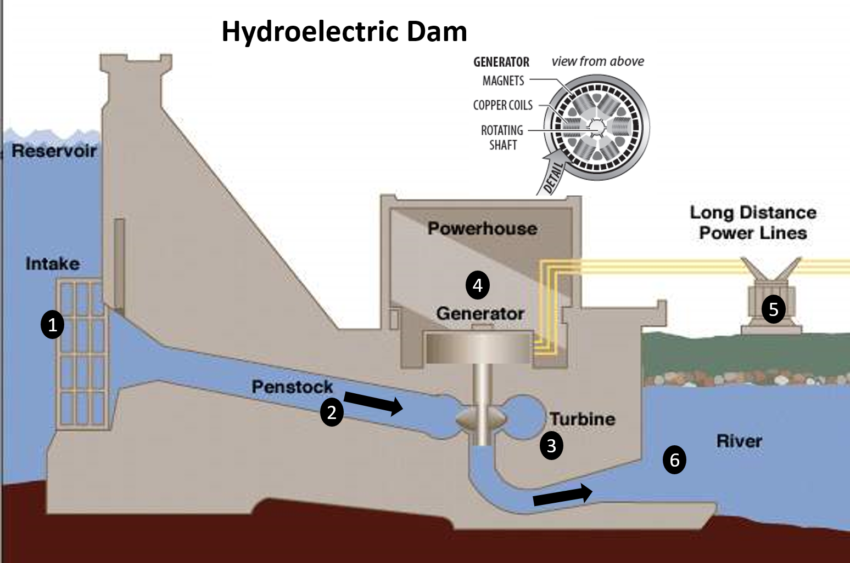
DAM
Notes:
So just how do we get electricity from water? Controlled flowing water is the power source used to turn a propeller-like piece called a turbine. The turbine then turns a metal shaft in an electric generator, which is the device that produces electricity.
The idea is to build a dam on a large river that has a large drop in elevation. There are not many hydroelectric plants in Kansas or Florida where rivers travel on flat land. The dam stores lots of water behind it in the reservoir. Near the bottom of the dam wall there is a water intake. Gravity causes it to fall through the penstock inside the dam. At the end of the penstock there is a turbine propeller, which is turned by the moving water. The shaft from the turbine goes up into the generator, which produces the power. Power lines are connected to the generator that carry electricity to your home and mine. The water continues past the propeller through the tailrace into the river past the dam and exits with great force.

Slide 9
Turbine Generator
Notes:
In a hydropower plant, a hydraulic turbine converts the energy of flowing water into mechanical energy. A hydroelectric generator converts this mechanical energy into electricity. The operation of a generator is based on the principles discovered by Faraday. He found that when a magnet is moved past a conductor (in this case, coils of copper wire), it causes electricity to flow through the wire.
In a hydropower plant, a hydraulic turbine converts the energy of flowing water into mechanical energy. A hydroelectric generator converts this mechanical energy into electricity. The operation of a generator is based on the principles discovered by Faraday. He found that when a magnet is moved past a conductor (in this case, coils of copper wire), it causes electricity to flow through the wire.

Slide 10
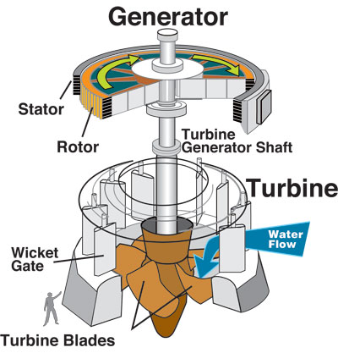
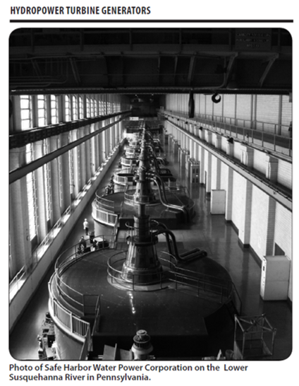
Notes:
In a large generator, electromagnets are made by circulating direct electrical current through loops of wire wound around stacks of magnetic steel laminations. These are called field poles, and are mounted on the perimeter of the rotor. The rotor is attached to the turbine shaft, and rotates at a fixed speed. When the rotor turns, it causes the field poles (the electromagnets) to move past the conductors mounted in the stator, or the wall. This, in turn, causes electricity to flow and a voltage to develop at the generator output terminals.
Rotational Speed
The rotational speed of the generator is usually the same as the speed of the turbine, because they are directly connected. Some plant designs incorporate a speed-increasing gearbox between the turbine and generator. The speed of the turbine is determined by the design and hydraulic conditions. Speeds for hydro generators are typically in the range of 50 and 600 revolutions per minute (rpm). For a generator operating in a 60-Hz system, the rotational speed (in rpm) times the number of field poles on the rotor is always 7,200.
The Stator
The stator is a donut-shaped structure surrounding the rotor. The stator is made up of a steel frame supporting stacked steel laminations. The conductors, called the stator winding, are recessed in slots in this lamination structure. The stator winding is arranged so that when the rotor turns, the field poles pass only a fraction of an inch from it. The movement of the magnet next to the conductor causes electricity to flow in the conductor. Stator windings of larger generators are made up of individual stator coils. Each coil is made of multiple strands of copper. In a modern insulation system, the copper is insulated with mica held in place with an epoxy or polyester resin. The individual coils are connected to each other through jumpers and then to a ring bus. The ring bus is connected to the generator leads, which in turn are connected to a power step-up transformer. Finally, the transformer is connected to electrical power grid. Some generator designs use half-coils (bars) in lieu of full coils.

Slide 11
Advantages
Renewable Energy
Clean Energy Source
Domestic Energy Source
Generally Available As Needed
Provides Recreational Opportunities
Water Supply and Flood Control
Notes:
Hydropower is a fueled by water, so it's a clean fuel source. Hydropower doesn't pollute the air like power plants that burn fossil fuels, such as coal or natural gas.
Hydropower is a domestic source of energy, produced in the United States.
Hydropower relies on the water cycle, which is driven by the sun, thus it's a renewable power source.

Slide 12
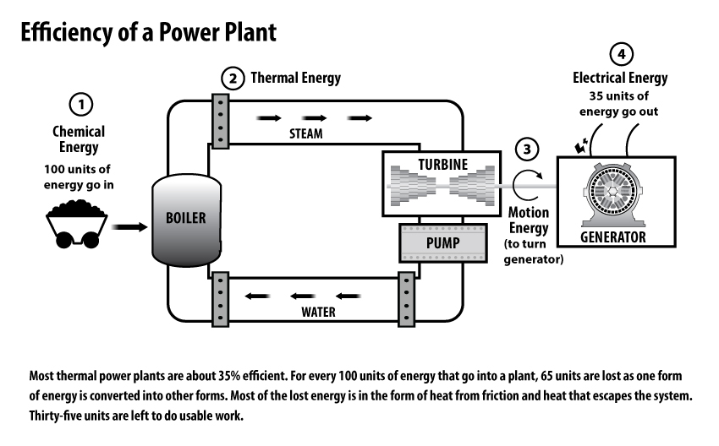
Power Plant Efficiency
Notes:
Another advantage is the high efficiency of hydroelectric power plants.
Efficiency of a power plant is determined by calculating the amount of energy going into a power plant compared to the amount of useful energy generated by the plant. In the case of most thermal power plants, for every 100 units of energy (coal, natural gas, etc.) that go into that plant, only 35 units of electricity are produced. This means they are only 35% efficient. 65 units are converted into other types of energy (mostly heat which is dissipated into the atmosphere).

Slide 13
Coal vs. Hydro Kinetic Energy Conversion
35%
95%
Notes:
A hydropower plant, on the other hand, converts about 95 percent of kinetic energy of the water flowing through the system into electricity.

Slide 14
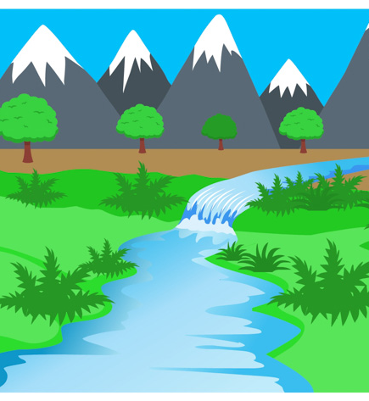
Possible Environmental Impacts
Fish Population
Quality and Flow of Water
Ecosystems of Rivers and Streams
Notes:
A hydropower plant produces no air pollution because it does not burn fuel, but hydro-powered electricity is not without its drawbacks and does affect the environment in other ways.
Fish populations can be impacted if fish cannot migrate upstream past impoundment dams to spawning grounds or if they cannot migrate downstream to the ocean. Upstream fish passage can be aided using fish ladders or elevators, or by trapping and hauling the fish upstream by truck. Downstream fish passage is aided by diverting fish from turbine intakes using screens or racks or even underwater lights and sounds, and by maintaining a minimum spill flow past the turbine.
Hydropower can impact water quality and flow. Hydropower plants can cause low dissolved oxygen levels in the water, a problem that is harmful to riparian (riverbank) habitats and is addressed using various aeration techniques, which oxygenate the water. Maintaining minimum flows of water downstream of a hydropower installation is also critical for the survival of riparian habitats.
In addition to the significant threat that dams pose to fish populations and the ecosystems of rivers and streams, hydropower can negatively impact both the flow and quality of water. Lower levels of oxygen in the water can present a threat to animal and plant life. However, these issues can be addressed if fish ladders are put in place to ensure safe passage around the area, and the water is aerated on a regular basis to maintain adequate oxygen levels safe for animal and plant life . The flow of water should be monitored closely to prevent the ecological dangers associated with over-stressing bodies of water. These dangers can easily be avoided by shutting down pumping operations temporarily to allow balance to return to damaged ecosystems.

Slide 15
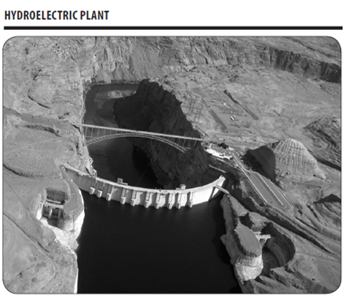
Other Disadvantages
Drought
Impact on Local Environment and Land Use
Preservation Concerns
Notes:
Hydropower can be impacted by droughts. When water is not available, the hydropower plants can’t produce electricity.
New hydropower facilities impact the local environment and may compete with other uses for the land. Those alternative uses may be more highly valued than electricity generation. Humans, flora, and fauna may lose their natural habitat.
Local cultures and historical sites may be impinged upon. Some older hydropower facilities may have historic value, so renovations of these facilities must also be sensitive to such preservation concerns and to impacts on plant and animal life.

Slide 16
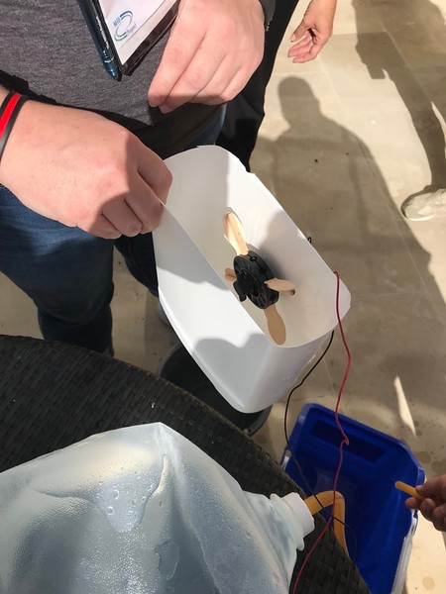
For More Information
NEED’s Hydropower Resources: www.need.org/resources/hydropower-materials/
The NEED Project
www.need.org
info@need.org
1-800-875-5029
U.S. Energy Information Administration
www.eia.gov
EIA Kids - Hydropower: www.eia.gov/kids/energy-sources/hydropower

