Slide 1
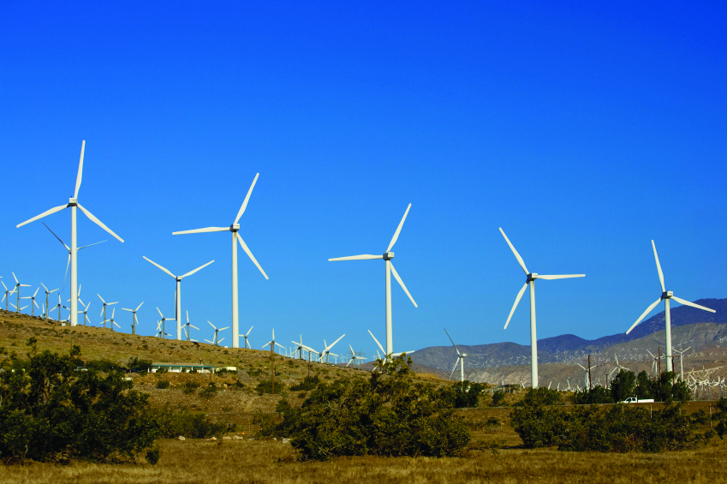
Exploring Wind Energy

Slide 2
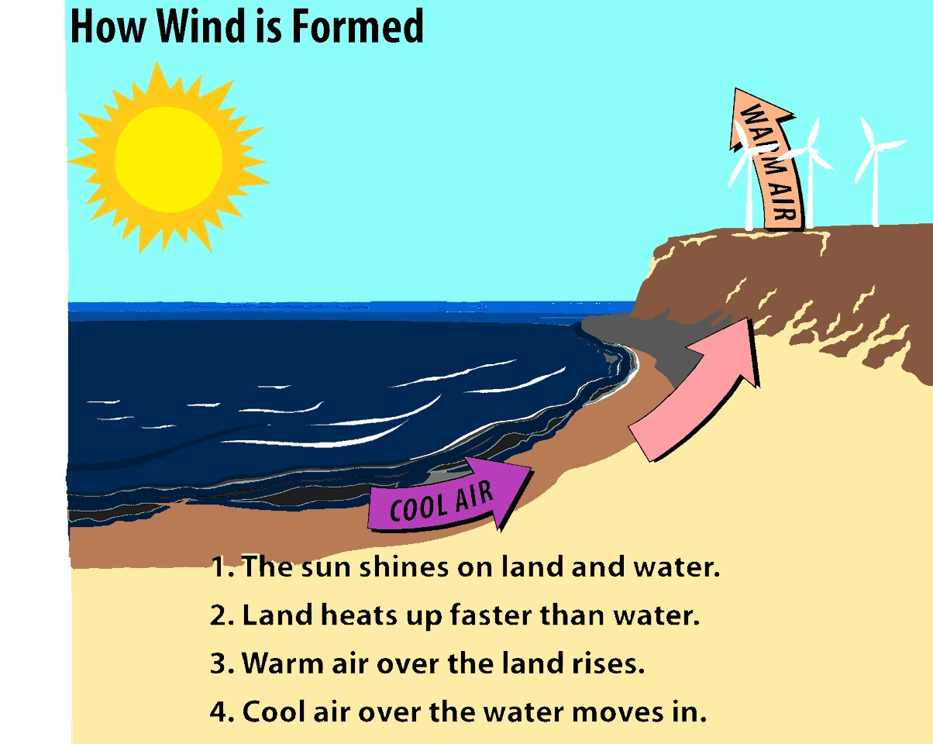
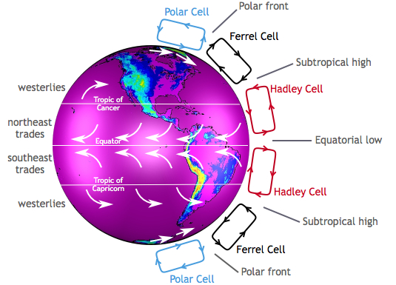
Wind Formation
Image source: Center for Multiscale modeling of Atmospheric Processes via NASA
Notes:
Wind is the result of uneven heating of the earth. Land heats and cools faster than water. In the day, warm air expands and rises, and cooler air from the water moves in to take its place; at night the opposite occurs. Water doesn’t have to be present for wind to occur, though. Differences in atmospheric pressure, along with the Coriolis effect on the atmosphere, result in wind patterns. In the Northern Hemisphere, for the most part, weather patterns follow the westerlies and move west-to-east. Storm systems can disrupt this pattern.

Slide 3
History of Wind Energy
5000 BC
Sailboats used on the Nile indicate the power of wind
500-900 AD
First windmills developed in Persia
1300 AD
First horizontal-axis
windmills in Europe
1850s
Daniel Halladay and
John Burnham build
Halladay Windmill; start
US Wind Engine Company
Late 1880s
Thomas O. Perry
conducted 5,000
wind experiments;
starts Aermotor Company
1888
Charles F. Brush
used windmill to generate electricity
in Cleveland, OH
Early 1900s
Windmills in CA
pumped saltwater
to evaporate ponds
1941
In VT, Grandpa’s
Knob turbine
supplies power to
town during WWII
1979
First wind turbine
rated over 1 MW
began operating
1985
CA wind capacity
exceeded 1,000 MW
1993
US WindPower developed
first commercial variable-speed wind turbine
2004
Electricity from
wind generation
costs 3 to 4.5 cents per kWh
2016
Block Island Offshore Wind Farm was brought online (US’s first offshore wind farm)
2022
Wind power provided
10.25% of electricity in the United States
Notes:
Wind energy has been used for millennia to help people accomplish several tasks. The first electricity-generating wind turbine was installs in Vermont. Grandpa’s Knob turbine was made with steel vanes and because of its rigid nature, did not survive long in Vermont’s harsh winter winds. The first variable-speed, utility-scale wind turbine was developed by US WindPower in 1993, and wind energy saw exponential growth in the first two decades of the 21st century. Today wind energy provides the most electricity of any renewable energy source. In 2022, it accounted for just over 10 percent of all electricity generated in the US.

Slide 4

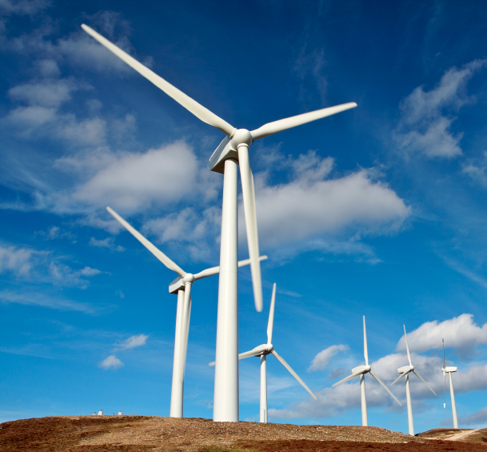
Why Should We Use Wind Energy?
Clean, zero emissions
  NOx, SO2, CO, CO2
  Air quality, water quality
  Climate change
Reduce fossil fuel dependence
  Energy independence
  Domestic energy—national security
Renewable
  No fuel-price volatility
Notes:
There are several reasons to use wind energy. First, at the point of generation, there are no pollutants or emissions that contribute to poor air quality or climate change. (This does not take into account the impacts of steel, concrete, fiberglass, and transportation to construct the turbine.)
Because there is no tax or fee associated with wind energy, it is not subject to volatility of market prices the way natural gas and petroleum are. And because wind energy is available domestically, it reduces our dependence on imported electricity from Canada and imported oil, too, as electric vehicles become more prominent.

Slide 5
Rapid Growth of Wind Generation
Data Source: EIA
Notes:
This chart shows the amount of electricity, in thousand megawatt-hours, generated by each of the renewable energy sources. Wind is represented by the slightly thicker, teal line. As you can see, the amount of electricity generated by wind energy started to rapidly grow between 2005 and 2010.
The data is from the EIA, and only goes back to 2001.

Slide 6
Global Wind Installed Capacity vs. Time
Data Source: EIA
Notes:
This chart shows how wind installed capacity, in million kilowatts, has grown over time. It reflects the growth seen in the US, with small amounts installed in the early 2000s, and exponential growth starting in 2005. The total installed wind generating capacity in 2021 was just over 823 million kilowatts.

Slide 7
Data Source: EIA
Notes:
These are the top ten countries for installed wind capacity as of 2021. China has been leading the world in installing coal, natural gas, hydropower, wind, and solar generating capacity for the last several years.

Slide 8
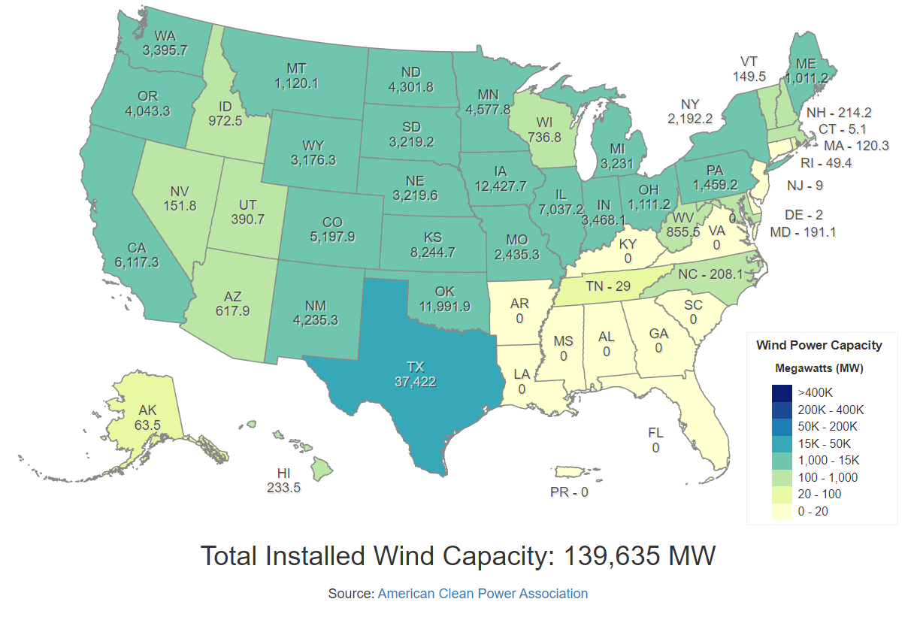
Top Wind Power Producing States, 2022
Rank | State
1 | Texas
2 | Iowa
3 | Oklahoma
4 | Kansas
5 | California
Notes:
Texas has been producing the most wind energy for at least the last ten years. States in the Midwest often shift in rank as new wind farms are installed. As offshore wind programs go online, expect to see California’s generating capacity, as well as that of states on the northern Atlantic coast, increase. Wind energy is also on the rise in Hawaii and Puerto Rico.

Slide 9
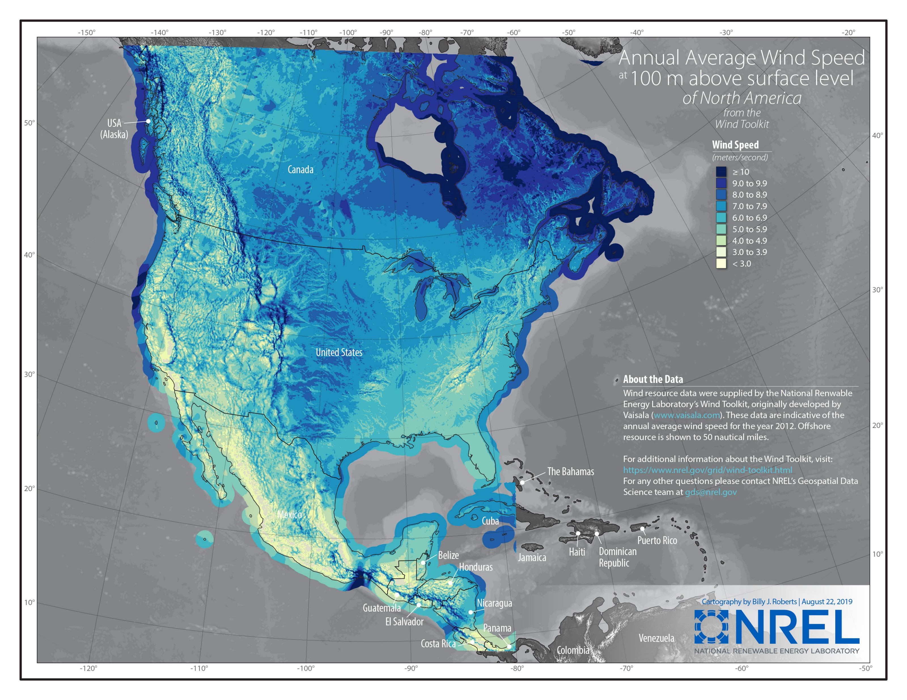
Wind Energy Resource
This map shows the wind speeds at 100 m above surface level for all of North America. Note that areas with strongest winds are also areas with very low population density, while major population centers are not situated near the strongest onshore winds. California’s central coast is an excellent candidate for offshore wind development and is not too far from San Francisco and Sacramento.
Notes:
This map of North America, prepared by NREL, shows where the winds are strongest, including wind speeds offshore. Darker blues indicate stronger winds while pale greens and yellows indicate light winds, usually not strong enough to make wind installations economically feasible. Note that while California itself has relatively light winds, offshore areas have very strong winds. The Maritime Provinces of Canada have great offshore wind potential.

Slide 10
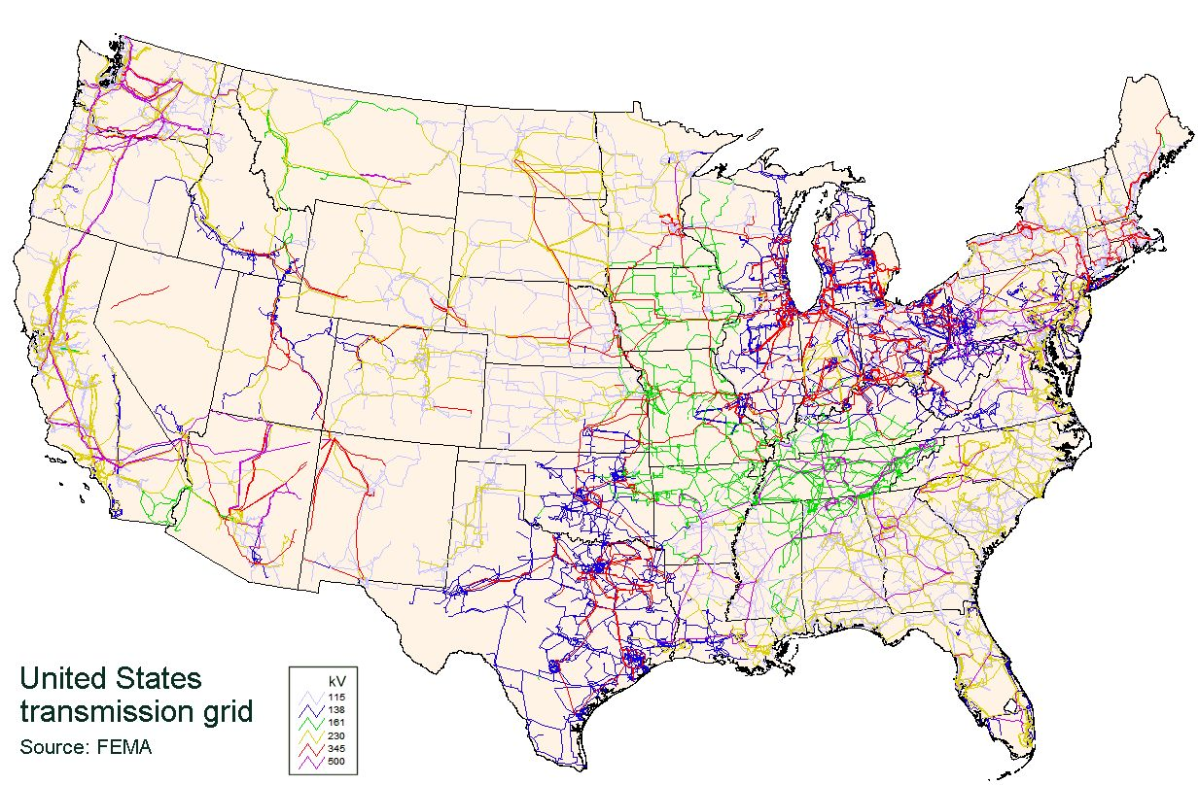
Transmission Challenges
Notes:
This slide is animated so that the transmission grid displays – talk about the location of the major transmission lines and where most people live. Then, when you click forward, an overlay of the NREL Wind resource map from the previous slide will appear. Remind participants of the location of the strongest winds and that they are not located near most population centers, except for offshore winds.
This is a map of the electric grid system of the contiguous United States. The different colors indicate the voltage the lines carry. Higher voltages are needed to carry electricity across greater distances. When the wind strength map from the previous slide is overlaid onto this one, you can quickly see how onshore winds do not align well with high concentrations of transmission lines or high population centers. This is perhaps the biggest challenge for wind energy. Wind turbines in eastern Wyoming, for example, would generate a significant amount of electricity but most of that energy would be lost due to transmission losses before it could reach many customers.

Slide 11
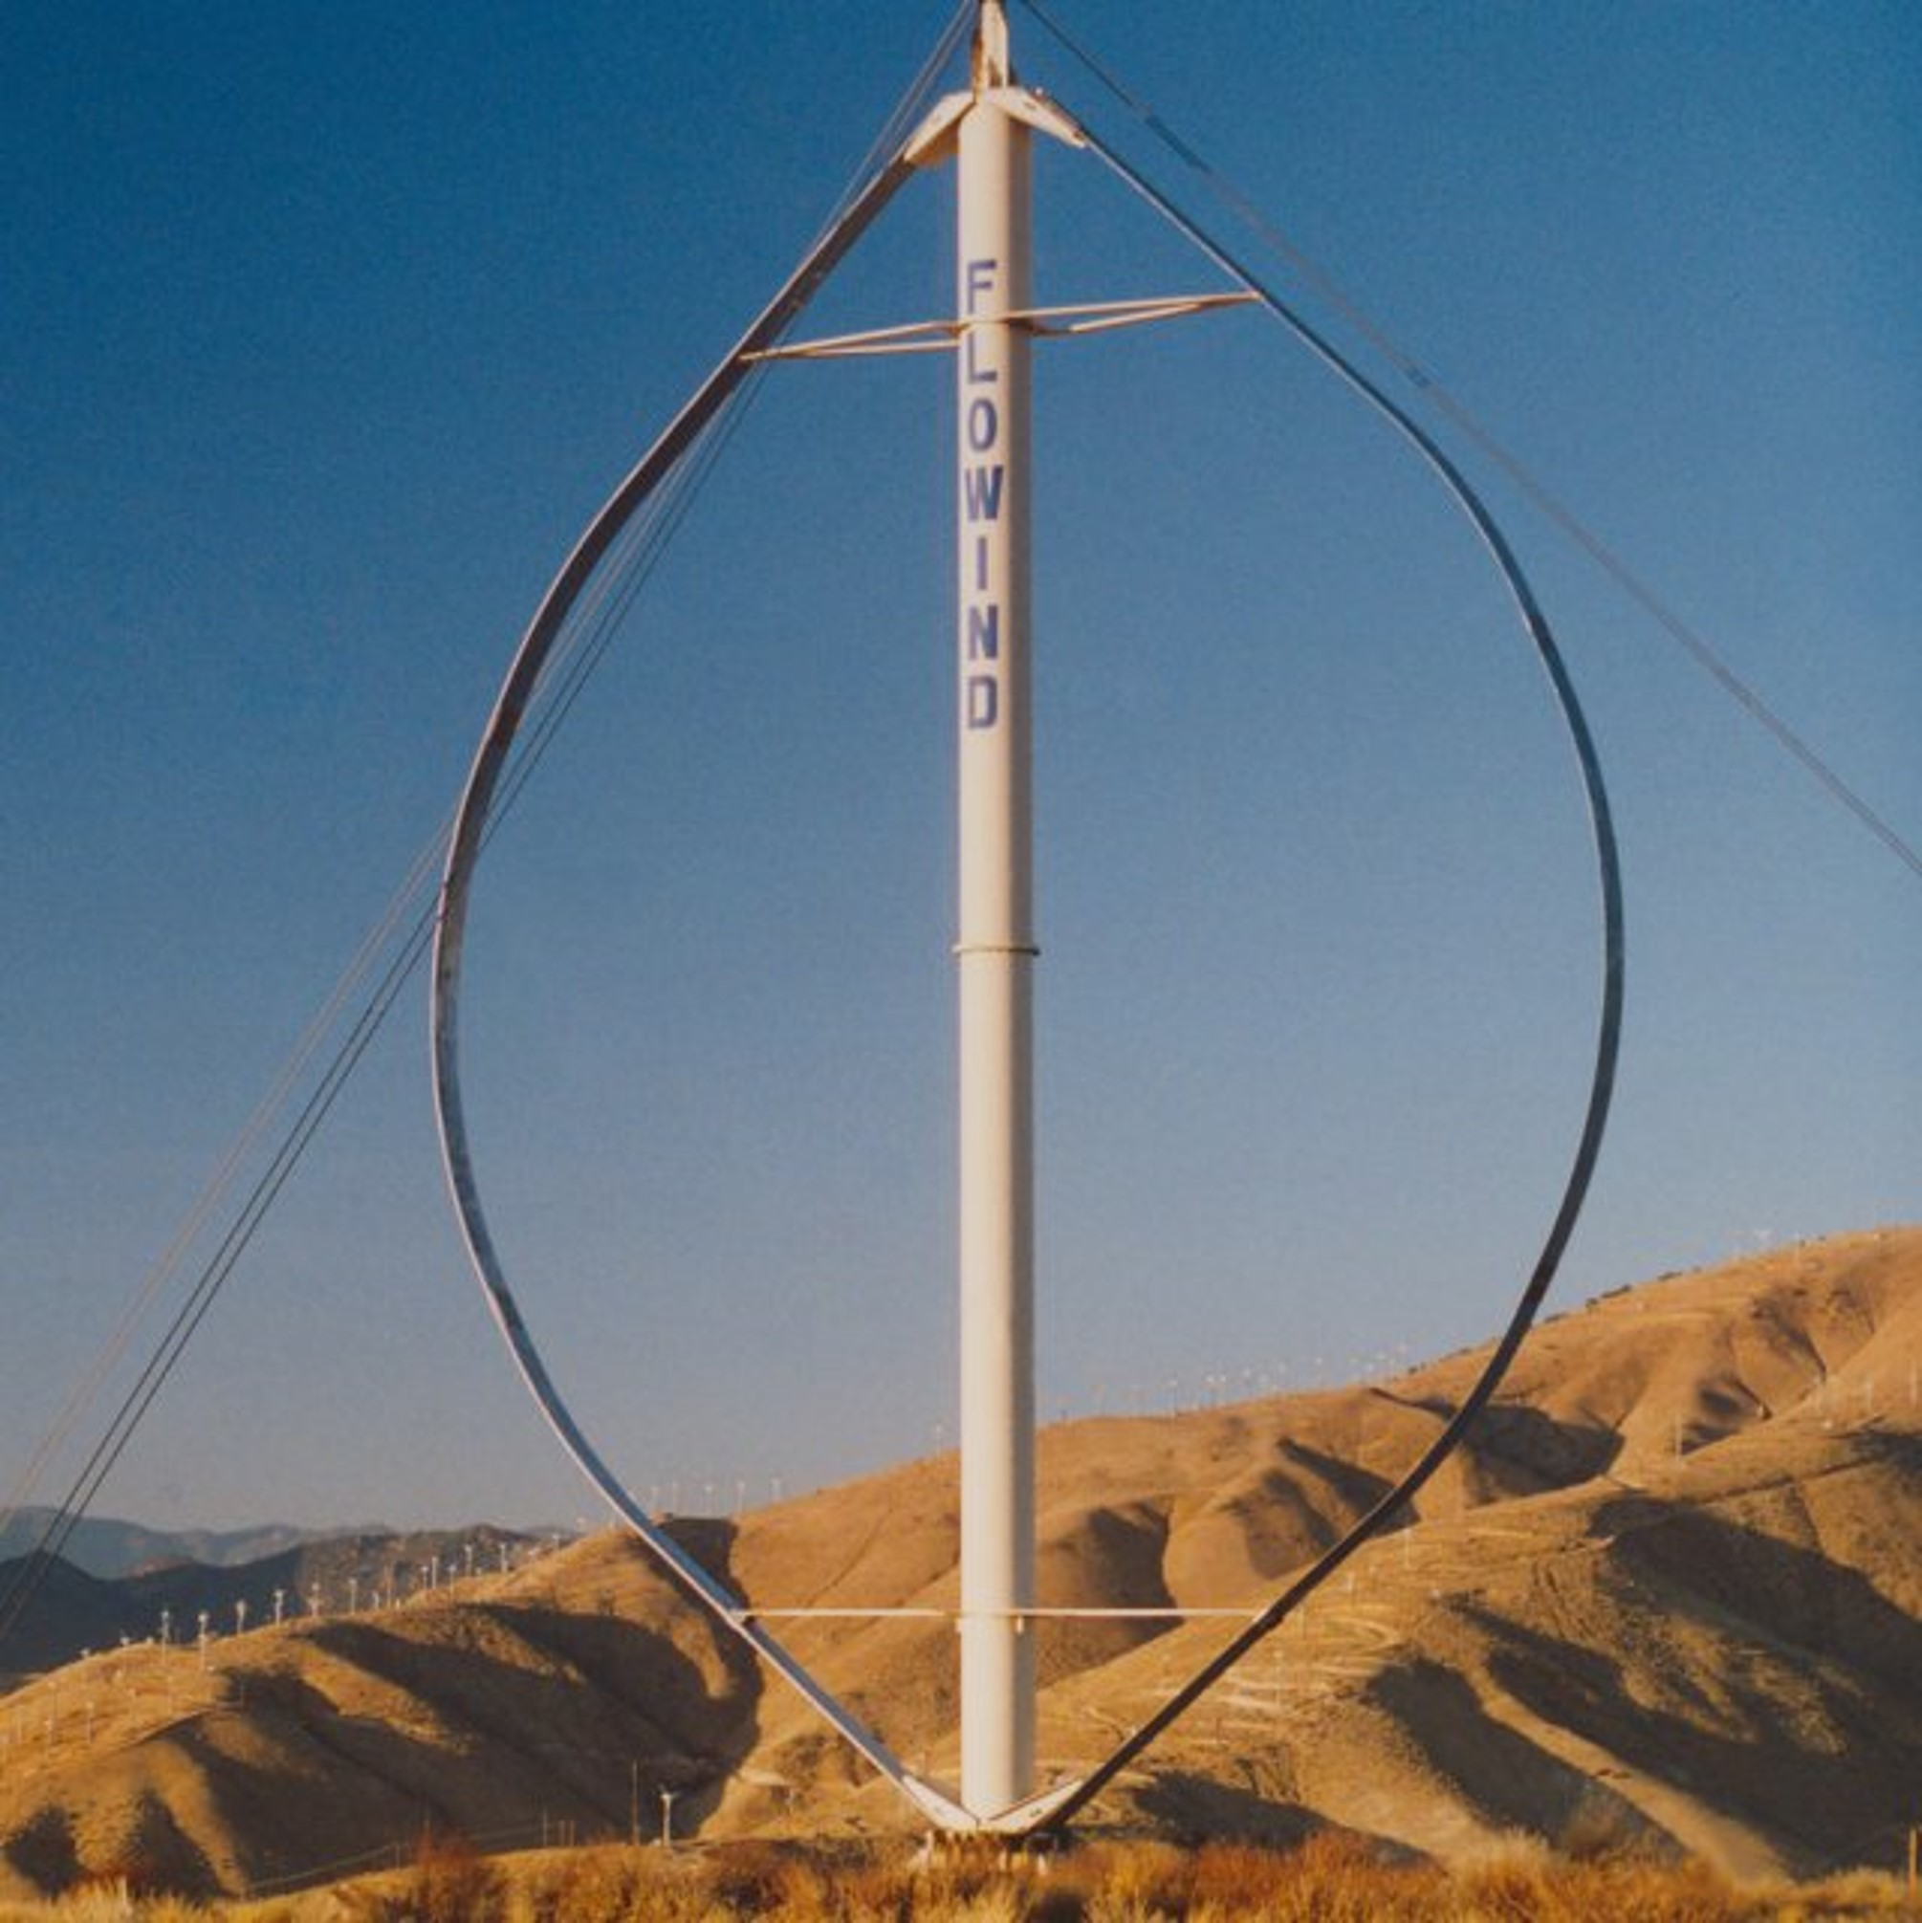
Wind Turbine Types
FloWind Full-Darrieus VAWT
Image Source: Geoffrey M. R. Hammond via iStock
Notes:
There are two basic wind turbine styles: Vertical axis and horizontal axis.
The turbine on the right is an example of a utility-scale vertical axis turbine. This design has the axis of rotation extending upward from the ground. The main advantage of this design is that it can capture the energy of wind from any direction. Thus in areas where winds are changing direction, this design may prove more advantageous. However, vertical axis turbines experience significant vibrations as the rotational frequency of the turbine coincides with harmonics inherent in the axis itself. To counteract this, utility-scale VATs require strong guy cables to both support the structure but also reduce vibrations in the axis. For this reason, most utility-scale turbines are not vertical axis. However, a smaller vertical axis turbine may be useful for small-scale generation on buildings because it requires less space and can be mounted closer to the ground.
The photograph on the right shows typical utility-scale horizontal axis turbines. These are mounted high above the ground and the axis of rotation lies parallel to the horizon. The vibrations associated with rotating the enormous blades are dampened within the tower and foundation of the turbine, and therefore are not as impactful on the turbine and generator themselves. A deep foundation of concrete is in the ground and the tower is bolted to the foundation. All wires and access points are located within the tower. All discussions of wind turbines from this point forward will be referencing horizontal axis wind turbines.

Slide 12
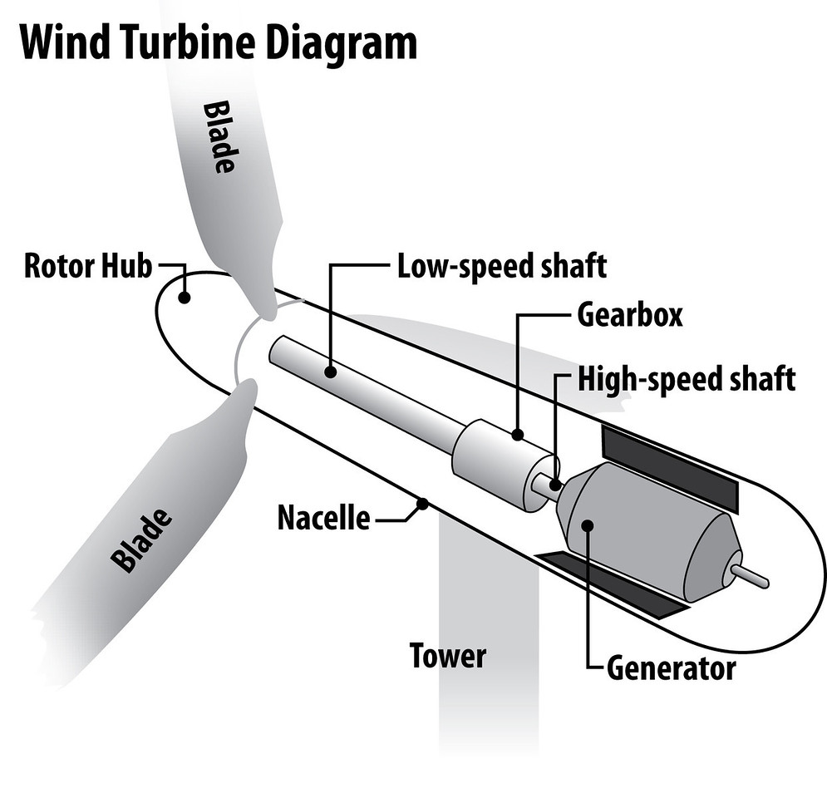
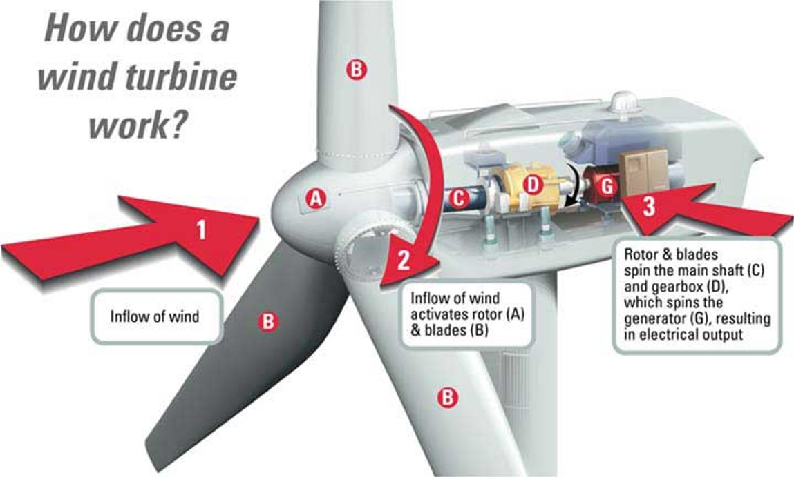
Wind Turbine Parts and Functionality
Image Source: DOE
Notes:
The left diagram shows a simplified version of a wind turbine. The blades are the long “arms” extending from the wind turbine that capture the wind energy. They are attached to the hub. Together the blades and hub transform the linear motion of the wind to rotational motion and transfer it inside the nacelle to the low-speed shaft. The shaft is connected to a gear box, and the gear box is connected to a generator which turns coils of wire inside a magnetic field to generate electricity.
The gear box is necessary because our electricity system operates at a frequency of 60 Hz. This means the polarity (positive and negative) of the wires changes 60 times in a second. However, the wind does not always move at a speed that harmonizes with that 60 Hz frequency. The gear box is used to increase or decrease the rotational speed accordingly, so the electricity generated by the wind turbine blends smoothly with the electricity already on the grid. Offshore wind turbines often lack a gear box to reduce the amount of maintenance that must be done in these more difficult to reach locations. As a result, offshore wind farms have a substation that changes the phase of the electricity generated by the offshore wind turbines so it harmonizes with the grid.
Wind turbines have wind sensors and controls that alert the power plant operator to the direction of the wind so the operator can change the direction the wind turbines are facing. They also have wind speed sensors connected to controls that will lock down a wind turbine if wind speeds exceed an upper limit. If the hub of a wind turbine spins too fast, friction will cause overheating and possibly cause a fire inside the nacelle, destroying the turbine. Another control can signal hydraulics to pull the blades back, reducing stress on them, if exceptionally high winds move through the area. If this happens, a wind turbine technician must reposition the blades before the turbine can be operational again.

Slide 13
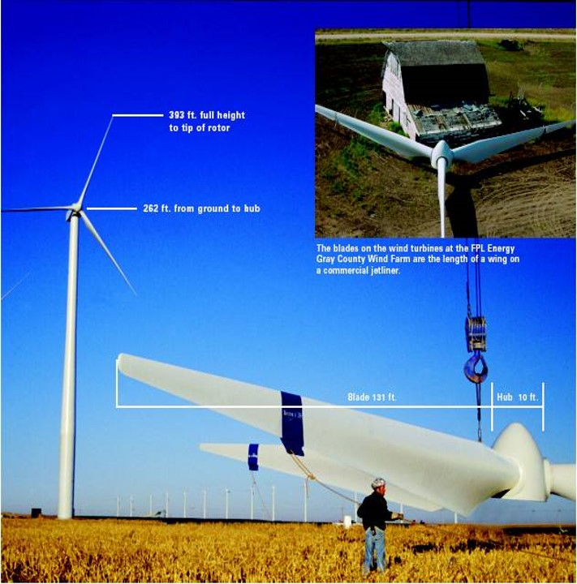
Installing a Wind Turbine
Notes:
Transporting the parts of a wind turbine to their installation site is a carefully choreographed cooperation of trains, cranes, trucks, law enforcement, and project managers. Because of their enormous size, the blades especially need special convoys and escorts from law enforcement to travel along interstates and highways to their final installation site.
The tower arrives in pieces. Each piece is lifted into place by a crane and secured in place. The nacelle is next. The hub and blades are connected on the ground, and the crane lifts the hub-blade assembly into place. Then technicians and electricians complete the installation by making all the internal connections and connecting the turbine to the grid.

Slide 14
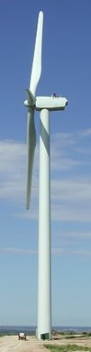
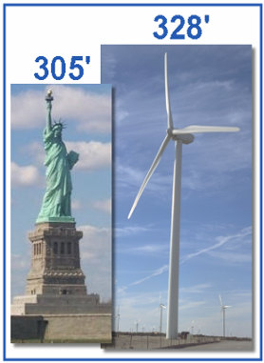
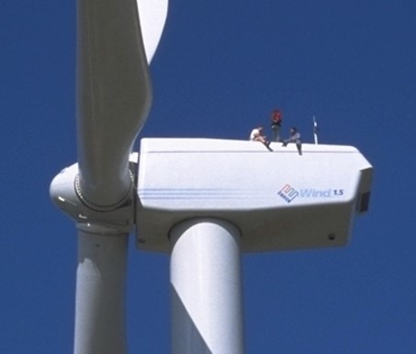
How tall is tall?
Notes:
When the blades are fully upright, as shown in these photographs, the tip of them are taller than the Statue of Liberty. The nacelle, where workers do maintenance and repair, is about 260 feet off the ground.
To be certified to work on a wind turbine, technicians must be able to carry all of their equipment up a ladder inside the tower and be able to bring a 125-pound dummy down. The dummy training teaches the technicians how to bring a coworker down the turbine should they become injured. Working on wind turbines requires extensive knowledge of electricity, mechanics, hydraulics, controls, and safety.

Slide 15
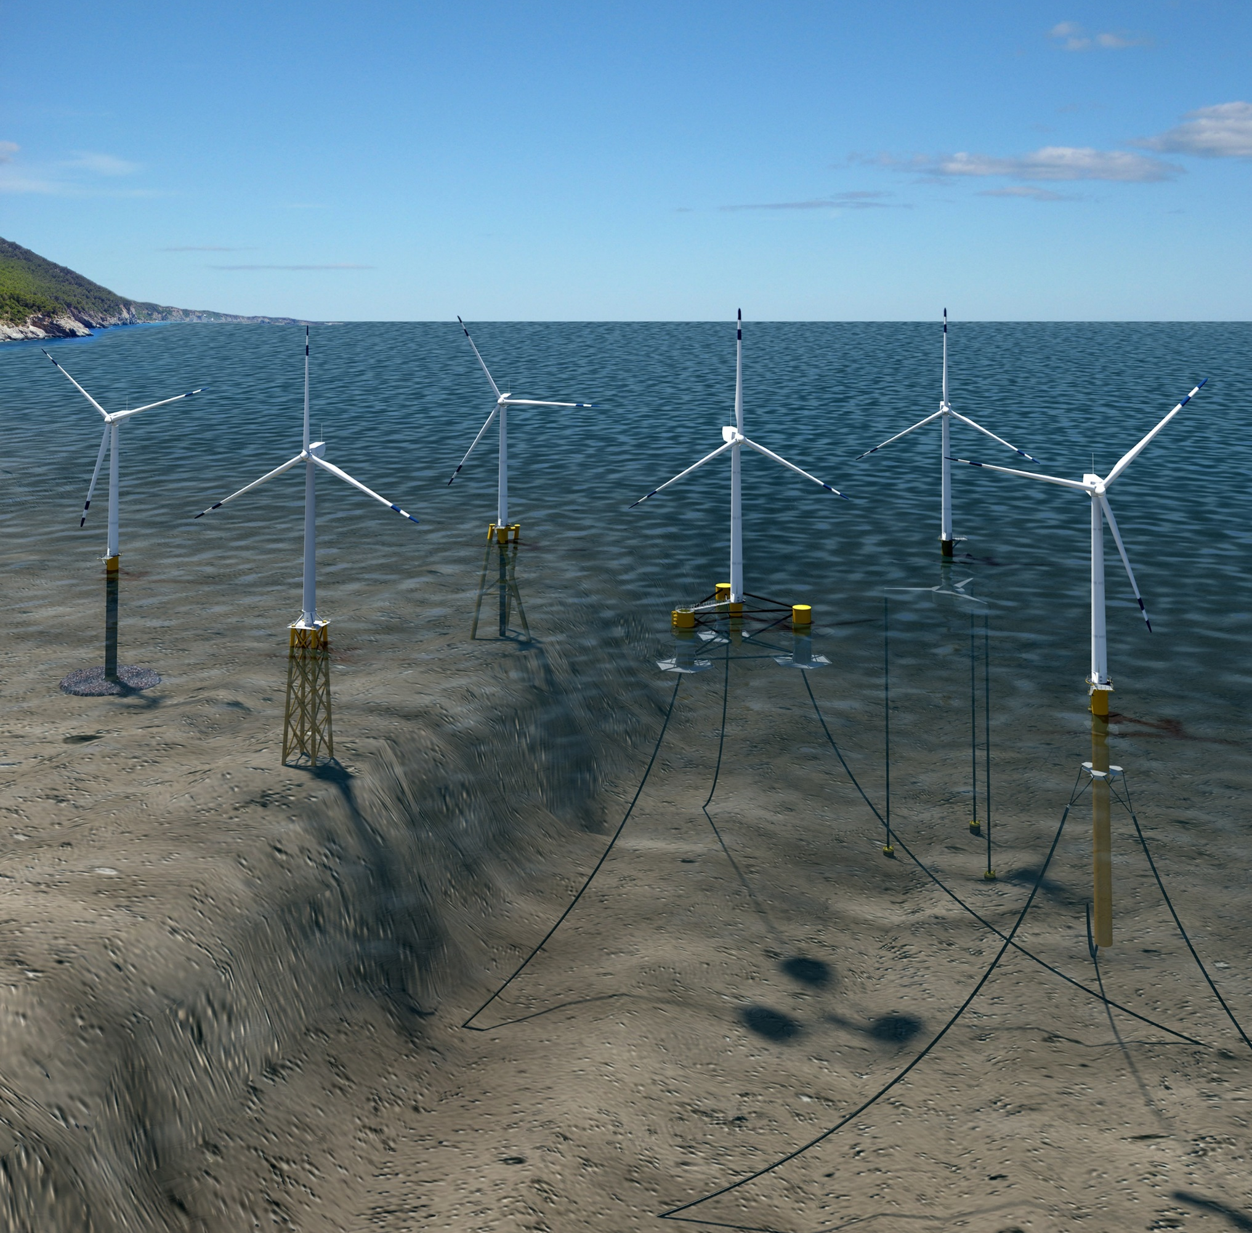
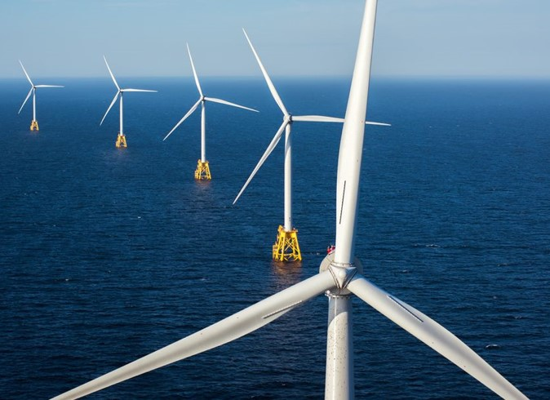
Offshore Wind
Block Island is the first offshore wind installation in the United States. Off the coast of Rhode Island, its 5 turbines total 30 MW capacity, or enough power for 17,000 homes.
Image Source: Illustration by Joshua Bauer, NREL
Notes:
Everything true about onshore wind is true about offshore wind, but only to a greater degree. Onshore wind turbines have a generating capacity of about 2.5 MW up to about 4 MW. Offshore wind turbines, however, are about 1/3 taller and can generate up to 16 MW. Installation requires a special ship made especially for the task. The ship has a crane, crew quarters, and all the parts and tools needed to build at least one, preferably several, turbines. Wind Turbine Installation Vessels, or WTIVs, have self-elevating jacks that anchor them to the sea floor and provide a stable platform for installation.
The depth of the water determines the type of foundation for offshore wind turbines. If the water is relatively shallow, such as off the Atlantic coast of North America, a fixed-bottom foundation is used. These are pictured on the left of the illustration from NREL, at the right of the slide. Floating foundations are moored to the sea floor when the water is prohibitively deep for a fixed—bottom foundation. The offshore wind leasing areas being administered by BOEM off California’s Central Coast will use floating foundations.

Slide 16
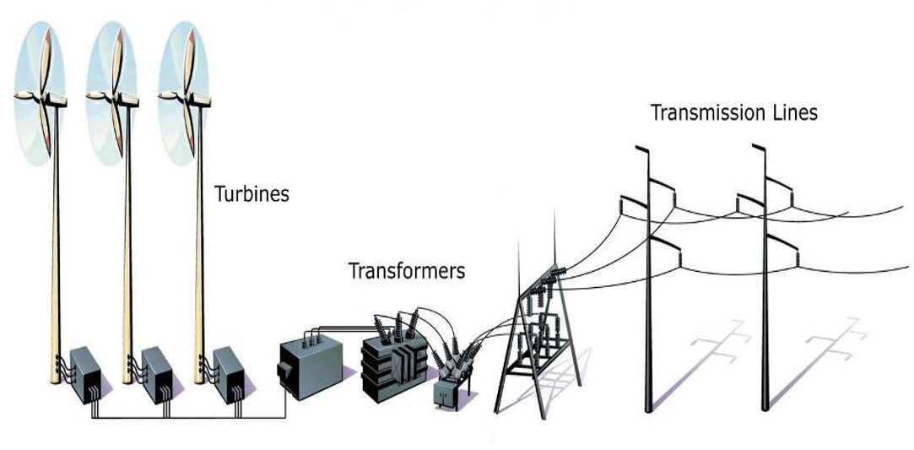
Onshore Wind Farms
Notes:
It isn’t enough to construct a wind farm and plug into it. The electricity must be added to the grid at high enough voltage for transmission, just as is the case with any other electricity generating site. Step-up transformers increase the voltage for transmission.

Slide 17
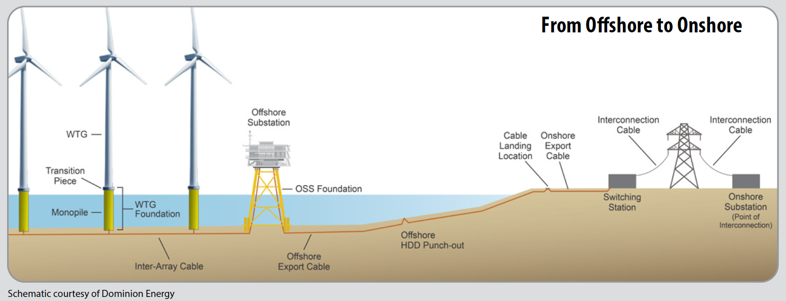
Offshore Wind Farms
Notes:
This diagram incorporates the offshore substation referenced earlier, where the frequency of the electricity coming from the wind turbines is “cleaned up” to sync with the grid.

Slide 18

Siting a Wind Farm – Mock Hearing
Notes:
This video demonstrates the mock wind turbine siting hearing that is at the end of Exploring Wind Energy. Students can assume roles and engage in this activity themselves.

