Slide 1
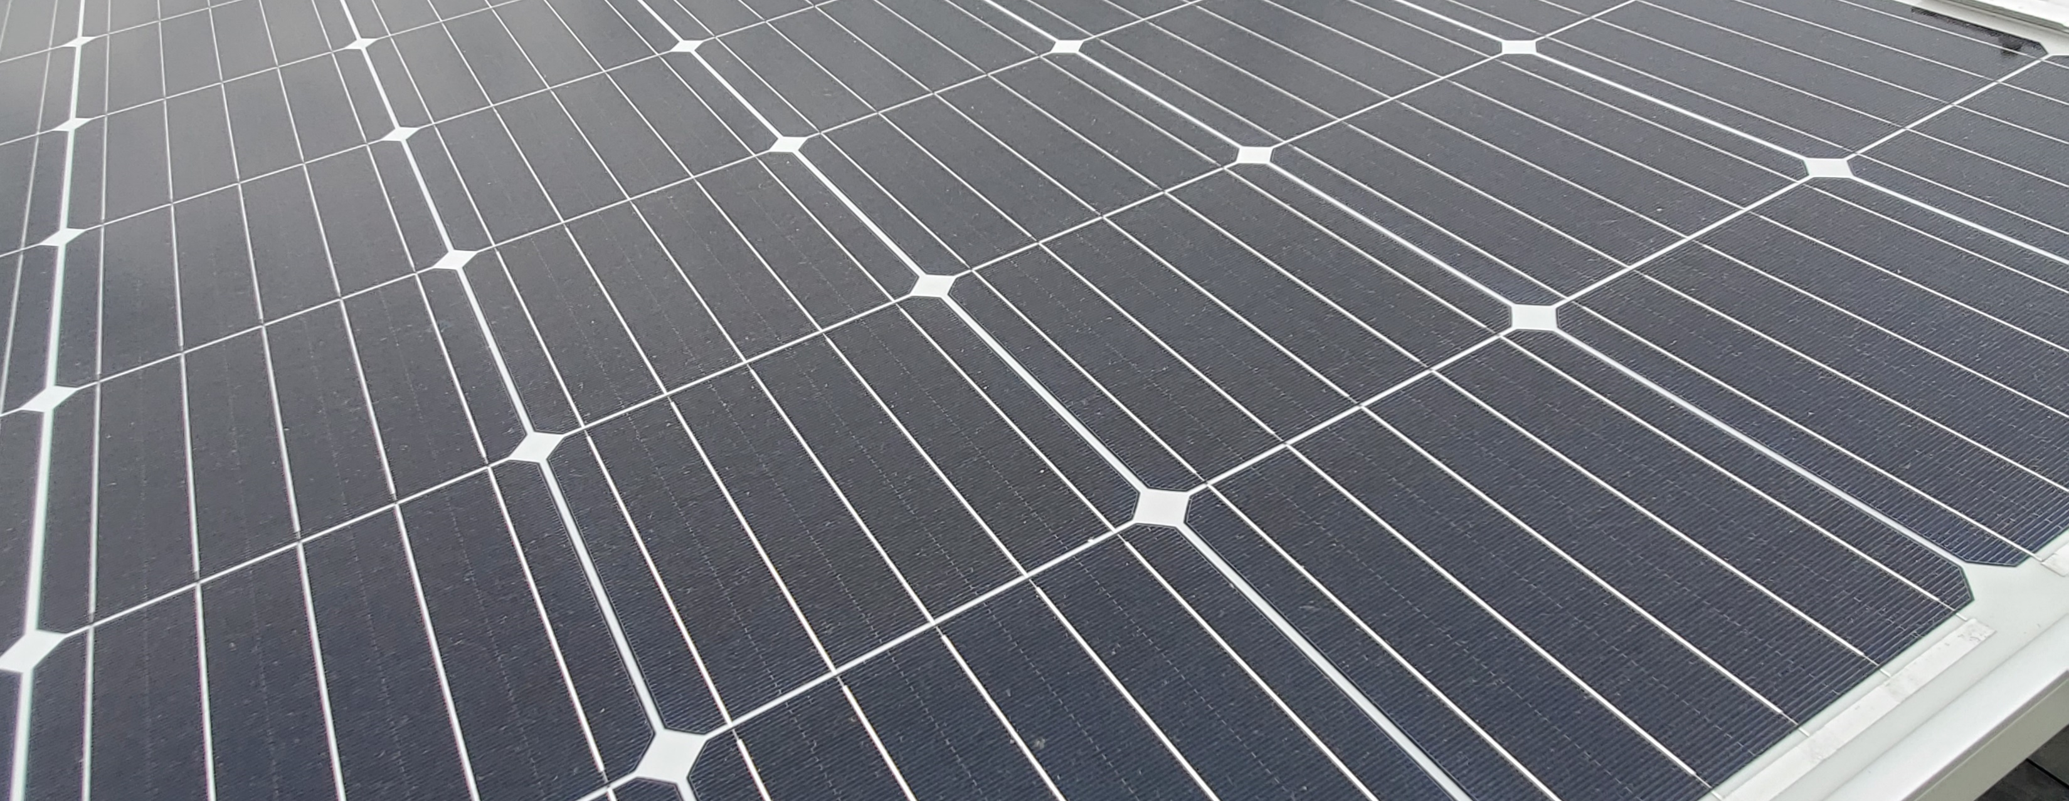
Exploring Solar Energy
All the bright kids are doing it!

Slide 2
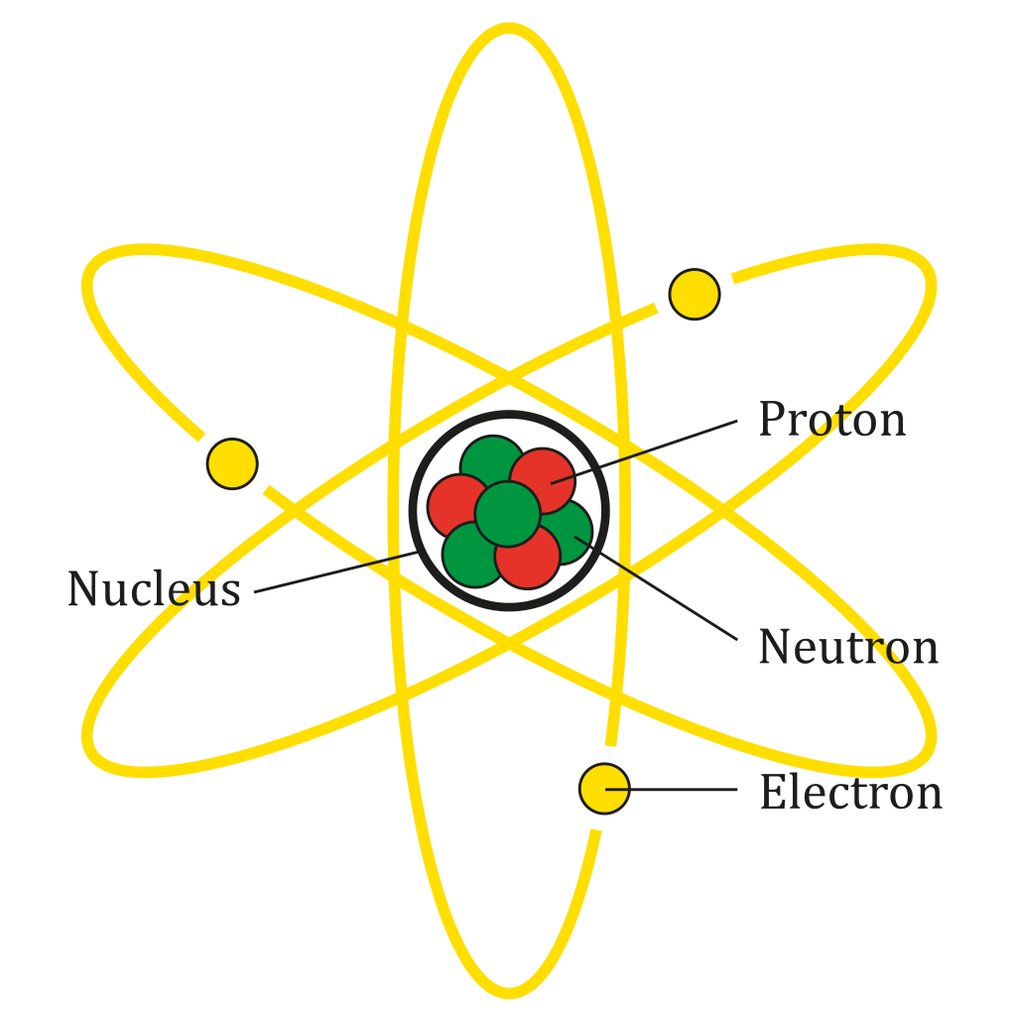
Review: Atomic Structure
Three particles
Nucleus
Electrostatic Force
Strong nuclear force
Image by AG Caesar - Own work, CC BY-SA 4.0, https://commons.wikimedia.org/w/index.php?curid=67059219
Notes:
To understand solar energy and nuclear fusion, you need to be familiar with the structure of atoms.
This diagram is just a representation of where atomic particles are positioned and is neither to scale nor does it show what atoms might look like should you be able to see them. There are three particles in an atom: Protons, which are positively charged; Neutrons, which have no electric charge; and Electrons, which are negatively charged. In a neutral, ordinary atom, the number of protons and electrons is the same, giving the atom no overall charge. The electrons are bound to the nucleus through electrostatic force, which is the fundamental force that attracts positive and negative charges to each other.
One might think that all those positively charged protons would repel each other and the nucleus would fly apart; this would definitely happen were it not for the strong nuclear force. This is a fundamental force – meaning we don’t know why it works, we just do – that is associated with neutrons. As nuclei get bigger, more neutrons are needed to hold the nucleus together. Smaller atoms, like oxygen, carbon, and magnesium, only need a 1:1 ratio of protons and neutrons to stay together. Larger nuclei, like copper, gold, and iodine, have a 1:1.5 ratio of protons to neutrons. Any element larger than bismuth, with 83 protons, is naturally radioactive. There is a limit to what strong nuclear force can do.

Slide 3
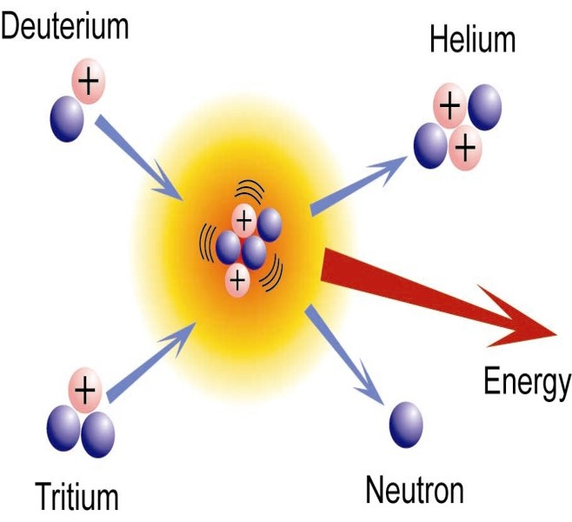
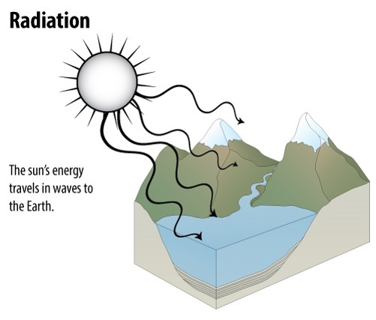
Sunlight is Radiant Energy
Notes:
The sun is so massive and has so much gravity that the atoms are pulled together with enough energy to create plasma – a state of matter even more energetic than gases. At this state, the electrons’ motion overcomes electrostatic force and they are able to move around independently of the nuclei with which they would ordinarily be associated. Because of this exceptionally high energy and gravitational force, small nuclei can be forced together in a process called nuclear fusion.
The diagram shows two isotopes of hydrogen. An isotope is a nucleus with the same number of protons but varying numbers of neutrons. Run-of-the-mill hydrogen is one proton and one electron. Deuterium has an atomic mass of 2 amu and tritium has an atomic mass of 3, but because each has only one proton they are isotopes of hydrogen.
If deuterium and tritium are fused, they form a helium nucleus and a free neutron, and release TREMENDOUS amounts of energy. This is just one of the fusion reactions taking place in the core of the sun and many other stars. The energy released by a fusion reaction will be an extremely high energy photon that we call gamma radiation. That photon can travel straight from the core of the sun to its surface and leave, or it can be absorbed and released multiple times by other atoms in the sun. Every time the energy is absorbed and released, the wavelength changes. The absorption / release process can occur for thousands of years before that photon leaves the sun; this is why sunlight is a broad spectrum of wavelengths, from gamma radiation down through long-wave radio waves. Each photon is a specific wavelength of electromagnetic radiation, or an electromagnetic wave.
Once a photon leaves the surface of the sun, it travels at 300,000 km/s and reaches Earth in about 8 minutes.

Slide 4
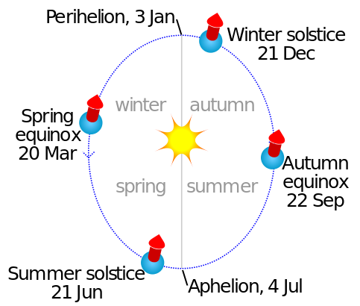
Uneven Solar Illumination
The axial precession, or “tilt”, of Earth causes variations in sunlight intensity throughout the year. In spring and autumn, the axis of Earth is perpendicular to the incoming sunlight, and on each equinox sunlight directly strikes the Equator. In the Northern Hemisphere, winter begins in December, when sunlight directly impacts the Tropic of Capricorn. Summer in the Northern Hemisphere occurs when upper latitudes are closer to the sun.
Image By Cmglee - Own work, CC BY-SA 3.0, https://commons.wikimedia.org/w/index.php?curid=30359851

Slide 5
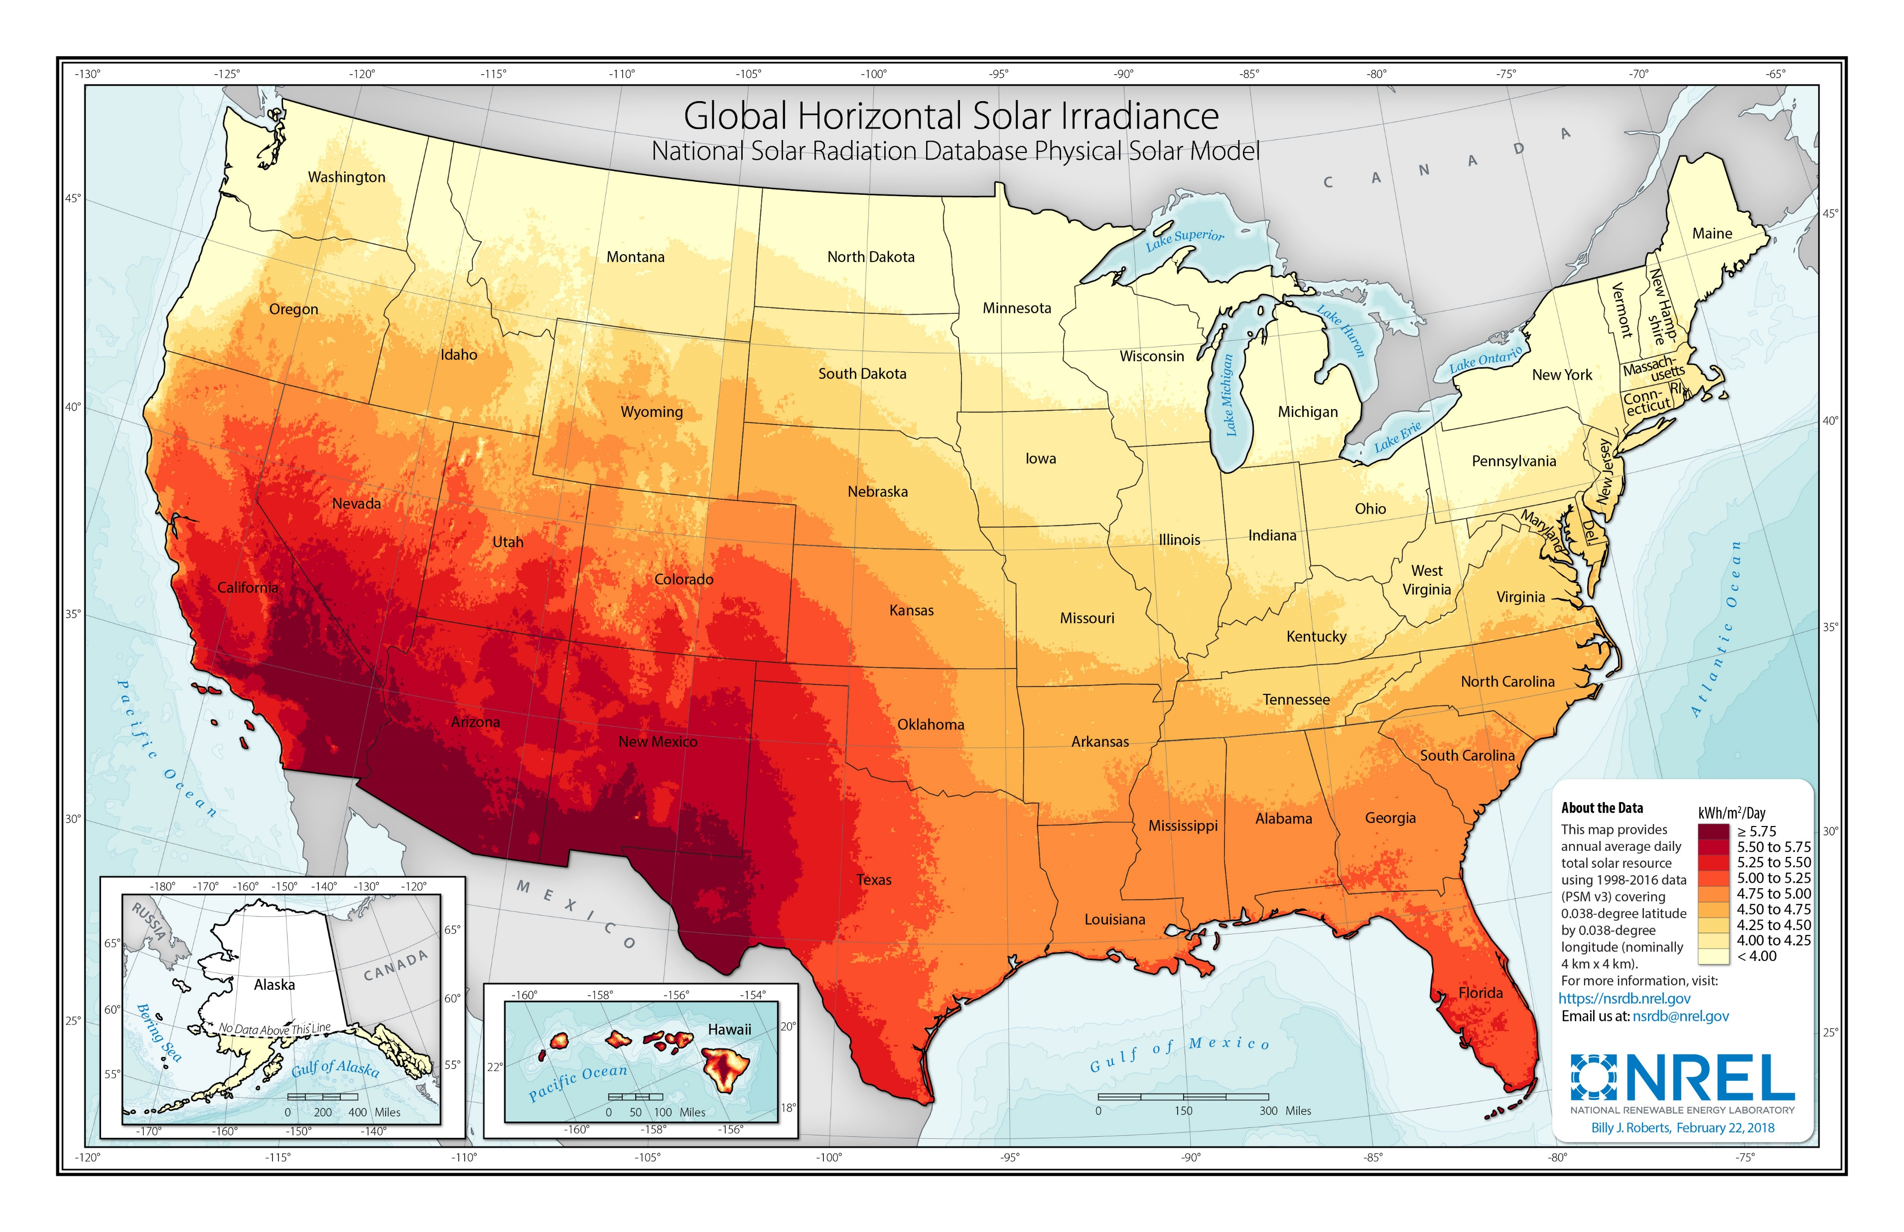
Average Daily Insolation Per Month
Notes:
This map, produced by NREL, shows where sunlight has the most power every day. The units are kWh per square meter per day. As one would expect, the arid southwestern states receive the most intense sunlight while northern states receive the lowest intensity. Parts of Hawaii where humidity is high and therefore cloud cover is frequent receive much less humidity than parts of the islands where humidity is lower.

Slide 6
Major Uses of Solar Energy
Daylight
Drying Agricultural Products
Space Heating
Water Heating
Generating Electrical Power
Concentrating Solar Power (CSP)
Photovoltaics
Notes:
These are the major uses of solar energy. Most recent technological developments have been in heating interior spaces and water, and generating electricity.

Slide 7

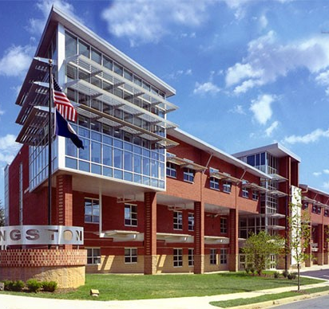
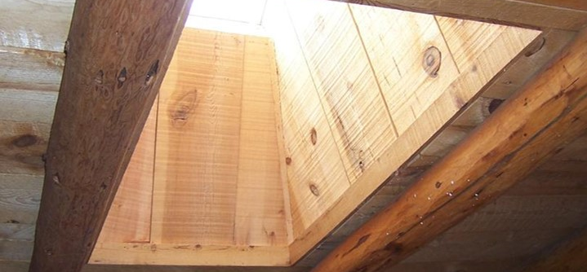
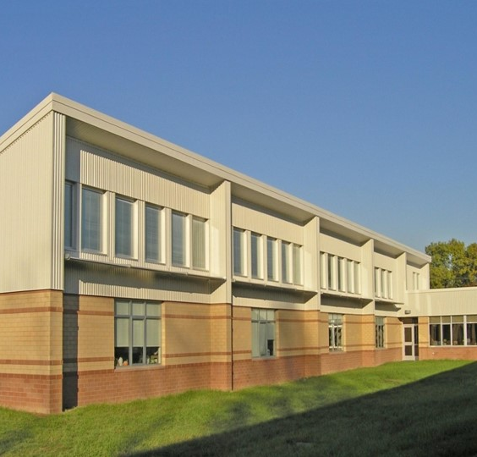
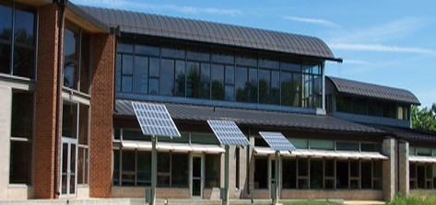
Daylighting
Notes:
Proper placement of windows and the use of skylights can reduce the need for artificial lighting.

Slide 8
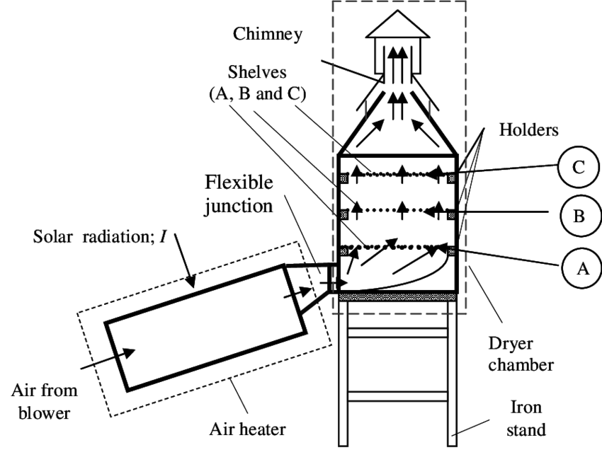
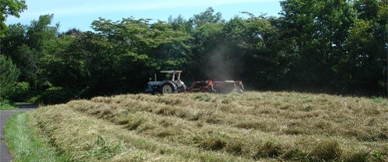
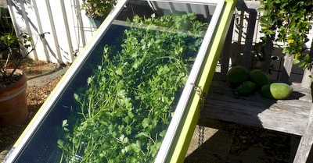
Drying Agricultural Products
Notes:
This shows some of the small and large-scale ways sunlight is used to dry crops.

Slide 9
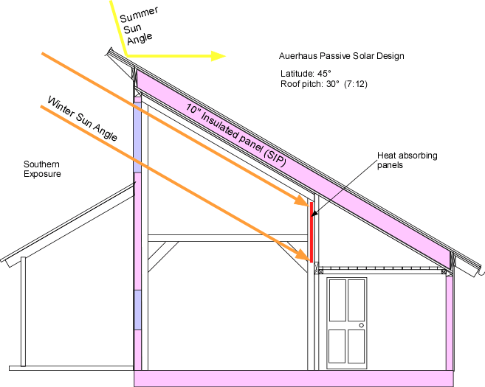
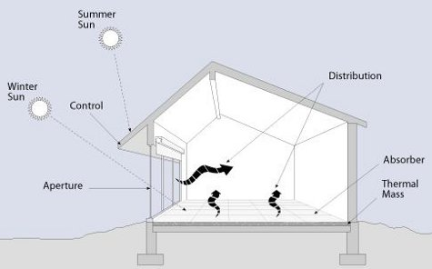



Space Heating Through Passive Solar
Notes:
Passive solar is a building design that uses a combination of direction, windows, overhangs, and interior building materials to capture the sun’s energy and store it in a thermal mass. The building is designed with overhangs specific to the latitude of the building site such that winter sun is able to enter but summer sun is kept out, thus capitalizing on heating from sunlight when it is wanted but blocking it when it is not wanted.
Each logo is linked to websites that discuss passive solar design and some provide contact information for passive solar architects and builders.

Slide 10
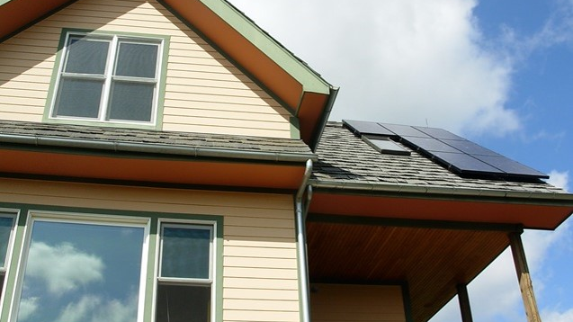
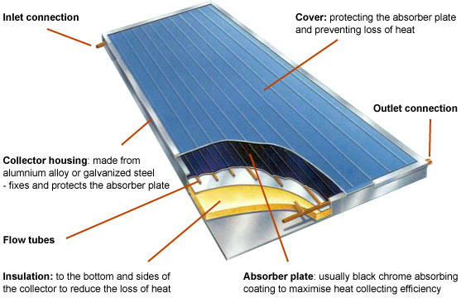
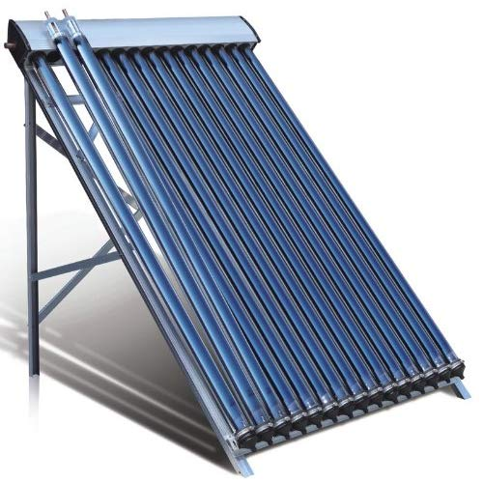
Active Solar Heating
Notes:
“Active solar” means we are using equipment specifically designed for using solar energy.
Flat plate solar collectors are usually large flat boxes with one or more glass covers. Inside the boxes are dark colored metal plates that absorb heat. Air or liquid, such as water, flows through tubes and is warmed by heat stored in the plates. These systems are particularly useful for providing hot water to households.

Slide 11

Solar Thermal Technologies
Unglazed solar collectors
Transpired solar air collectors
Flat-plate solar collectors
Evacuated tube solar collectors
Concentrating solar systems
Images source: EPA
Notes:
The EPA has a website describing all of these technologies and how they work. The internet icon is linked to the website.

Slide 12
Concentrating Solar Power (CSP)
Using sunlight to heat a fluid, which in turn heats water into steam.

Slide 13
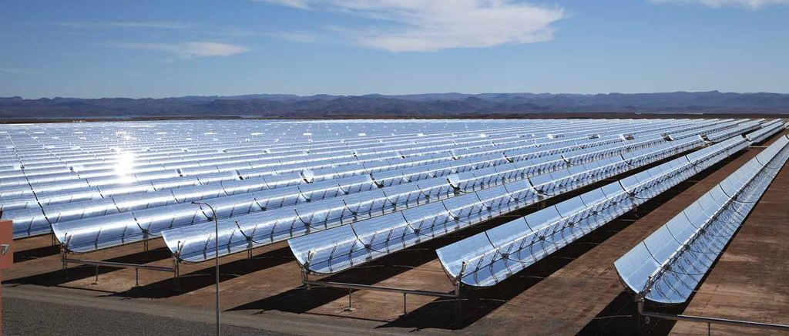
Trough Systems
Solar mirrors at the Noor 1 Concentrated Solar Power plant in Ouarzazate, Morocco. Courtesy Dewa
Notes:
Trough systems use trough-shaped mirrors bent in a parabola with a transparent tube mounted at the focus of the parabola. All sunlight that strikes the mirror is reflected into the tube. A fluid flows through the tube and is heated by the sunlight. That hot fluid than flows through a heat exchanger which boils water into steam, driving a steam-driven turbine just like any other thermal power plant (natural gas, waste-to-energy, nuclear, coal).

Slide 14
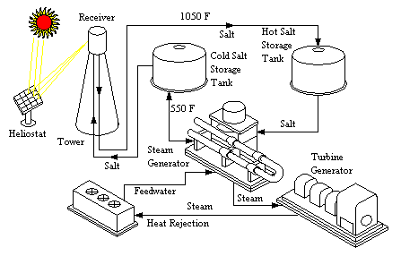
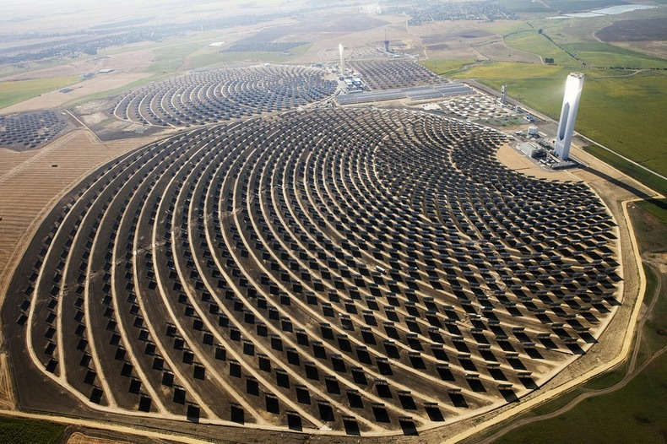
Power Towers
Notes:
Power towers have one single point of focus for the sunlight, which is a receiver at the top of a tower. Mirrors that track the sun continually reflect sunlight onto the receiver. Power tower systems use molten salt for thermal storage, which is run through a heat exchanger to boil water into steam and drive a turbine.
The photo is of the power tower in Seville, Spain, one of the world’s largest single tower systems.

Slide 15
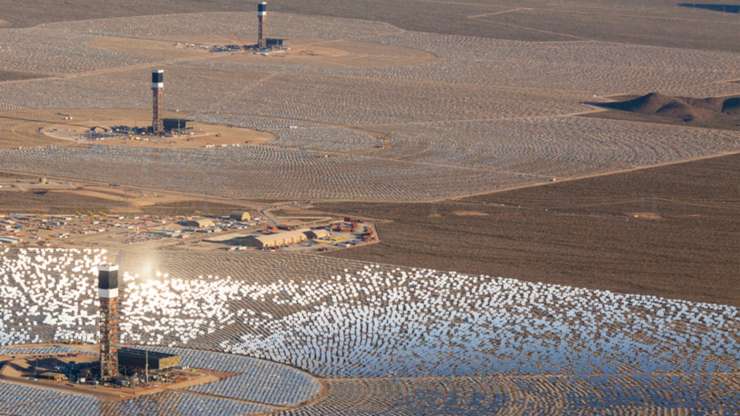
Ivanpah, Mojave Desert
The United States houses the largest CSP plant in the Mojave Desert
It uses 347,000 garage door-sized mirrors and 173,500 heliostats
Ivanpah is operated by NRG
Notes:
The world’s largest CSP plant is Ivanpah, located in the Mojave desert. It uses a combination of three towers and 347,000 mirrors to generate electricity. Each mirror is about the size of a single-bay garage door. The plant has a generating capacity of about 390 MW.
https://www.energy.gov/lpo/ivanpah

Slide 16
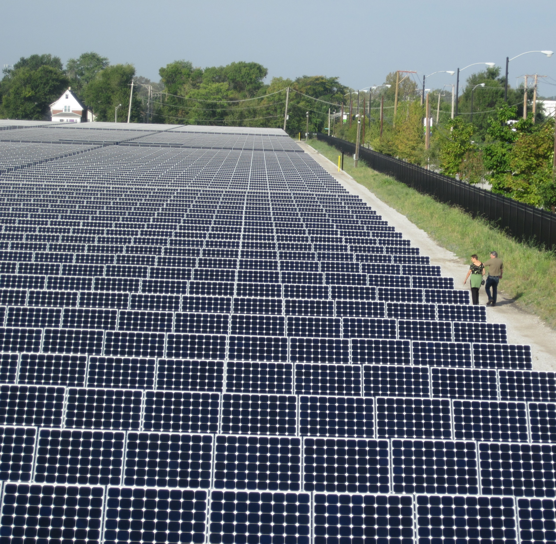
Photovoltaics
Using sunlight directly to generate electricity.
Notes:
Image is of Exelon City Solar in the West Pullman neighborhood of Chicago, IL. This 10 MW system was installed over a brownfield that could not be used for recreation or could not be built upon. Each row of panels is a single-axis tracking system, meaning the panels adjust in position to follow the track of the sun from east to west. At night they reset to be ready to face the morning sun the next day.
https://www.envdesigni.com/our-work/environmental-consulting/exelon-city-solar/

Slide 17
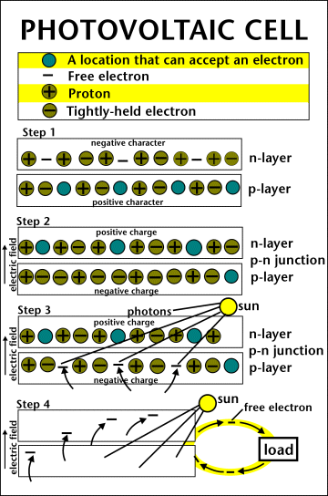
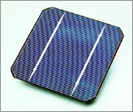
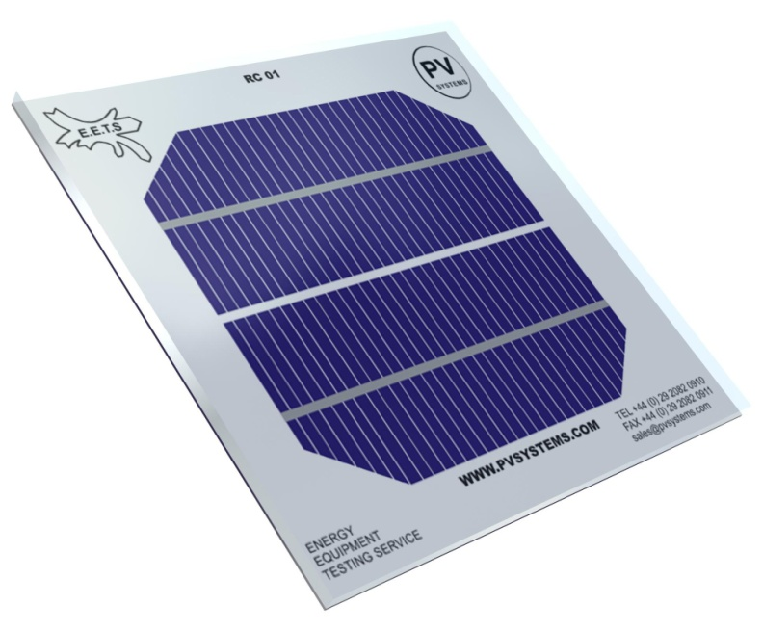
PV Cell
Notes:
The photovoltaic cell is the basic building block of a PV system. Individual cells can vary in sizes from about 1cm to about 10 cm across. Most cells are made with silicon today, which must be purified. This is one of the biggest expenses in the production of solar cells. One PV cell, regardless of size, will produce about 0.5V. However, larger cells produce more current and smaller cells produce less current. This is because of the number of electrons available to do work in the circuit to which the cell is attached.
A slab (or wafer) of pure silicon is used to make a PV cell. The sides of the wafer are painted, or doped, with substances with different numbers of valence electrons as compared to silicon. The one with more electrons is the n-layer while the side doped with a substance with fewer electrons is called the p-layer.
Where the n-type silicon and p-type silicon meet, free electrons from the n-type flow into the p-type to even out the electron distribution; as a result, an electric field forms, permanently bonding the two layers and preventing further electron movement (at ground state). This point of contact and barrier is called the p-n junction.
Placing the cell in sunlight causes radiant energy of the right wavelength to transfer energy to electrons. The electrons are energized, moving back into the n-layer. Energized electrons do not want to stay energized; they look for ways to shed that excess energy and return to ground state. In this case, connecting wires and a load to the cell allows electrons to flow through a circuit and use their excess energy to power the load, and return to ground state.

Slide 18
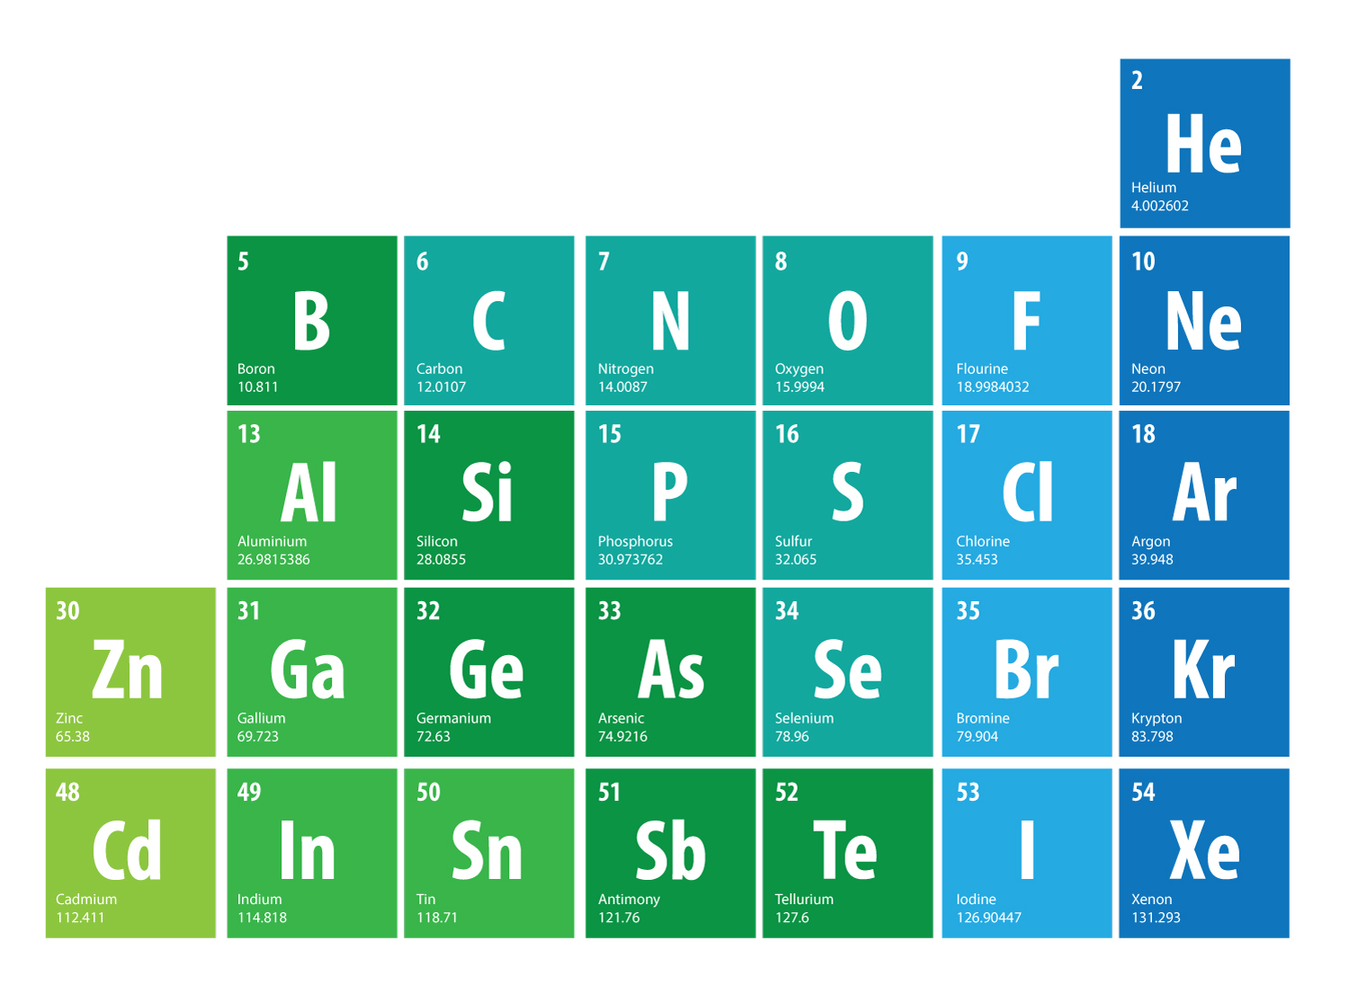
3 Valence Electrons
4 Valence Electrons
5 Valence Electrons
Notes:
Elements are arranged in the periodic table such that groups – columns – of elements have the same numbers of valence (outer) electrons. The valence electrons dictate the chemical behavior of the element. The green boxes are a grouping of elements called metalloids that are often used for their semiconductive properties.
Silicon is the most common semiconductor, but germanium is also used. A semiconductor will only conduct electricity under certain conditions, so it’s more easily controlled than something like copper or silver. Silicon has four valence electrons.

Slide 19
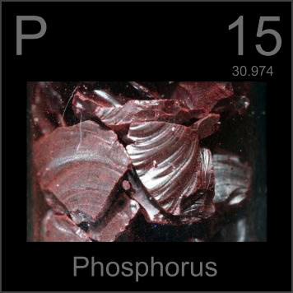
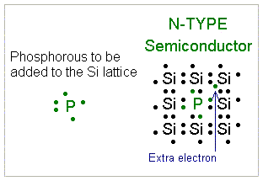
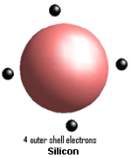
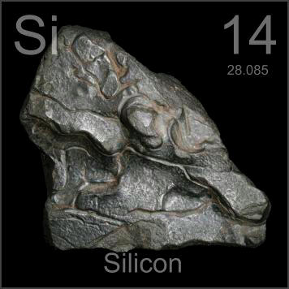
N-Type
Notes:
The two black boxes with photographs of purified phosphorus and silicon are clickable links to websites with more information on them.
Notice at the far right, when phosphorus atoms are placed in a silicon crystal, there are “extra” electrons available. When these electrons migrate to the p-layer, the protons in the phosphorus atoms give the N-layer its positive charge.

Slide 20
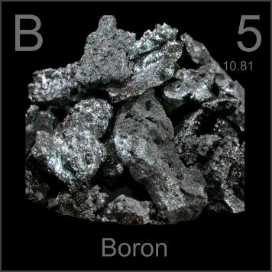
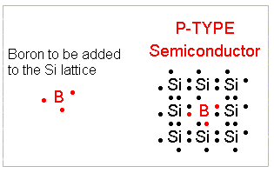
P-Type
Notes:
When boron atoms are interspersed among silicon atoms, there are “vacancies” that electrons could fill. When electrons migrate from the N-layer, they give the P-layer its negative charge. The unoccupied places around the boron atoms allow for the unpaired, “extra” electrons from phosphorous to create an even electron distribution in the entire silicon wafer.

Slide 21


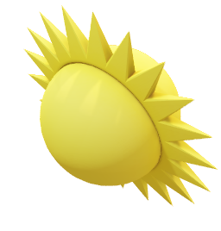
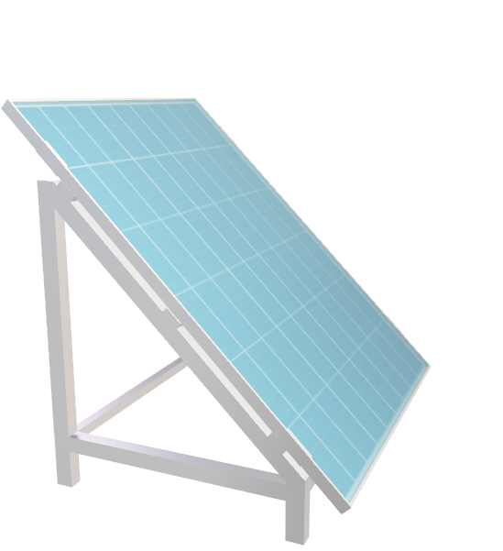
Current Flow in a PV Cell
Phosphorus-doped (N-type)
Silicon layer ~ 0.3:m
Photovoltaic Cell
Electrical Load
(-)
DC Current Flow
(+)
Boron-doped (P-type)
Silicon layer ~ 250:m
Notes:
Photovoltaic systems are DC systems, meaning they produce electric current that moves in one direction only, like a battery. The diagram shows the direction of the current through a load, such as an LED.

Slide 22
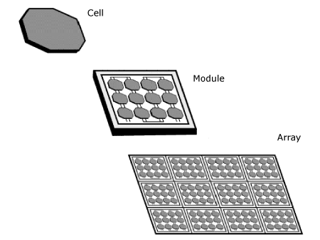
Components That Make a Solar Panel
One cell produces about 0.5 V; larger cells produce more current
Cells are connected in series to create modules (increases voltage)
Modules are connected in parallel to create arrays (increases current)
A “solar panel” is an array
Solar farms are often also called arrays – technically an array of arrays
Notes:
Cell, module, and array have specific meanings when discussing PV systems. However, as is often the case, colloquial usage blurs the meaning of “array”. Sometimes photovoltaic arrays are called “solar farms”.

Slide 23
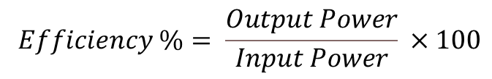
Conversion Efficiency
$$Efficiency \%= \frac{Output Power}{Input Power} ×100$$
Notes:
Most commercially available PV systems have a conversion efficiency of about 25%, meaning about 25% of the sunlight’s power is converted into electrical power. The royal blue lines, representing crystalline silicon cells, provide the top conversion efficiencies for commercially available solar systems.
This chart, produced by NREL, shows all of the conversion efficiencies of many different kinds of photovoltaic cells, not just silicon. Notice that efficiencies improved significantly from the 1970s until about 2000, when all but multi-junction cells (purple lines) more or less reached their peak efficiency.
Multi-junction cells work like color photographic film did, with different layers sensitive to different wavelengths, or colors, of light. The layers are stacked, utilizing three wavelengths of light in one space rather than just one. This increases their efficiency, but manufacturing multi-junction cells is prohibitively expensive for commercial use. Most multi-junction PV cells are experimental or installed on spacecraft. The green lines depict thin film technology, which have gained popularity because of their versatility across many applications, lower cost, and portability. The red lines show emerging technologies that are in experimental or developmental stages; watch for some of those technologies, especially perovskovites, to emerge.

Slide 24
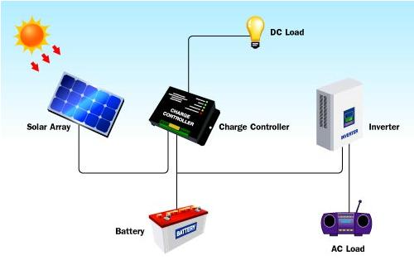
Solar System Components
Notes:
Because PV systems generate DC power, using it in a building wired for AC power requires modification. The device that changes DC power to AC power is called an inverter.
Systems that are built with battery storage or that directly power DC loads, such as on an RV or a house with a battery storage system, need charge controllers. These devices prevent the batteries from being overcharged, thus overheating them and causing a rupture or fire. They also prevent the batteries from being drained completely. Cell phones have built-in charge controllers that stop recharging of the battery when it is completely charged, and shut off the phone when the battery reaches less than 3%.

Slide 25
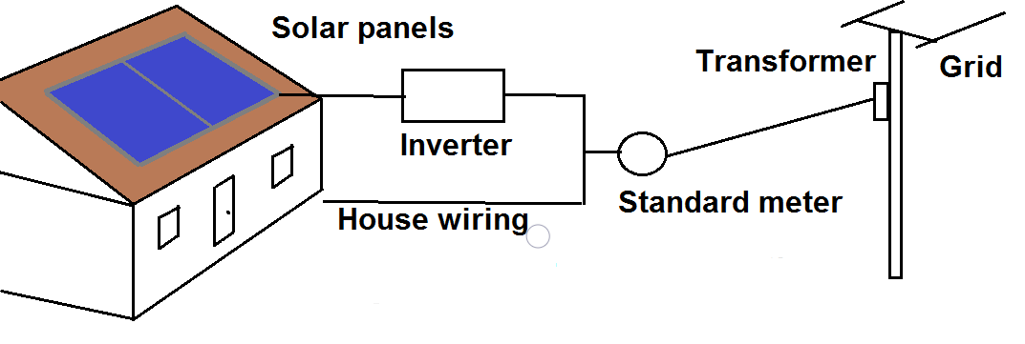
Connecting to the Grid and Net Metering
Notes:
There are many ways a home with solar panels can be connected to the grid. Most municipalities require homes to be grid-tied even if they have solar installed sufficient to meet the needs of the occupants. If the system produces more power than the building occupants are using, the meter will “run backward” and the excess power will be added to the grid. Owners of the system can be paid at the wholesale rate for this excess power in a system called net metering. If the building never pulls any power from the grid, the occupants will still receive a nominal bill from the utility to cover the cost of being grid-tied. Net metering reduces a building’s utility costs, but does not provide a source of income for the building because credits are given at wholesale rates while bills are generated at retail rates.

Slide 26
Customers Participating in Net Metering
Data source: EIA
Notes:
This chart shows how the number of residential customers participating in net metering, because they have some kind of power generating system installed (mostly solar), has increased dramatically over the last 10 years. Commercial customers typically do not install systems larger than they need. They also are charged for electricity at a rate lower than residential customers, which disincentivizes their net metering participation.

Slide 27
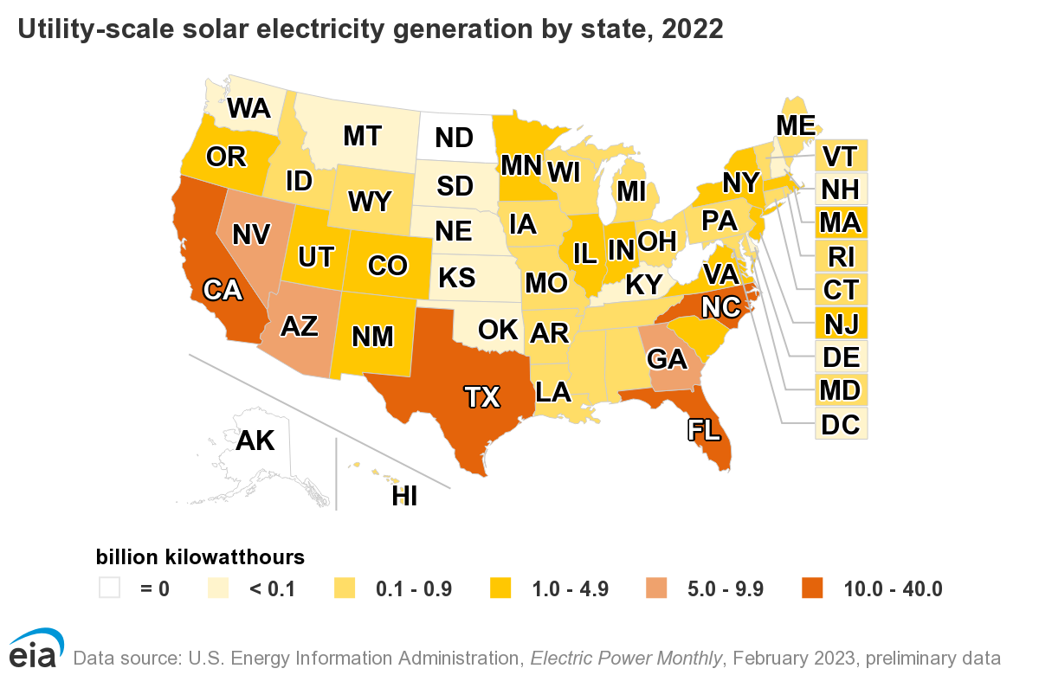
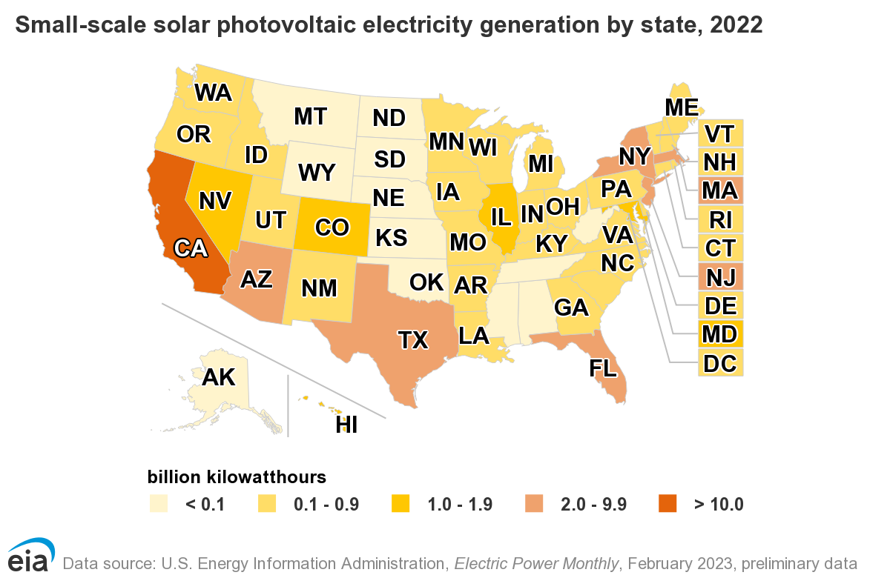
Solar PV in the United States
Notes:
Images sourced: https://www.eia.gov/energyexplained/solar/where-solar-is-found.php
In some states, utility scale installations have outpaced residential installations. In others, the reverse is true, especially in states with legislation that is not favorable to installing utility-scale systems.

Slide 28
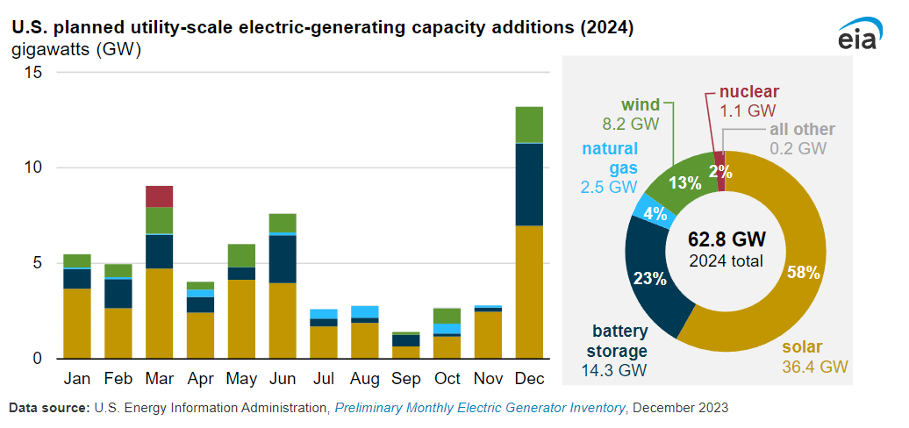
Solar in Electric Utility Growth
Notes:
Article where image was found: https://www.eia.gov/todayinenergy/detail.php?id=61424

Slide 29
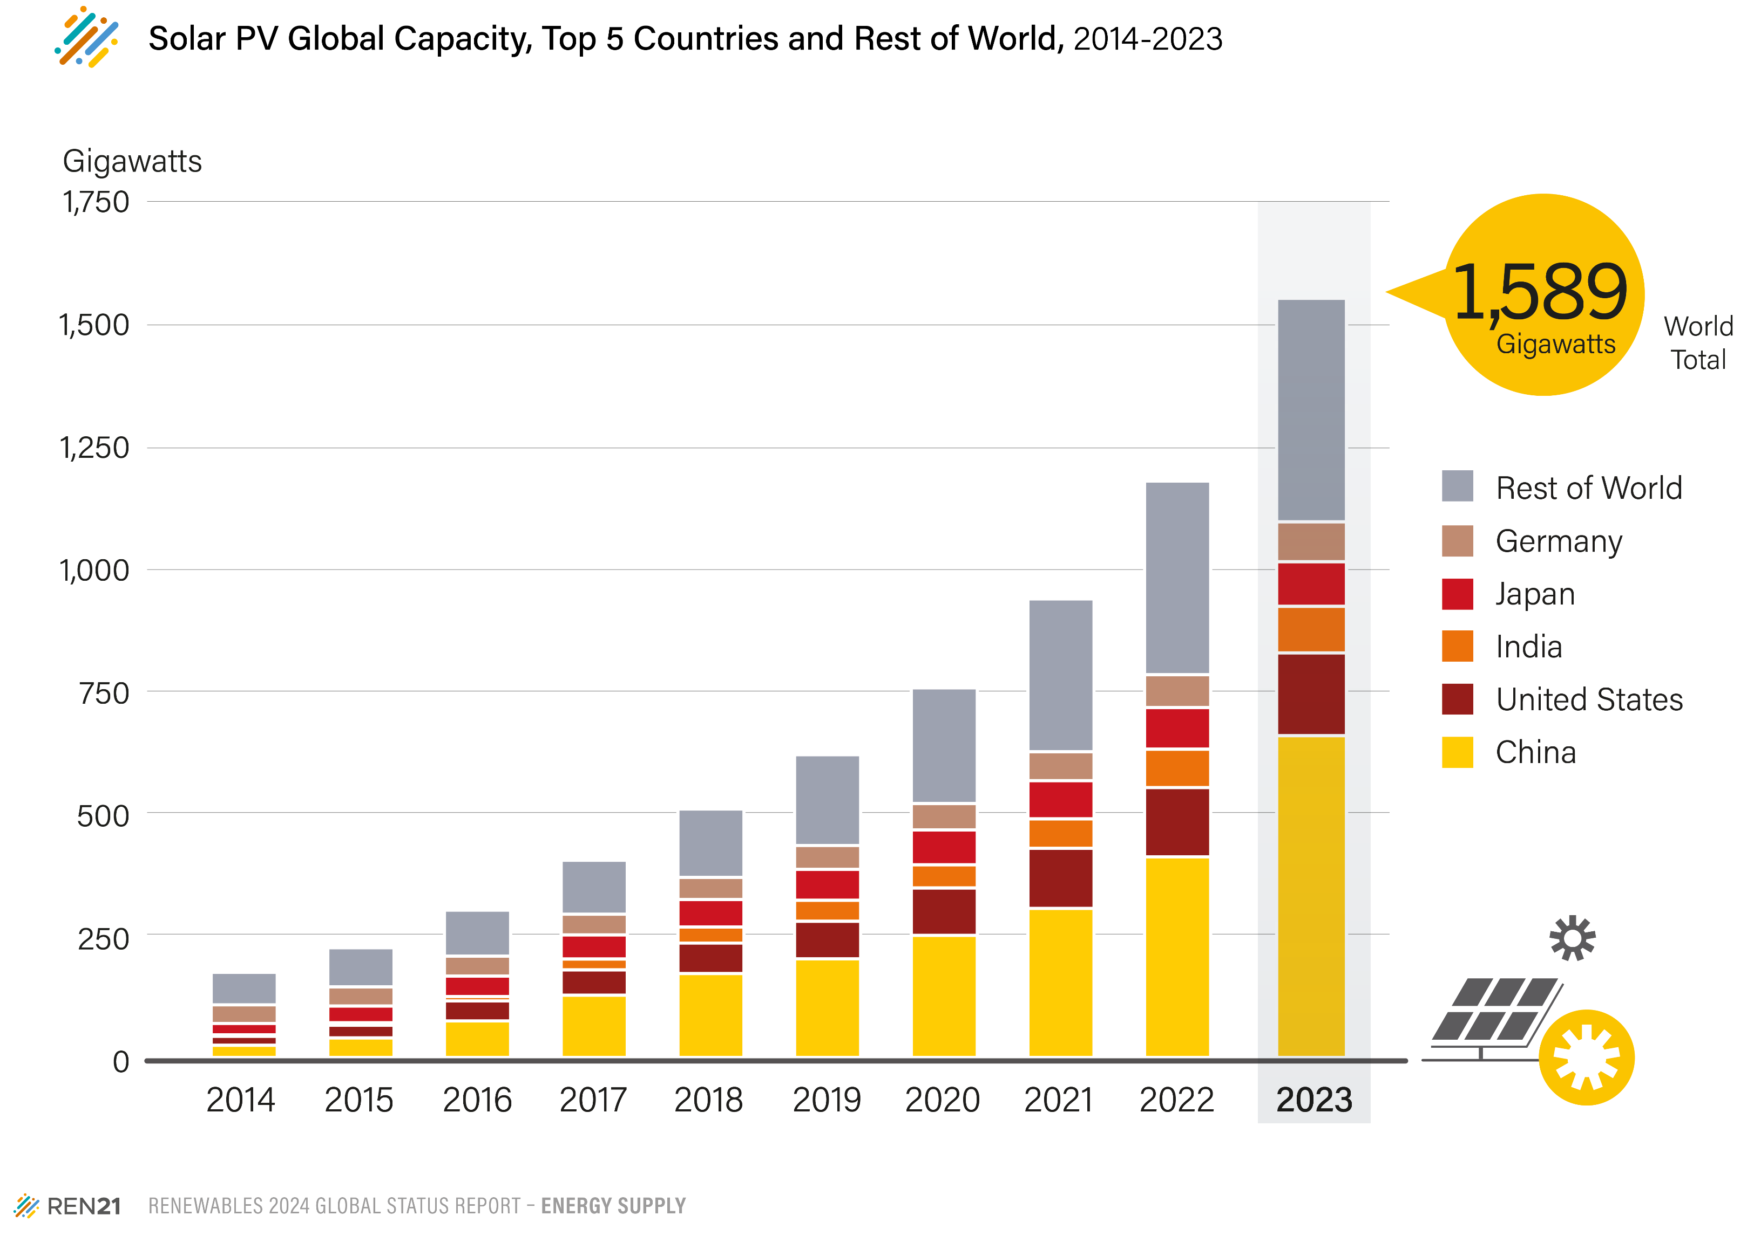
Notes:
Image source URL: https://www.ren21.net/gsr-2024/modules/energy_supply/02_market_and_industry_trends/07_solarpv/#top

Slide 30
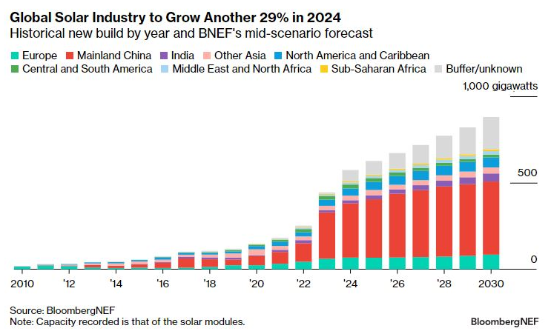
Projected Global PV Growth
Notes:
Image source: https://about.bnef.com/blog/1q-2024-global-pv-market-outlook/

Slide 31
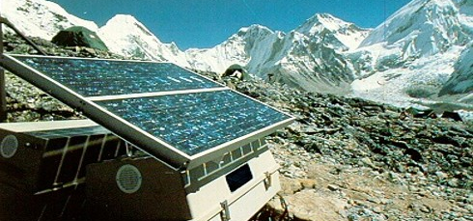
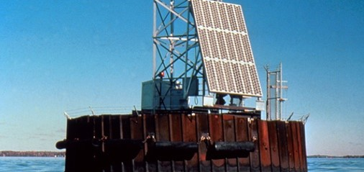
Advantages of Using Solar Energy
No emissions from generation
Sunlight is a free energy source
Sustainable
Provide electricity to remote locations
Notes:
Once solar systems are installed, they run clean, meaning no air pollution or byproducts, and have no moving parts so are easy to maintain.

Slide 32
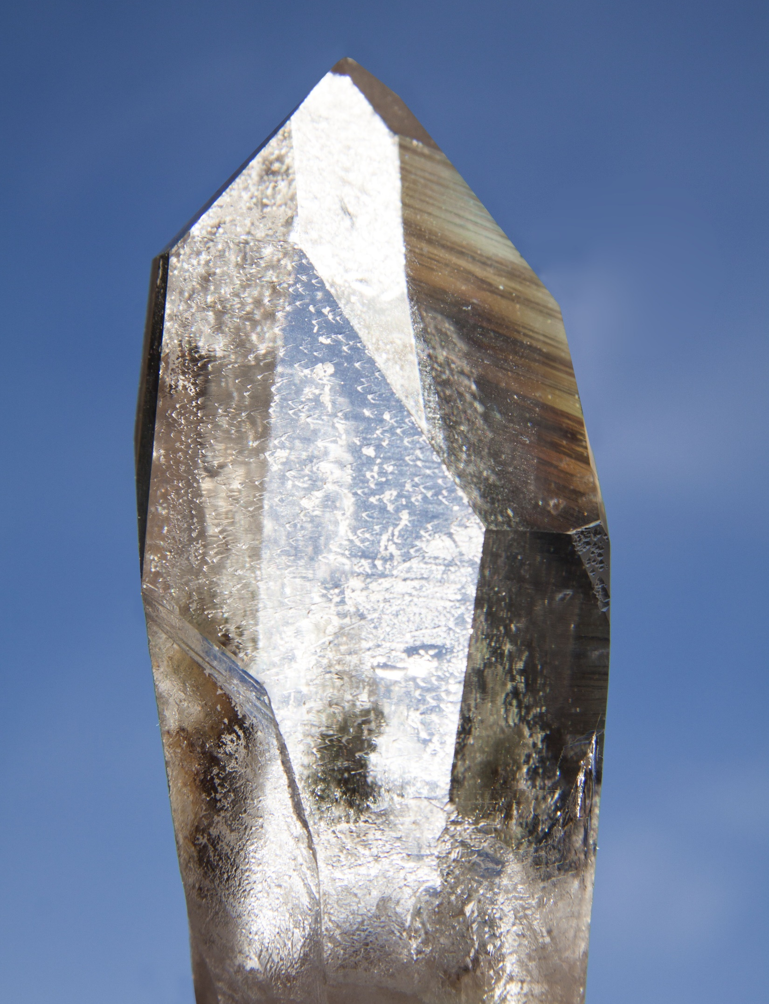
Disadvantages of Using Solar Energy
Less efficient and costly equipment
25% vs 35% of thermal power plant; ignores transmission losses
Residential systems about $3.50/watt installed
Peak production does not coincide with peak demand for electricity
Amount of power available depends on location and season
Environmental impact of PV cell production
Image: Quartz crystal
Image source: Pixabay
Notes:
The first point is becoming less of an issue because the cost of solar systems has decreased dramatically in the last 5 years. Because many PV systems are installed on the buildings where they will be used (called distributed generation), they are not subject to transmission losses. Utility-scale systems, of course, are.

Slide 33
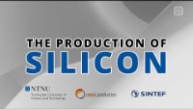
A Deeper Dive into Silicon Production
Notes:
This video is a little less than 8 minutes long but really shows the process by which silicon is produced from raw materials. It’s an energy-intensive process with some heavy metal byproducts.

Slide 34
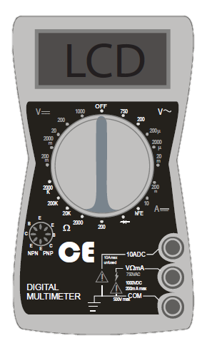
Using a Digital Multimeter
Indicates voltage from alternating current. Do not use.
DC Voltage Scale
DC Current Scale
Resistance Scale. Do not use.
Notes:
Different multimeter models have different arrangements of the controls, but the same symbols and markings are found on all of them. For the solar experiments NEED uses at workshops, AC voltage and resistance are not used.
Connect the red lead to the “VΩmA” terminal, and the black lead into the “COM” terminal.

Slide 35
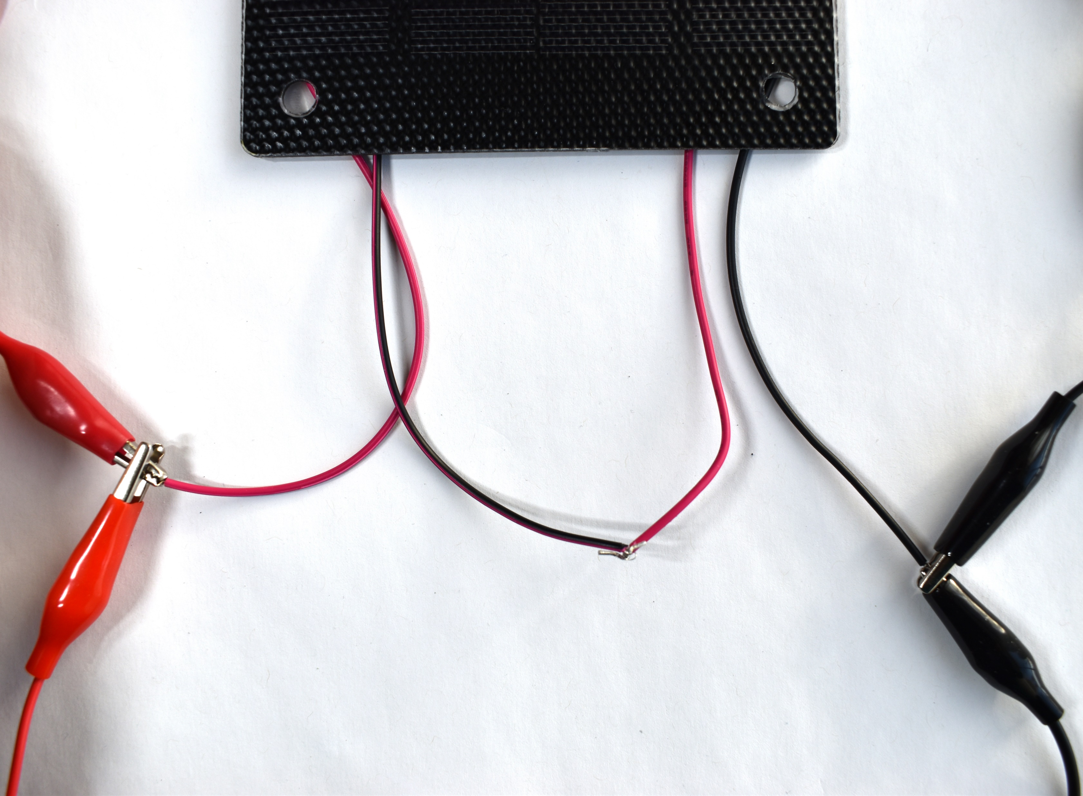

Connecting the PV Modules
Series
Parallel
Notes:
This shows how to connect the modules for series and parallel work.

