Slide 1
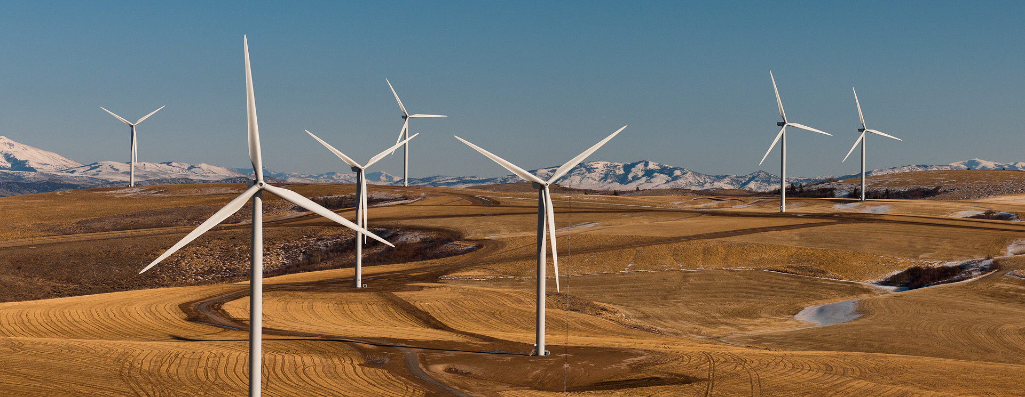
Renewable Energy Overview
Everybody loves it, but we don’t use much of it. Why is that?

Slide 2
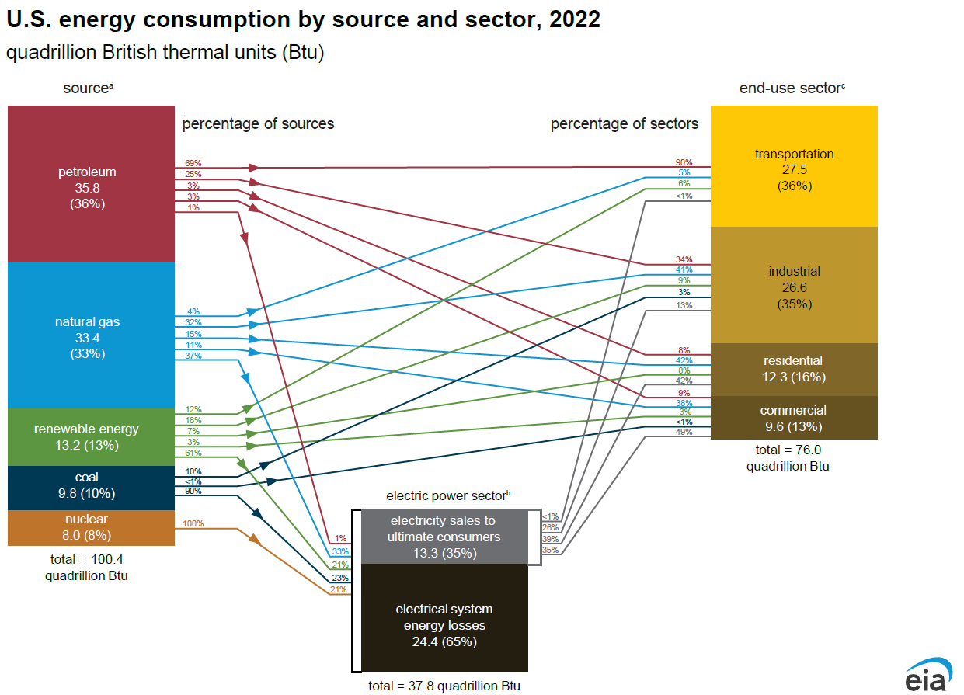

Slide 3
Using Renewable Energy
Most renewable sources are used primarily for generating electricity
Biomass is the big exception
Hydropower can be used for baseload generation as water flows 24/7
Wind generation peaks overnight
Solar generation peaks midday
Geothermal can be used for baseload generation but is limited to specific geographical areas
Many homes use wood or wood pellets as the primary heating fuel
Gasoline can have as much as 15% ethanol and be used in an ordinary engine
Diesel can have as much as 20% biodiesel
Vehicles can be equipped with engines to burn E85 or B100

Slide 4
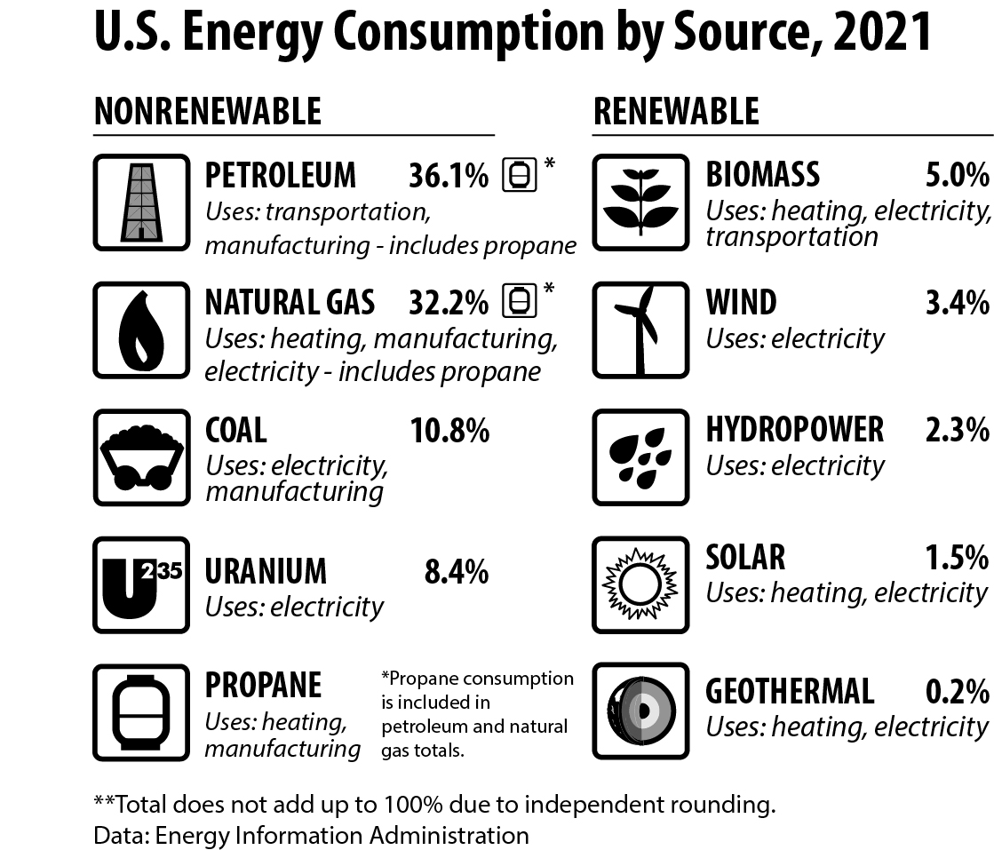
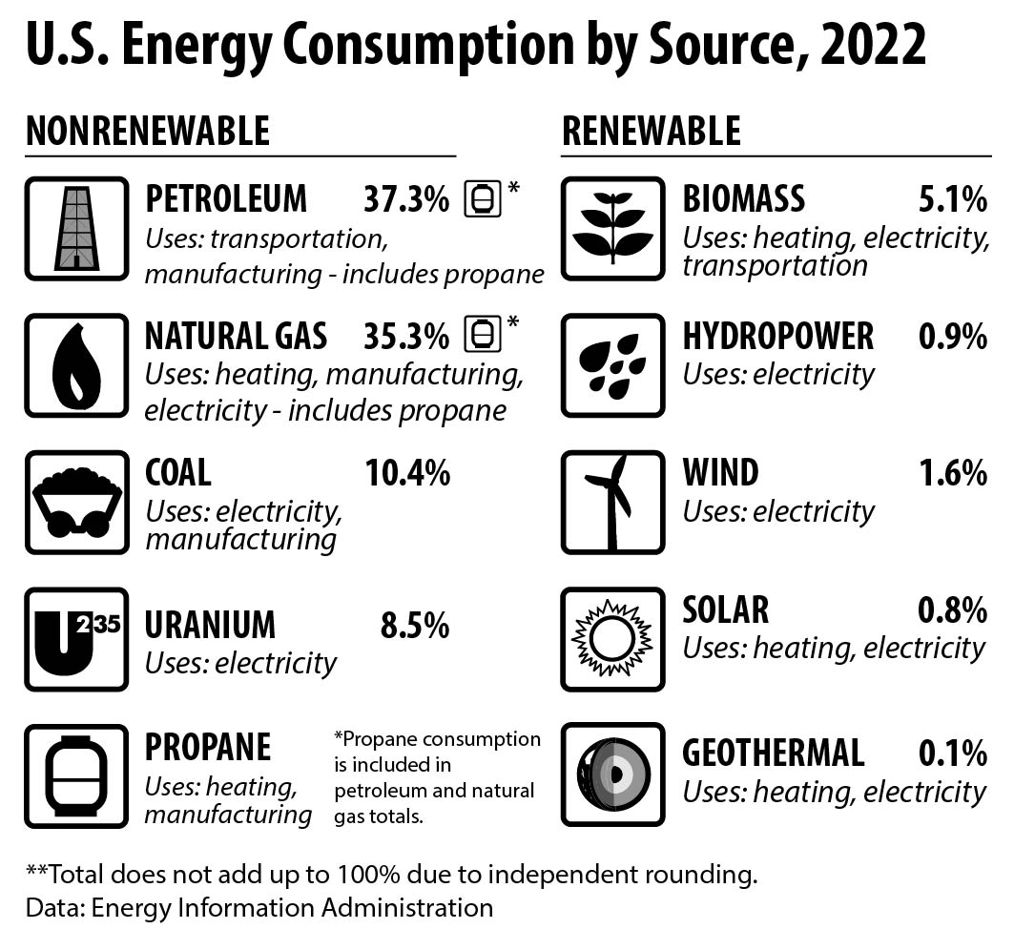
U.S. Energy Consumption by source, 2022
88.1%
8.5%
2.5%
0.8%
0.1%
91.5%
8.5%
Notes:
After teachers/students have completed part one, introduce the US Energy Consumption buy Source graphic. Explain that most of our data is acquired from the US Energy Information Administration, a branch of the Department of Energy. We update our curriculum with the most current data available at the time of printing. Sometimes teachers will be able to get more recent data from the EIA, but we as an organization need to use what is finalized by EIA and available when we go to print. Our data may be a couple years behind, but it won’t be much more behind than that most of the time. There are a few exceptions, though, such as efficiency data obtained from the Residential Energy Consumption Survey (RECS) or the Commercial Building Energy Consumption Survey (CBECS). These surveys are conducted every 5 or 6 years. Climate science information usually follows the release of the UN Intergovernmental Panel on Climate Change (IPCC) reports.
**Note for 2022 data: Any teachers who have been using NEED materials for awhile may wonder why in 2021 the nonrenewable / renewable percentage distribution was 87.5% and 12.5%, respectively. The change is due to the EIA changing the way they calculate the energy content of hydropower and wind. Instead of making an annual heat content every year through other calculations, they have adopted the 1 kWh = 3,412 BTU conversion factor. This changed how the numbers align. The same amount of electricity has been generated from renewable sources, but the way they’re represented in the total energy consumption calculation has changed.

Slide 5

Biomass
“Recently living things” including agricultural wastes, biofuels, and garbage
Biofuels are currently made from virgin crops; research into using crop residues such as corn stalks (ethanol from cellulose) and algae
Agricultural wastes are often used on-site as a heat source
Wood is used to heat homes, especially in northern, rural areas

Slide 6
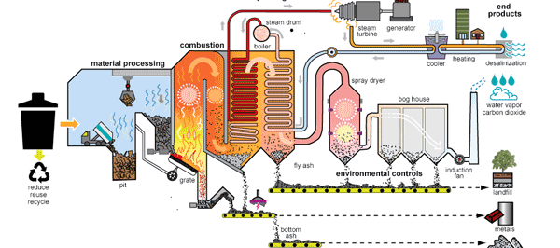
Waste-to-Energy: Alleviating Two Problems

Slide 7
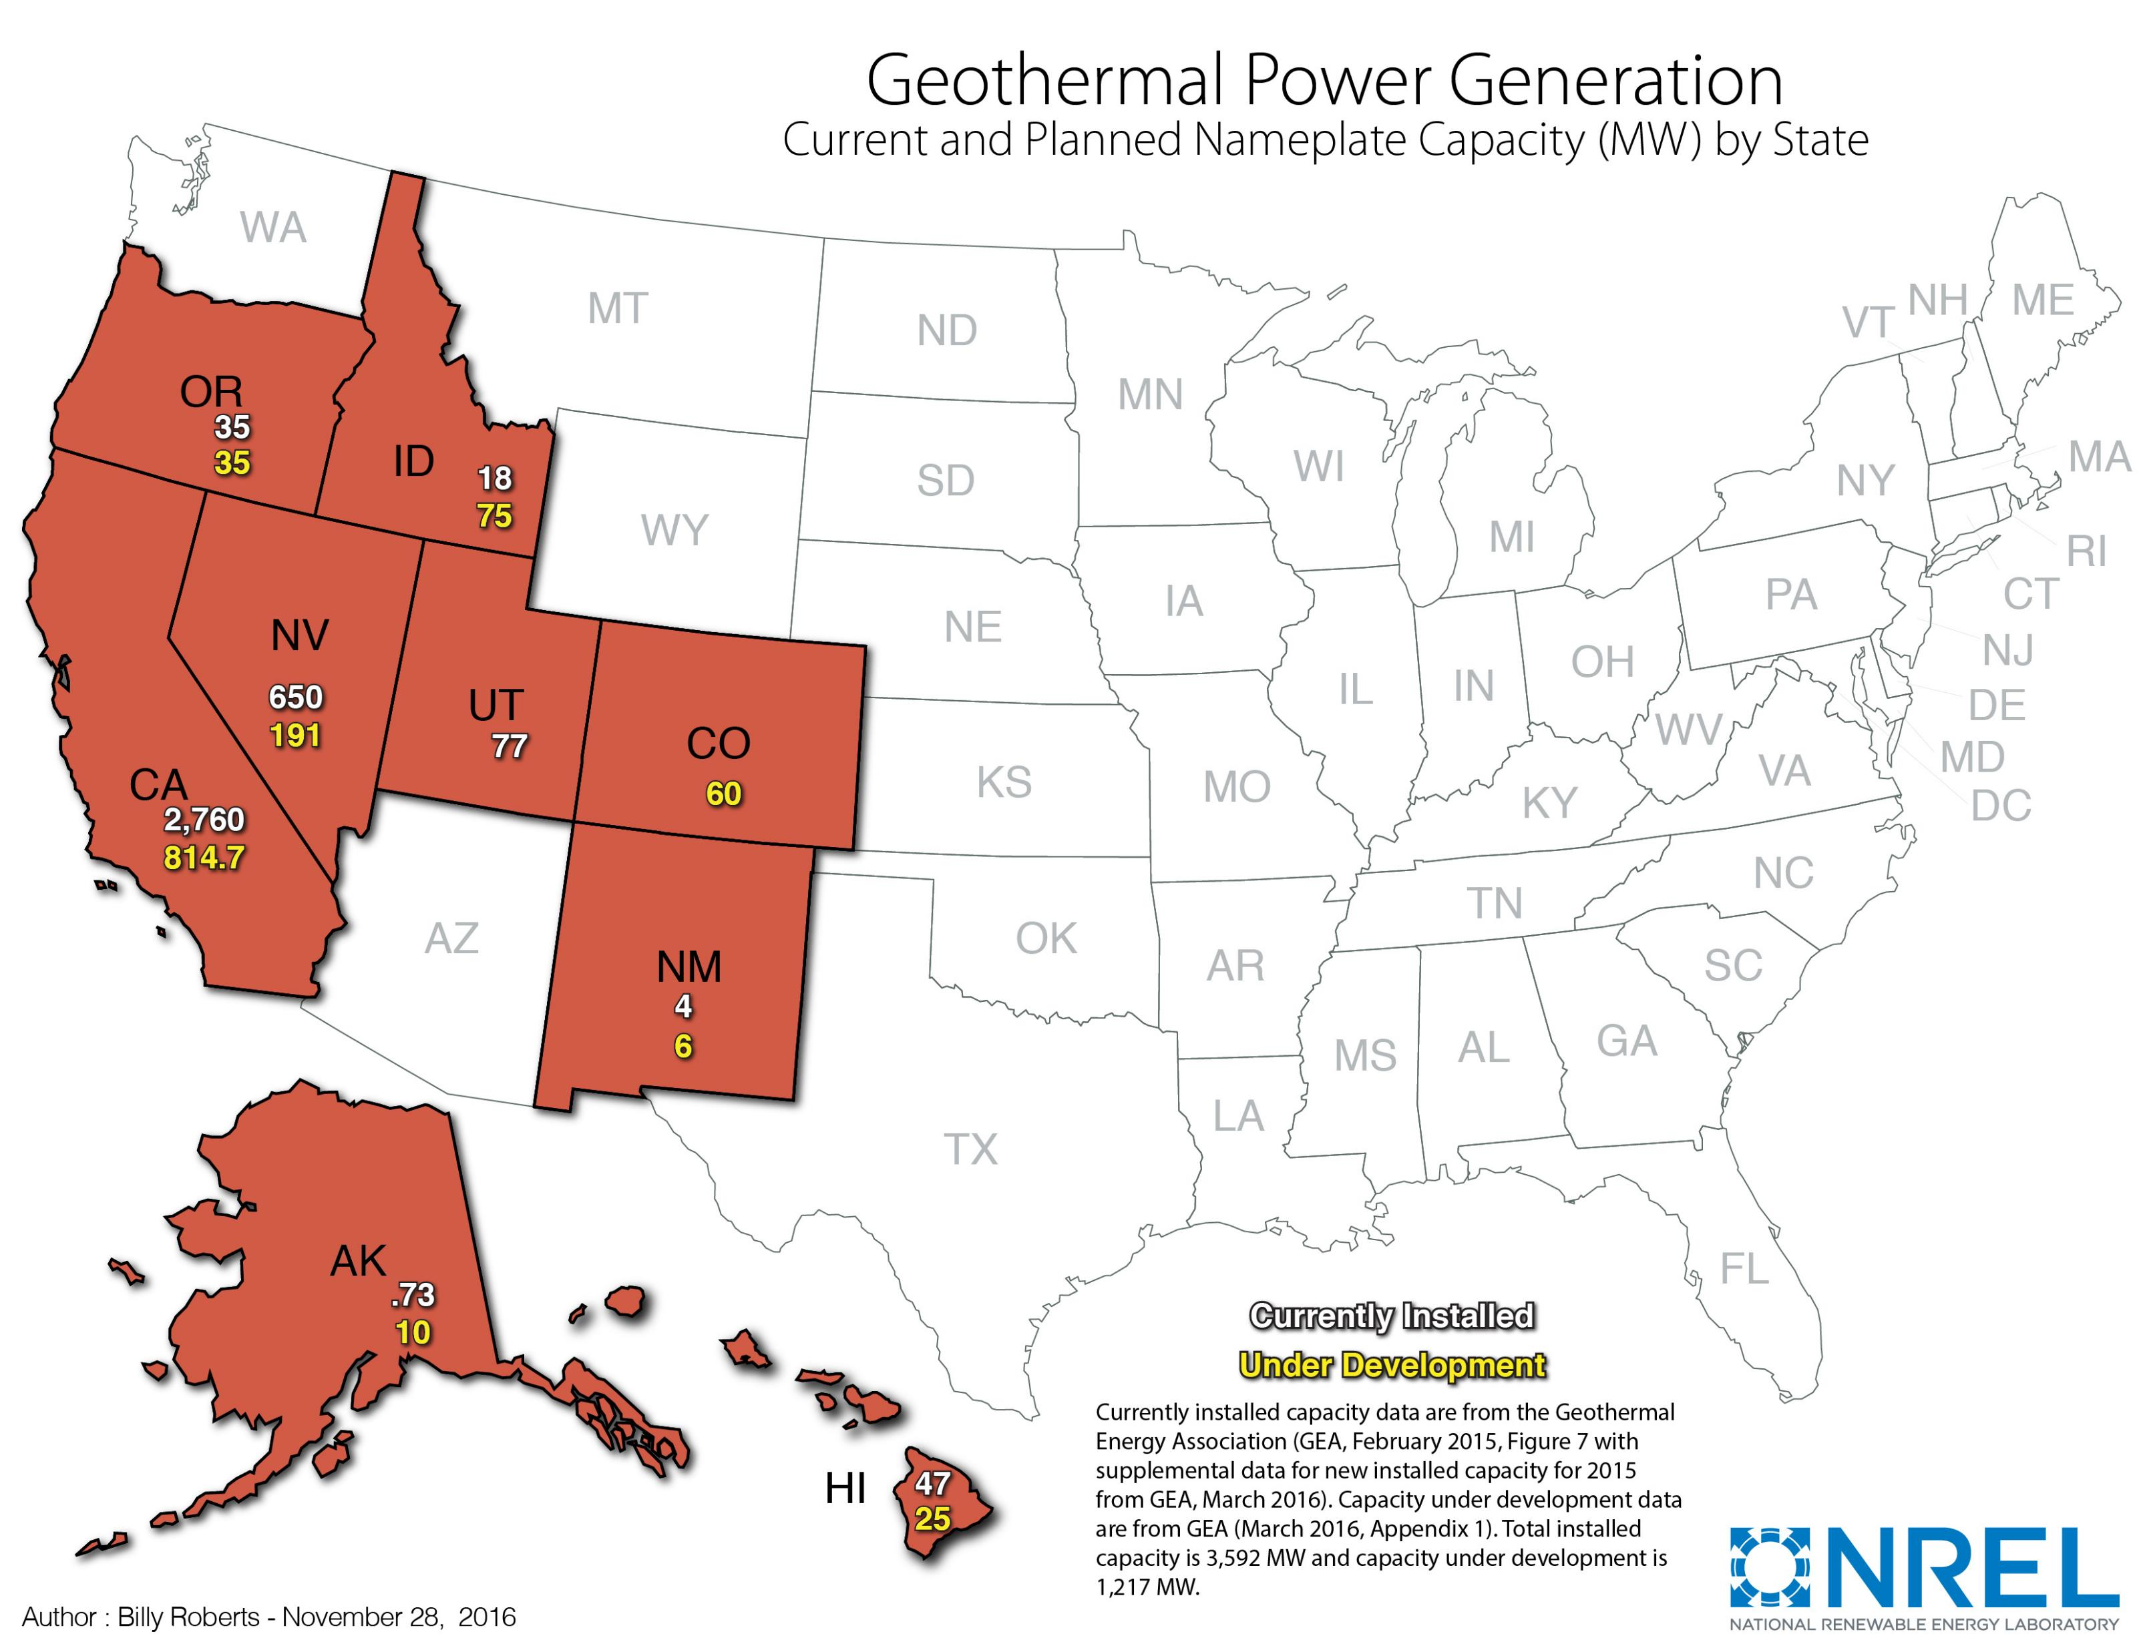

Geothermal
Small-scale use for heating and cooling homes – nation-wide
Utility-scale use for generating electricity
  Limited to locations with sufficient geothermal activity
  Less than 1% of all electricity generated by geothermal

Slide 8
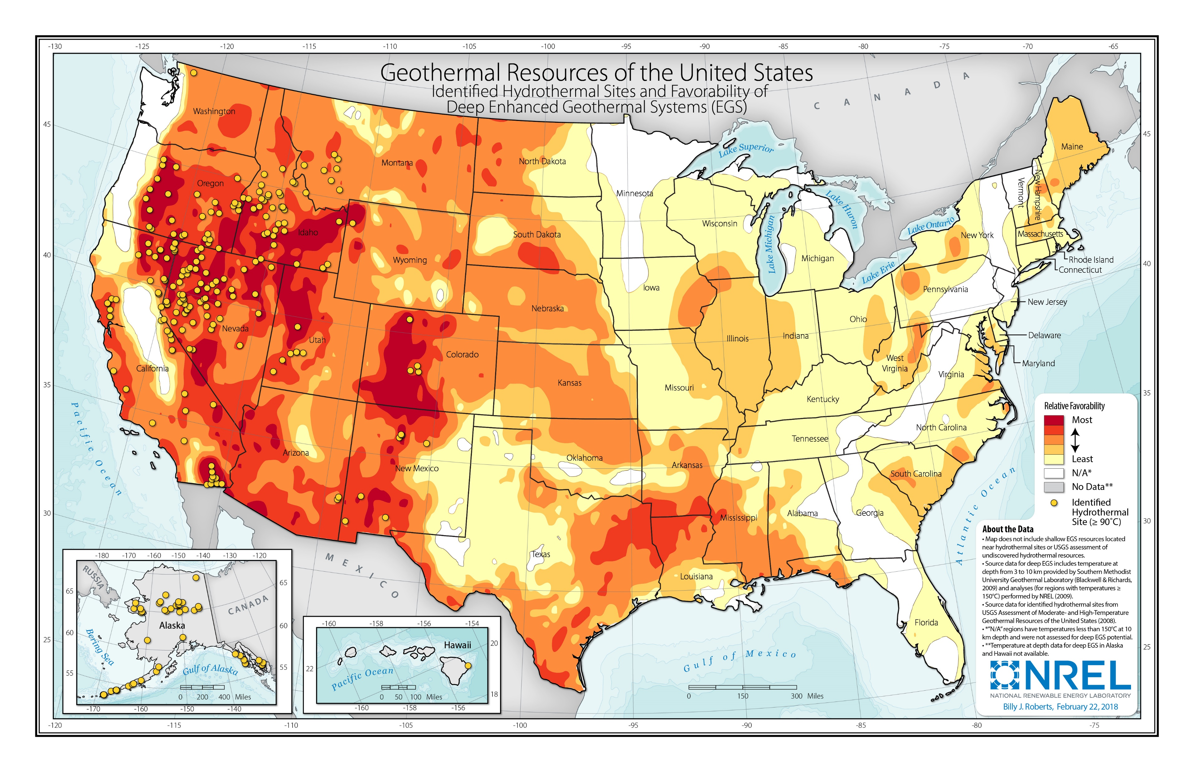
Geothermal Resource Map

Slide 9

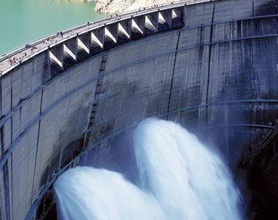
Hydropower
About 2400 sites across the country generate electricity from flowing water – many more sites can be retrofit with generating capabilities
Historically, hydropower provides about 6-10% of our electricity
Construction of the facilities, especially large dam structures, can have a significant impact on environment
Operation of hydropower is fairly clean
Modern facilities have fish ladders and other structures for fish populations
No emissions from hydropower facilities

Slide 10
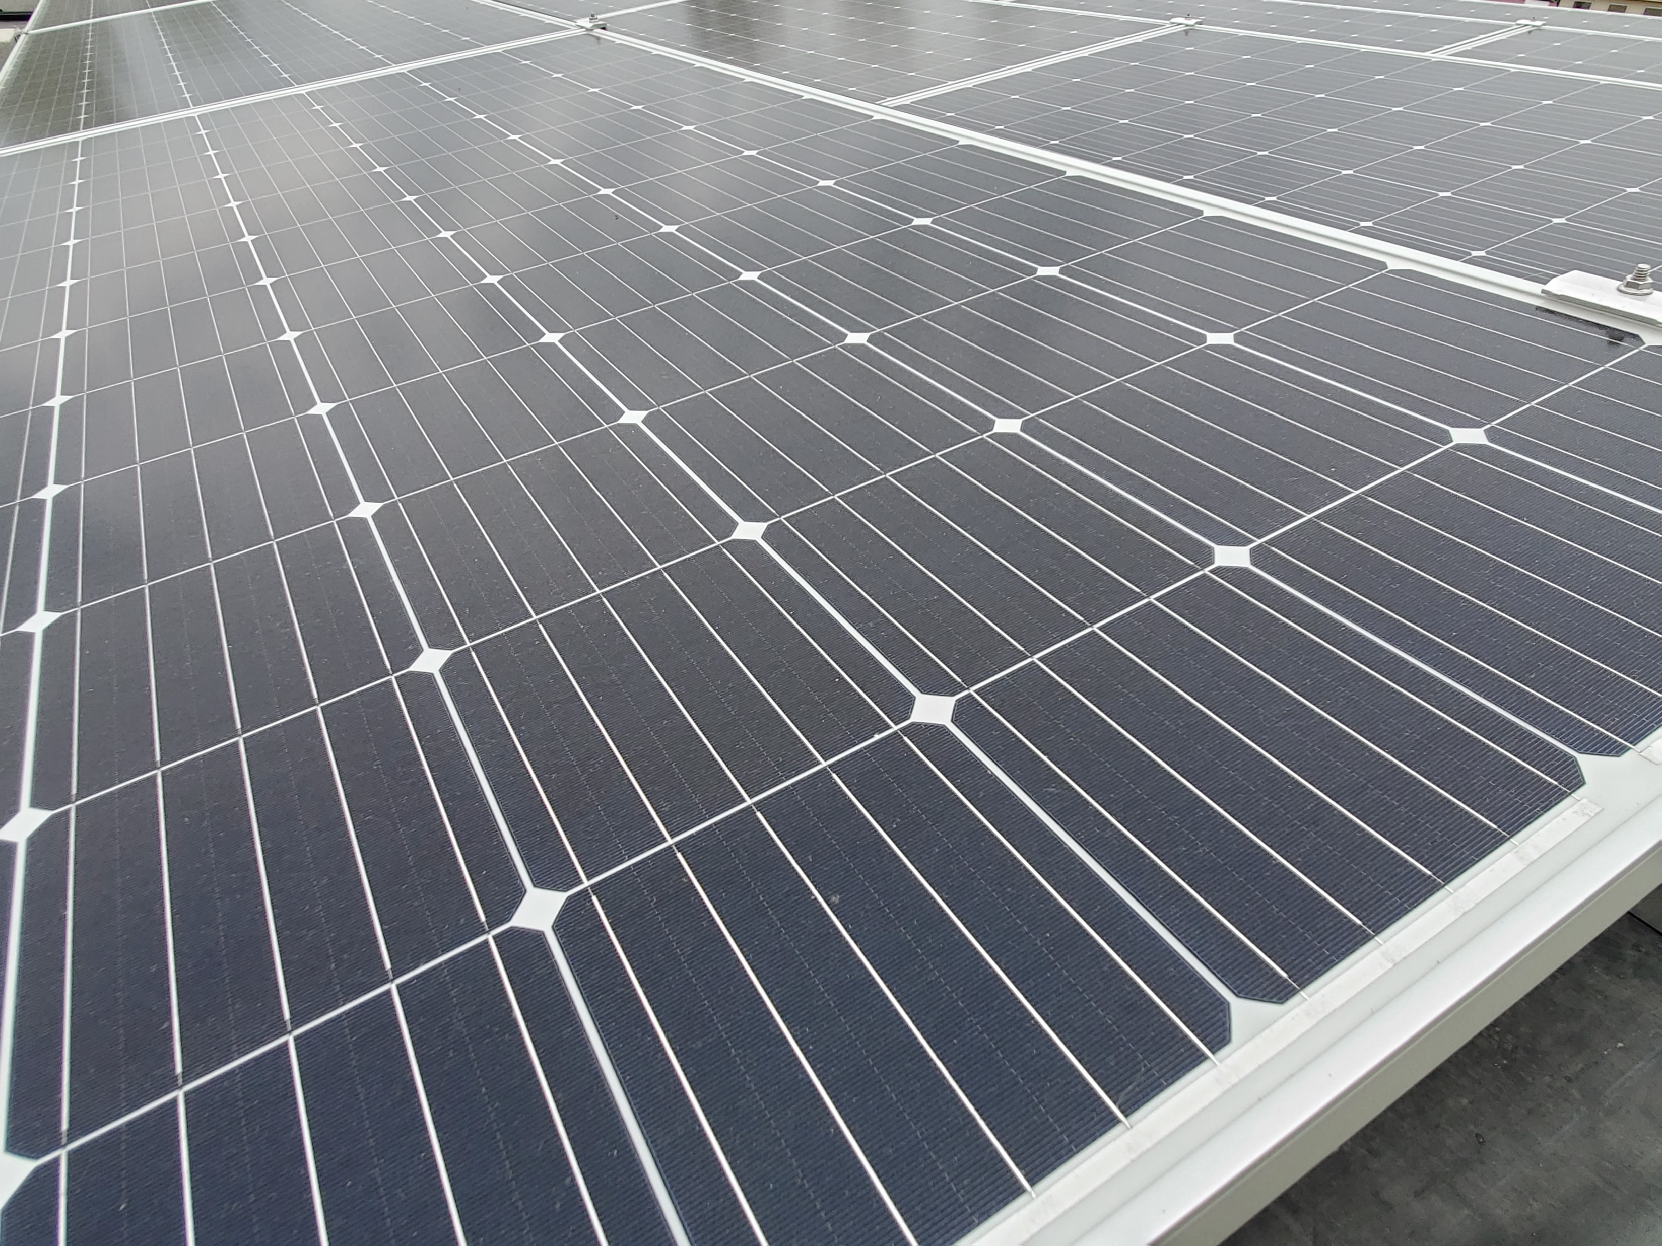

Solar Energy
The ultimate energy source
Very diffuse
Two technologies
  Concentrated Solar Power
  Photovoltaics
Generating electricity

Slide 11
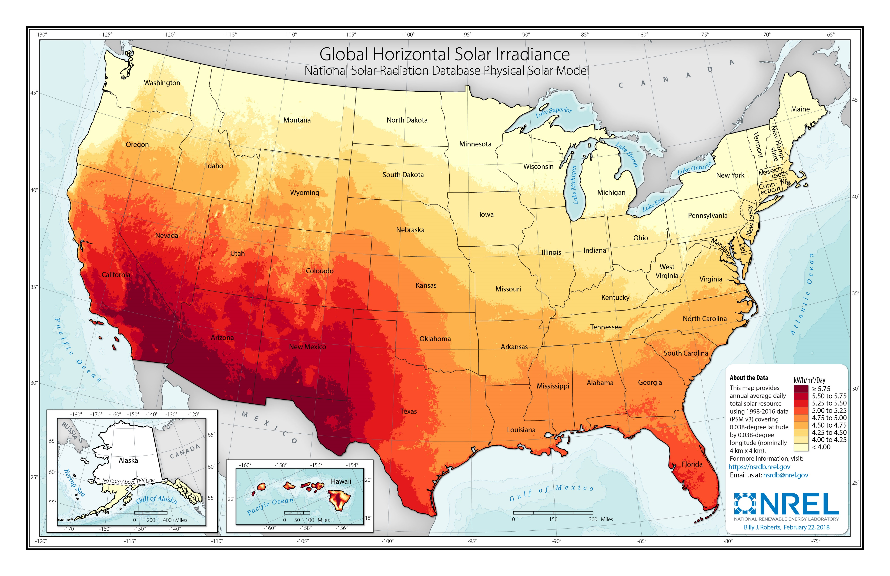
Solar Energy Resource Map

Slide 12
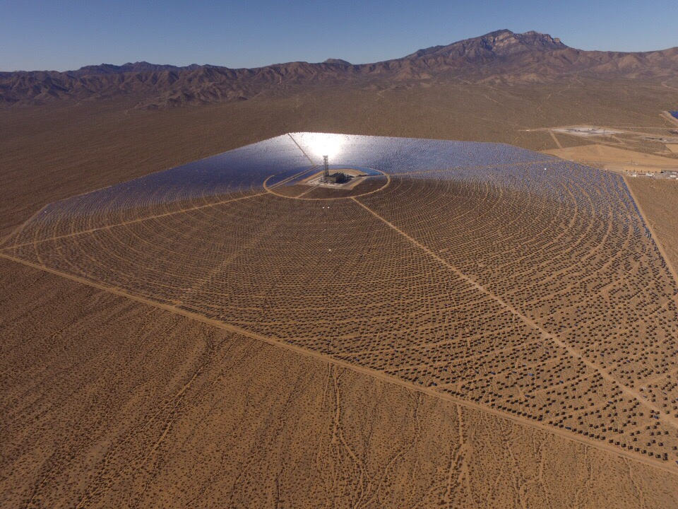
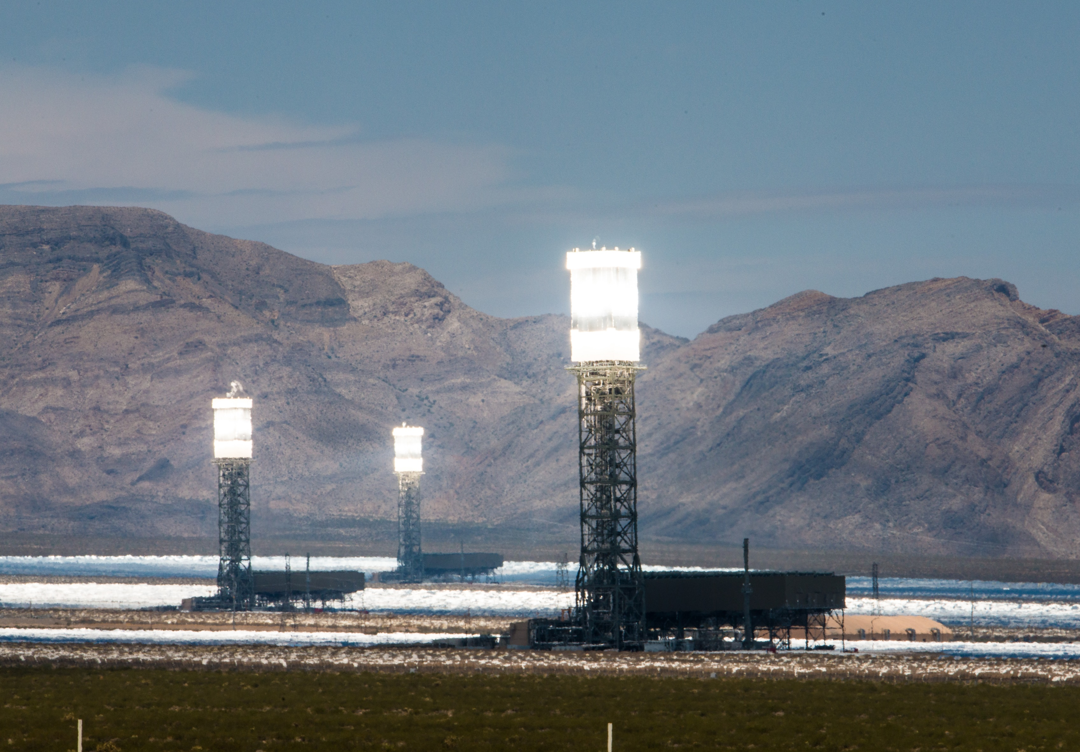
Concentrated Solar Power (CSP)

Slide 13
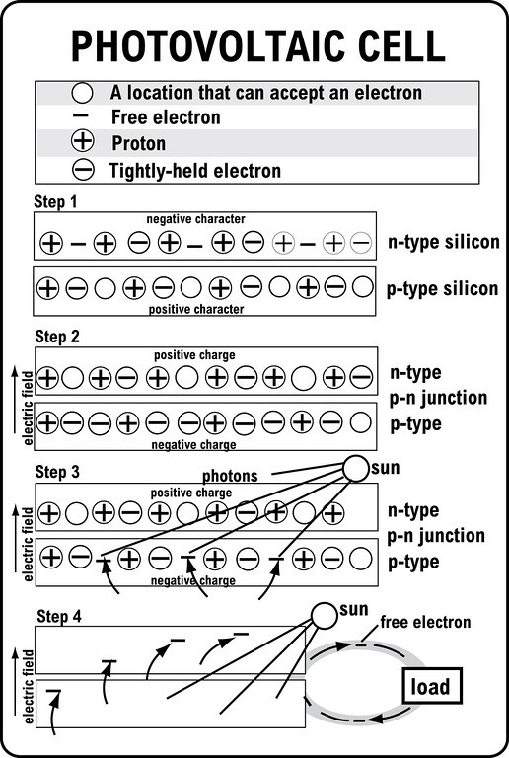
Photovoltaics
A.k.a. solar cell or solar panel
Made of silicon, doped with materials with 1 more, and 1 fewer, valence electrons (B and P)
Several solar cells in series = module
Several modules in parallel = array
Several solar panels connected together is also an array

Slide 14

Wind Energy
Wind results from convection and the Coriolis effect
Uses vary historically
Transportation (sail boats)
Grinding grain (wind mills)
Pumping water
Generating electricity
Modern-day turbines are complicated machines
A group of wind turbines is called a wind farm
Not all winds are created equal – meaning, the wind must be strong enough, but not too strong, to generate electricity

Slide 15
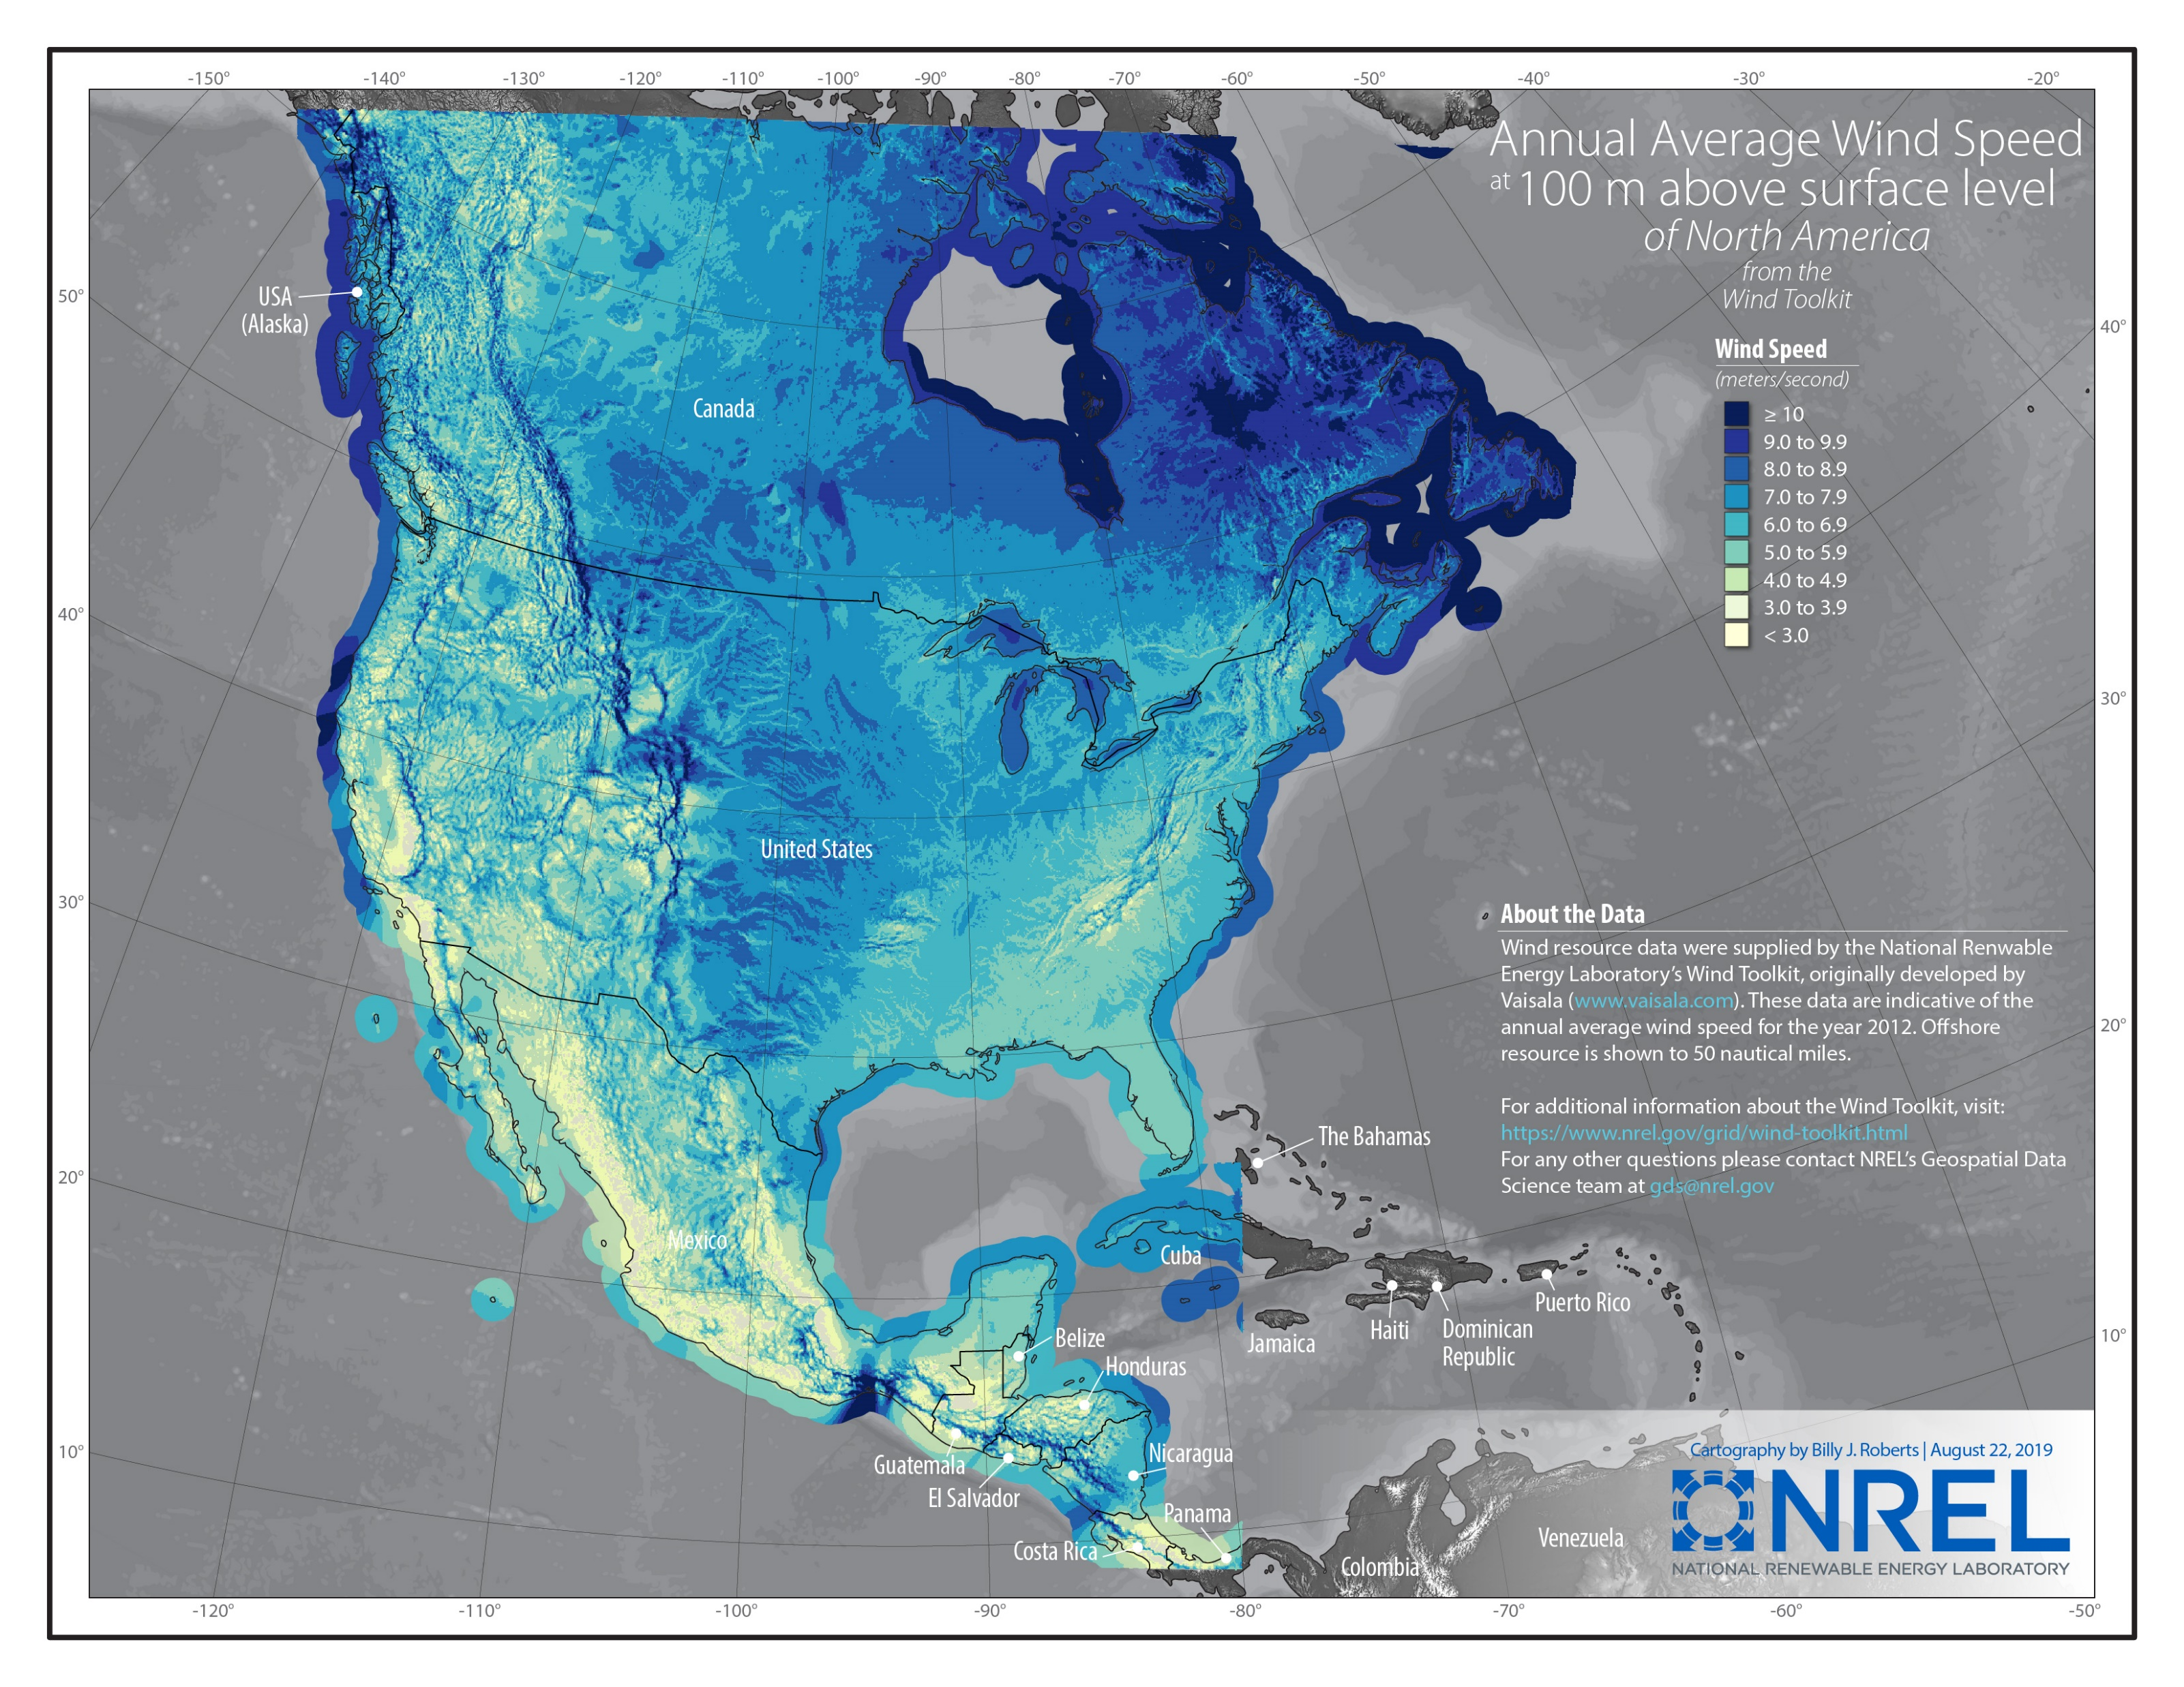
Wind Energy Resource Map

Slide 16
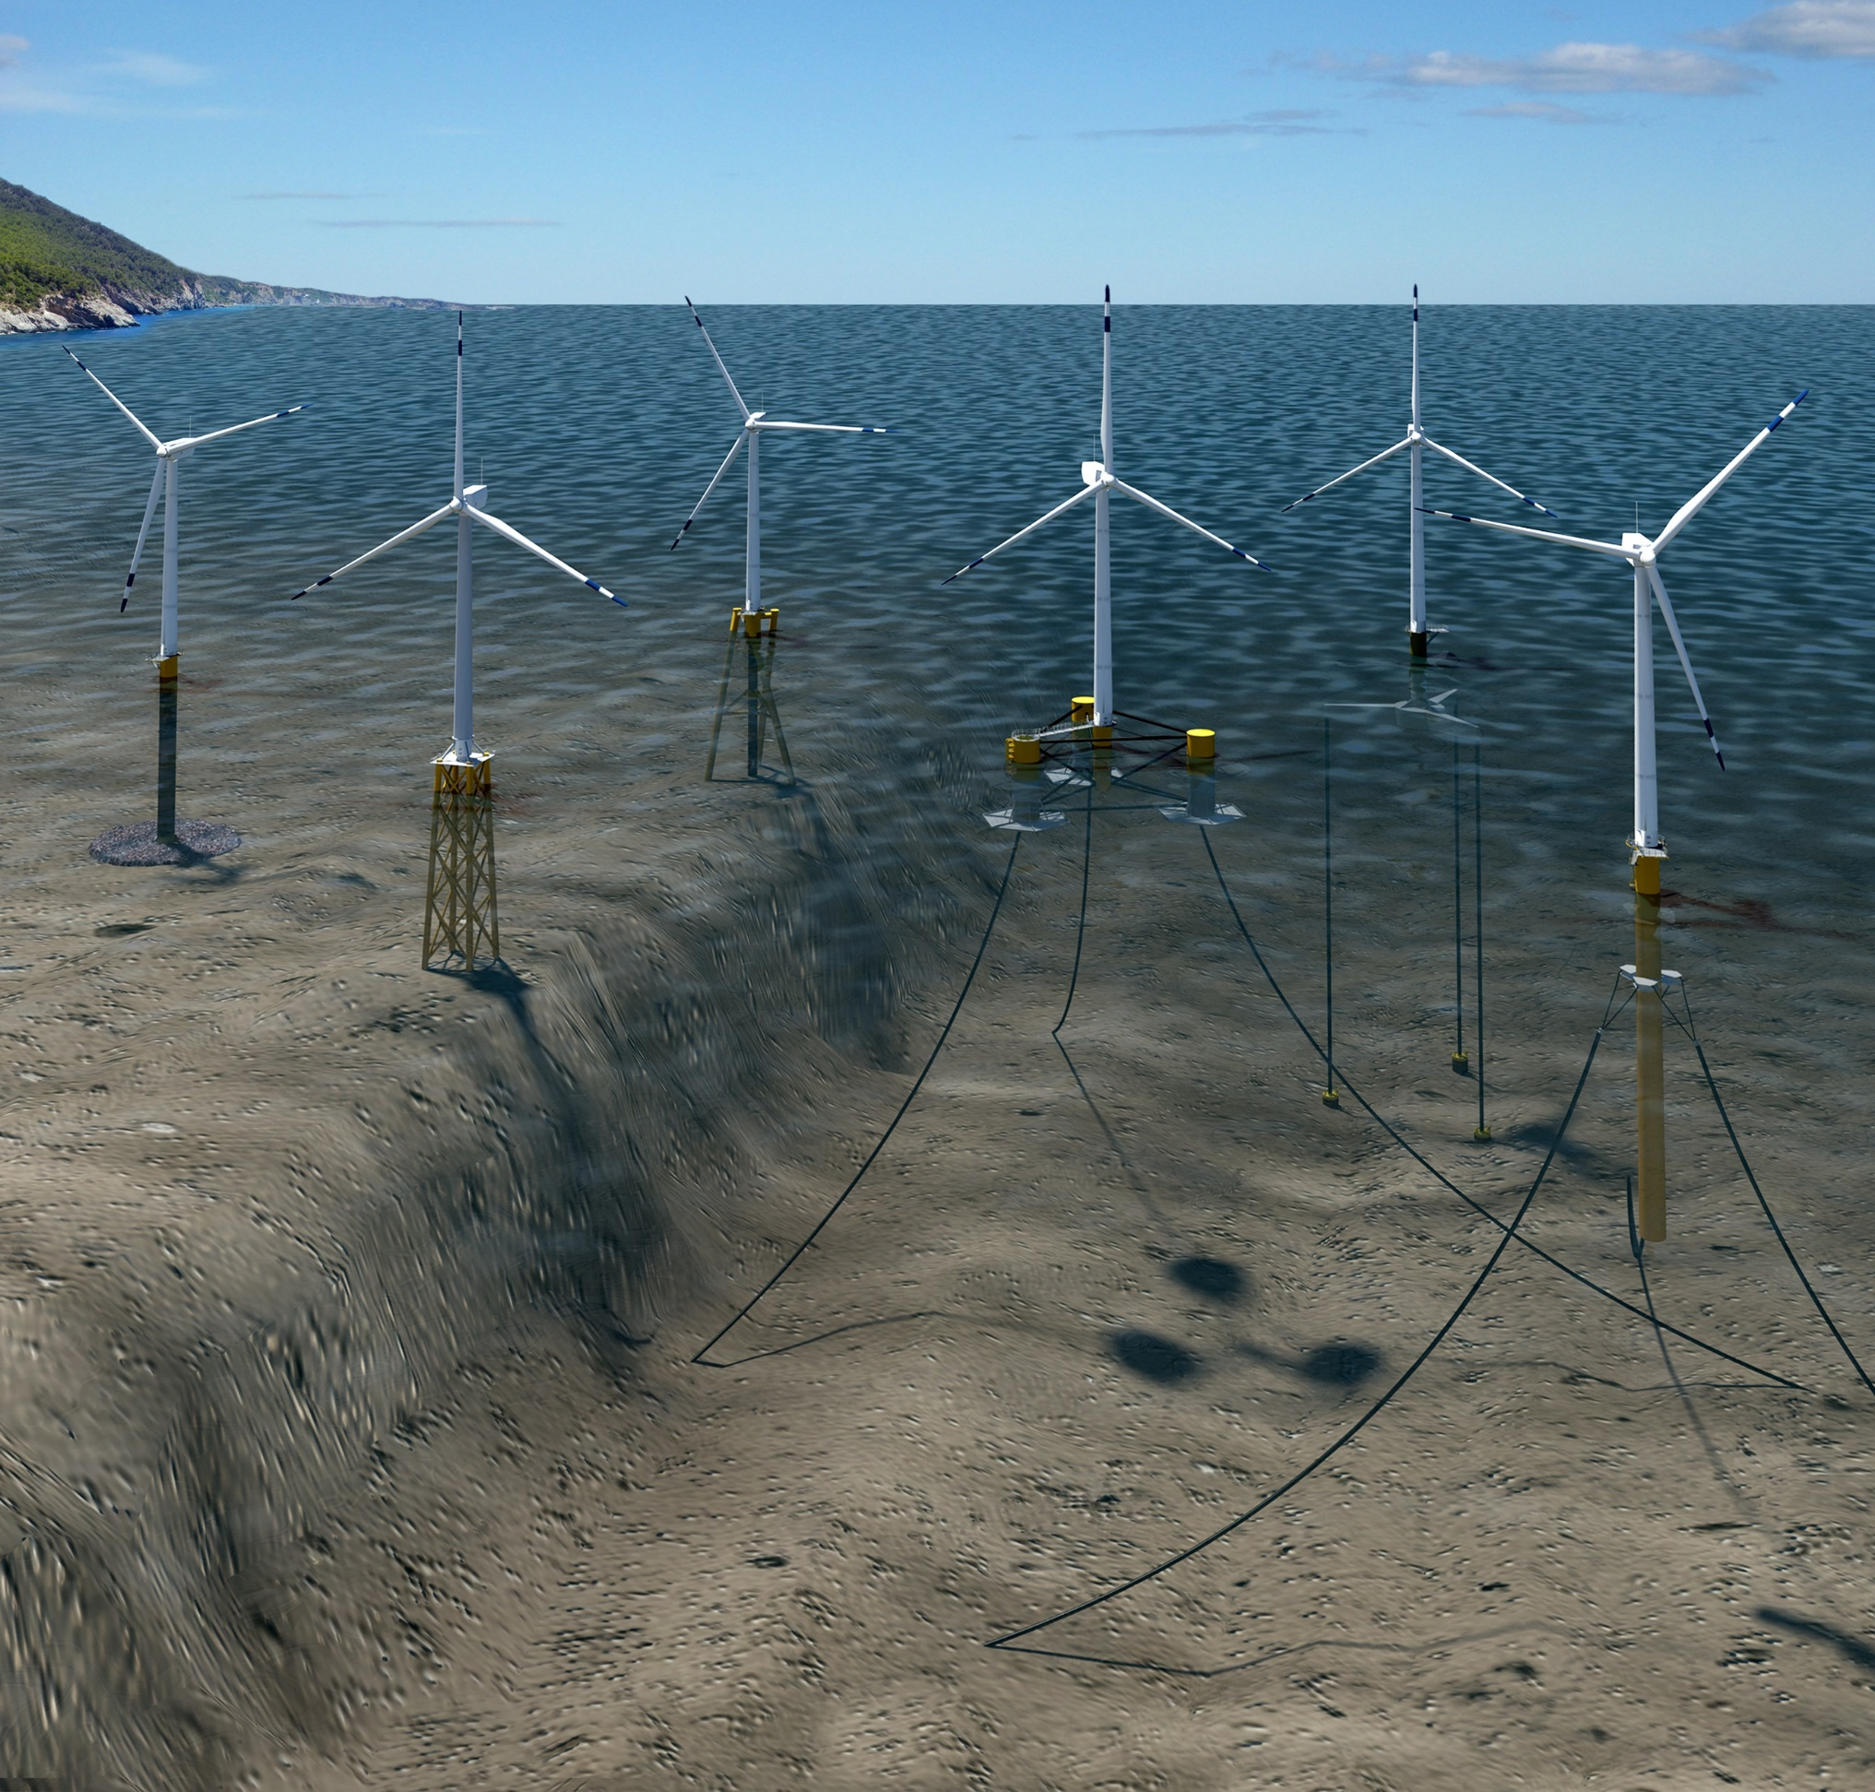
U.S. Offshore Wind Energy
Offshore turbines are taller, higher generating capacity
Turbines offshore can be located closer to population centers
Entirely new set of challenges
To reduce maintenance needs and time, offshore turbines are often direct-drive (no gear box)

