Slide 1
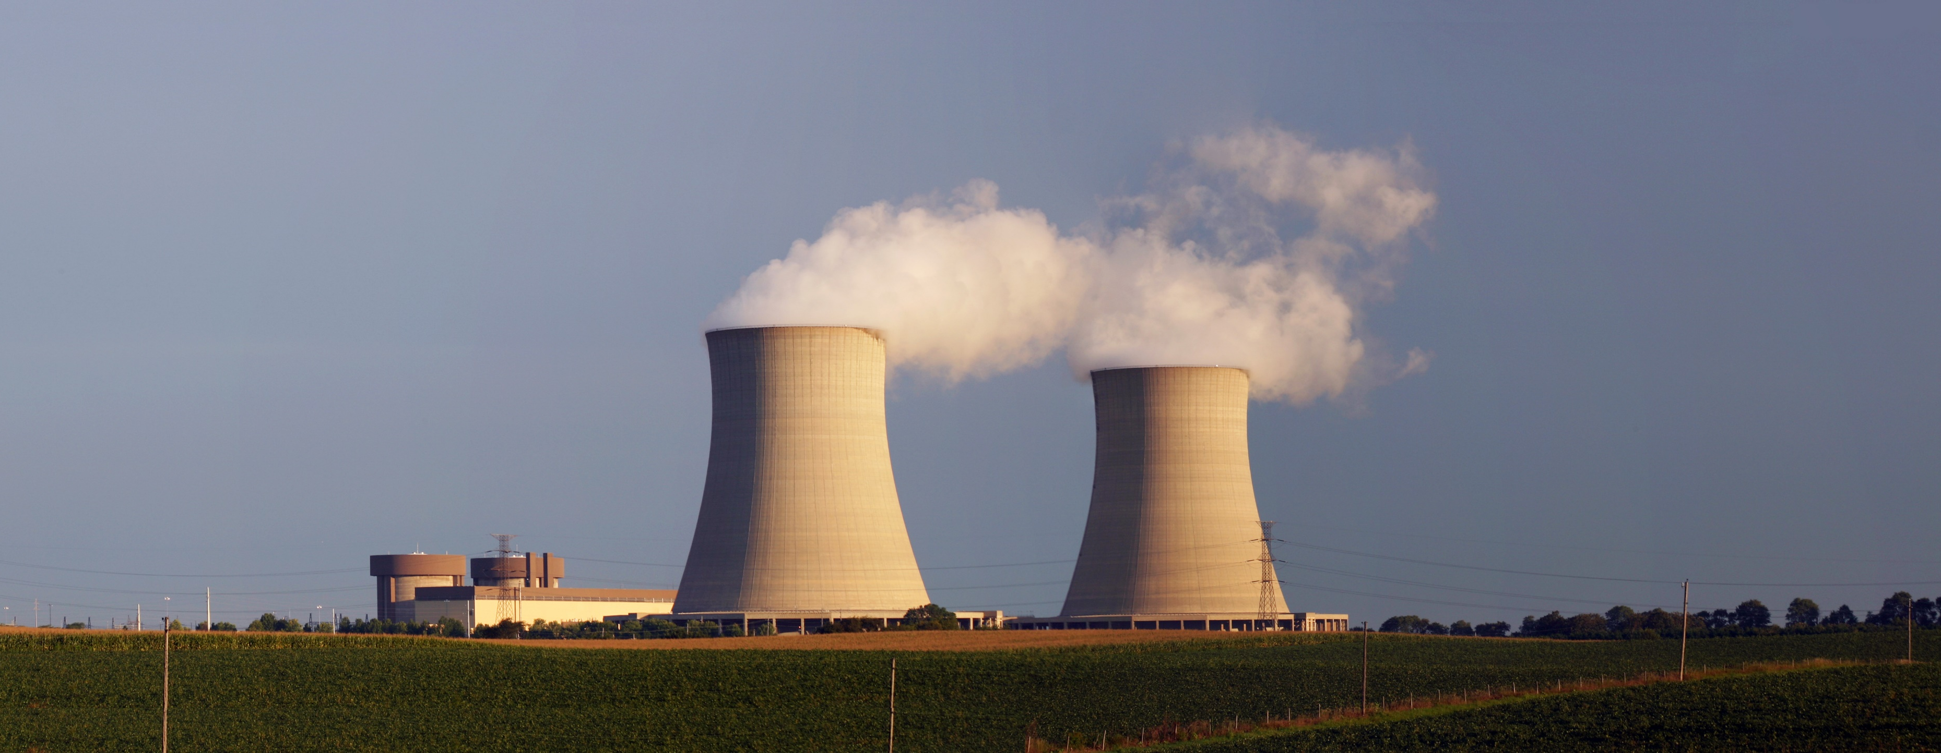
Exploring Nuclear Energy

Slide 2
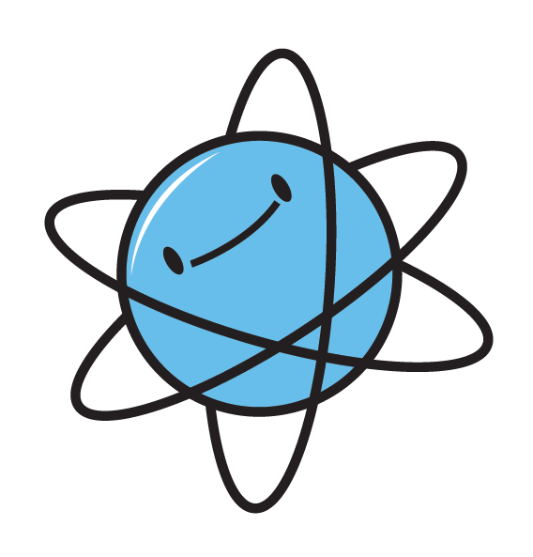
Two Ways Nuclei Release Energy
Nuclear Fusion
Nuclear Fission
Small nuclei combined to form one large nucleus
Requires immense amounts of energy to start and sustain
Process in the core of stars
Currently only a laboratory process
Large nuclei split into smaller nuclei
Requires a critical mass to sustain the reaction
Process used in Naval vessels as well as nuclear power plants
Power plants use U-235
Iron is the “dead end” of both fusion and fission. As the lowest energy nucleus, it cannot be split nor fused.
Notes:
These are the two nuclear processes from which we get vast amounts of energy.
Nuclear fusion is the process that powers our sun and other stars (see Solar 101 Long)
Nuclear fission is the process of splitting large atoms into smaller pieces. Lise Meitner, exiled from Germany in the late 1930s, corresponded with her colleague, Otto Hahn, about work they had started at the Planck Institute. Hahn was bombarding large nuclei with neutrons, attempting to make them even larger, but was getting what he thought were contaminants – atoms of much smaller mass than uranium. Eventually Meitner realized what was happening, and after doing calculations confirmed that the atoms were indeed being split, and the energy released was the amount of mass loss in the process according to Einstein’s equation, E=mc².
Only certain isotopes are fissile, meaning able to be split. Uranium ore is high in U-238, which is not fissile; however, it does contain U-235, which is fissile. The ore goes through a series of chemical reactions and spinning in a centrifuge to enrich the uranium. Uranium must be at least 4% U-235 to sustain a nuclear fission reaction. Concentrations lower than this do not have the critical mass necessary to maintain fission. The enrichment process is stopped at 4% for nuclear fuel, or is allowed to continue to nearly 100% for weapons-grade plutonium using the same facility and processes.
The two nuclear weapons deployed in World War II used fission. Little Boy contained U-235 while Fat Man contained Plutonium-239. The two weapons used two different mechanical methods for achieving critical mass and initiating the uncontrolled, destructive reaction. Modern nuclear weapons are fusion bombs (a.k.a. “H-bombs”) that use fission to initiate the fusion reaction between hydrogen atoms. These weapons are orders of magnitude more powerful.
The nuclear fuel in a power plant can never explode like a nuclear weapon. It is not of high enough concentration. That’s not to say it cannot trigger a chemical reaction – just not a nuclear weapon-type reaction.

Slide 3
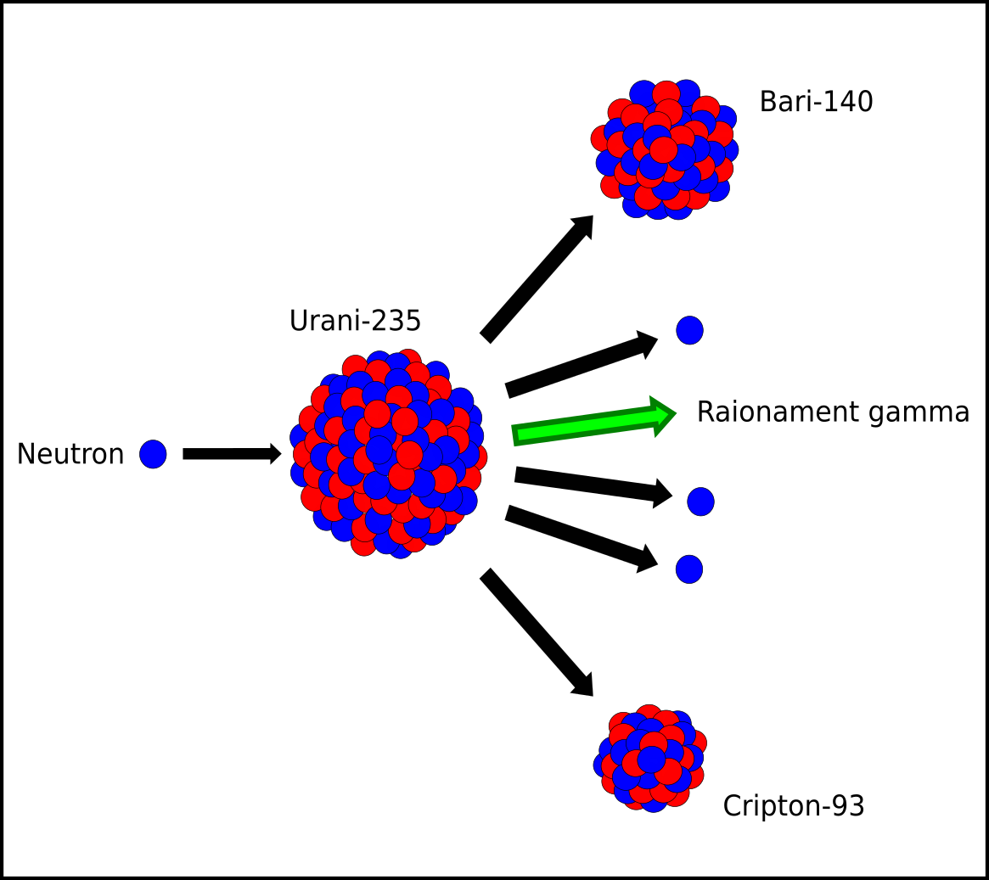
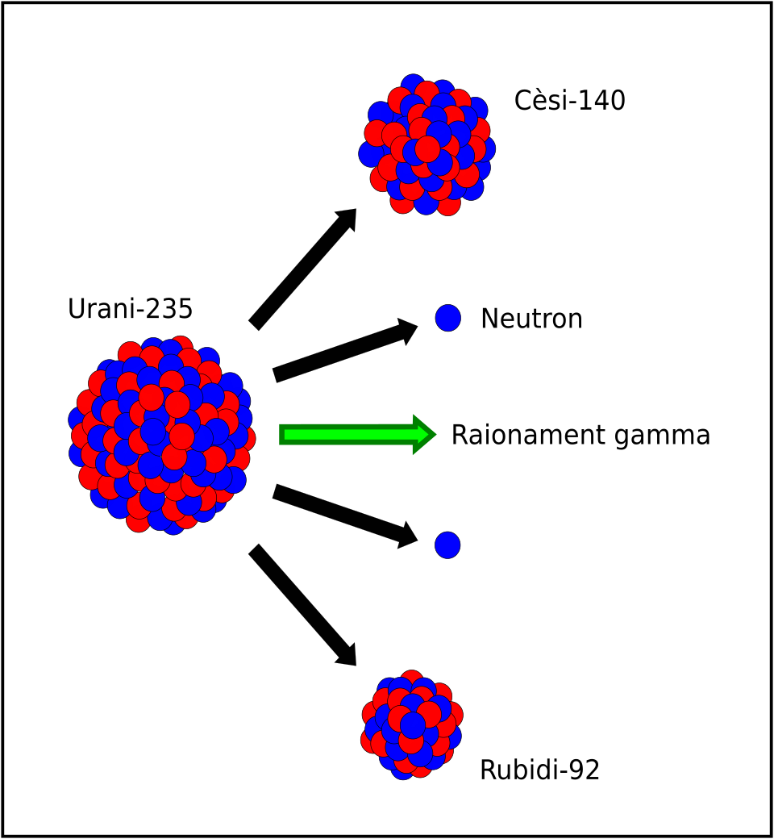
Nuclear Fission Up Close and Personal
Barium-140
Cesium-140
Uranium-235
Neutron
Uranium-235
Neutron
Gamma Radiation
Gamma Radiation
Neutron
Neutron
Neutron
Neutron
Krypton-93
Rubidium-92
Notes:
We often characterize U-235 as releasing 2 neutrons and forming Cs-140 and Rb-92. The fact is there are several different product scenarios that release 2, 3, or even 4 neutrons. It just depends on the incoming neutron impacts the uranium nucleus. Regardless, the neutrons ejected in the process then impact other uranium nuclei, triggering more reactions, and so on. Each fission releases energy in the form of gamma radiation, which heats up the water in the reactor core. Control rods are used in nuclear power plants to absorb some of the neutrons when the reaction needs to be slowed but not stopped.

Slide 4
Global Energy Consumption 2022
Data Source: EIA
Notes:
Since the Fukushima Daiichi accident in 2009, world nuclear power production has gone down. In 2009, 13.1% of electricity worldwide was produced by nuclear power. In 2011 that number had dropped to 10.8%.

Slide 5
History of Global Nuclear Energy
Fukushima disaster in Japan
Chernobyl disaster in Belarus
Data Source: EIA

Slide 6
Top Nuclear Generating Countries, 2022
Country | Nuclear Generation (BkWh) | Nuclear as percent of Total Generation
United States | 772 | 17.98%
China | 418 | 4.70%
France | 279 | 62.51%
Russia | 223 | 19.62%
South Korea | 167 | 27.58%
Country | Nuclear as percent of Total Generation
France | 62.51%
Slovakia | 60.68%
Ukraine | 54.47%
Belgium | 45.79%
Hungary | 44.19%
Data Source: EIA

Slide 7
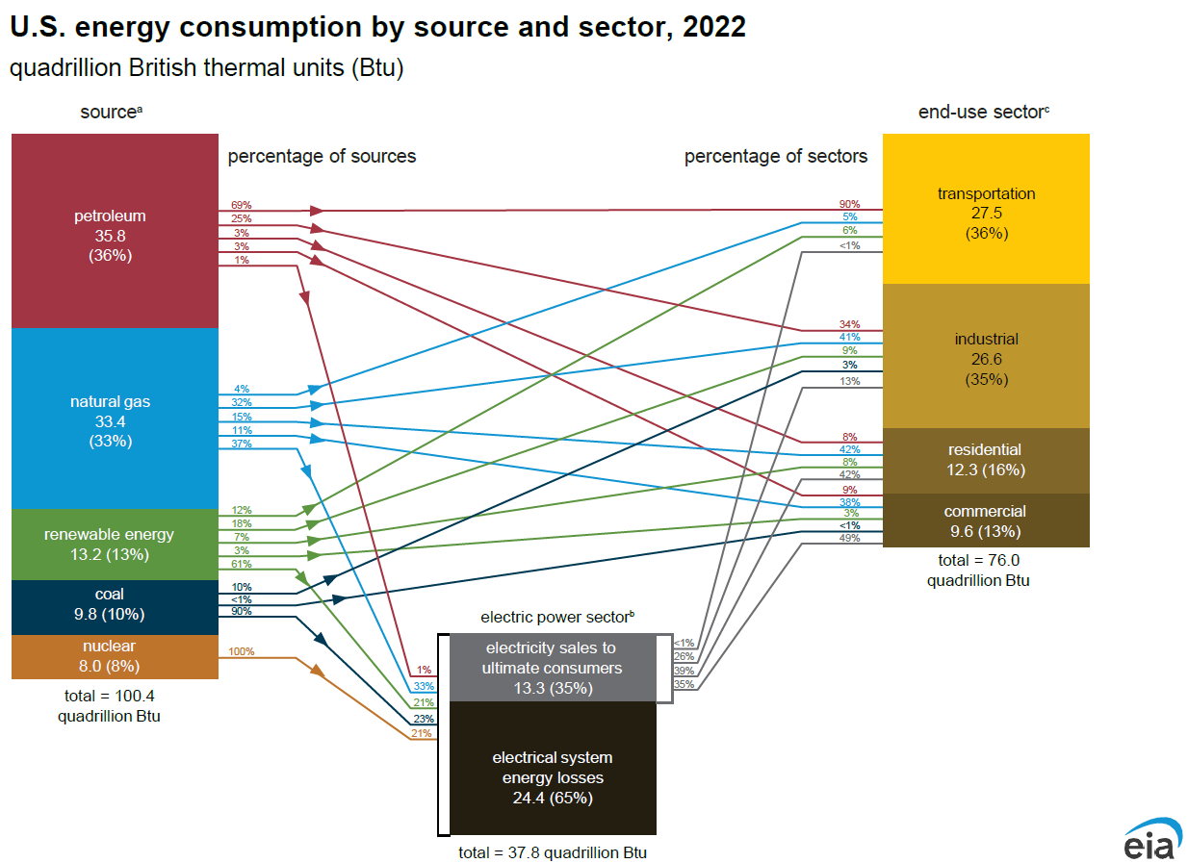

Slide 8
US Electricity Generation by Source, 2022
Data Source: EIA

Slide 9
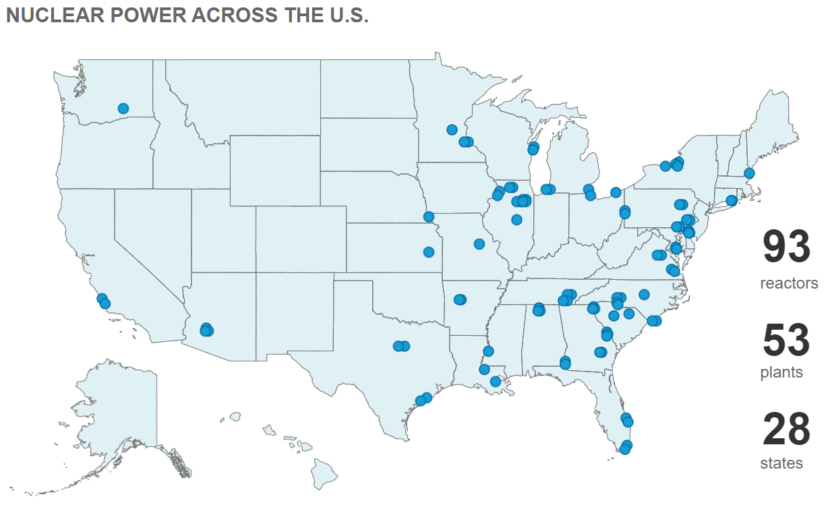
Nuclear Power Plant Locations
Image source: Nuclear Energy Institute
Notes:
28 states have at least one nuclear power plant.
Reactors 3 and 4 at the Vogtle generating station in Georgia were scheduled to come online in 2016, but that has been pushed back several times for the last several years. Reactor 3 started commercial operation in 2023. Reactor 4 has had hot testing nor has begun generating electricity.

Slide 10
Top Ten States for Nuclear Generation by Percent of Total, 2023
32.30%
32.47%
32.0%
32.90%
38.1%
34.22%
39.7%
41.62%
43.5%
44.09%
44.8%
47.79%
54.64%
54.86%
57.94%
US Total – 18.6%
Data Source: EIA
Notes:
This bar graph looks a little messy, but it is in order from bottom to top of most electricity generated as a percentage of the total in 2023. New Hampshire generates the greatest percentage of its electricity from nuclear energy, but Illinois generates the greatest number of thousand-megawatt-hours from nuclear power.

Slide 11
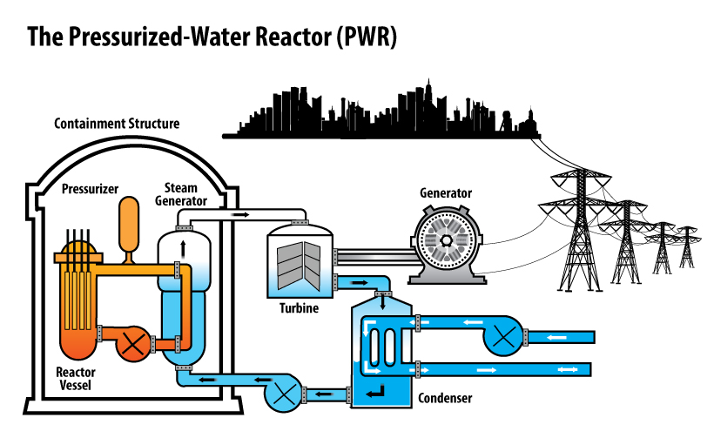
Anatomy of a Nuclear Power Plant
Image Source: NRC
Notes:
The pressurized water reactor (PWR) is the most common type of commercial reactor design used worldwide. It has primary, secondary, and external heat exchange systems and is pressurized to prevent water from boiling in the reactor.
Pressurized steam is piped into the reactor. Fission is taking place in the fuel rods within this reactor. The steam passing through the reactor is super heated.
The super heated pressurized steam then travels to the steam generator to heat a secondary water system.
The steam produced there travels through a steam line to the turbine to turn the generator and create electricity.
Unused steam continues to a condenser where water from the environment condenses it back into liquid water. The cooling water in the environment never comes into contact with the steam so it is safe to return to the environment. The newly condensed water can be pumped back into the containment building and reheated in the steam generator to start the process over again.
The pressurized steam loops back from the steam generator to the reactor to be super heated again.

Slide 12
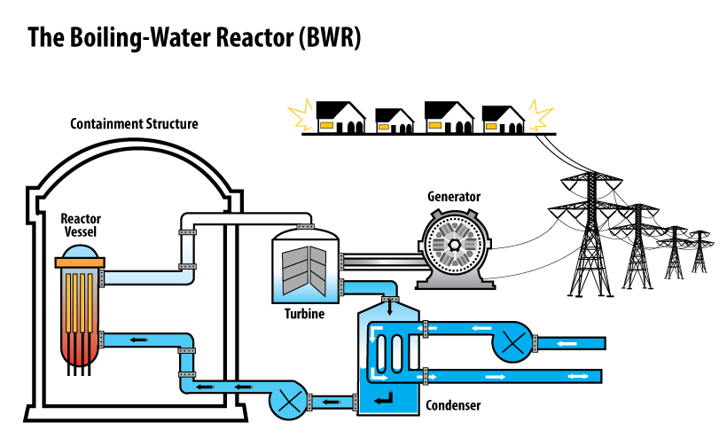
Anatomy of a Nuclear Power Plant
Image Source: NRC
Notes:
A Boiling Water Reactor (BWR) is less common. In this design there is only one loop for the water to travel from the reactor to the turbine, whereas with the PWR there is a secondary loop.
In this model, water is pumped into the reactor creating steam and hot water that will turn the turbine attached to the generator to generate electricity. The unused steam/water mixture travels to the condenser and is condensed by water from the environment. The cooling water in the environment never comes into contact with the steam so it is safe to return to the environment. The resulting water in the condenser is pumped back into the reactor vessel to begin the process again.
Few nuclear power plants use the boiling-water design.

Slide 13
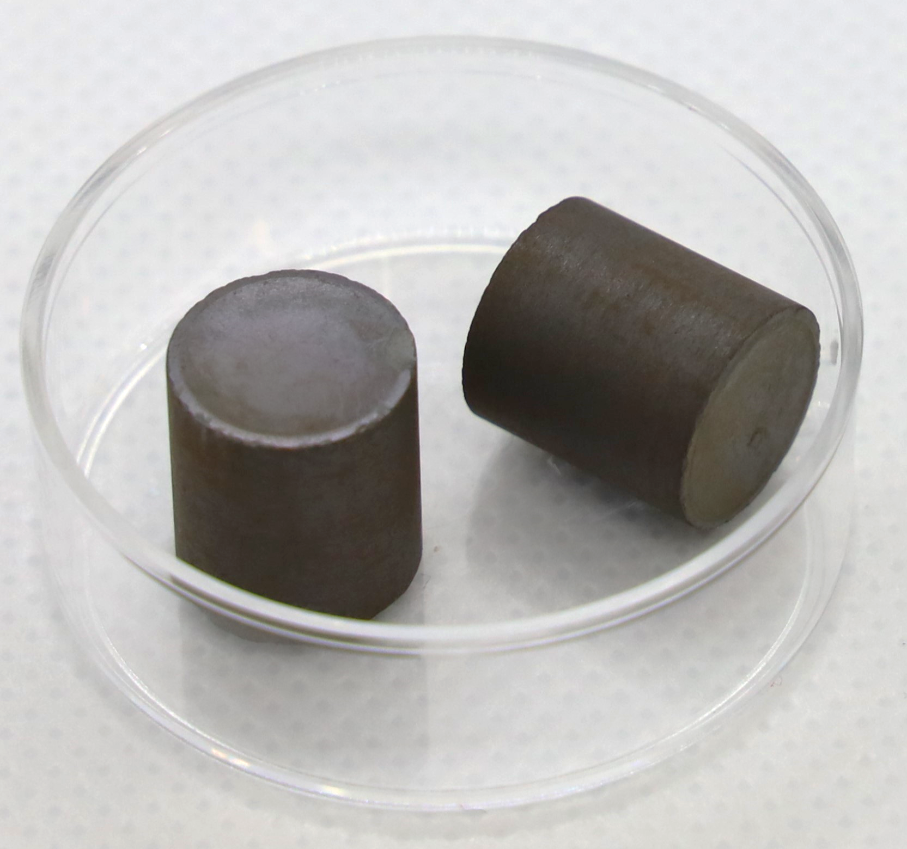
Advantages of Nuclear Power
No Air Pollution from Generation
No Carbon Emissions from Generation
High Energy Density in Uranium
Operating Cost is Low After Construction
One fuel pellet = 1 ton coal
Image Source: Wikimedia Commons
Notes:
The fuel pellets in the photograph are about 1 cm in diameter. Each has the ability to generate the same amount of electricity as 1 ton of coal.

Slide 14
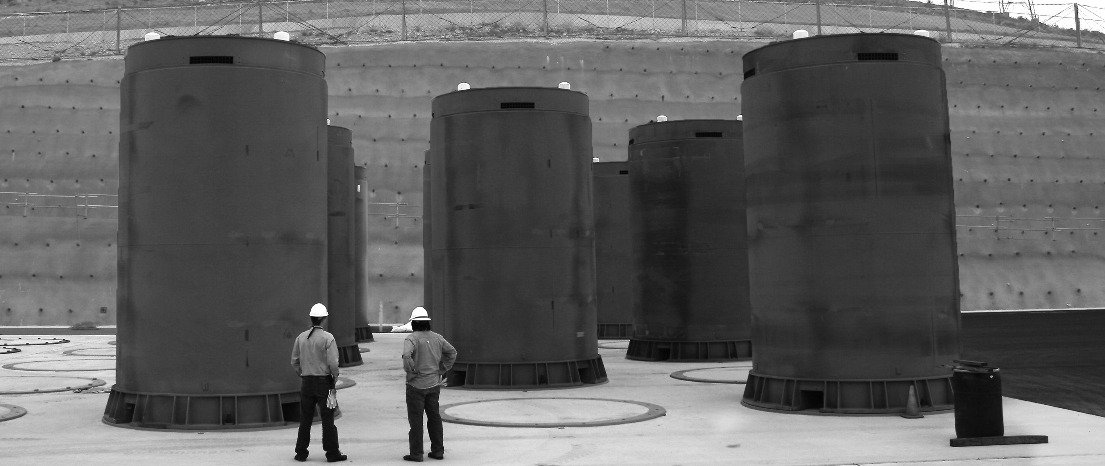
Drawbacks to Using Nuclear Power
Initial Construction Costs
Radioactive Waste Byproduct
Storage of Waste Byproduct
Natural Disasters Pose Threat
Public Perception
Dry cask storage of radioactive waste at Diablo Canyon
Image Source: NRC
Notes:
There have been three large-scale nuclear accidents in the history of global nuclear power. Two were from mechanical or human failures and one, in Fukushima, Japan, was from a natural disaster.
The first was Three Mile Island, in 1979, in Pennsylvania.
The second was Chernobyl in 1986, in Bellarus.
The third was Fukushima in 2009, in Japan.

Slide 15
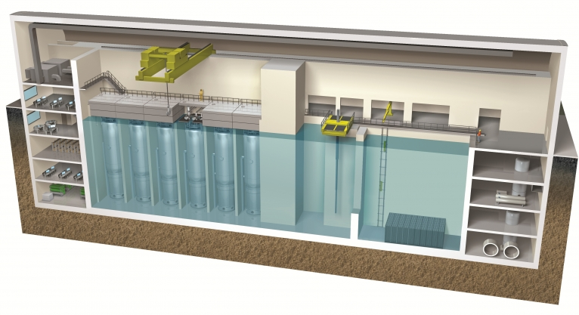
Advancing Nuclear power
Advanced Small Modular Reactors
Light Water Reactor Sustainability
Advanced Reactor Development
Breeder Reactors
Image Source: Department of Energy
Notes:
Small Modular Reactors (SMRs) are nuclear power plants that are smaller in size (300 MWe or less) than current generation base load plants (1,000 MWe or higher). These smaller, compact designs are factory-fabricated reactors that can be transported by truck or rail to a nuclear power site and are built mostly underground. These reactors are built to withstand major environmental events, and even plane crashes! These modules reduce construction time, capital costs, increase flexibility of siting, and allow for multiple generation sources on one site.
Light Water Reactor is the type of reactor present in currently operating nuclear power plants; the Department of Energy is working on keeping these power plants sustainable through equipment upgrades and structure reinforcement.
Breeder reactors could increase the amount of energy extracted from Uranium while reducing the amount of radioactive waste products.
Bill Gates is backing a demonstration power plant to be built in Kemmerer, WY. The power plant will be cooled with sodium rather than water and power up to 345,000 homes. The site was chosen because the small town’s coal plant is scheduled to close.

Slide 16
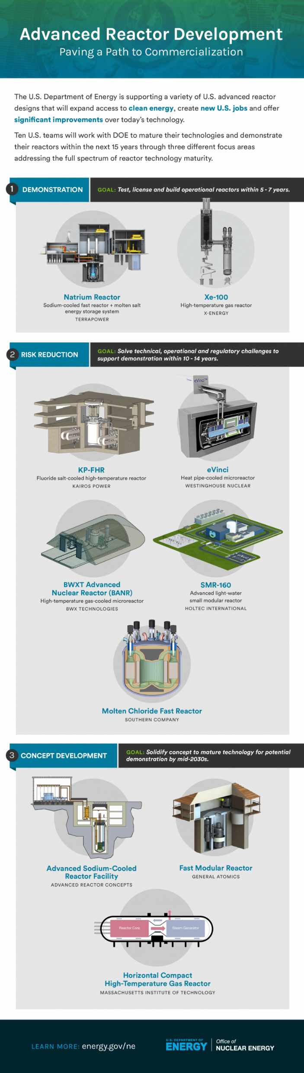


Advanced Reactor Development
Demonstration
Risk Reduction
Concept Development
Notes:
The Department of Energy has been working with several entities to develop new nuclear technologies; some of them are shown here. Clicking on the internet icon will take you to the DOE page where this infographic is found, which includes links back to the Department of Energy’s nuclear page.
The Natrium Reactor by Terrapower is the device that is proposed and being developed for Kemmerer, Wyoming. https://natriumpower.com/

Slide 17
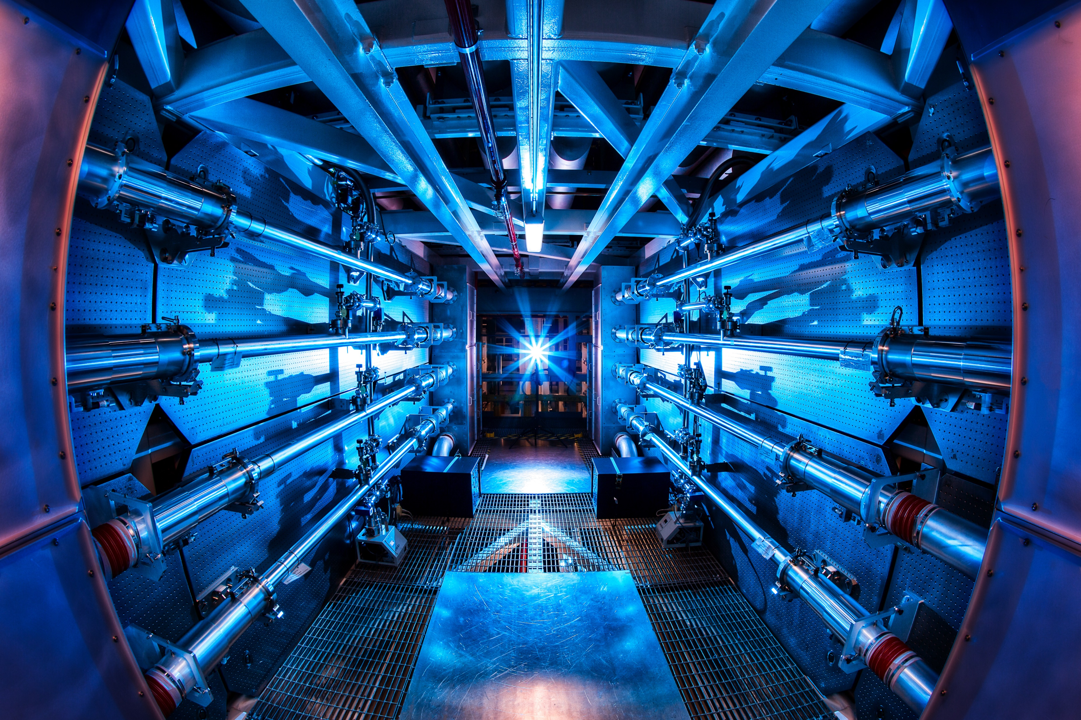
What About Fusion?
So-called “cold fusion” from 1989 was not, in fact, fusion
DOE’s National Ignition Facility at Lawrence Livermore National Laboratory uses 192 laser beams aligning on a pea-sized target
December, 2022, at LLNL, a fusion reaction produced more energy than was required to initiate the fusion reaction; this only accounts for the energy within the lasers, not the energy needed to form the laser beams themselves
Image Source: LLNL
Notes:
The photograph is of the preamplifier chamber at the National Ignition Facility at LLNL. It increases the energy of the lasers before they reach the target chamber.
The fusion reaction referenced in December, 2022 was the first ever to achieve net energy. CNBC Article: https://www.cnbc.com/2022/12/13/nuclear-fusion-passes-major-milestone-net-energy.html

Slide 18
When Things Go Wrong
Three Mile Island
Pressurized Water Reactors
Cooling malfunction caused part of the core in Reactor 2 to melt.
Some radioactive gas was released; health studies indicated it was not enough to cause adverse health effects.
Chernobyl
Engineers were testing low power threshold of reactor Number Four.
Reactor went out of control.
Resulting excessive heat generated hydrogen gas, led to an explosion and breach of the reactor building.
Fukushima
Earthquake with magnitude 9.0 led to a tsunami near the east coast of Honshu, the main island of Japan.
The tsunami overwhelmed the power plant, which is situated on the shoreline, and power went out.
Backup generators were in the lower levels of the power plant, and these were lost when the lower level was flooded.
The loss of backup power led to overheating and partial meltdown in three of the four reactors. Chemical explosions soon followed which breached the reactor buildings and allowed radioactive material to escape.

Slide 19
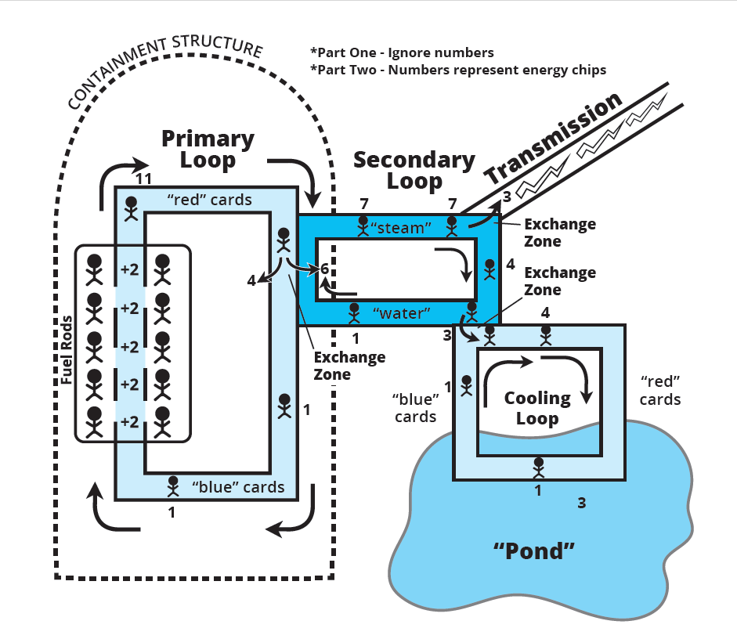
Nuclear Power Plant Simulation

