Slide 1
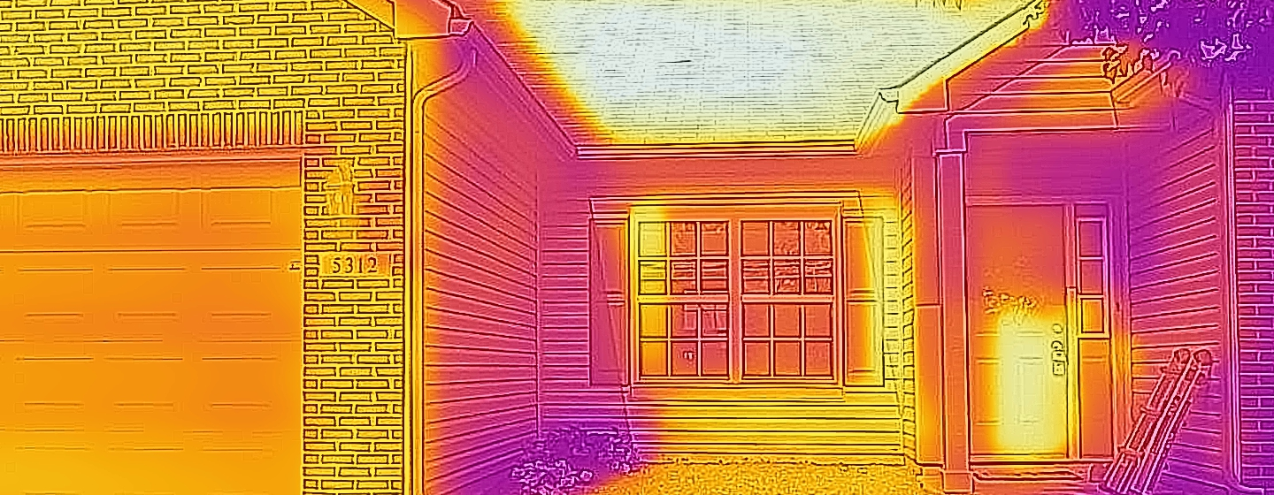
Introduction to Energy Efficiency and Conservation
Notes:
The photograph is an infra-red image of an east-facing home just before noon. Lighter colors indicate higher temperatures, while pinks and purples indicate lower temperatures. The siding is a yellow-cream color; bricks are red, and the roof is charcoal gray.

Slide 2
Energy Management
Like time management, or money management, where a finite resource is used wisely, energy management follows the same principles
Energy management does not advocate zero energy use; rather it is in favor of using energy as needed, with no waste
Good energy management results in better air quality and reduced utility bills, and leads to a reduction in carbon emissions
Notes:
Nobody in energy management is advocating that we stop using all energy all the time. We must use some to maintain our quality of life and expected average life span. Food preservation and medical needs dictate that we continue using at least some energy, not to mention keeping our homes dry and comfortable throughout the year. Energy management looks for ways to reduce the amount of energy used so there is none being wasted.

Slide 3
Two Sides, Same Coin
Energy Efficiency
Energy Conservation
Using technology to reduce energy use
EnergyStar rated devices
Vehicle fuel efficiency
Lighting
Using behavior modification to reduce energy use
Close the refrigerator door!
Carpooling or public transportation
Turn the lights off, don’t wait for the motion sensor
Notes:
Energy management involves efficiency and conservation. Energy Efficiency refers to the technology being used. How much energy does it use to do its job? All refrigerators use electricity to keep food cool. Some refrigerators use more electricity than others, and they are less efficient.
Energy Conservation refers to our behaviors as we use energy. Perhaps we cannot afford to purchase a brand new, Energy Star refrigerator, but we can, and should, use it intelligently by keeping it full rather than empty to keep it from running less, and we can close the door while we pour a glass of milk. Note: If a person does not keep a full refrigerator for whatever reason, filling empty, clean soda and milk jugs with water and putting them in the back of the refrigerator will help the refrigerator run less.

Slide 4
Benefits of Good Energy Management
Stretches nonrenewable energy source supplies
Eases burden on the grid
Improves air quality and the environment overall
Improves economy
Reduced demand → lower prices
Reduced consumption → less energy imports
Improves energy security
In 2021, 43% of US petroleum consumption was supplied from imports
Using domestically produced energy sources keeps US economy robust
Notes:
There are many good reasons to use less energy. These are some of the top reasons.

Slide 5
Energy Costs for U.S. Schools
American educational institutions spent $15.8 billion on energy in their buildings in 2018 (CBECS 2018, Table C3)
That amounts to an average of $1.17 / ft² spent on energy in buildings used for education (CBECS 2018, Table C3)
Energy Star rated commercial buildings cost $0.54 / ft² less to operate than those that are not Energy Star rated (www.energystar.gov)
Notes:
This data comes from the Commercial Building Energy Consumption Survey which is administered by the US Department of Energy’s Energy Information Administration. www.eia.gov is the website address.

Slide 6

What is Energy Star?
Joint program of the U.S. Environmental Protection Agency and the U.S. Department of Energy
National symbol for energy efficiency
Products and/or buildings must meet certain standards to display label
For homes & businesses
Notes:
Energy Star rated devices are the most efficient in their class. Refrigerators are not compared to TVs, for example, but to other refrigerators. Buildings can also be Energy Star rated if they meet certain energy consumption criteria. https://www.energystar.gov

Slide 7
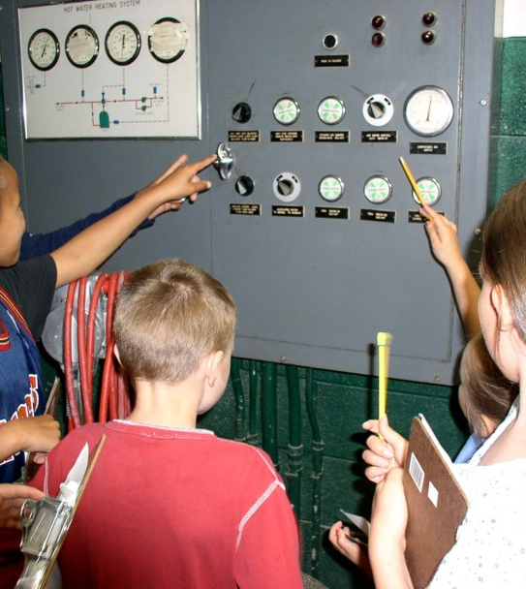
When we look for ways to save energy in a school, we must keep in mind…
The health and safety of the occupants.
Indoor air quality – adequate ventilation.
The comfort of the occupants.
Notes:
We cannot just shut everything off. We’d be sitting in a hot or cold room in the dark. Schools must use a certain amount of energy; we just need to be mindful of the energy that we do use because energy is the #2 expenditure for school districts after salaries and benefits.

Slide 8
How Schools Use Energy
Building Envelope
Walls
Roof
Floor
Doors and Windows
HVAC
Heating
Ventilation
Air Conditioning
Lighting
Plug Loads

Slide 9
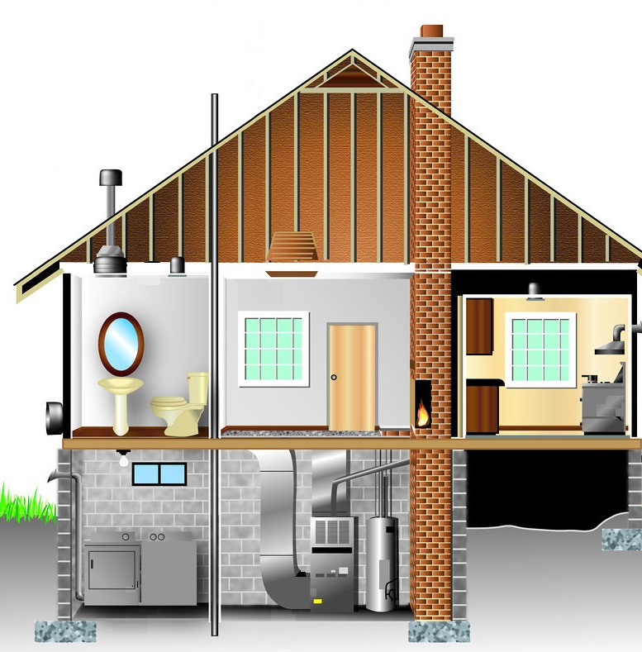
Building Envelope
Notes:
The building envelope keeps the insides in. Its purpose is to keep a conditioned environment inside – warm in the winter, cool in the summer, with the right amount of moisture and free from insects and other critters.

Slide 10
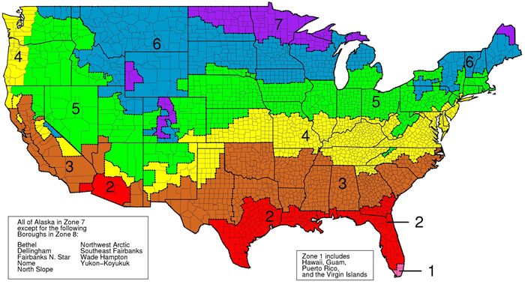
Be Hot, Stay Cool
Image Source: EnergyStar.gov
Notes:
The amount of insulation needed depends on your geographic location. Insulation doesn’t help keep us warm in winter, it also keeps us cool in summer. The Department of Energy has recommendations for the amount of insulation your home should have.

Slide 11
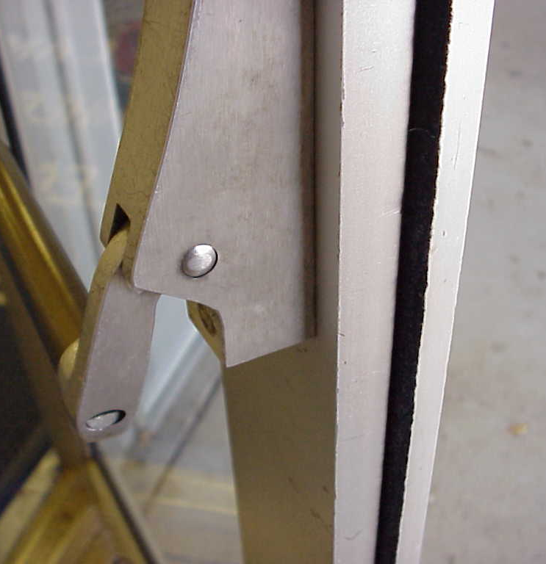
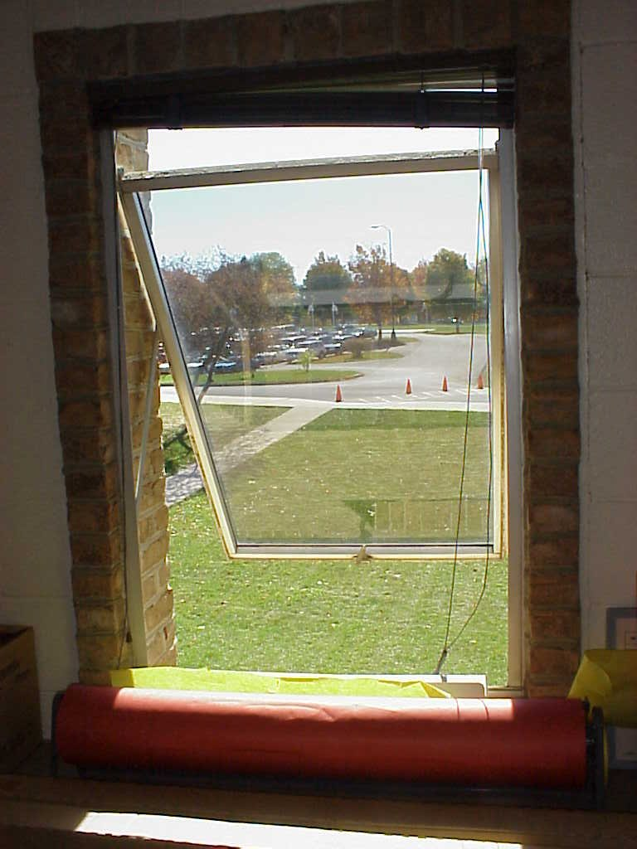
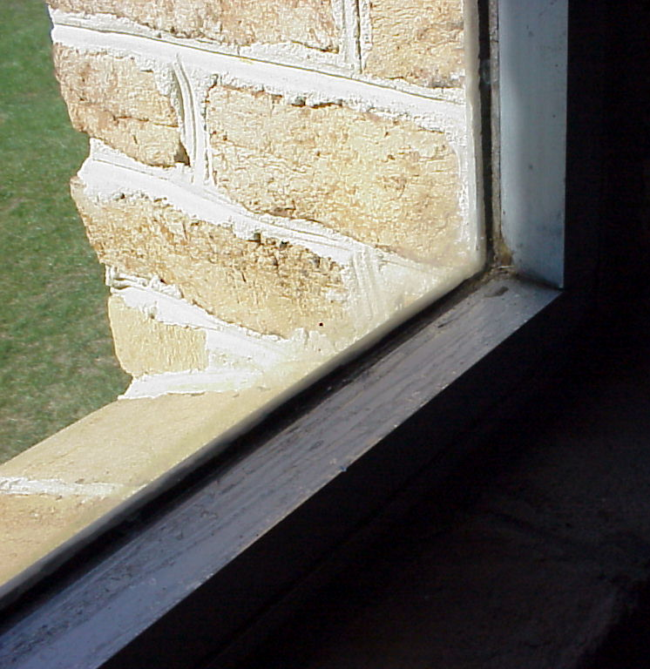
Savings Opportunities: Building Envelope
Inadequate Weatherstripping
Windows Left Open
Single Pane Window
Notes:
Improving these areas on the building envelope will help prevent air infiltration from outside, which will in turn allow the heating and cooling systems to run less often.

Slide 12

HVAC Systems

Slide 13
HVAC System(s)
Heating
Ventilation
Air Conditioning
Also includes
Water heating
Thermostats or sensors
Duct work and/or pipes

Slide 14
35% of School Energy is for Heating
Notes:
This was excerpted from the 2018 CBECS report. Most northern schools, and certainly most in New England and the Midwest, are heated with natural gas.

Slide 15
Heating Overview
Most heating systems use convection to distribute thermal energy
Fluid (water or air) is heated in a heat exchanger
Fluid is then distributed to the rest of the building
Small buildings or spaces can use forced air
In larger buildings, it is more efficient to heat water and pump it around
Secondary heat exchanger in each room might blow air across the water pipe(s) to heat the room
Hot water or steam may be used to radiate thermal energy to interior spaces
Notes:
Convection is the distribution of thermal energy via a flowing fluid. If water is heated and pumped around, or if air is heated and blown through ducts, the system is using convection.

Slide 16
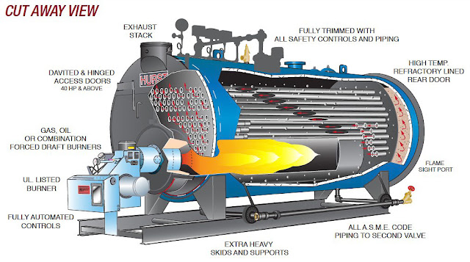
Interior of a Boiler
Water leaves the boiler
Combustion gases leave through a flue
Water exits the heat exchanger
Water enters the heat exchanger
Ignition control
Fire box
Notes:
Schools have two boilers, which serves two purposes. They can alternate by day or week, which allows for regular maintenance and keeps them from failing quickly, and they both can run in really cold weather so neither is overly taxed. Secondly, having two boilers allows school to continue should one fail – the other boiler can run. If a school has no heat and the temperature outdoors is below a standard, the school day is canceled.

Slide 17

11% of School Energy is for Cooling
Cooling a Home | Cooling a School
Window Air Conditioner Central Air Conditioner | Chiller
Circulate cold air | Circulate cold water
Keep the doors open | Keep the doors closed
Increase or decrease the temperature several times in a day according to occupancy, activity, etc. | Nudge the temperature, wait a day, nudge it again
Pro tip: if the AC is on, and you need a scarf or earmuffs, the temperature is too cool.
Notes:
Schools with “central” air conditioning will have large chillers that are located outside the school near the boiler room. They may be on the roof or enclosed by a fence on the ground. They use the refrigeration cycle to get water very cold. That cold water is then circulated through the pipes in the school using the same circulation system as the heating system / boilers do in winter.

Slide 18
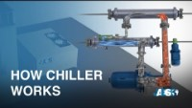
Commercial Chillers
Notes:
Gets kind of technical. Presenter discretion is advised.

Slide 19
Ventilation System
The need for proper ventilation is high
People off-gas carbon dioxide and fragrances from hygiene products
Volatile organic compounds from finishes and furnishings
Cooking, cleaning, and chemistry lab
Residential buildings do not have ventilation systems
Lower occupancy density
Buildings often “breathe” well enough
Commercial buildings must have ventilation systems
High occupancy density
Very well sealed buildings
Separate air handlers inject fresh air into commercial buildings
Typically are zoned – one air handler ventilates a specific zone of the building
Have multiple filters that need regular replacing
Covid restrictions may have required filters the air handlers were not designed to use
Ventilation is measured in “room changes per hour”
Minimal commercial ventilation is 2.5 room changes in one hour
Notes:
Note about covid: the ASHRAE recommendation was at least a MERV-13 filter (the higher the number, the smaller the particles the filter will remove; HEPA is MERV-16). Some schools opted to not use filters with a higher MERV rating than the fan system could handle.

Slide 20
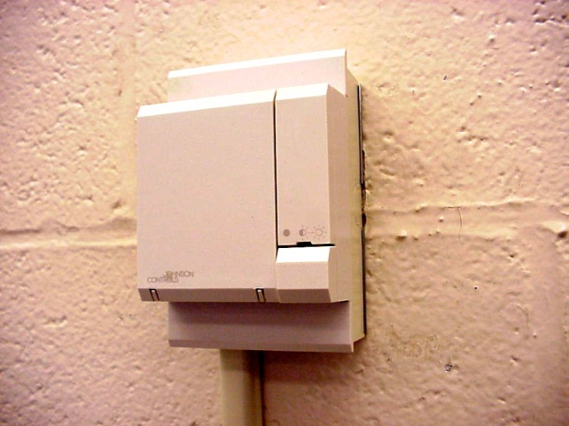
Building Automation System (BAS)
Provides school personnel with real time energy and performance data to manage the building’s energy needs.
Temperature Sensor
Notes:
Most modern HVAC systems in commercial buildings use a building automation system rather than individual thermostats to control the system. A BAS has a central computer that can monitor many more parameters at once, such as temperature, humidity level, and carbon dioxide level.

Slide 21
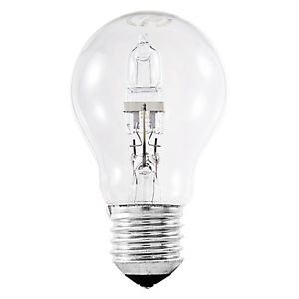
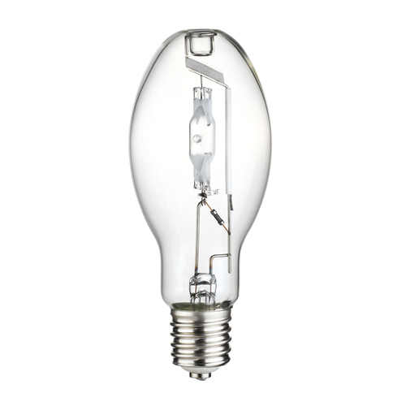
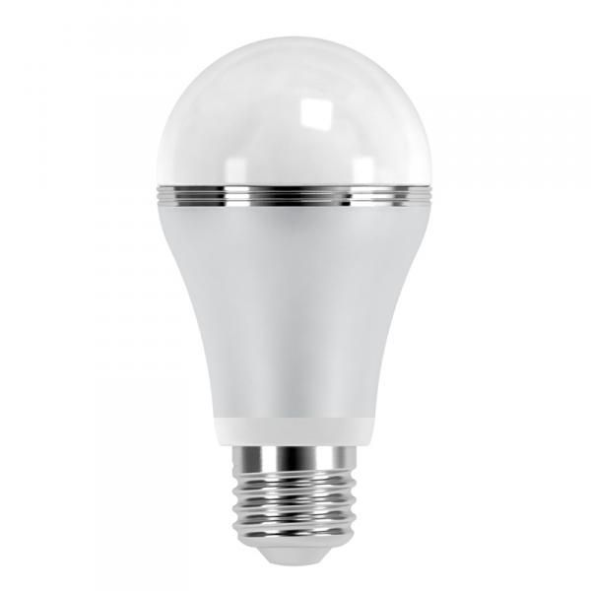
Lighting
Lighting accounts for 9 percent of a school’s energy use, which translates to about 17% of the school’s electricity bill.

Slide 22

Types of Lighting Found in Commercial Buildings
Incandescent (less common)
Fluorescent (most common)
High Intensity Discharge (HID)
Light Emitting Diode (LED)
Notes:
Incandescent bulbs are continuing to be phased out – they are 90% Inefficient.
HID lamps are found in parking lights and in many gymnasiums and natatoriums.

Slide 23
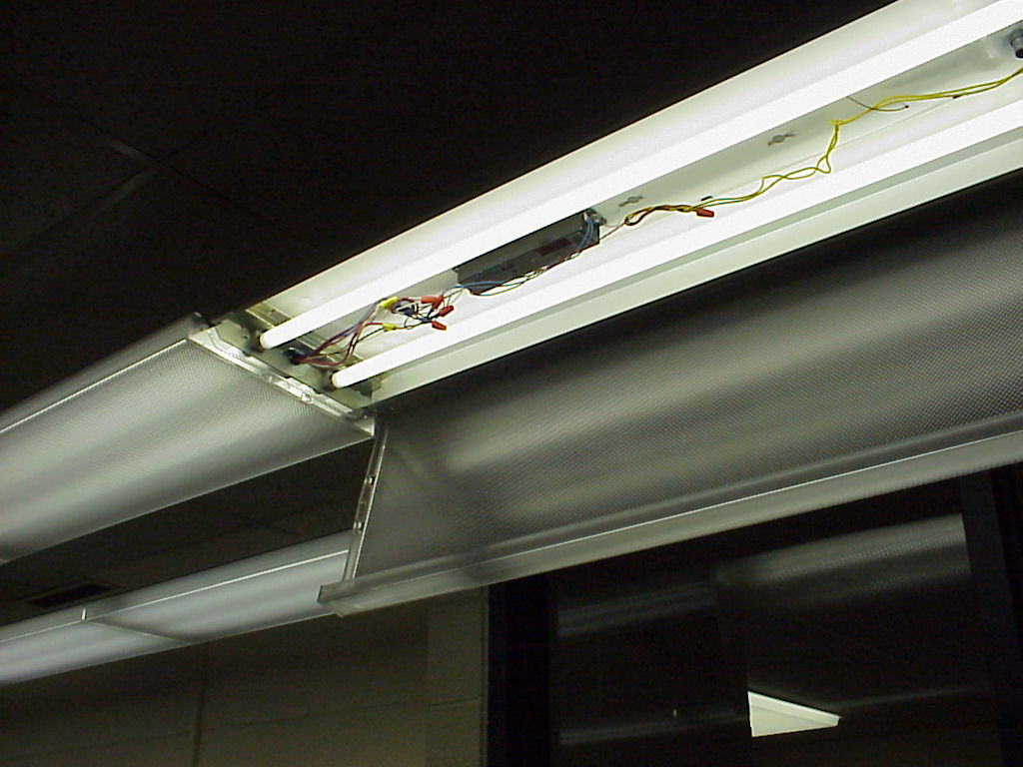
Fluorescent Lighting
Mercury vapor changes electric current into UV light
Phosphor coating changes UV light into visible light
Requires a ballast
Magnetic ballasts are old-school
Electronic ballasts are newer and much, much, much more efficient

Slide 24
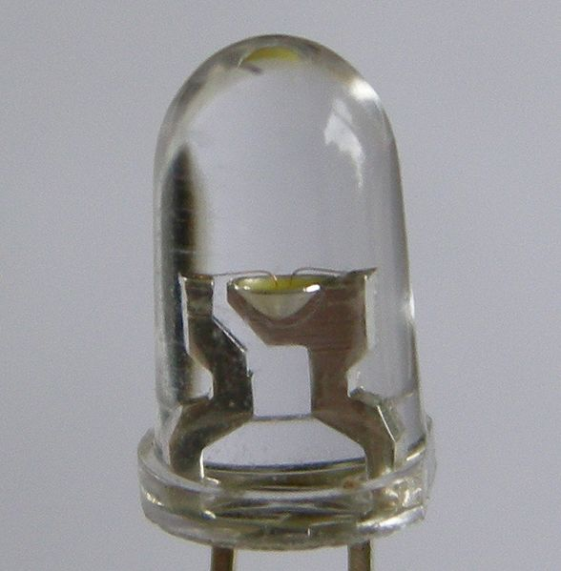
LED Lighting
Solid, very efficient
Works like a PV cell in reverse
Current will only flow in one direction
Current energizes electrons and they move from N-type across depletion zone to P-type
Electrons then return to lower energy state and release energy as light

Slide 25
Dimmable LED Lamps (“bulbs”)
Dimmer Beware
Can only dim down to 5 to 20% (incandescents down to 1%)
LED Dropout = sudden drop to zero as approach the maximum dim percentage
Flickering or “dead travel” which is how far the dimmer switch decreases before the lamp dims
Pulse-width Modulation
Turn the LED on and off at a very high speed
Pro: LED is on less time
Con: Potential for noise, flickering, and electromagnetic interference
Constant Current Reduction
A.k.a. analog dimming
Reduced current to light the lamp
Pro: Increased lamp life because thermal energy generation is decreased
Con: Color temperature is not always maintained
Notes:
Everything and more you’ve ever wanted to know about dimmable LEDs.

Slide 26
Building Science
All systems have to be in good working order to be efficient
Air flow in and out of building must be regulated
Entire building envelope must be properly insulated
Interruptions in building envelope (doors, windows, light fixtures, chimneys, etc.) must be properly sealed
HVAC must be cleaned and maintained
Proper and efficient lighting should be used

Slide 27
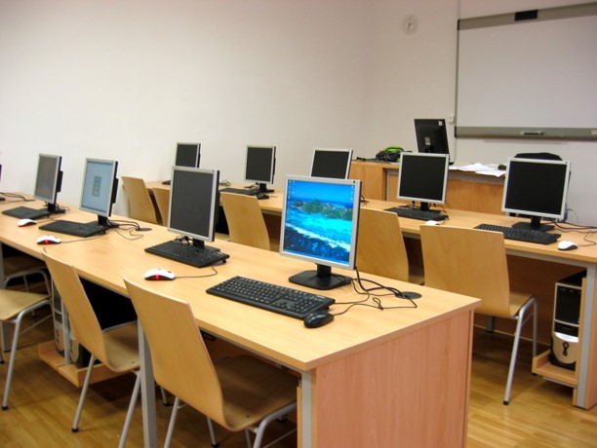
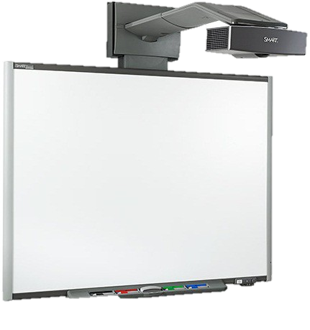
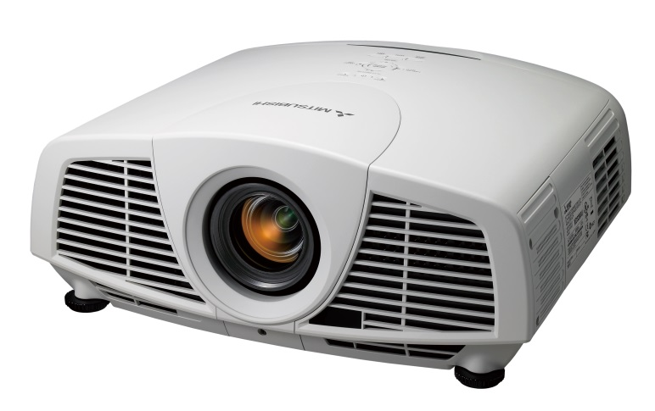
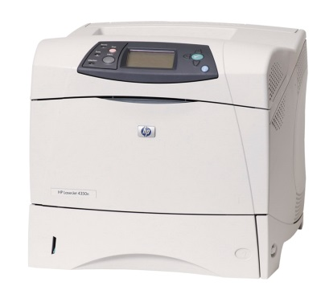
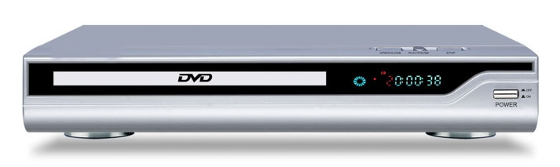
Plug Loads and Phantom Loads

Slide 28
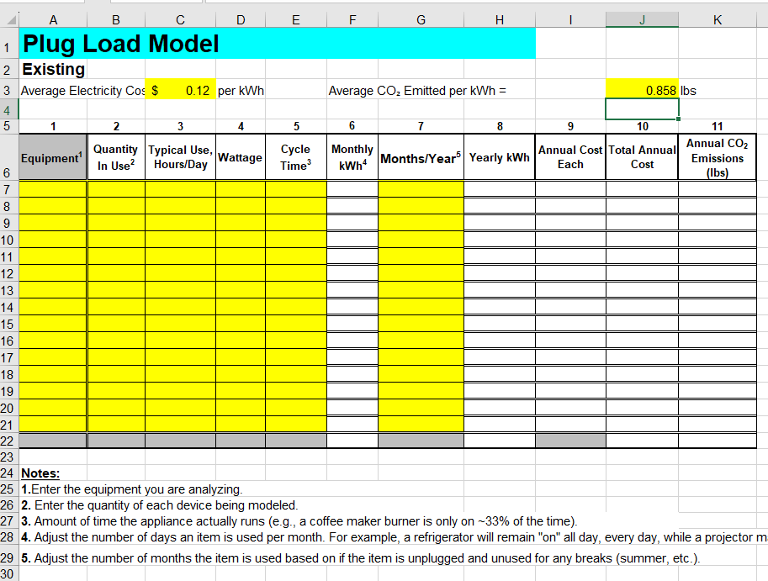
Plug Loads
Students count electrical devices
Students estimate number of hours per week device is used
Excel spreadsheet uses formulas to compute cost
Students can use the UL plate on a device, or a Kill-a-Watt meter to collect real power data

Slide 29
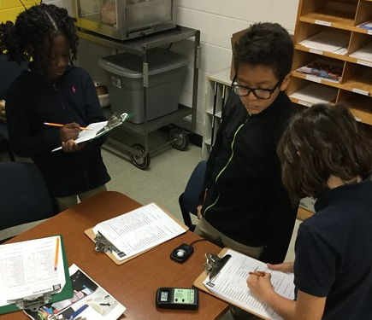
Student Energy Audit
Investigate school building and observe the following:
Fluorescent light ballast type (only older buildings)
Light levels
Humidity levels
Temperature
Electricity usage from plug loads
Reporting Form (Before and After)

Slide 30
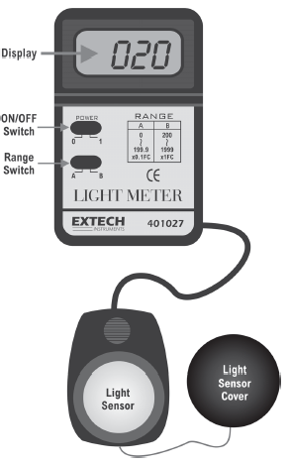

Light Meter
A light meter measures the amount of light in a space in units of foot candles. Spaces that are overly lit may be using more energy than necessary.

Slide 31
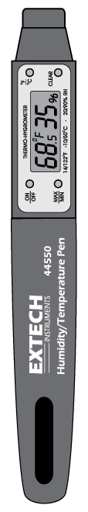

Hygrometer
A hygrometer measures relative humidity. Warmer air can hold more moisture, so if cold air is heated, it will feel very dry unless humidified.

Slide 32
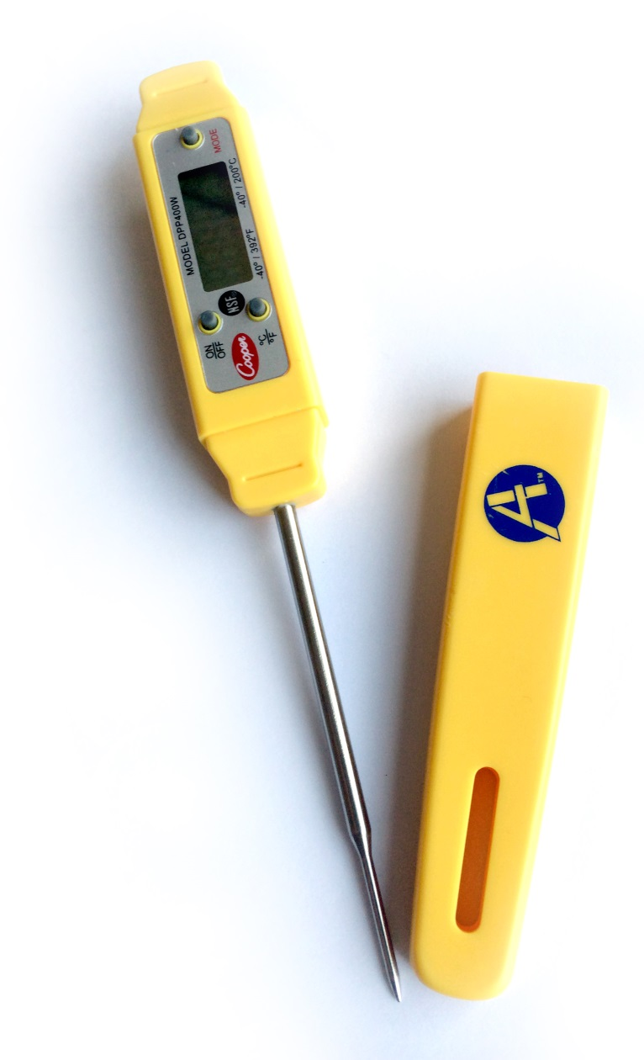
Digital Thermometer
The digital thermometer can be used to tell if a room is of the appropriate temperature, and compare how spaces may be infiltrated by thermal energy or moving air. Waterproof versions can also help check the temperature setting of your water heating system.

Slide 33
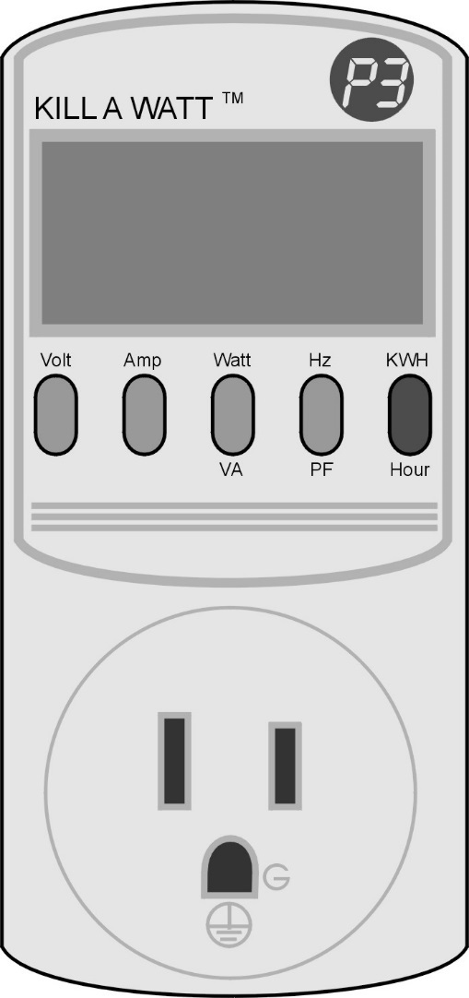
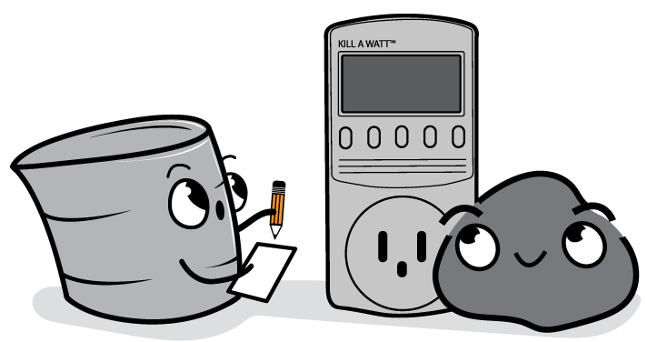
Kill A Watt™ meter
This tool allows you to measure how much power (Watts) an electrical device uses at any given time. By changing the display, it will also measure kWh consumed over a period of time.

Slide 34
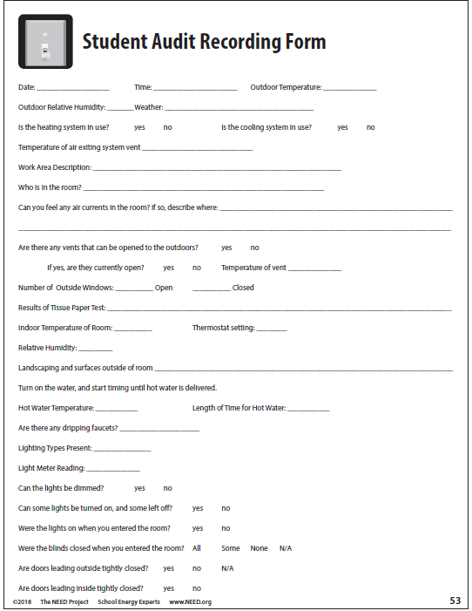
Energy Efficiency: The Assessment

