Slide 1
Hydrogen 101
Notes:
Photos:
Top – When electric current passes through a tube full of hydrogen, it emits a lovely pink-purple light.
Bottom – when the light from the lamp is viewed through a spectroscope, the bright red, blue, and purple bands of the emission spectrum are visible. Each element has its own characteristic emission spectrum.

Slide 2
Properties of Hydrogen
Smallest atom
1 proton, 1 electron in Hydrogen-1
Three known isotopes, hydrogen (H-1), deuterium (H-2) and tritium (H-3)
Most abundant element in the universe
Readily bonds with almost all the other non-metals (not noble gases) and many metals
Hydrogen gas is diatomic (H₂)
Hydrogen is very low in density, flammable, and when in solid form behaves like a metal

Slide 3
Hydrogen Sources
Hydrogen may be most abundant in the universe, but on earth is only found combined with other things
Most common sources are water (H₂O) and methane (CH₄)
Ammonia (NH₃) is being investigated as a “hydrogen carrier”
Water
Methane
Ammonia
Notes:
Hydrogen is found all over Earth, in minerals as well as organic matter. Any substance with hydrogen could theoretically be a source of hydrogen, but water, methane, and ammonia are the most common because the hydrogen is relatively easily removed from the molecule.

Slide 4
Methods of Hydrogen Production
Most common is steam reforming
Electrolysis is viable but energy-intensive
Ammonia cracking is viable but not yet commercially ready
Several methods are in developmental / experimental stages

Slide 5
Taste the Rainbow
Blue hydrogen is produced primarily from natural gas via steam reforming and incorporates carbon capture and storage
Gray hydrogen is produced primarily from natural gas via steam reforming without carbon capture
Black / Brown hydrogen is produced using energy from coal or lignite
Pink / Red / Purple hydrogen is produced via electrolysis using nuclear power
Turquoise hydrogen uses methane pyrolysis and produces solid carbon and hydrogen; experimental stage
Yellow hydrogen is produced via electrolysis using solar power
White hydrogen is native, naturally-occurring hydrogen in geological formations; no strategies use white hydrogen
Green hydrogen is hydrogen produced through electrolysis using surplus renewable electricity
Notes:
The use of the word “native” here does not indicate origin of birth or residency. It is how a pure element is referenced, as compared to ions or combined in compounds. For example, native copper is metallic copper while copper ore contains copper bonded in minerals with other elements.

Slide 6
Steam Reforming
Methane is the hydrogen source
High-temperature steam provides oxygen and thermal energy
Byproduct is carbon dioxide
H
+
H
H
+
C
H
H
O
C
H
H
H
H
O
H
H
H
H
O
O
+
O
H
+
C
C
H
O
H
Notes:
Industry produces hydrogen by steam reforming, a process in which high-temperature steam separates hydrogen atoms from carbon atoms in methane (CH₄).
High-temperature, high-pressure steam can also be reacted with renewable liquids, such as ethanol, to produce hydrogen. The liquid is brought to the site where it is used to produced hydrogen, and the hydrogen is used immediately.
Today, most of the hydrogen produced by steam reforming is not used as fuel but in industrial processes. Steam reforming
is the most cost-effective way to produce hydrogen today and accounts for about 95 percent of the hydrogen produced in the
U.S. Because of its limited supply, however, we cannot rely on nonrenewable natural gas to provide hydrogen over the long
term. Instead, we will need to produce hydrogen using other resources, such as renewable natural gas and other technologies. Renewable natural gas (RNG) is methane produced from the decomposition of organic matter. RNG can be used interchangeably with conventional, nonrenewable natural gas, thus it is a great source for steam reforming to create hydrogen.

Slide 7
Electrolysis of Water
Energy needed to break the H-O bond is provided by energized electrons (electric current)
Two electrodes are placed in an aqueous electrolyte solution
Anode is the site of oxygen production
Cathode is the site of hydrogen production
The volume of hydrogen gas to oxygen gas is about 2:1
Depending on the electrolyte, some side reactions may occur
NaCl → Cl₂ production (do not use!)
Other electrolytes produce other byproducts, so the 2:1 ratio can be affected
This is the method demonstrated in the H2Educate Curriculum Guide
Notes:
Electrolysis involves passing an electric current through water (H₂O) to separate the water molecules into hydrogen (H₂) and
oxygen (O₂) gases.
The electricity needed for electrolysis can come from a power plant, wind turbine, photovoltaic cells, or any other electricity generator.
If the electricity is produced by renewable energy or nuclear power, there is no net increase in greenhouse gases added to the
atmosphere. Hydrogen produced by electrolysis is extremely pure, but it is very expensive because of equipment costs and other
factors. On the other hand, water is renewable and abundant in many areas.
Technological advances to improve efficiency and reduce costs will make electrolysis a more economical way to produce hydrogen in
the future.

Slide 8
Ammonia as a Hydrogen Carrier
Similar to methane, ammonia is a rich source of oxygen
Ammonia can be compressed to a greater degree than hydrogen, therefore providing more hydrogen per unit volume
Cracking ammonia into nitrogen and hydrogen is a fairly simple process
Hydrogen from ammonia is called “blue hydrogen”
2NH₃ → 3H₂ + N₂
Notes:
Ammonia, NH₃, is 17.8% hydrogen by weight. It is already manufactured in large quantities for agricultural and industrial use by way of the Haber-Bosch process, which converts nitrogen (N₂) in the atmosphere to ammonia (NH₃) through a reaction with hydrogen. Recently, scientists have analyzed whether ammonia could be a carbonless source of hydrogen. Decomposition of ammonia is endothermic, meaning the reaction requires an input of some kind of energy, most often thermal energy.
In a process known as catalyzed ammonia cracking, or ammonia cracking, a catalyst is used to reduce the amount of energy needed to break ammonia down. Liquefied ammonia could essentially be transported in tanks that are already commercially available, and decomposed at the point of use of hydrogen, with the only “tailpipe emission” being nitrogen gas. There are five different types of catalysts scientists are researching: thermocatalytic; reforming; plasma; photocatalytic; and electrocatalytic. Thermocatalytic cracking uses a combination of temperature and pressure to decompose ammonia nearly completely into nitrogen and hydrogen. Reforming catalysts use the surface structure of the catalyst to shift bonds between atoms by temporarily bonding them with the catalyst itself. Plasmas are ionized gases; this technology uses the ions in the plasma to break the bonds in the ammonia molecule. Photocatalytic technology uses light, usually ultraviolet, to activate a metal oxide catalyst and begin the cracking process. Electrocatalytic cracking involves using electricity as the energy source for breaking the bonds in the ammonia molecule. While each have limitations and drawbacks, the most promising technology is nonthermal plasma technology because of its low operating temperatures. Electrocatalytic systems could also be useful if a renewable energy source, like solar energy in a photovoltaic system, can provide the electrical energy.

Slide 9
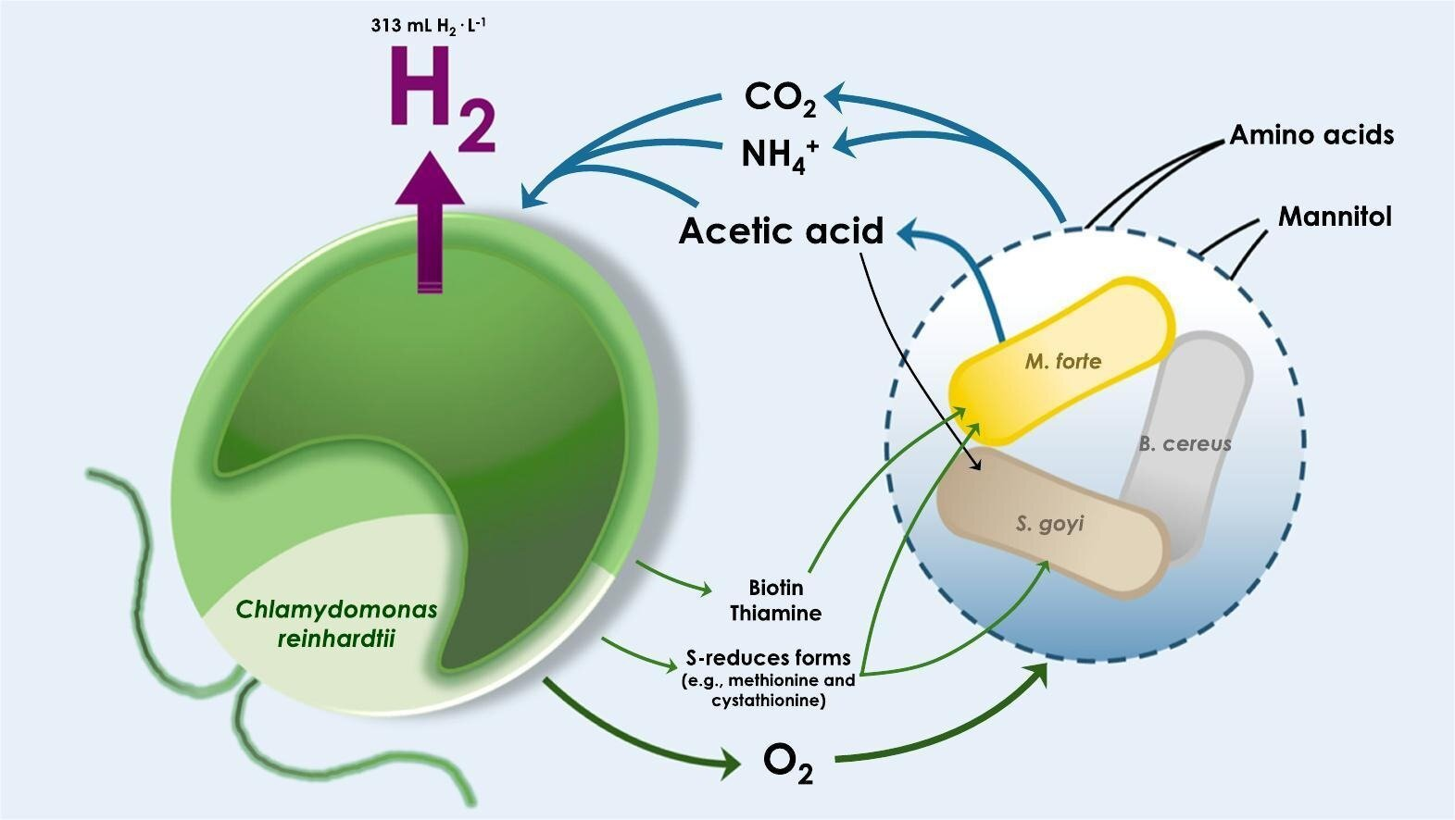
Experimental and Developmental Methods
Photoelectrochemical Production
Light → Electricity, then same as electrolysis
Biomass Gasification
Biomass + Thermal Energy → Hydrogen + Other Gases
Photobiological Microbial Production
Algae and Bacteria + Light → Hydrogen
Coal Gasification with Carbon Sequestration
Coal + Thermal Energy → Hydrogen + Carbon Dioxide
Nuclear Thermochemical Production
Fission or Fusion → Thermal Energy; Thermal Energy + Water → Hydrogen + oxygen
Methane Pyrolysis
Uses thermal energy to decompose methane into hydrogen and solid carbon
Photobiological Microbial Production
Image Credit: Science of The Total Environment (2023). DOI: 10.1016/j.scitotenv.2023.169559

Slide 10
Hydrogen As a Transportation Fuel in Combustion Engines
Internal combustion engines can be manufactured to use hydrogen instead of petroleum-based fuels
On a mass basis, the energy content of hydrogen is about 3x more than that of gasoline (120 MJ/kg vs 44 MJ/kg)
On a volume basis, the energy content of hydrogen is about one-fourth of gasoline (8 MJ/L vs 32 MJ/L)
If a fueling fire occurs, the flame is elevated above the ground because of hydrogen’s very low density
Video Source: Toyota
Notes:
Internal combustion engines can be manufactured to burn hydrogen instead of other fuels like gasoline or ethanol with only minor modifications. The catch is that hydrogen is dissimilar enough from gasoline in its energy content to create an issue with storage. When comparing the same mass of hydrogen to gasoline, hydrogen has more energy. However, because of hydrogen’s exceptionally low density, the same volume of hydrogen has less energy than gasoline. For a hydrogen combustion engine vehicle to have the same range as a gasoline-powered vehicle, the fuel tank would need to be four times larger than a gasoline tank.

Slide 11
Hydrogen Fuel Cell Vehicles
Run by an electric motor, similar to an EV
Use hydrogen and fuel cells rather than rechargeable batteries
Just as quiet as hybrids and EVs when running
Limited cargo space to get desired range
Limited range to keep cargo space

Slide 12
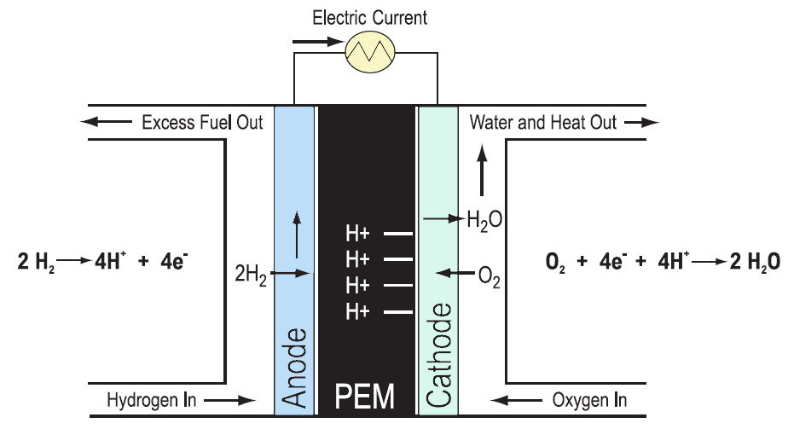
Fuel Cells
e-
e-
e-
e-
e-
e-
A fuel cell is a DC power source
Hydrogen is oxidized, giving up electrons
The electrons go through a circuit and do work
The electrons rejoin the protons (H+) and combine with oxygen at the cathode, creating water vapor
A catalyst, usually platinum, allows the process to occur at ambient temperatures
A PEM cell has a Proton Exchange Membrane
Notes:
(Consider using a laser pointer to show where the hydrogen molecules, H+ / protons, and electrons go through the fuel cell.)

Slide 13
Can Hydrogen Really Fuel Vehicles?
Notes:
This video does a good job of providing the pros / cons of using hydrogen, and what needs to happen for hydrogen to be widely adopted as a transportation fuel.

Slide 14
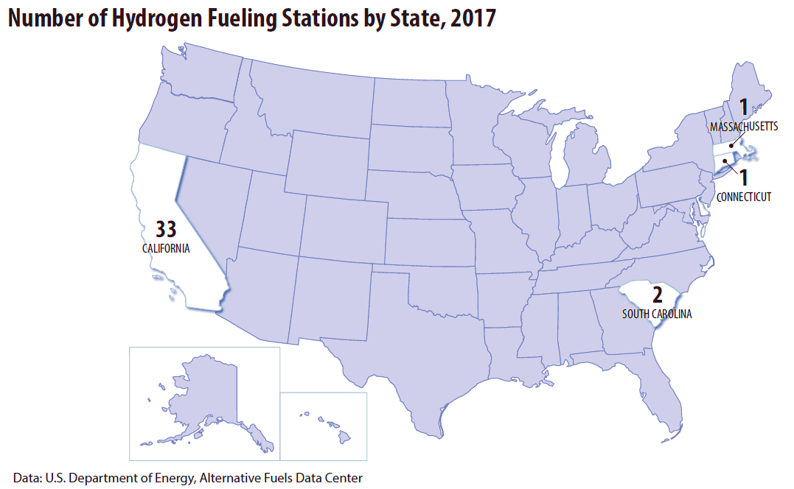
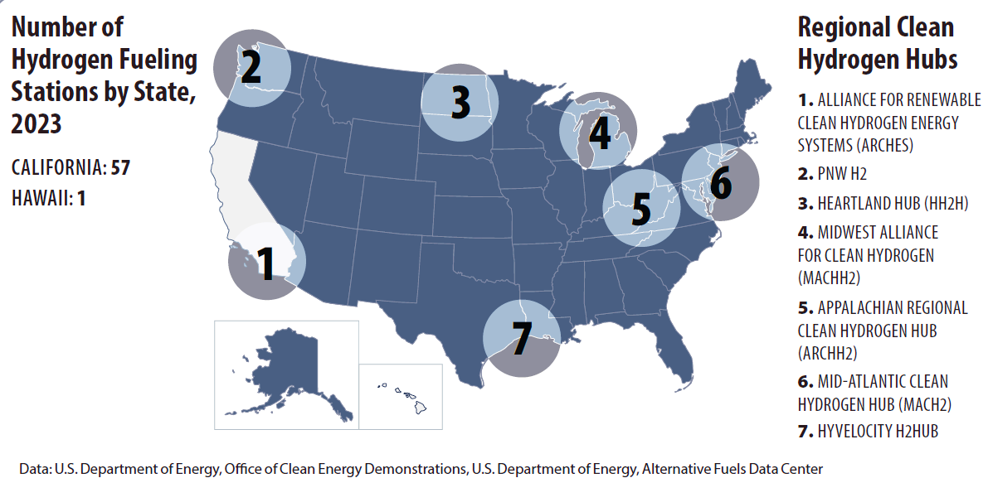
Infrastructure Challenges
Notes:
Implementing hydrogen as a transportation fuel is a chicken vs egg paradox. Hydrogen cars will not be purchased by consumers who do not have access to fueling stations. Fueling stations will not be built by private investors unless there are customers to purchase the fuel. The 2010 Winter Olympics in Vancouver, BC, demonstrated how hydrogen can fuel transportation with a framework of buses used to shuttle people around Whistler. The Canadian government invested $89 million in buses and fueling infrastructure; similar investments by governments will likely need to be made to get hydrogen transportation fueling up and running.
The Regional Clean Hydrogen Hubs have been established over the last few decades to coordinate production, distribution, and storage networks for hydrogen.

Slide 15
For More Information
To reach NEED:
www.need.org
info@need.org
(800) 875-5029
For more hydrogen information:
EIA – www.eia.gov
DOE - https://www.energy.gov/eere/fuelcells/hydrogen-and-fuel-cell-technologies-office

