Slide 1
Introduction to Fossil Fuels
Where are the dinosaurs?

Slide 2
Fossil Fuels Are…
Nonrenewable energy sources
Formed from the remains of ancient creatures
Hundreds of millions of years ago – pre-dating dinosaurs
Buried under hundreds of meters of sediment and rock
Primarily hydrocarbons – compounds with only carbon and hydrogen

Slide 3
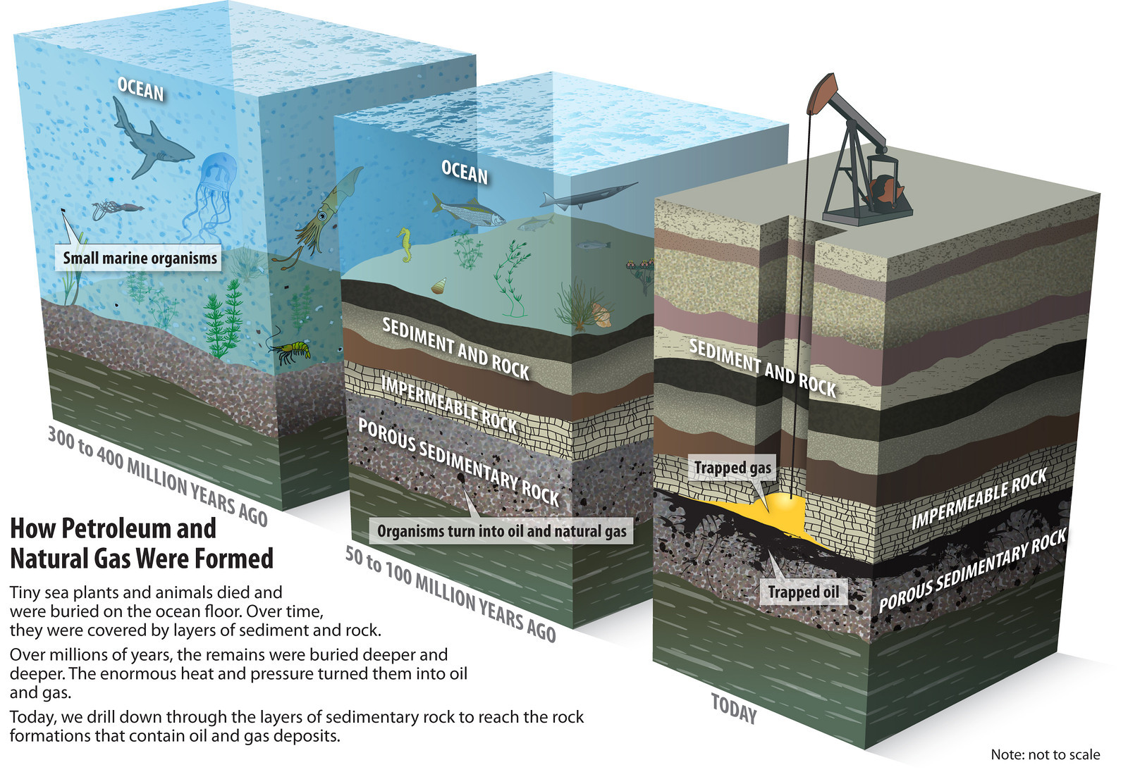
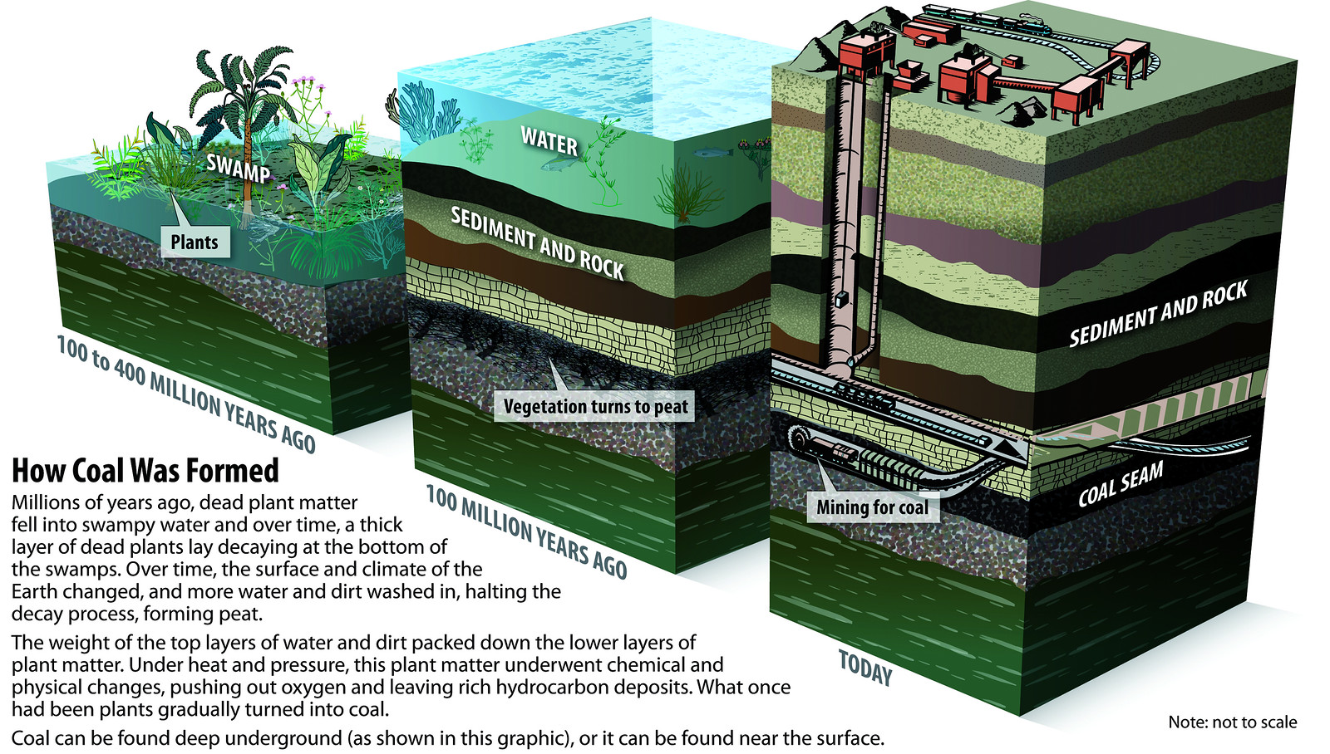
Fossil Fuel Formation

Slide 4
What’s So Great About Fossil Fuels?
High in energy density
Relatively easy to…
extract
transport
Petroleum is a rich mixture of useful compounds
Coal is the most plentiful energy source in the US
Natural gas is very clean-burning; almost no sulfur or other contaminants
find
Amount of energy per unit volume
Second highest after uranium
Each has a high point

Slide 5
Coal
Black, satiny-looking solid
Removed by mining
Without coal, the Industrial Revolution might not have happened as and when it did
Coal was once our leading source for electricity generation

Slide 6
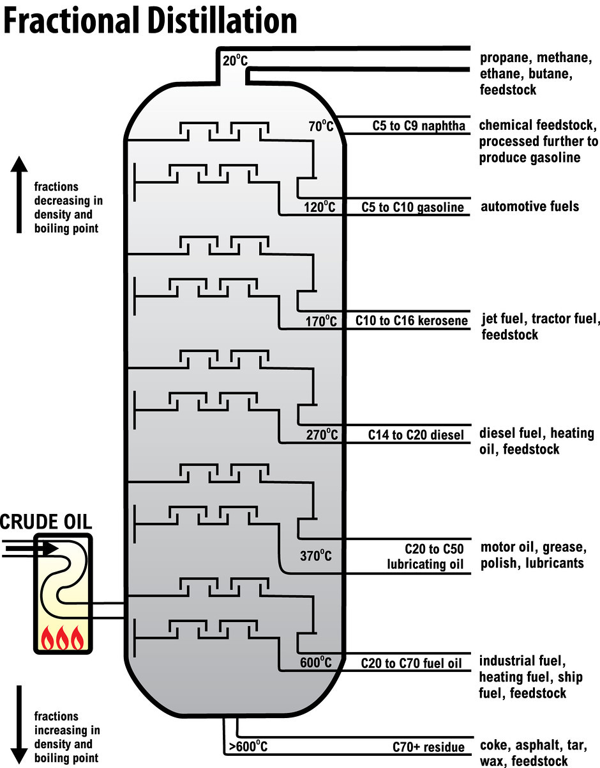
Petroleum
High variation in color and viscosity
Must be separated to be useful
Separated using fractional distillation
More than 90% of transportation fuel is a petroleum product
About 20% of petroleum is used for making everyday products

Slide 7
Without Petroleum We Would Not Have…
Anything plastic
Balloons
Camera
CD
Chap Stick®
Chunk of asphalt
Clothing (polyester or nylon)
Comb
Crayon
Deodorant
Dice
Electrical tape
Fake Nails
Fertilizer
Fishing lures
Glue
Golf balls
Lotion
Insect repellent
Lipstick
Makeup
Masking tape
Paint
Shampoo
Shoes
Shoe polish
Sports equipment
Sunglasses
Toothbrush
Toothpaste
Umbrella
Wax paper
AND MANY MORE!

Slide 8
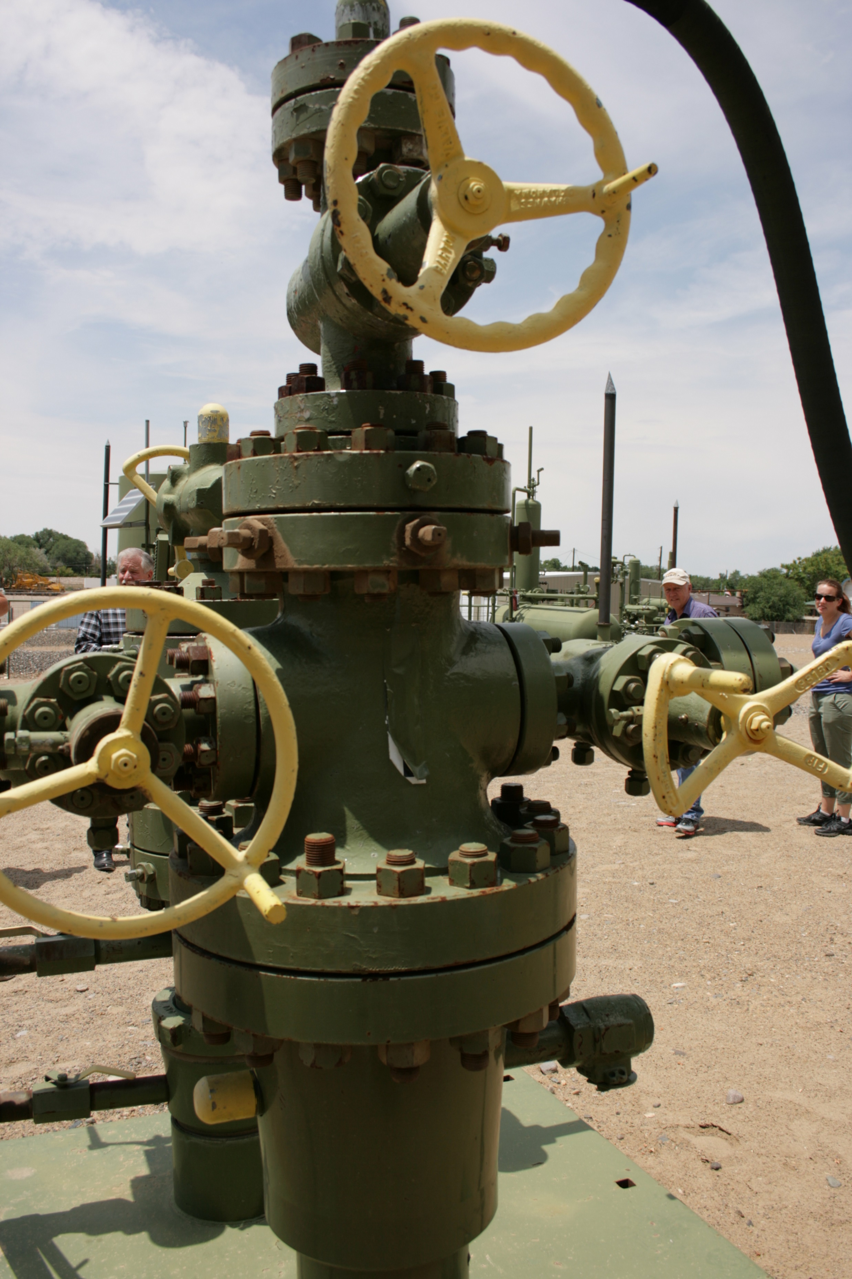
Natural Gas
Found associated with coal and mixed in petroleum
Also in deposits by itself on and offshore
Renewable natural gas comes from landfills and agriculture
Methane is the most prevalent compound in natural gas
Colorless
Odorless
Methane is a greenhouse gas
22x more effective than carbon dioxide
breaks down in the atmosphere faster

Slide 9
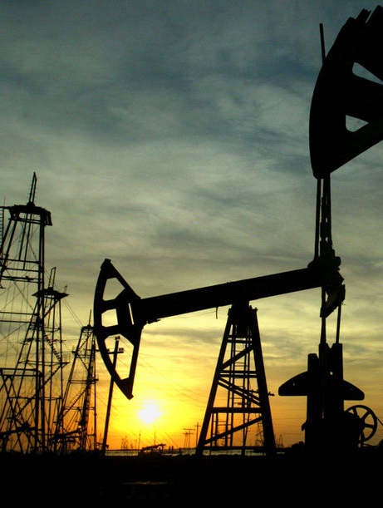
What’s Wrong With Fossil Fuels?
Energy is extracted through combustion, releasing carbon dioxide
Mining and working oil and gas fields are hazardous occupations
Production can do harm to the surrounding ecosystems
Transportation requires a lot of energy – mostly from fossil fuels

Slide 10
Fossil Fuel Combustion is Causing Climate Change
Climate
Aggregated data
What to expect
Weather
Single data points
What we’re getting
Annual or monthly averages
Daily occurrences

Slide 11
Carbon Dioxide – Too Much of a Good Thing
Chemical formula CO₂
Primary focus of climate change mitigating action
Byproduct of aerobic respiration and hydrocarbon combustion
Cellular Respiration: C₆H₁₂O₆ + 6 O₂ → 6 CO₂ + 6 H₂O
Methane Combustion: CH₄ + 2 O₂ → CO₂ + 2 H₂O
Octane Combustion: 2 C₈H₁₈ + 25 O₂ → 16 CO₂ + 18 H₂O
Combustion of Tetradecane: 2 C₁₄H₃₀ + 43 O₂ → 28 CO₂ + 30 H₂O

Slide 12
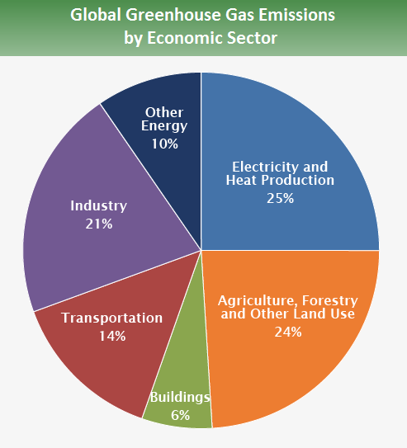
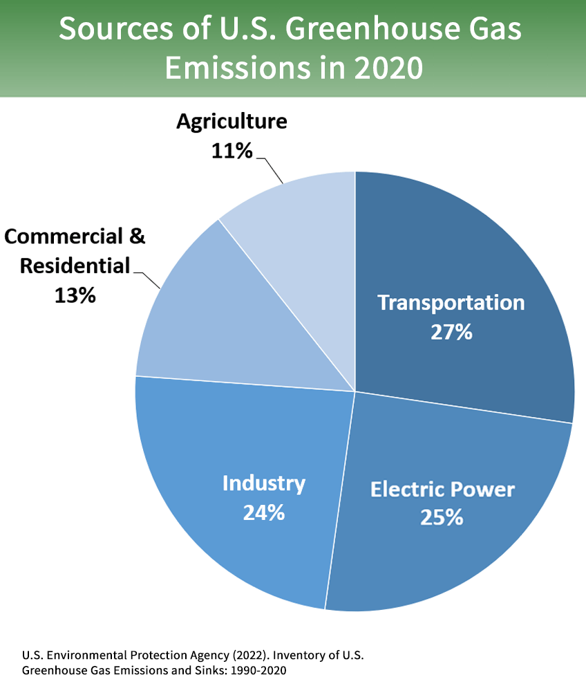
Images source: EPA

Slide 13
One More Thought

