Slide 1
Energy House

Slide 2
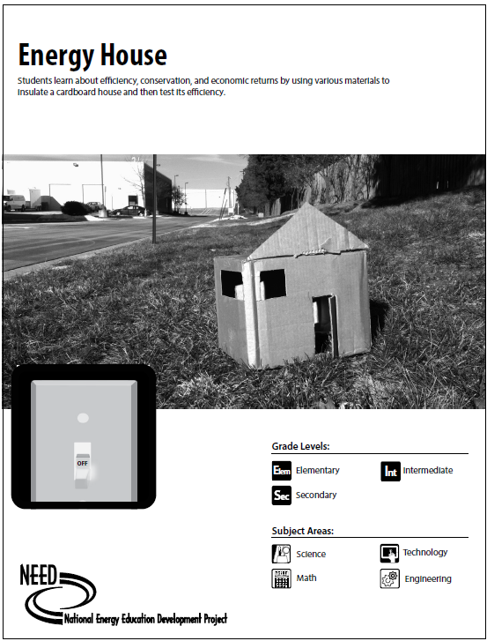
Energy House
You must have at least 1 door, at least 10 cm x 6 cm and it must open
You must have at least 2 windows each 5 cm x 5 cm. The window must be transparent.
The ceiling must be at least 5 cm above the top of the door.
Insulation on the floor and walls cannot exceed 1 cm in thickness.
No insulation can be exposed. All insulation must be covered by ceiling, wall or floor (poster board).

