Slide 1
NOTE FOR FACILITATORS
There are notes for most of the slides, with the exception of things like title slides and activity placeholders.
Look through the slides before your workshop; you will want to hide slides you won’t use because they are redundant or inappropriate for the group to which you are presenting. Hidden slides have a \ through the slide number at left.
Please do not change the wording on the slides as they have been vetted and are consistent with NEED curriculum
Please do not alter the appearance of the slides by applying a different design template. You may add slides as needed; for example, if you have a speaker, you may want to add a slide with the speaker’s name and a couple points of introduction. Please keep the colors, design template, and overall appearance of the presentation consistent.

Slide 2

The Science of Energy
A Student-centered Study of Energy Transformations
Notes:
Title Slide ☺

Slide 3
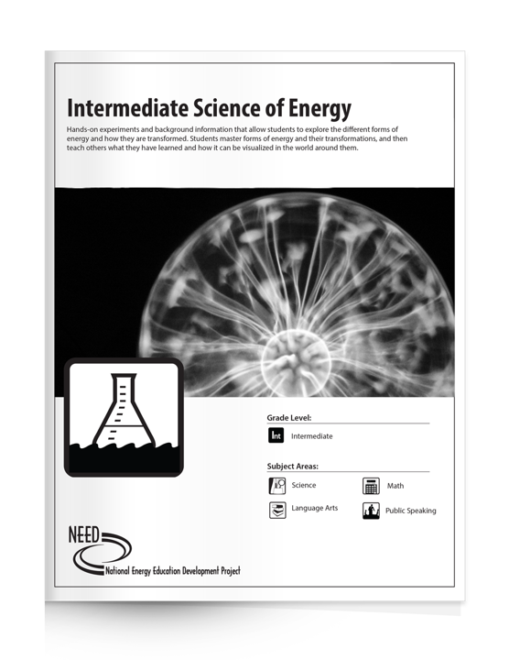
Science of Energy Unit Structure
Focus on energy transformations
Teacher demo
Six independent stations
Three levels
  Elementary
  Intermediate
  Secondary
Kit includes materials for all six stations plus teacher demonstration
Primary Science of Energy is a different kit with different materials, for grades K-2
Notes:
This slide talks about how the unit is structured. The focus of this curriculum unit is on energy forms and how they are transformed into other forms. It begins with a teacher demonstration using jars of sand. From there students are divided among six stations, each of which can function independently of the others.
One way to divide students is to have them evenly distributed among the six stations and learn it well, usually about 2 class periods. Then jigsaw the kids so one student from each station is in one group (groups of six). Have students rotate and each student presents their station to the rest of the group.
Another way is to distribute kids evenly among station. Then, at each station, half those students are A’s and half are B’s. Both the A’s and the B’s spend some time learning their respective stations. The first rotation days, the B’s rotate through the stations while the A’s present. Then the B’s present while the A’s rotate.
Science of Energy exists in three levels – elementary, grades 3-5; intermediate, grades 6-8; and secondary, grades 9-12. One curriculum kit contains materials for all six stations, the teacher demo materials, and curriculum guides for all three levels. The guides have reproducible pages appropriate for each level.

Slide 4
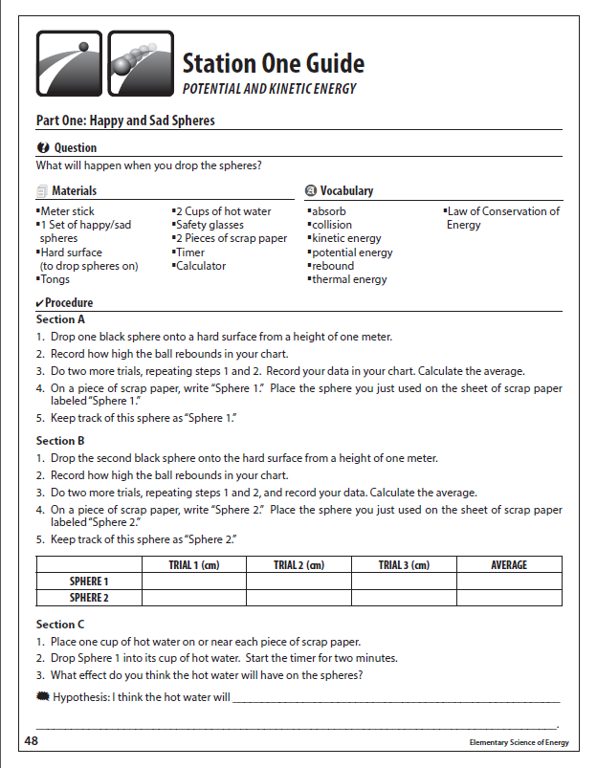
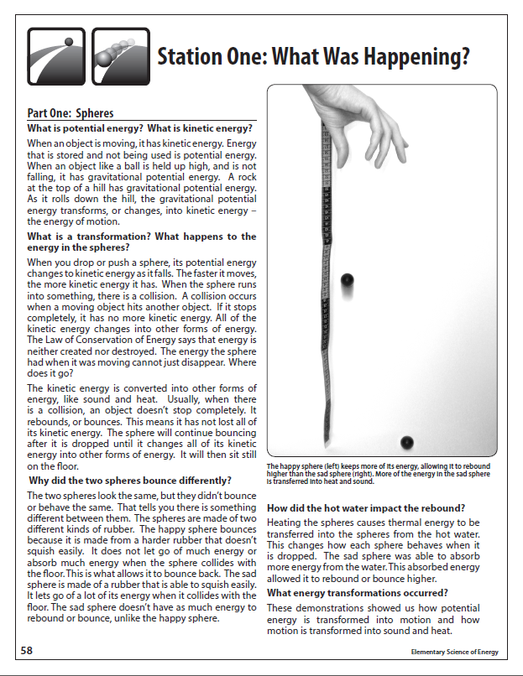
Notes:
This is an example of what a student station guide might look like. The left shows instructions for completing the activity, while the right, the “What was happening?” pages, shows an explanation for the activity. Some teachers provide these pages to students at the beginning of the unit, some provide them on “presentation day” as a backup for students who are nervous, and some do not distribute them until after completing the unit.
Science of Energy allows for differentiation and specialization of the unit to meet your classroom needs. Because each grade level uses the same station contents, students or entire classes can level up or down accordingly, and they will be doing the same things for the most part but at a more appropriate learning level.

Slide 5

Teacher Demonstration
 | Full Jar of Sand | Half-full Jar of Sand
Temperature Before | °C / °F | °C / °F
Temperature After | °C / °F | °C / °F
Change in Temperature | °C / °F | °C / °F
Notes:
**Delete the C or the F to leave the temperature scale you are using for the workshop**
Start with the Teacher Demo if you have time. Record the temperature of each jar of sand. Then recap the sand, and have everyone shake it, while handling the jars the same. Demonstrate what this means.
In the meantime, explain the forms of energy. After everyone has shaken the jars of sand, immediately record the temperature after shaking and calculate the change in temperature.
Ask students/teachers why the half-full jar (should have) showed a greater increase in temperature. One response will probably be that there’s more room in the jar for more collisions, and this is true. It is also an adequate explanation for younger students that isn’t too complicated yet will not lead to misconceptions.
A deeper, more thorough explanation is that while the collisions and friction between sand particles increases the temperature, shaking the jar transfers energy from the arms and hands to the sand inside the jars. Temperature is a measure of the average kinetic energy of each particle – in this case each particle in the sand. Because the same amount of energy is transferred to each jar, and because the full jar has more sand than the half-full jar, the half-full jar’s average increase in kinetic energy will be greater. It’s like giving 5 pizzas to 20 kids or 10 kids. The kids in which group get more pizza?

Slide 6
Energy
The ability to do work or make a change
Potential Energy
Stored energy and the energy of position
Kinetic Energy
Motion of waves, electrons, atoms, molecules, and substances
Notes:
Energy is divided into two main categories
Potential energy is stored in some way
Kinetic energy is moving around in some way
Almost everyone will be familiar with these two terms. Each category is broken down further into forms of potential and forms of kinetic energy.

Slide 7
Energy Explained Further
Movement
Heat
Light
Sound
Growth
Technology
Notes:
If your audience seems to be struggling with what “ability to do work or make a change” means, unhide and use this slide to break it down. These energy categories are from EnergyWorks, which deals with forms of energy without regard to transformations. Younger students may find EnergyWorks a better starting point before transitioning to Science of Energy.

Slide 8


Chemical Energy
Energy stored in the bonds of atoms and molecules
Nuclear Energy
Energy stored in the nucleus of an atom – the energy that holds the nucleus together
Potential Energy
Stored energy and the energy of position
Gravitational Energy
Energy of place or position
Elastic Energy
Energy stored in objects by the application of force.
Notes:
This slide works well with students and teachers alike. Hide if you’re using slide #7
Explain each form, define them, and provide examples as appropriate.

Slide 9
Potential Energy Forms
Chemical Energy
Nuclear Energy
Gravitational Energy
Elastic Energy
Energy stored in the bonds between atoms in molecules
Energy stored in the nucleus of an atom; the energy that holds the nucleus together
Energy of place or position
Energy stored in objects by the application of force (compression or stretching)
Notes:
This slide is good for adult audiences but not as engaging for student audiences. Hide if you’re using slide #6.
Explain each form, define them, and provide examples as appropriate.

Slide 10





Radiant Energy
Electromagnetic energy that
travels in transverse waves
Thermal Energy
Internal energy in substances –
vibration or movement of
atoms and molecules
in substances a.k.a. “heat”
Kinetic Energy
Motion of waves, electrons, atoms, molecules, and substances
Sound Energy
Movement of energy
through substances
in longitudinal waves
Motion Energy
Movement of substance
from one place to another
Electrical Energy
Movement of electrons
Notes:
This slide works well with students and teachers alike. Hide if you’re using slide #9.
Explain each form, define them, and provide examples as appropriate.

Slide 11
Kinetic Energy Forms
Radiant Energy
Thermal Energy
Sound Energy
Motion Energy
Electrical Energy
Electromagnetic energy that travels in transverse waves
Internal energy in substances; the vibration or movement of atoms and molecules in substances, a.k.a. “heat”
Movement of energy through substances in longitudinal waves
Movement of substances from one place to another
Movement of electrons
Notes:
This slide is best for adult audiences and is not as engaging with students. Hide if you’re using slide #8.
Explain each form, define them, and provide examples as appropriate.

Slide 12
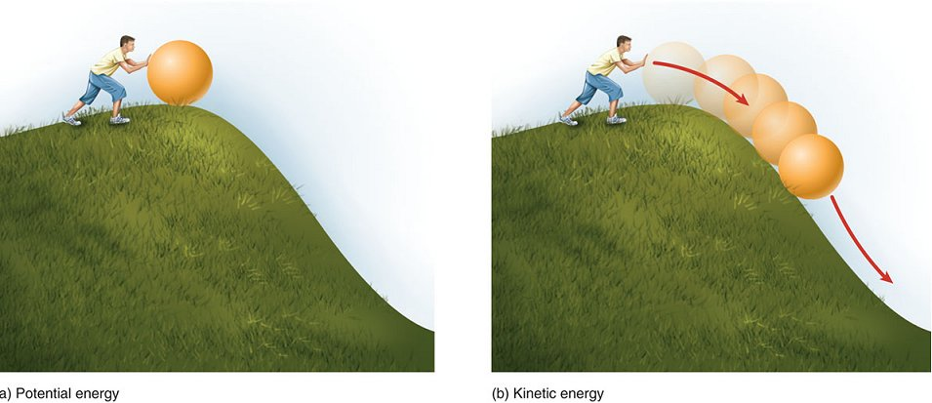
Example: Child Rolls a Ball Down a Hill
At the top of the hill, the ball has gravitational potential energy. At the instant the ball starts to roll down the hill, that potential energy begins to transform into motion energy. At the bottom of the hill, all of the potential energy has transformed into kinetic energy.
Notes:
Energy changes form as we use it. One good example that is easy to understand is a child rolling a large ball down a hill. At the top of the hill, the ball has gravitational potential energy. If we know the height of the hill and the mass of the ball, we can calculate the amount of energy stored in that ball’s position. When the child releases the ball and it starts to roll down hill, the stored gravitational potential energy begins to transform into kinetic energy. Most of the energy is motion energy, but a little will be changed into sound and a little more will be changed into thermal energy.
All energy transformations result in some thermal energy and some sound energy. It’s entirely possible that the sounds will be imperceptible to human ears, but there are always substances vibrating when energy transforms, creating sound. The sound and thermal energy in transformations mean we will never get 100% of the energy transformed into the form we want. The surroundings or environment will gain some energy in the form of heat and sound.

Slide 13
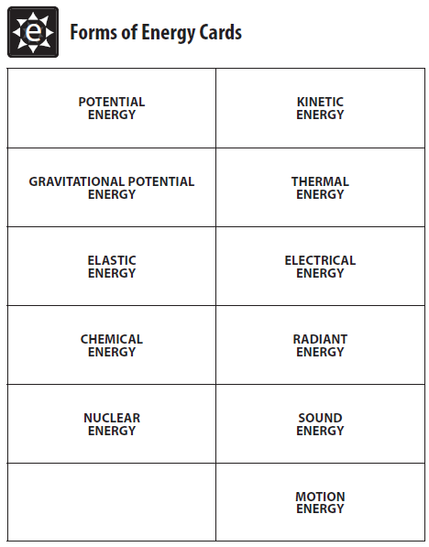
Forms of Energy Cards
Manipulative referenced in Elementary Science of Energy
Students cut apart and place them in order for each station’s energy transformations
It’s not a bad idea to make them available to middle and high school students until they catch on to recognizing forms of energy transforming
Notes:
The Elementary Science of Energy instructions direct students to use their Forms of Energy cards to show the forms being transformed, in order. For example, shaking the jar of sand transforms motion energy into thermal energy. So the students would put the motion energy card on the left and the thermal energy card on the right.
This manipulative helps students organize their learning. It can be useful for intermediate and secondary level students, too, while they adjust to using the correct scientific terms for what they are observing.
At this point, divide teachers / students into six groups and have them start rotating through stations.

Slide 14
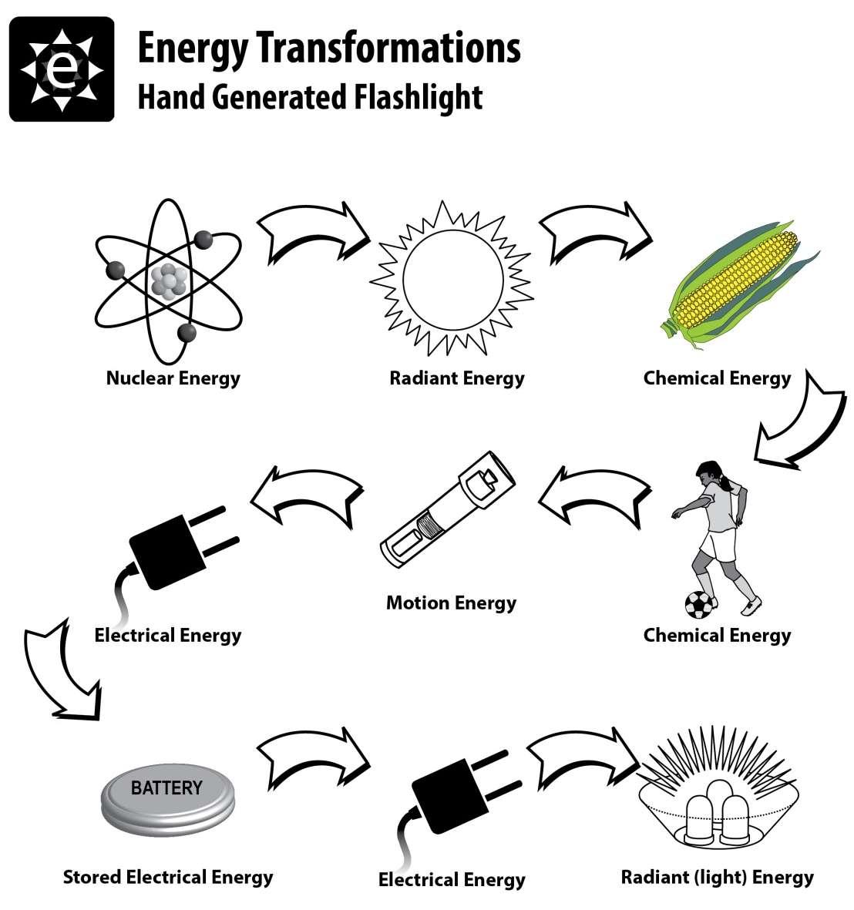
Energy Flows
When we use energy, we typically transform energy multiple times through several forms. The shake flashlight is a great tool to illustrate this.
Notes:
After teachers / students have finished with the activities at each station, reassemble the large group and distribute the handout pictured above. On the back should be all of the forms of energy with each definition.
Walk the group through the transformations on the front, starting with the flashlight and moving forward, then going back to the flashlight and working backward.
Nearly every energy flow on Earth starts in the form of nuclear energy, fusion, from the core of the sun or other stars. Uranium is the result of stellar processes long before the earth began.
There are some ecosystems at the bottom of the ocean where bacteria use chemisynthesis for energy; in that case our sun is not the origin of energy in that system. Geothermal energy results primarily from the pressure due to Earth’s gravity. But fossil fuels, all the renewable sources except geothermal, and uranium have their origins in nuclear fusion.

Slide 15
Forms and Sources of Energy, Part One
Forms
how science classifies energy
Sources
the origins of the energy we use
how we colloquially discuss energy
4 Potential, 5 kinetic
Chemical
Chemical
Chemical
Motion
Chemical
Motion
Nuclear
Radiant
Chemical
Thermal
Notes:
Distribute the Forms and Sources of Energy page. Give a brief overview of the renewable and nonrenewable sources of energy and what they are primarily used for. Instruct teachers/students to identify the form of energy that we use in each source. Complete Petroleum together, then allow the group a couple minutes to finish the other nine.
Each click of the mouse or forward arrow button on the keyboard will display the next answer, working down the columns.

Slide 16
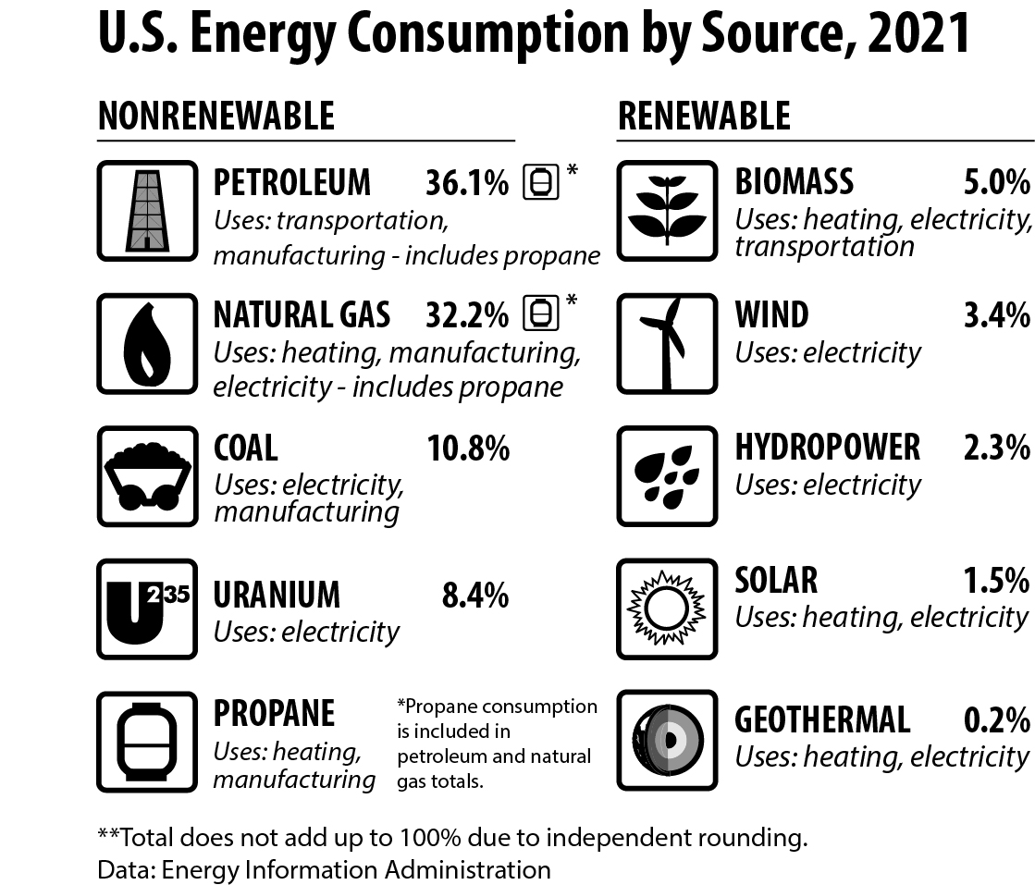
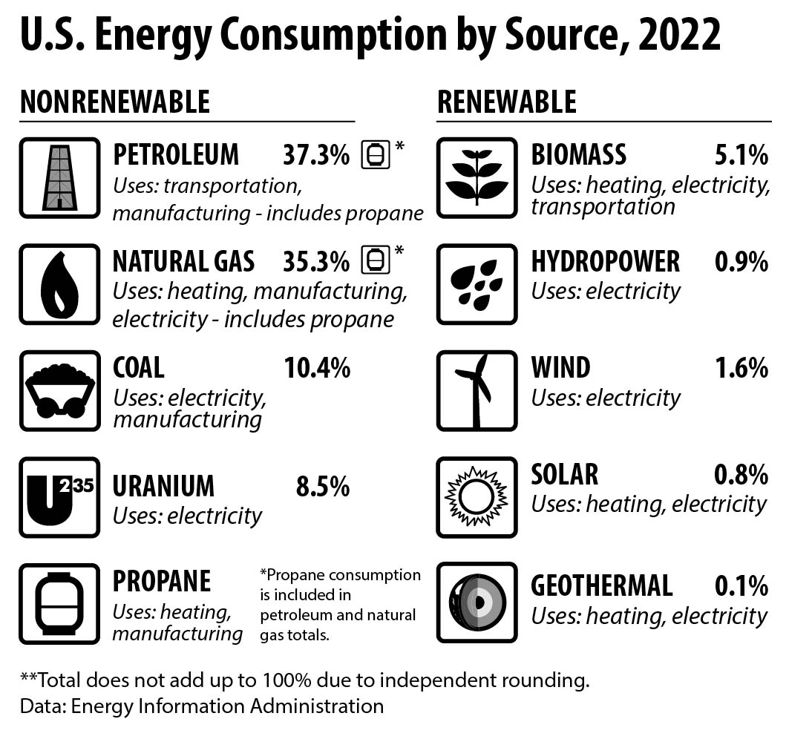
Forms and Sources, Part Two
88.1%
8.5%
2.5%
0.8%
0.1%
91.5%
8.5%
Notes:
After teachers/students have completed part one, introduce the US Energy Consumption buy Source graphic. Explain that most of our data is acquired from the US Energy Information Administration, a branch of the Department of Energy. We update our curriculum with the most current data available at the time of printing. Sometimes teachers will be able to get more recent data from the EIA, but we as an organization need to use what is finalized by EIA and available when we go to print. Our data may be a couple years behind, but it won’t be much more behind than that most of the time. There are a few exceptions, though, such as efficiency data obtained from the Residential Energy Consumption Survey (RECS) or the Commercial Building Energy Consumption Survey (CBECS). These surveys are conducted every 5 or 6 years. Climate science information usually follows the release of the UN Intergovernmental Panel on Climate Change (IPCC) reports.
**Note for 2022 data: Any teachers who have been using NEED materials for awhile may wonder why in 2021 the nonrenewable / renewable percentage distribution was 87.5% and 12.5%, respectively. The change is due to the EIA changing the way they calculate the energy content of hydropower and wind. Instead of making an annual heat content every year through other calculations, they have adopted the 1 kWh = 3,412 BTU conversion factor. This changed how the numbers align. The same amount of electricity has been generated from renewable sources, but the way they’re represented in the total energy consumption calculation has changed.

Slide 17
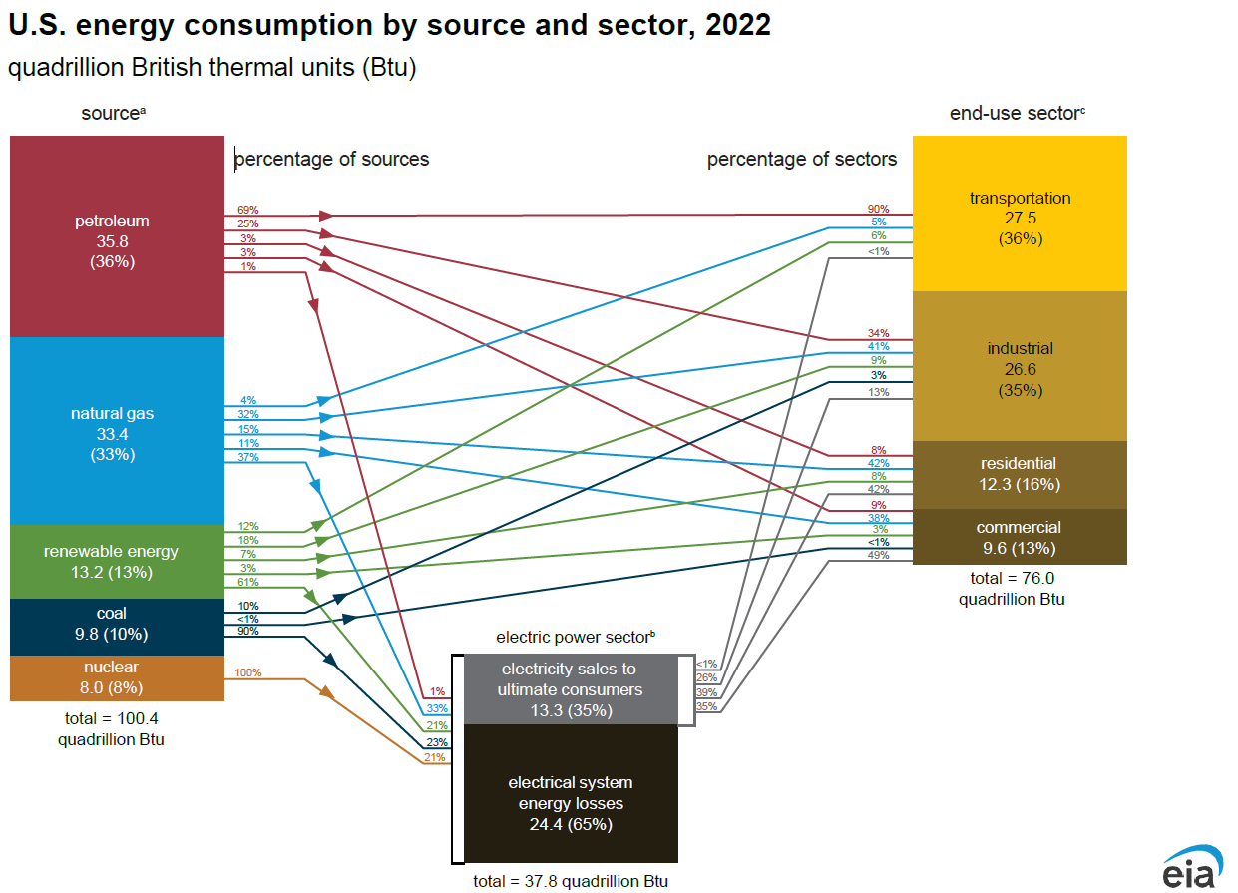



Notes:
This is the spaghetti plot, taken directly from the EIA. On the left are all the sources we use. On the right are the end-users of energy, divided into sectors. Note that all renewables are represented by the green rectangle. If this is not a petroleum workshop, this may be the best time to discuss imported petroleum. Also, if you are not playing Electric Connections, this may be the best time to discuss the average price per kilowatt-hour for retail customers in the US.
Looking at the sources side it is easy to see that the energy source providing most of our energy is petroleum. The red numbers leading away from the petroleum rectangle indicate the percentage of petroleum going to each sector. In other words, 69% of petroleum goes to transportation.
Looking at the sectors side, you can see where each sector gets its energy. For example, 90% of the energy used by the transportation sector comes from petroleum.
Note that the electric power sector is on its own, at the bottom. This is because it takes energy from the sources and then distributes that energy as electricity on the grid system. Note that about 2/3 of the energy consumed by the electric power sector is lost as thermal energy losses during generation. This explains why the electric power sector us the sector using the most energy out of all of them.
Unless this is an oil/gas workshop, this is the best place to explain the origins of our imported petroleum.

Slide 18
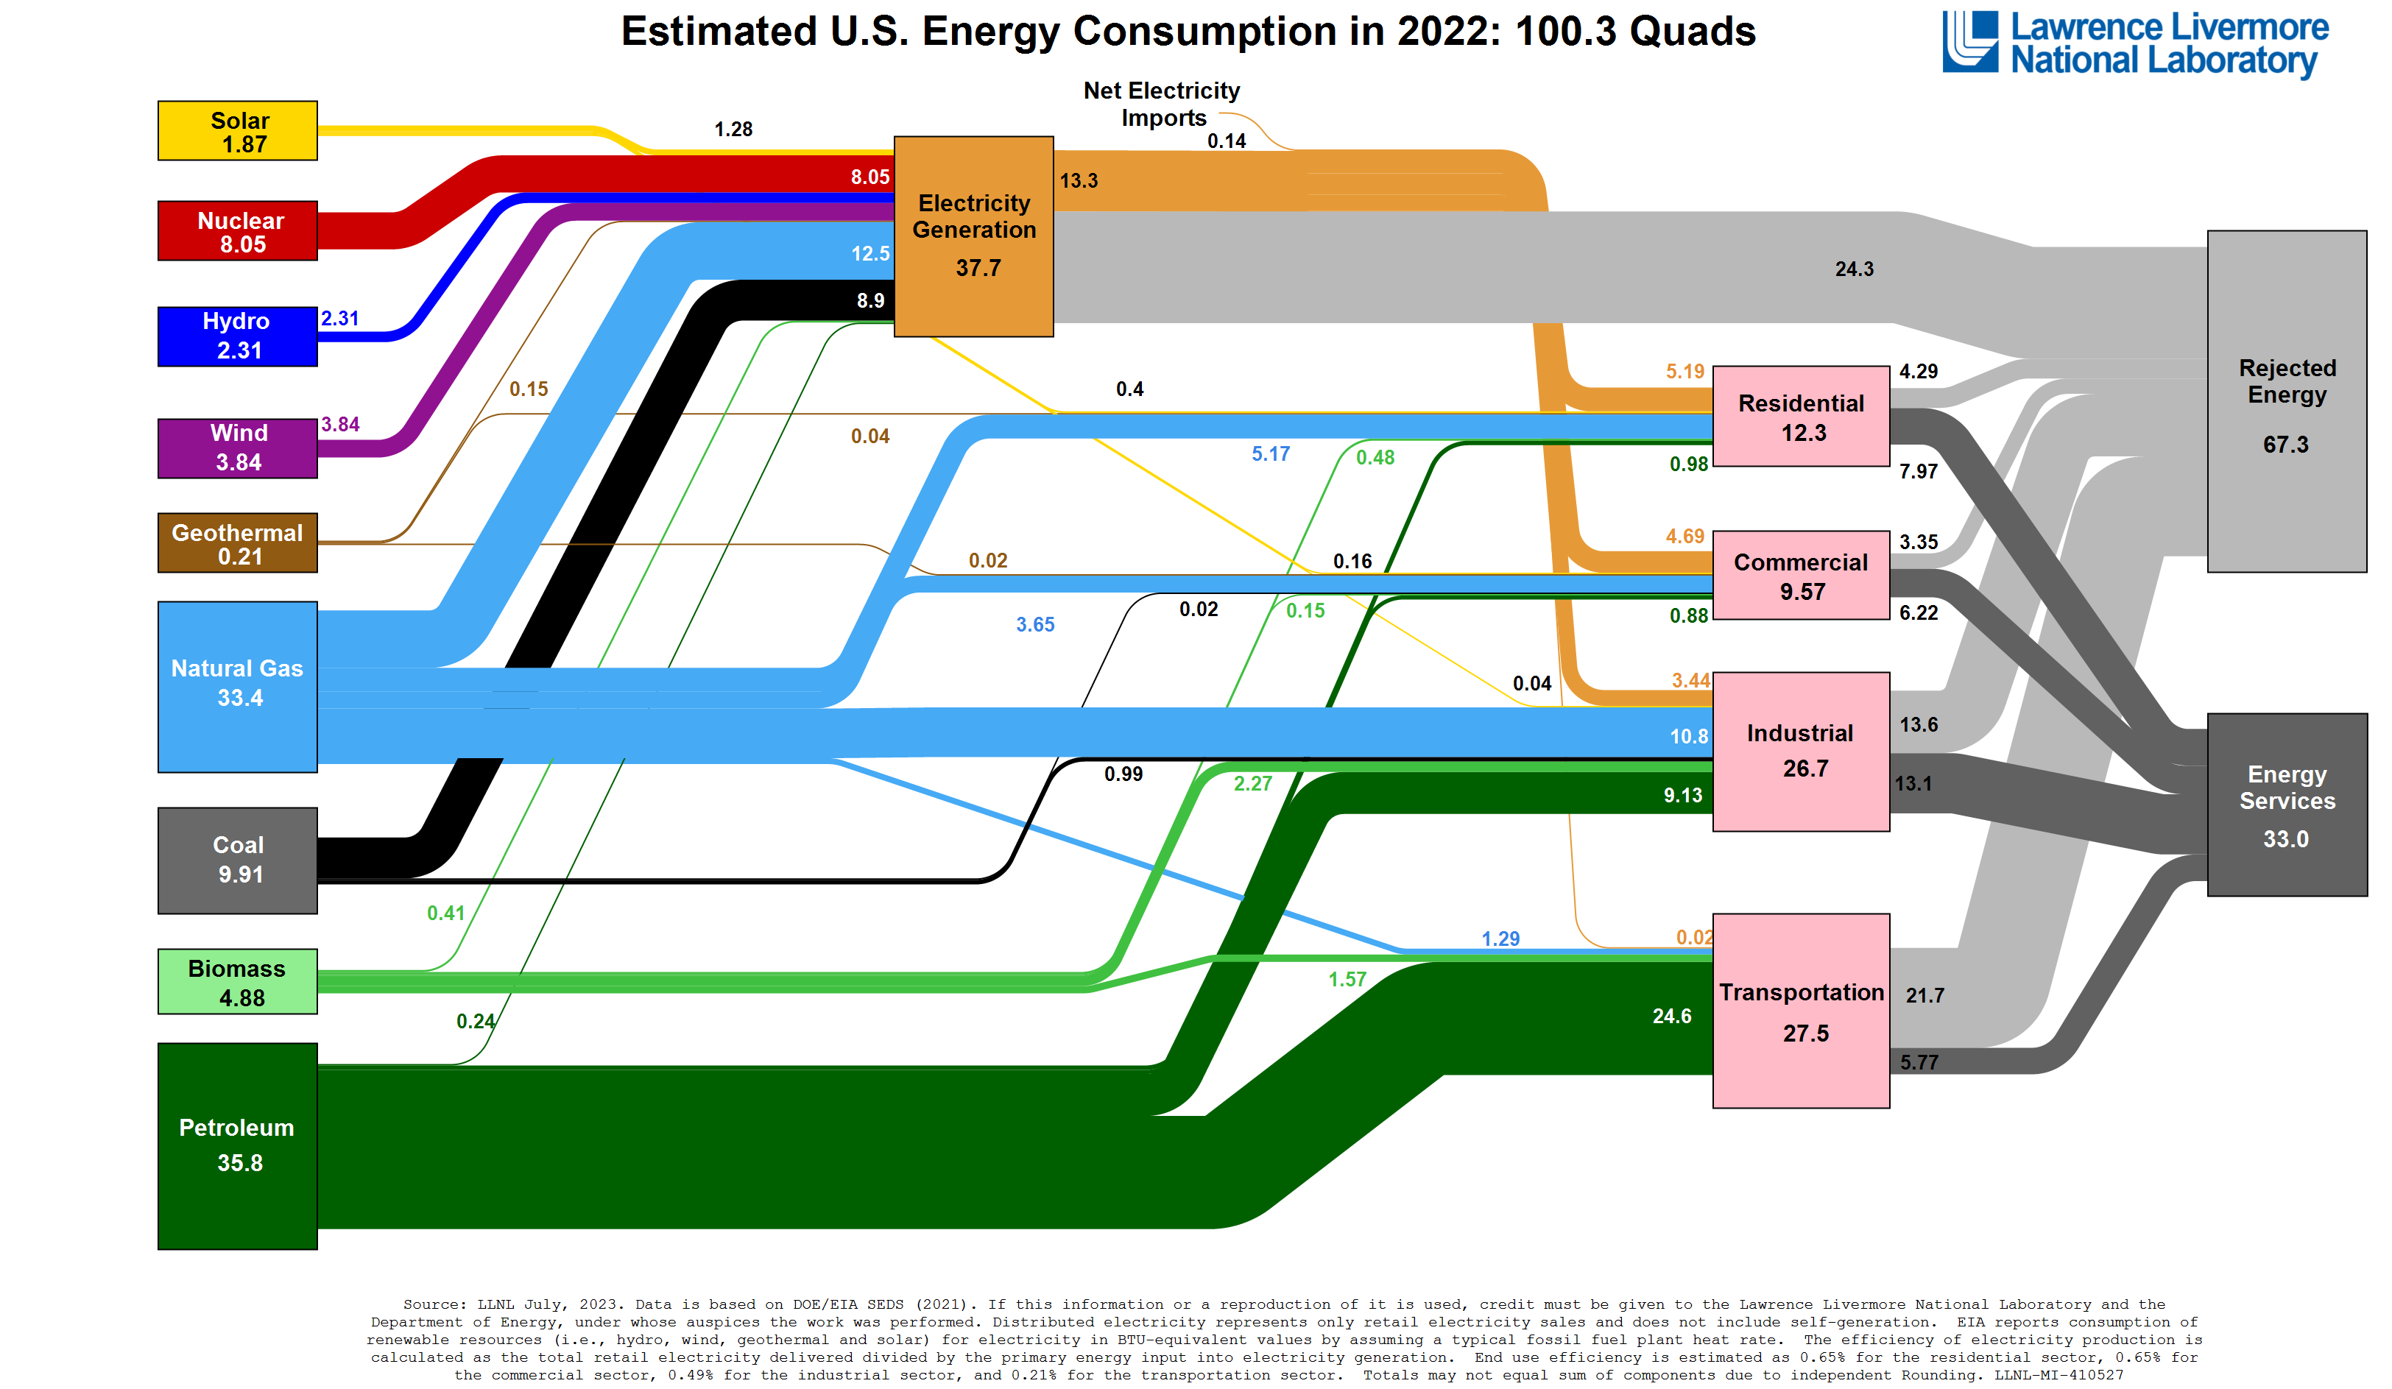
Notes:
This slide has the Sankey plot, produced by Lawrence Livermore National Laboratory. It uses data from the EIA, without the percentages. However, it shows energy use as a continuous flow, and shows more detail than the spaghetti plot on slide 15. Know your audience! If this is a plot appropriate for use with them, use it. However, the standard NEED slide is the EIA Spaghetti plot on slide 15.
If you decide to use this slide, you may want to hide slide 15 to avoid confusion.

Slide 19





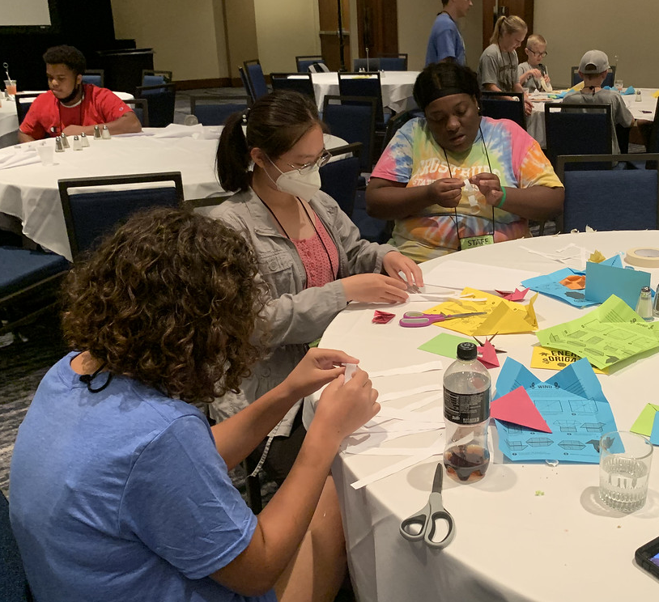
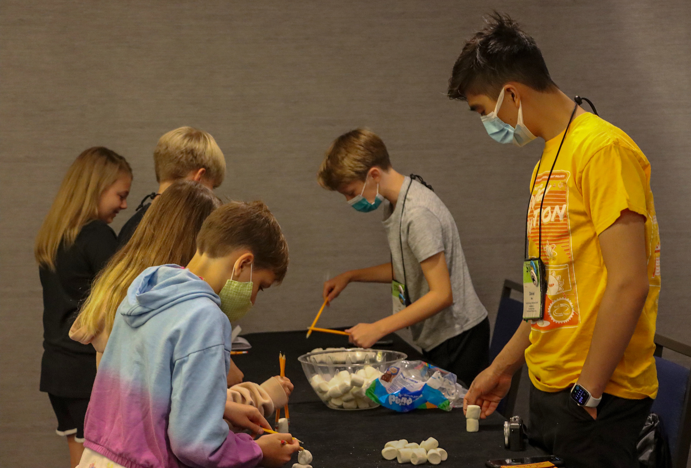

NEED schools have outstanding classroom-based programs in which students learn about energy. Some schools have student leaders who extend these activities into their communities. To recognize outstanding achievement and reward this leadership, The NEED Project conducts the National Youth Awards Program for Energy Achievement.
Notes:
Introduce the YAPEA program. Discuss the program, and explain how schools can be recognized as state or national winners. Show the large group the YAP site, where they can look at past projects and find out more information.

Slide 20
Stay up-to-date with NEED. “Like” us on Facebook! Search for The NEED Project, and check out all we’ve got going on!
Follow us on Instagram and check out the photos taken at NEED events, instagram.com/theneedproject
Follow us on Twitter. We share the latest energy news from around the country, @NEED_Project
We have great videos for you on our YouTube channel – activities, career interviews, and so much more! https://www.youtube.com/@NEEDproject
Notes:
Encourage teachers and students to check out our social media. We are not on TikTok (yet) but we are on Facebook, Instagram, Twitter, and YouTube. The links on this slide are clickable so you can show teachers those pages if you have time.

