Slide 1
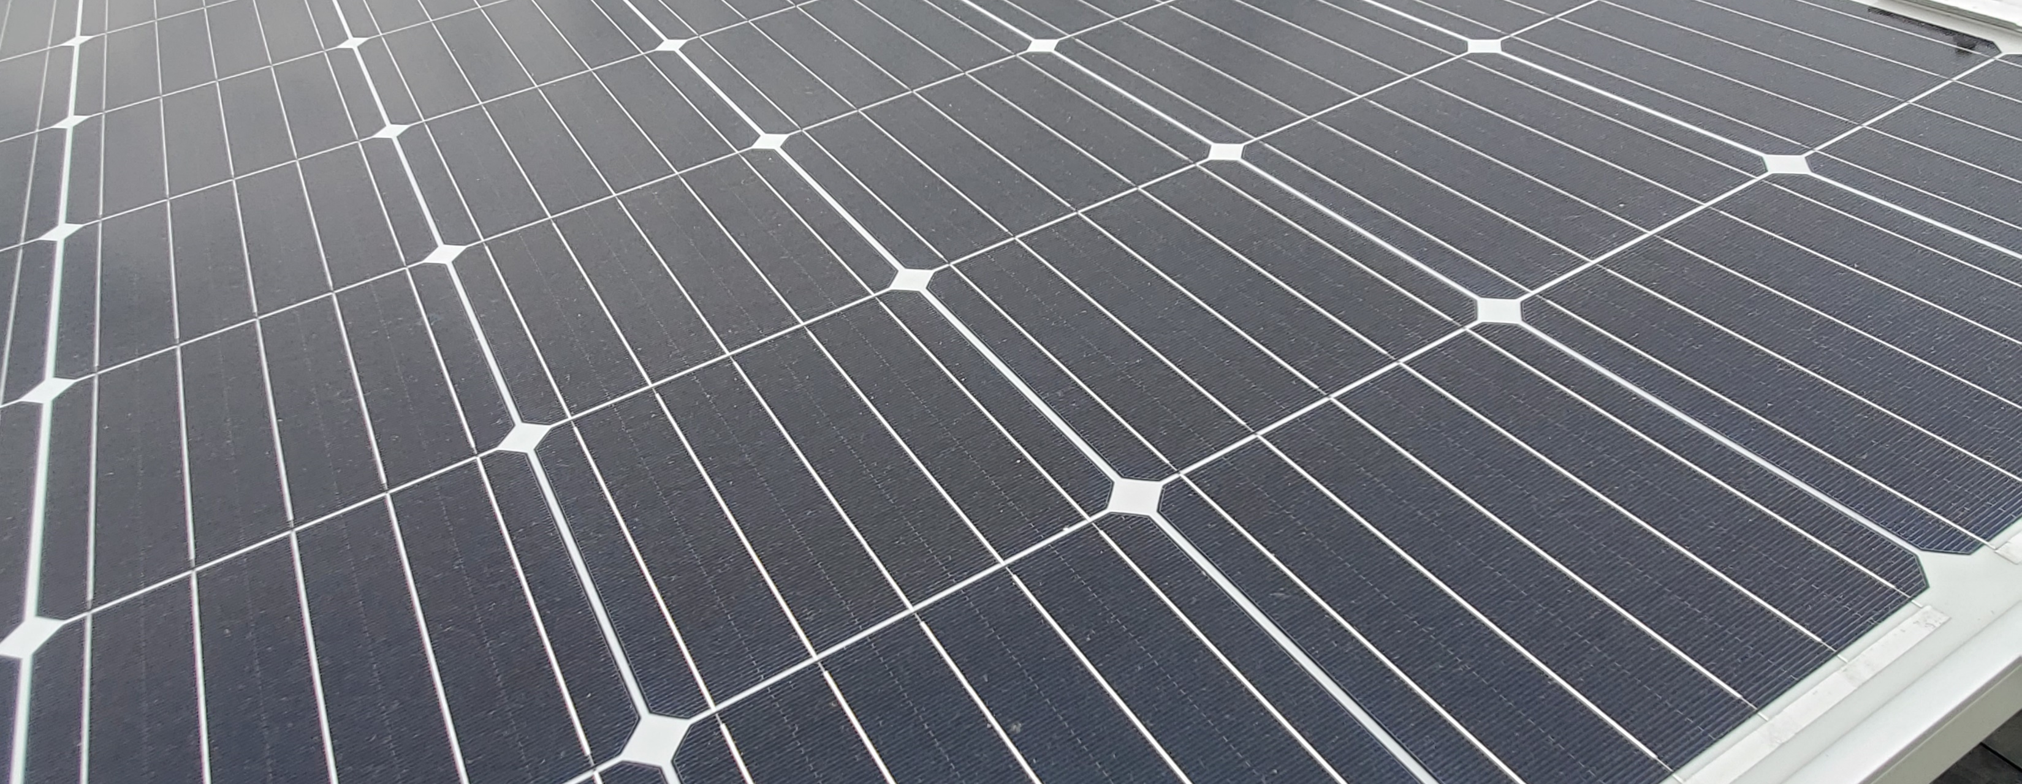
Exploring Solar Energy
All the bright kids are doing it!

Slide 2
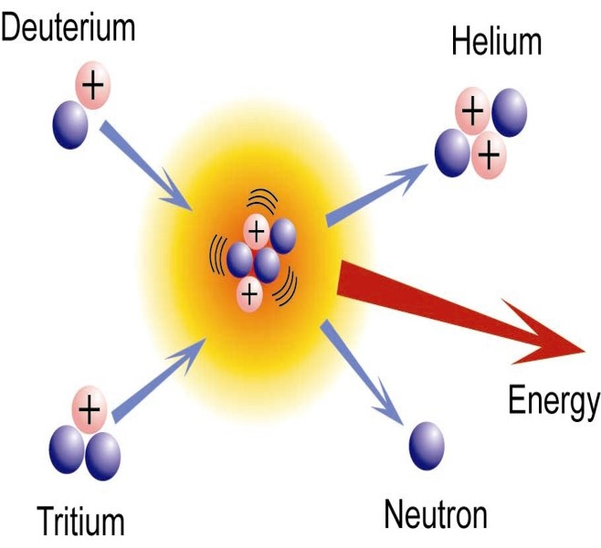
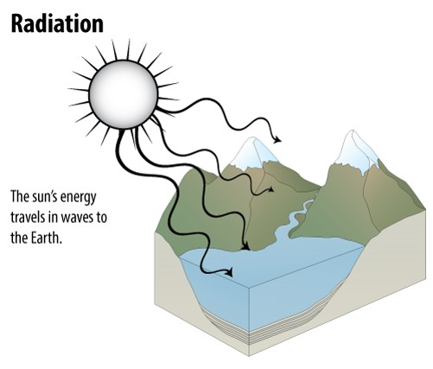
Sunlight is Radiant Energy
Notes:
The sun is so massive and has so much gravity that the atoms are pulled together with enough energy to create plasma – a state of matter even more energetic than gases. At this state, the electrons’ motion overcomes electrostatic force and they are able to move around independently of the nuclei with which they would ordinarily be associated. Because of this exceptionally high energy and gravitational force, small nuclei can be forced together in a process called nuclear fusion.
The diagram shows two isotopes of hydrogen. An isotope is a nucleus with the same number of protons but varying numbers of neutrons. Run-of-the-mill hydrogen is one proton and one electron. Deuterium has an atomic mass of 2 amu and tritium has an atomic mass of 3, but because each has only one proton they are isotopes of hydrogen.
If deuterium and tritium are fused, they form a helium nucleus and a free neutron, and release TREMENDOUS amounts of energy. This is just one of the fusion reactions taking place in the core of the sun and many other stars. The energy released by a fusion reaction will be an extremely high energy photon that we call gamma radiation. That photon can travel straight from the core of the sun to its surface and leave, or it can be absorbed and released multiple times by other atoms in the sun. Every time the energy is absorbed and released, the wavelength changes. The absorption / release process can occur for thousands of years before that photon leaves the sun; this is why sunlight is a broad spectrum of wavelengths, from gamma radiation down through long-wave radio waves. Each photon is a specific wavelength of electromagnetic radiation, or an electromagnetic wave.
Once a photon leaves the surface of the sun, it travels at 300,000 km/s and reaches Earth in about 8 minutes.

Slide 3
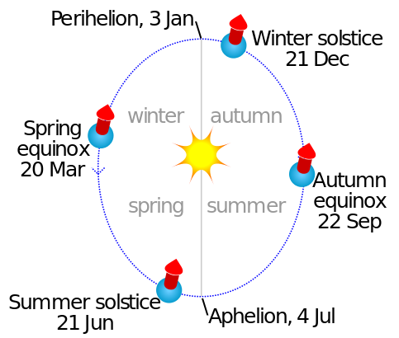
Uneven Solar Illumination
The axial precession, or “tilt”, of Earth causes variations in sunlight intensity throughout the year. In spring and autumn, the axis of Earth is perpendicular to the incoming sunlight, and on each equinox sunlight directly strikes the Equator. In the Northern Hemisphere, winter begins in December, when sunlight directly impacts the Tropic of Capricorn. Summer in the Northern Hemisphere occurs when upper latitudes are closer to the sun.
Image By Cmglee - Own work, CC BY-SA 3.0, https://commons.wikimedia.org/w/index.php?curid=30359851

Slide 4
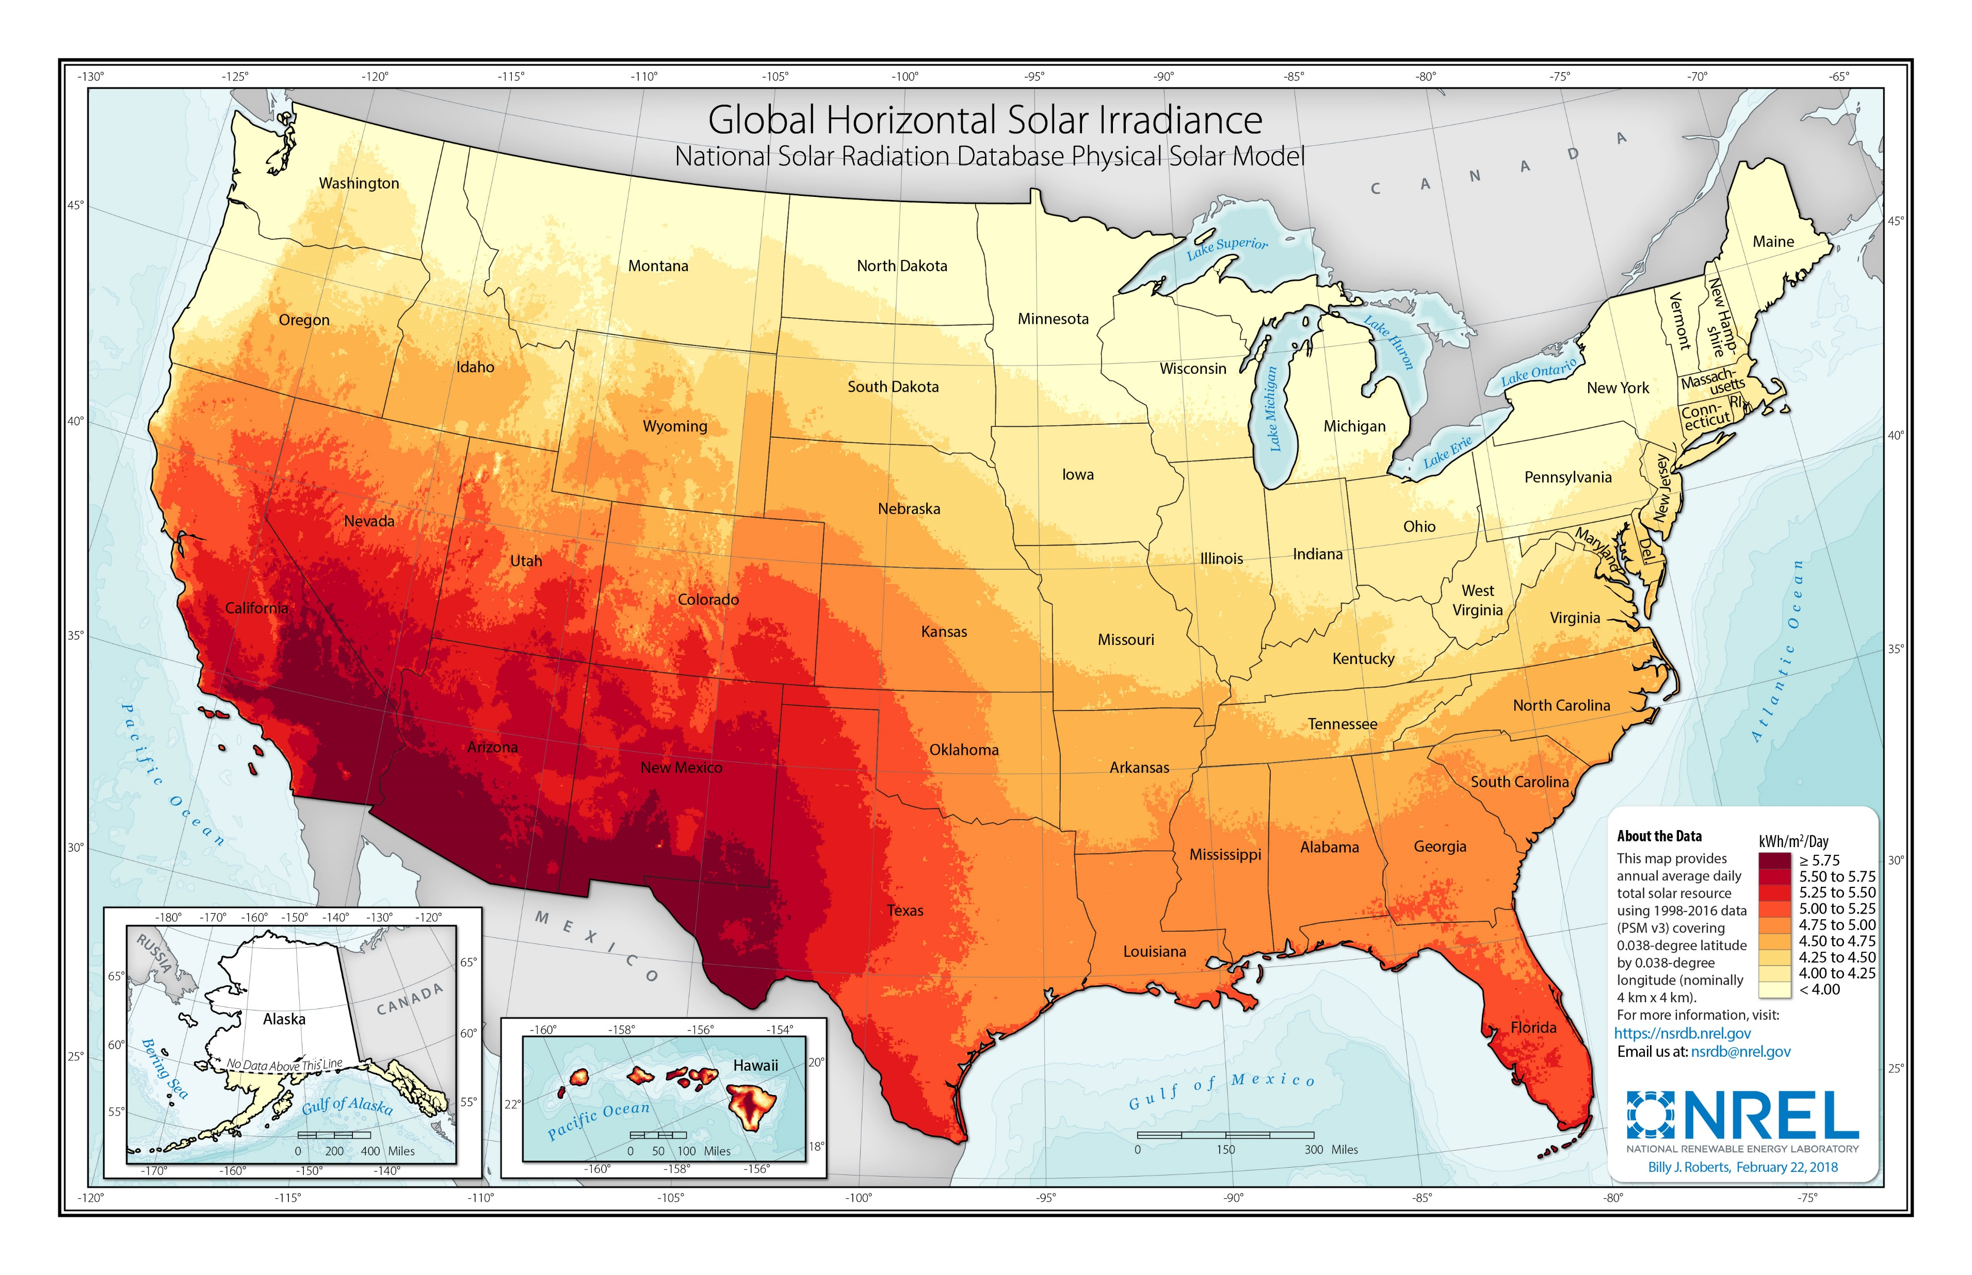
Average Daily Insolation Per Month
Notes:
This map, produced by NREL, shows where sunlight has the most power every day. The units are kWh per square meter per day. As one would expect, the arid southwestern states receive the most intense sunlight while northern states receive the lowest intensity. Parts of Hawaii where humidity is high and therefore cloud cover is frequent receive much less humidity than parts of the islands where humidity is lower.

Slide 5
Major Uses of Solar Energy
Daylight
Drying Agricultural Products
Space Heating
Water Heating
Generating Electrical Power
Concentrating Solar Power (CSP)
Photovoltaics
Notes:
These are the major uses of solar energy. Most recent technological developments have been in heating interior spaces and water, and generating electricity.

Slide 6
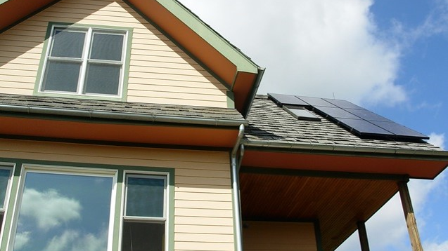
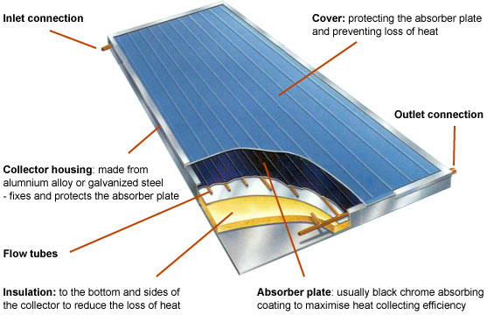
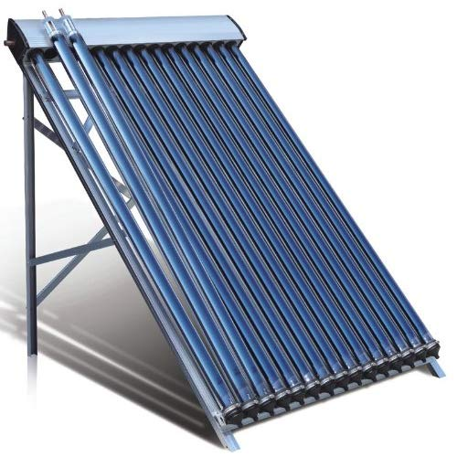
Active Solar Heating
Notes:
“Active solar” means we are using equipment specifically designed for using solar energy.
Flat plate solar collectors are usually large flat boxes with one or more glass covers. Inside the boxes are dark colored metal plates that absorb heat. Air or liquid, such as water, flows through tubes and is warmed by heat stored in the plates. These systems are particularly useful for providing hot water to households.

Slide 7
Concentrating Solar Power (CSP)
Using sunlight to heat a fluid, which in turn heats water into steam.

Slide 8
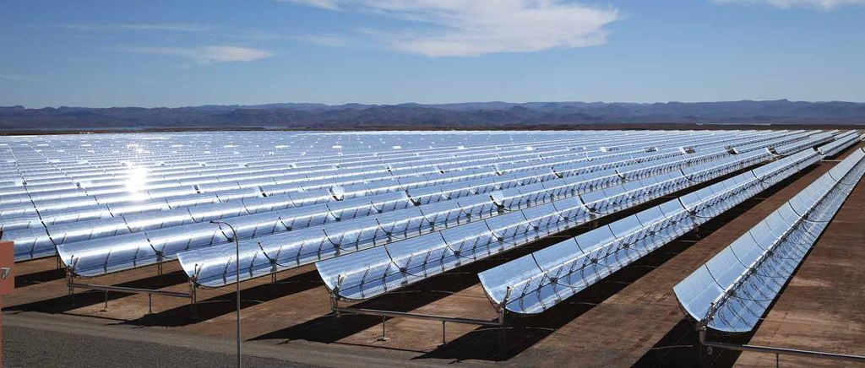
Trough Systems
Solar mirrors at the Noor 1 Concentrated Solar Power plant in Ouarzazate, Morocco. Courtesy Dewa
Notes:
Trough systems use trough-shaped mirrors bent in a parabola with a transparent tube mounted at the focus of the parabola. All sunlight that strikes the mirror is reflected into the tube. A fluid flows through the tube and is heated by the sunlight. That hot fluid than flows through a heat exchanger which boils water into steam, driving a steam-driven turbine just like any other thermal power plant (natural gas, waste-to-energy, nuclear, coal).

Slide 9
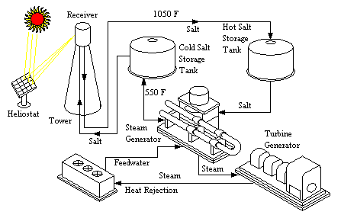
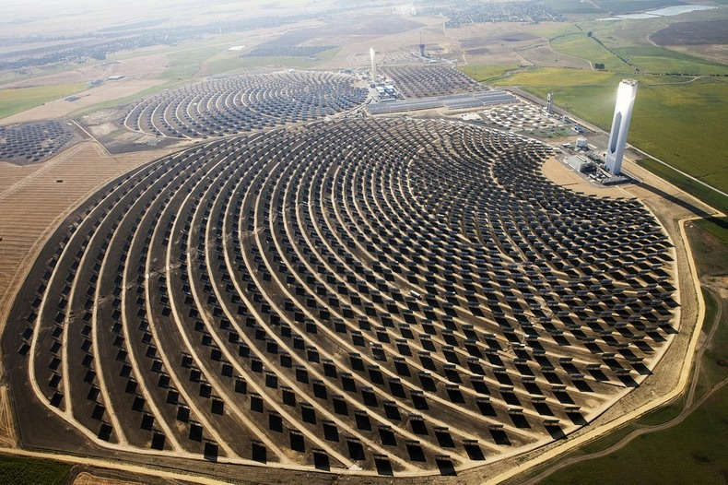
Power Towers
Notes:
Power towers have one single point of focus for the sunlight, which is a receiver at the top of a tower. Mirrors that track the sun continually reflect sunlight onto the receiver. Power tower systems use molten salt for thermal storage, which is run through a heat exchanger to boil water into steam and drive a turbine.
The photo is of the power tower in Seville, Spain, one of the world’s largest single tower systems.

Slide 10
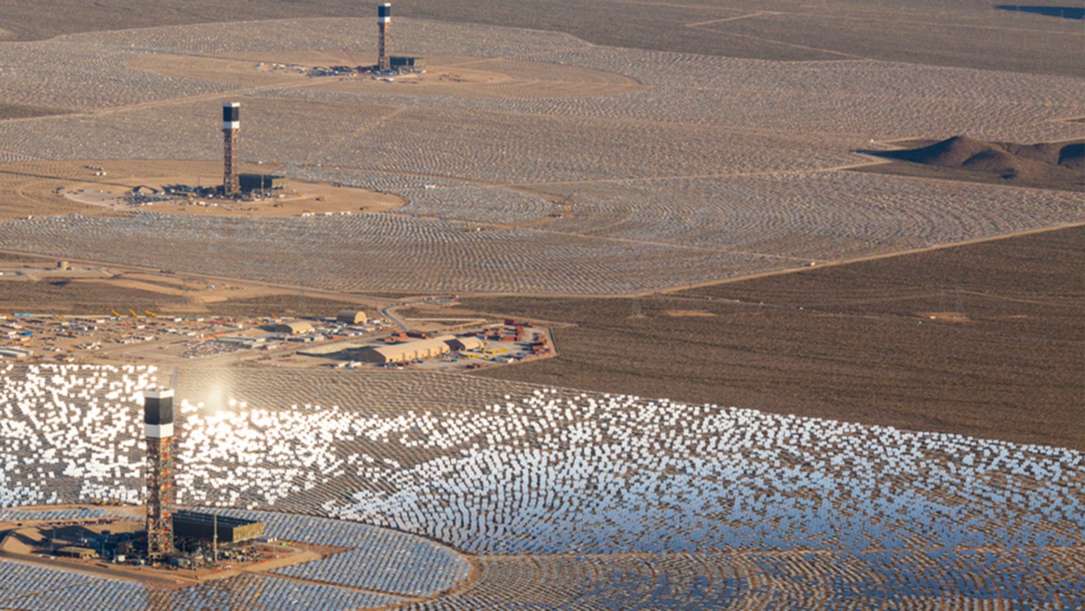
Ivanpah, Mojave Desert
The United States houses the largest CSP plant in the Mojave Desert
It uses 347,000 garage door-sized mirrors and 173,500 heliostats
Ivanpah is operated by NRG
Notes:
The world’s largest CSP plant is Ivanpah, located in the Mojave desert. It uses a combination of three towers and 347,000 mirrors to generate electricity. Each mirror is about the size of a single-bay garage door. The plant has a generating capacity of about 390 MW.
https://www.energy.gov/lpo/ivanpah

Slide 11
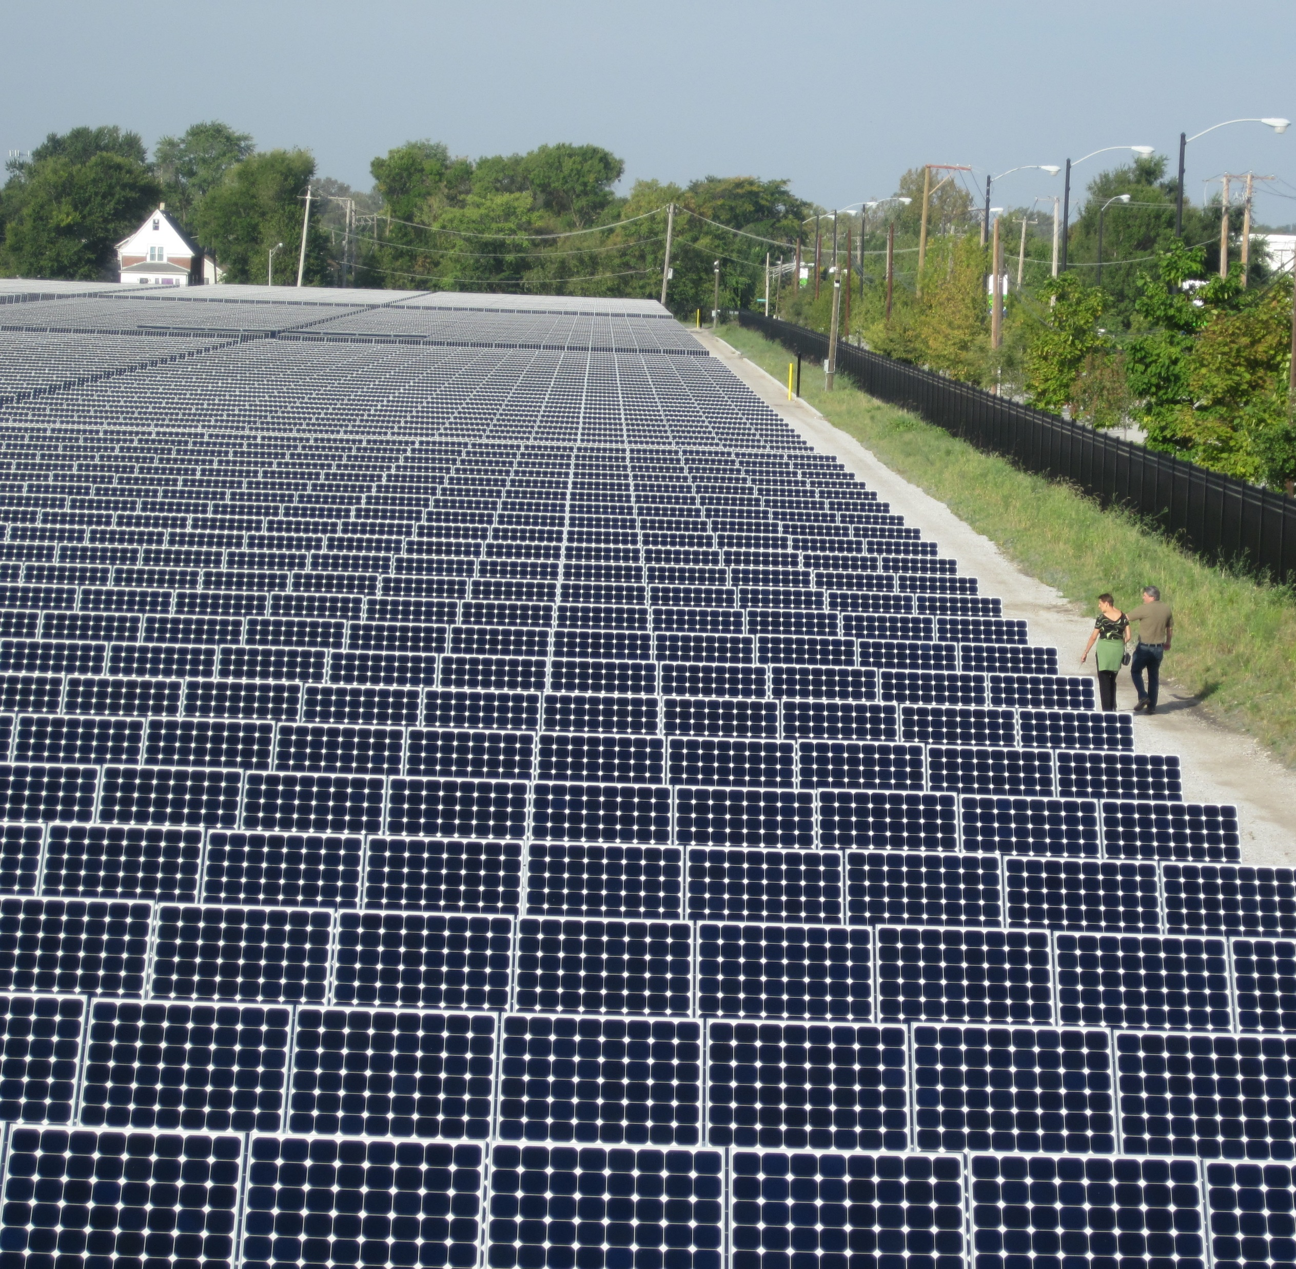
Photovoltaics
Using sunlight directly to generate electricity.
Notes:
Image is of Exelon City Solar in the West Pullman neighborhood of Chicago, IL. This 10 MW system was installed over a brownfield that could not be used for recreation or could not be built upon. Each row of panels is a single-axis tracking system, meaning the panels adjust in position to follow the track of the sun from east to west. At night they reset to be ready to face the morning sun the next day.
https://www.envdesigni.com/our-work/environmental-consulting/exelon-city-solar/

Slide 12
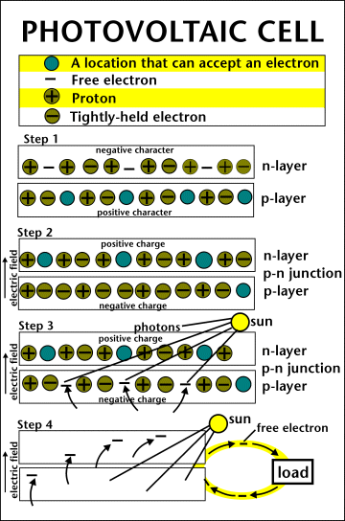
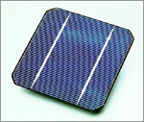
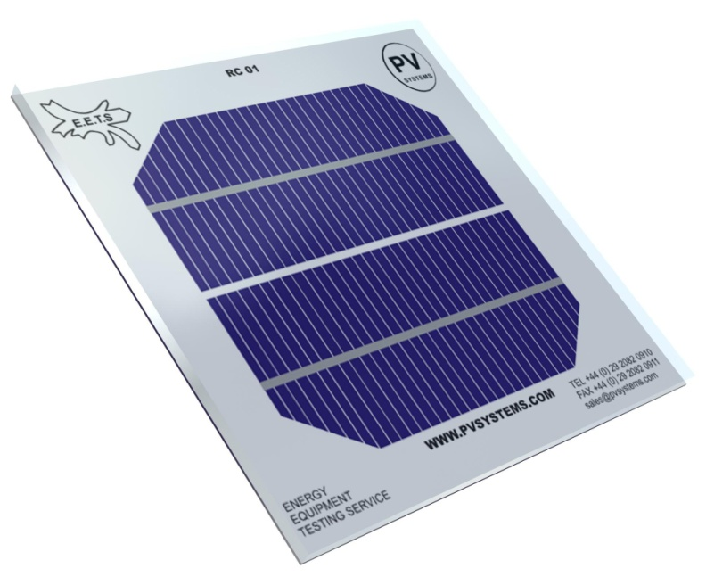
PV Cell
Notes:
The photovoltaic cell is the basic building block of a PV system. Individual cells can vary in sizes from about 1cm to about 10 cm across. Most cells are made with silicon today, which must be purified. This is one of the biggest expenses in the production of solar cells. One PV cell, regardless of size, will produce about 0.5V. However, larger cells produce more current and smaller cells produce less current. This is because of the number of electrons available to do work in the circuit to which the cell is attached.
A slab (or wafer) of pure silicon is used to make a PV cell. The sides of the wafer are painted, or doped, with substances with different numbers of valence electrons as compared to silicon. The one with more electrons is the n-layer while the side doped with a substance with fewer electrons is called the p-layer.
Where the n-type silicon and p-type silicon meet, free electrons from the n-type flow into the p-type to even out the electron distribution; as a result, an electric field forms, permanently bonding the two layers and preventing further electron movement (at ground state). This point of contact and barrier is called the p-n junction.
Placing the cell in sunlight causes radiant energy of the right wavelength to transfer energy to electrons. The electrons are energized, moving back into the n-layer. Energized electrons do not want to stay energized; they look for ways to shed that excess energy and return to ground state. In this case, connecting wires and a load to the cell allows electrons to flow through a circuit and use their excess energy to power the load, and return to ground state.

Slide 13


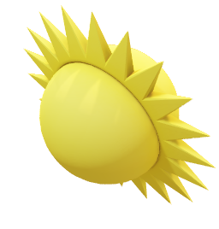
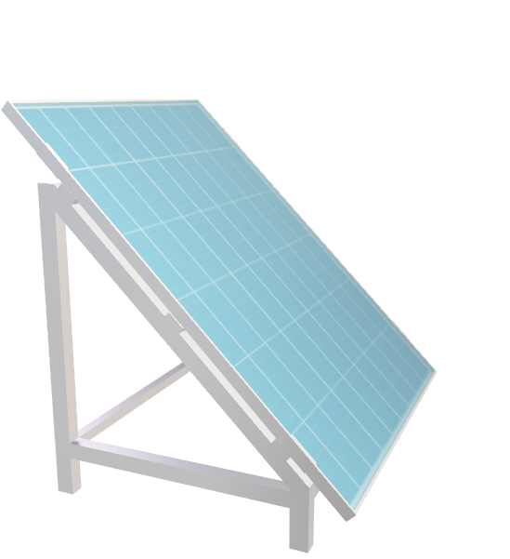
Current Flow in a PV Cell
Phosphorus-doped (N-type)
Silicon layer ~ 0.3:m
Photovoltaic Cell
Electrical Load
(-)
DC Current Flow
(+)
Boron-doped (P-type)
Silicon layer ~ 250:m
Notes:
Photovoltaic systems are DC systems, meaning they produce electric current that moves in one direction only, like a battery. The diagram shows the direction of the current through a load, such as an LED.

Slide 14
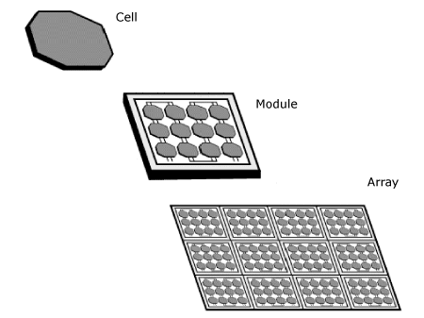
Components That Make a Solar Panel
One cell produces about 0.5 V; larger cells produce more current
Cells are connected in series to create modules (increases voltage)
Modules are connected in parallel to create arrays (increases current)
A “solar panel” is an array
Solar farms are often also called arrays – technically an array of arrays
Notes:
Cell, module, and array have specific meanings when discussing PV systems. However, as is often the case, colloquial usage blurs the meaning of “array”. Sometimes photovoltaic arrays are called “solar farms”.

Slide 15
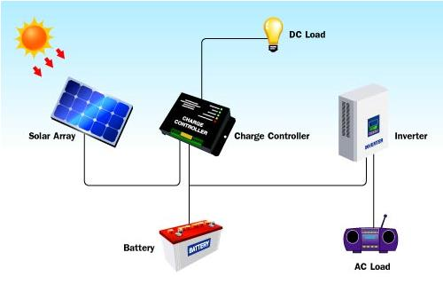
Solar System Components
Notes:
Because PV systems generate DC power, using it in a building wired for AC power requires modification. The device that changes DC power to AC power is called an inverter.
Systems that are built with battery storage or that directly power DC loads, such as on an RV or a house with a battery storage system, need charge controllers. These devices prevent the batteries from being overcharged, thus overheating them and causing a rupture or fire. They also prevent the batteries from being drained completely. Cell phones have built-in charge controllers that stop recharging of the battery when it is completely charged, and shut off the phone when the battery reaches less than 3%.

Slide 16
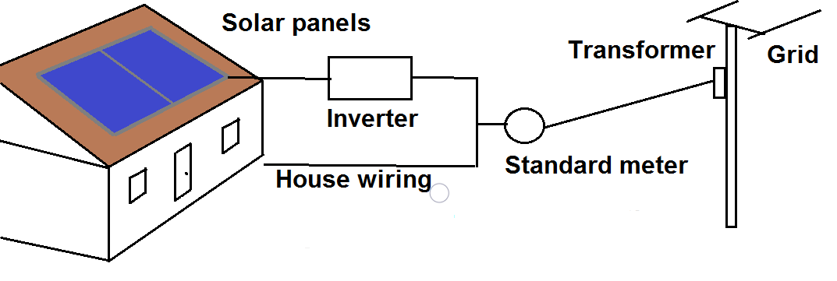
Connecting to the Grid and Net Metering
Notes:
There are many ways a home with solar panels can be connected to the grid. Most municipalities require homes to be grid-tied even if they have solar installed sufficient to meet the needs of the occupants. If the system produces more power than the building occupants are using, the meter will “run backward” and the excess power will be added to the grid. Owners of the system can be paid at the wholesale rate for this excess power in a system called net metering. If the building never pulls any power from the grid, the occupants will still receive a nominal bill from the utility to cover the cost of being grid-tied. Net metering reduces a building’s utility costs, but does not provide a source of income for the building because credits are given at wholesale rates while bills are generated at retail rates.

Slide 17
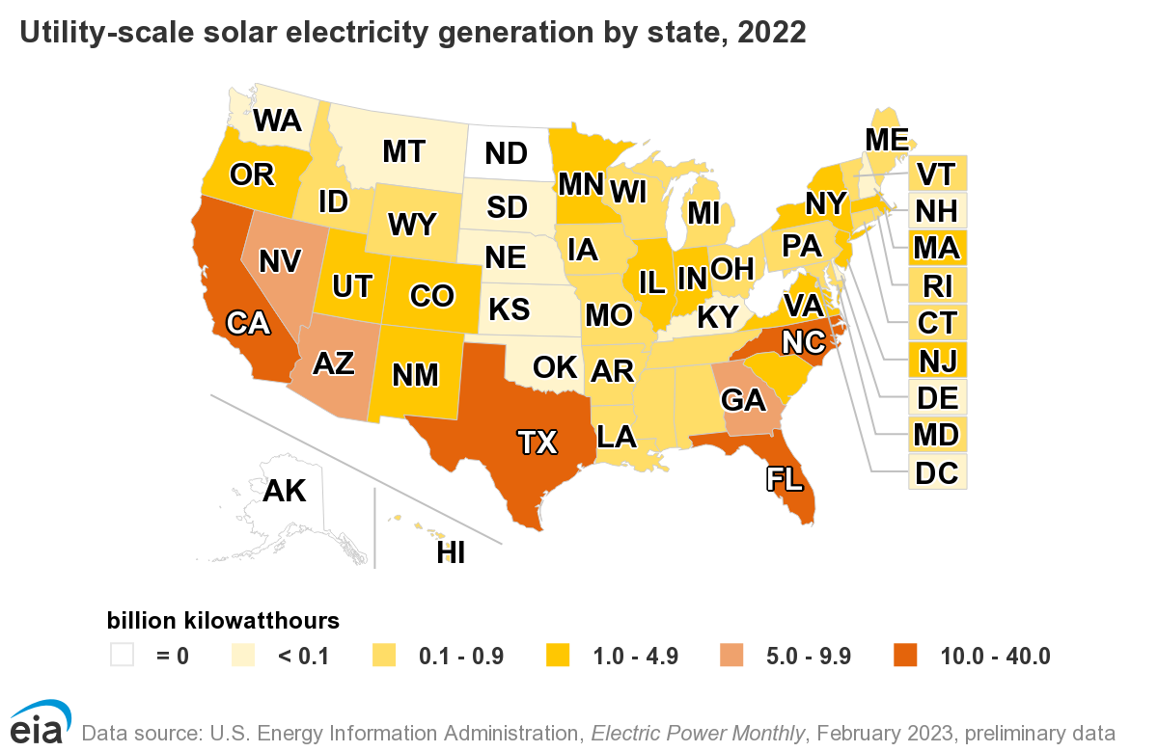
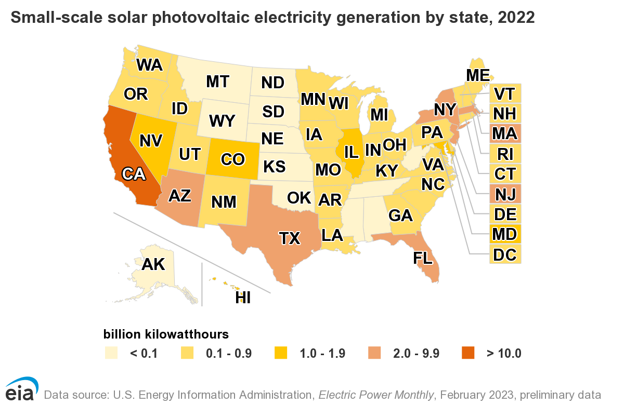
Solar PV in the United States
Notes:
Images sourced: https://www.eia.gov/energyexplained/solar/where-solar-is-found.php
In some states, utility scale installations have outpaced residential installations. In others, the reverse is true, especially in states with legislation that is not favorable to installing utility-scale systems.

Slide 18
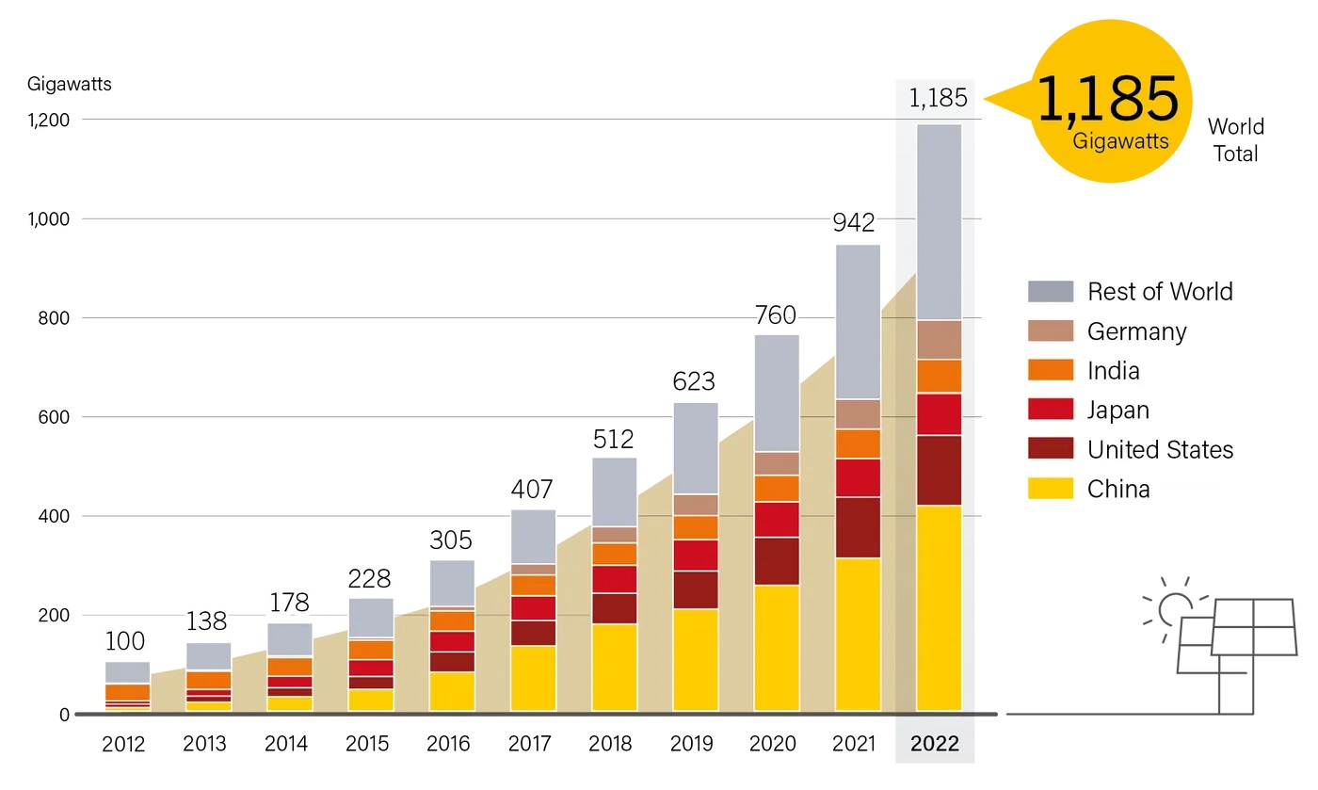
Top Countries for Installed PV Capacity
Image Source: ren21.net

Slide 19
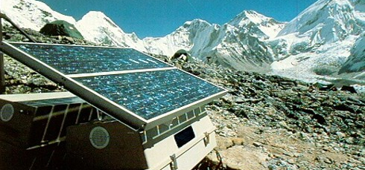
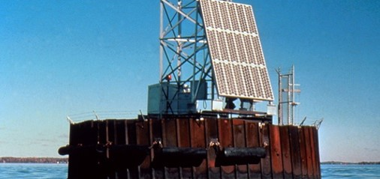
Advantages of Using Solar Energy
No emissions from generation
Sunlight is a free energy source
Sustainable
Provide electricity to remote locations
Notes:
Once solar systems are installed, they run clean, meaning no air pollution or byproducts, and have no moving parts so are easy to maintain.

Slide 20
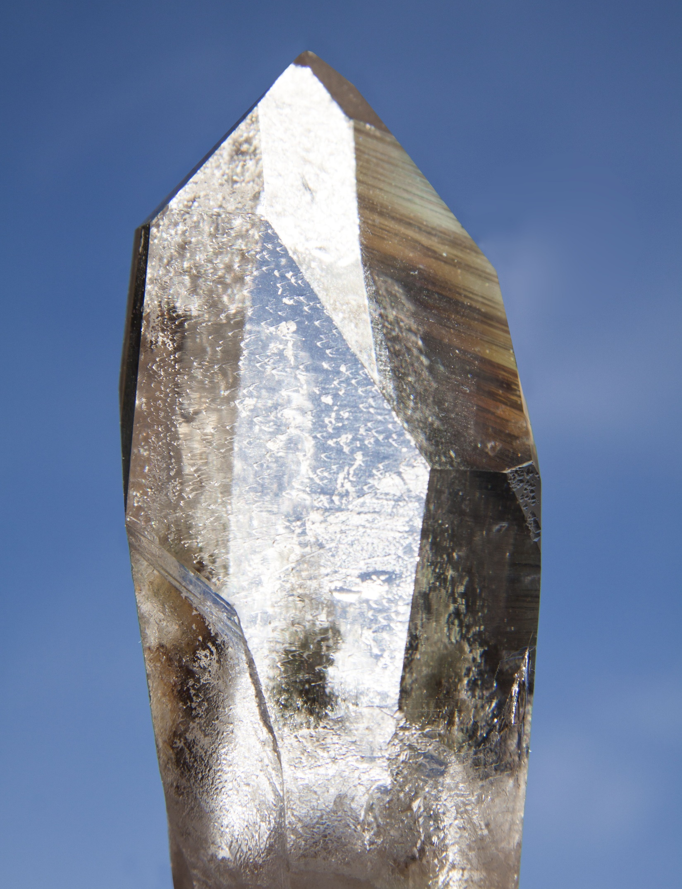
Disadvantages of Using Solar Energy
Less efficient and costly equipment
25% vs 35% of thermal power plant; ignores transmission losses
Residential systems about $3.50/watt installed
Peak production does not coincide with peak demand for electricity
Amount of power available depends on location and season
Environmental impact of PV cell production
Image: Quartz crystal
Image source: Pixabay
Notes:
The first point is becoming less of an issue because the cost of solar systems has decreased dramatically in the last 5 years. Because many PV systems are installed on the buildings where they will be used (called distributed generation), they are not subject to transmission losses. Utility-scale systems, of course, are.

Slide 21
NEED’s Classroom Photovoltaics
Exploring Photovoltaics
Experiments help students understand the conditions needed for optimal power production
Focus of secondary-level solar curriculum
Use digital multimeters

Slide 22
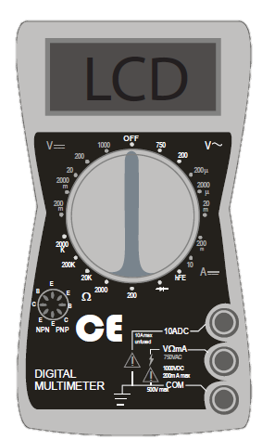
Using a Digital Multimeter
Indicates voltage from alternating current. Do not use.
DC Voltage Scale
DC Current Scale
Resistance Scale. Do not use.
Notes:
Different multimeter models have different arrangements of the controls, but the same symbols and markings are found on all of them. For the solar experiments NEED uses at workshops, AC voltage and resistance are not used.
Connect the red lead to the “VΩmA” terminal, and the black lead into the “COM” terminal.

Slide 23
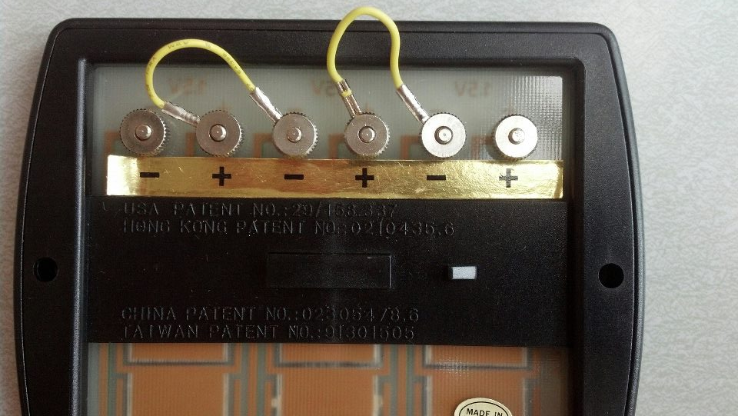
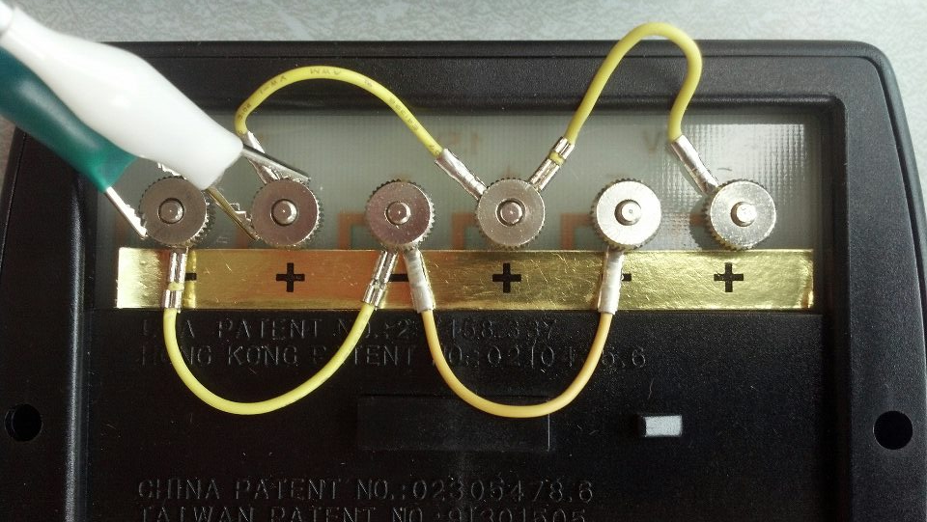
Wiring the PV Modules
Series
Parallel
Notes:
This shows how to connect the modules for series and parallel work.

Slide 24
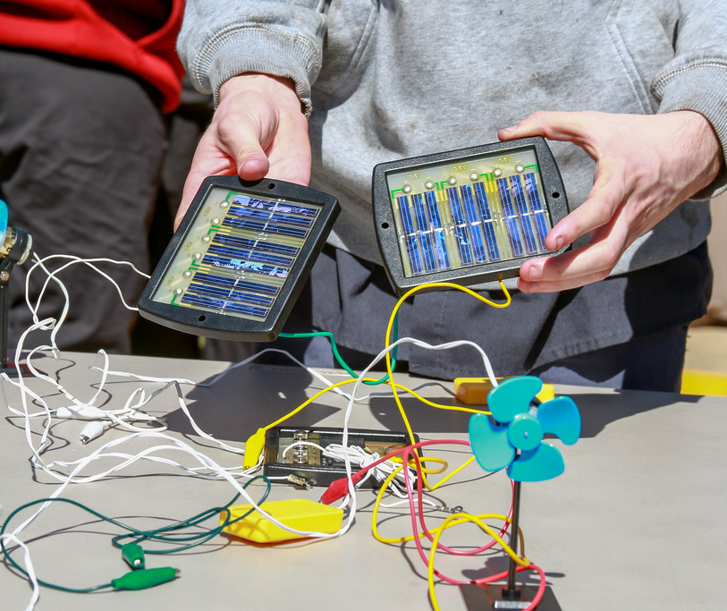
For More Information
The NEED Project
  www.need.org
  info@need.org
  1-800-875-5029
Energy Information Administration
  U.S. Department of Energy
  www.eia.gov
Notes:
Feel free to insert your own email address here if you don’t teachers contacting you.

Slide 25
NEED schools have outstanding classroom-based programs in which students learn about energy. Some schools have student leaders who extend these activities into their communities. To recognize outstanding achievement and reward this leadership, The NEED Project conducts the National Youth Awards Program for Energy Achievement.

Slide 26
Stay up-to-date with NEED. “Like” us on Facebook! Search for The NEED Project, and check out all we’ve got going on!
Follow us on Instagram and check out the photos taken at NEED events, instagram.com/theneedproject
Follow us on Twitter. We share the latest energy news from around the country, @NEED_Project
We have great videos for you on our YouTube channel – activities, career interviews, and so much more! https://www.youtube.com/@NEEDproject

