Slide 1
Baseload Balance

Slide 2
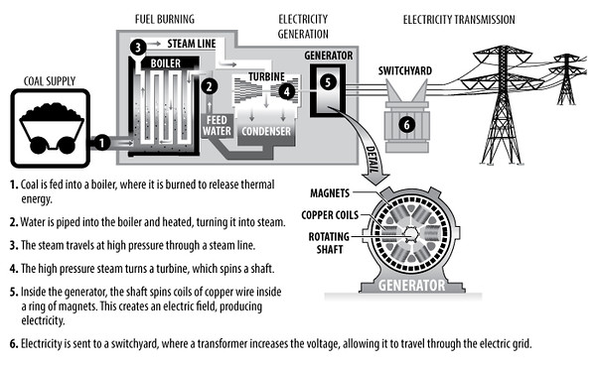
Introduction to Electricity Generation, Supply, and Demand
Key Vocabulary:
Generation - creation of electric power at a power plant
Megawatt – 1x 10⁶ Watts, used to describe amount of power generated by a power plant
Baseload Balance 2021 ©The NEED Project

Slide 3
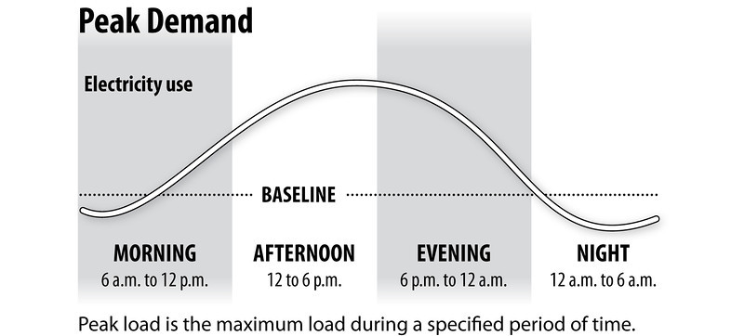
Introduction to Electricity Generation, Supply, and Demand
Key Vocabulary:
Baseload power – minimum amount of electricity that we need all the time, utilities must provide at lowest cost
Peak demand – a period of time when many consumers are using electricity at the same time or in higher quantity, may require additional generation by the utility
Baseload Balance 2021 ©The NEED Project

Slide 4
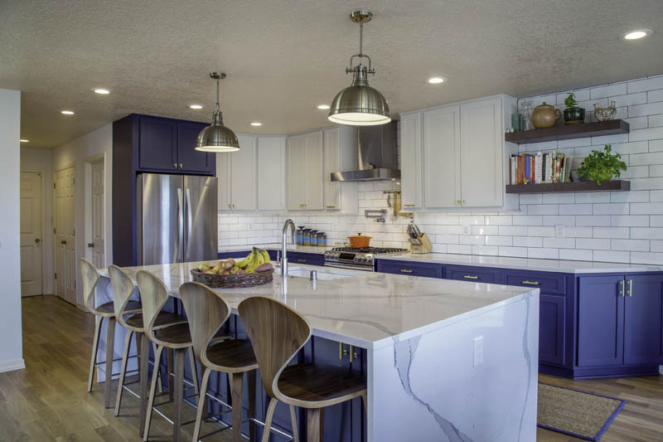
Let’s Go! - Demand
All day and night we use electricity.
115 MW

Slide 5
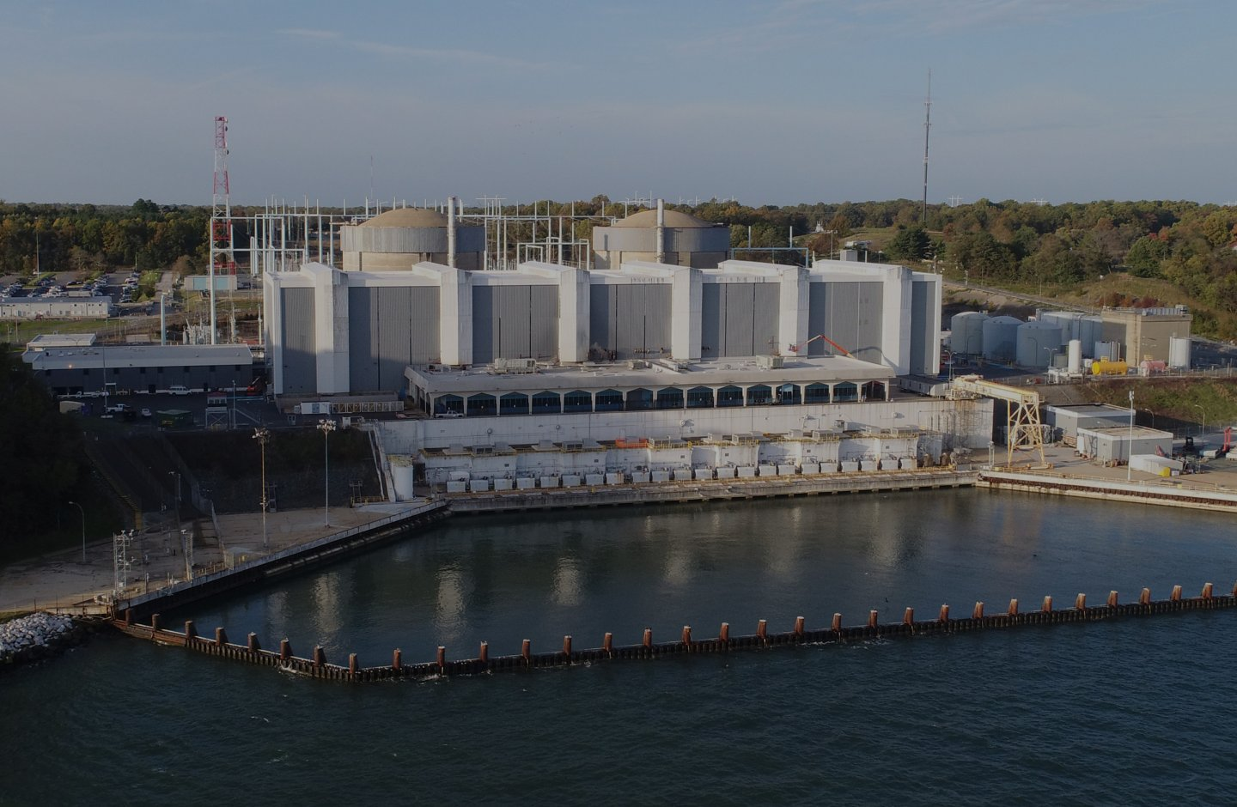
Let’s Go! - Generation
All day and night power plants generate electricity. Coal, natural gas, hydropower, and nuclear power plants run all day and night generating electricity.
115 MW

Slide 6
7:00 am – Morning Peak Demand
How do we use electricity in the morning?

Slide 7
Who has morning demand?

Slide 8
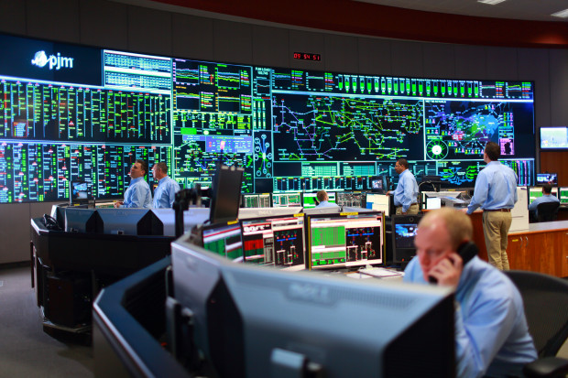
What will the power company do?

Slide 9
Financial Impact
How much did it cost the utility to meet the demand of its consumers?

Slide 10
Financial Impact
Utilities want to spend as little as possible to meet demand so electric bills down increase in the future.
Do you want to make changes to the sources used to meet demand?

Slide 11
All Day Demand
What is turned on and runs all day? (School/Business hours)

Slide 12
Who has all day demand?

Slide 13
What will the power company do?

Slide 14
5:00 p.m.
School is over, offices are closing, people are going home. How do we use energy now?
Change the mass on demand side.

Slide 15
What will the power company do?

Slide 16
Who has evening peak demand?

Slide 17
What will the power company do?

Slide 18
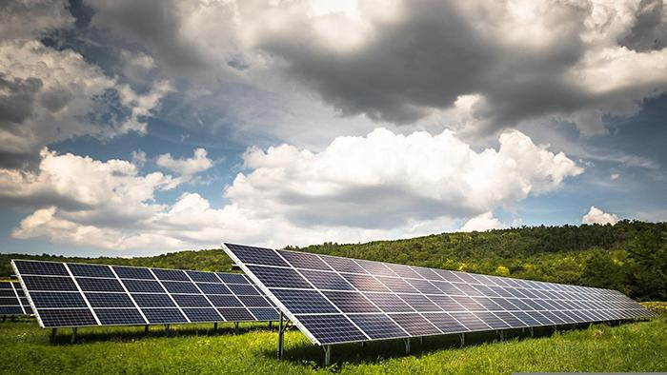
What happens to the sources we were using to generate electricity?

Slide 19
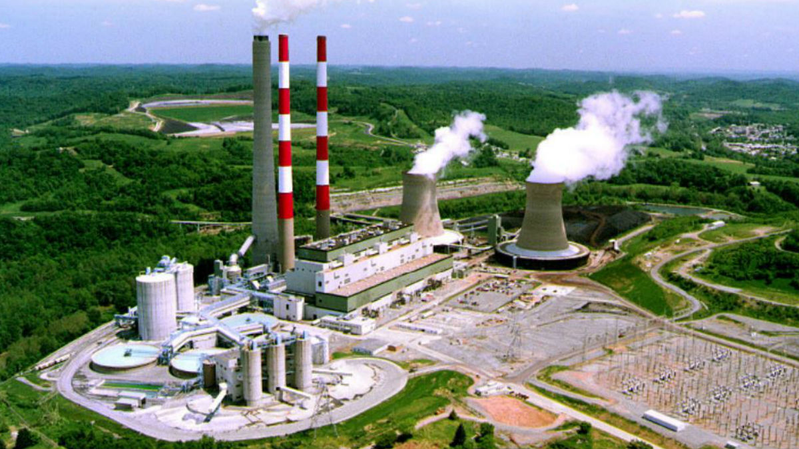
11:00 p.m. – Back to Baseload

Slide 20
Think about it…
Does energy usage remain the same throughout the year?
Does energy generation remain the same throughout the year?

