Slide 1
Who Am I?
Oil & Gas Career Round Up

Slide 2
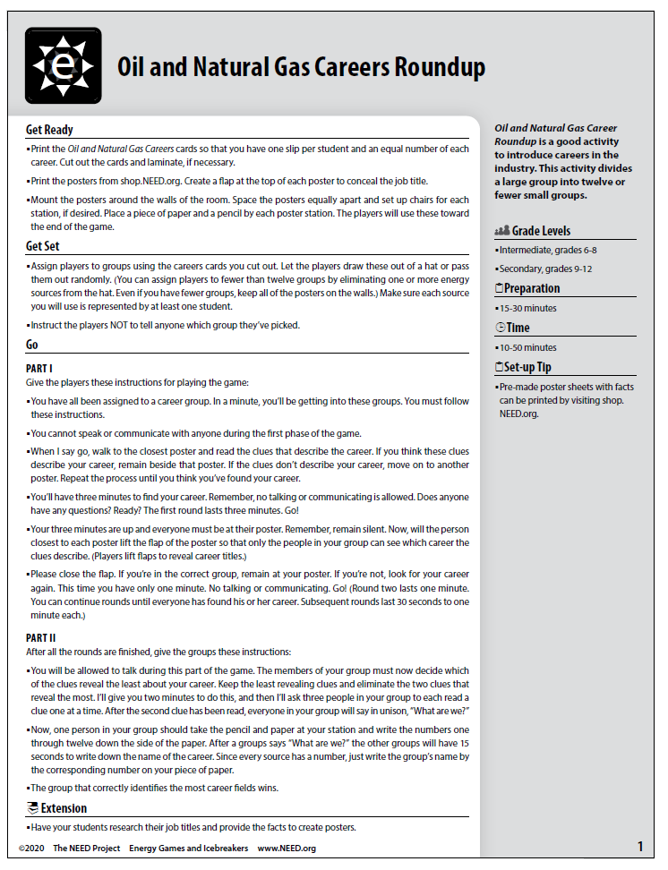
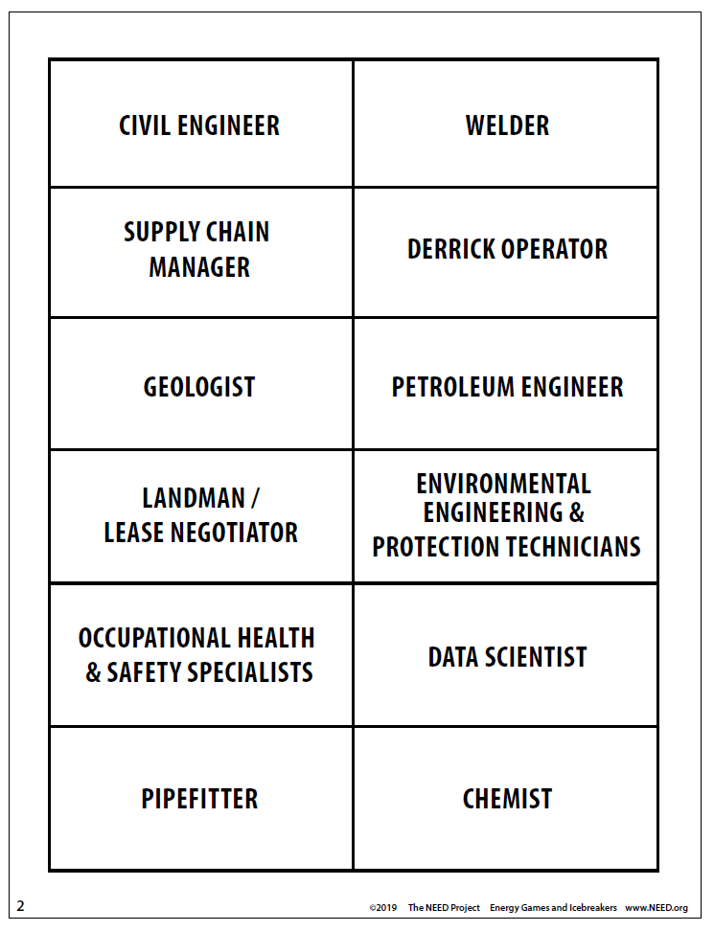

Slide 3
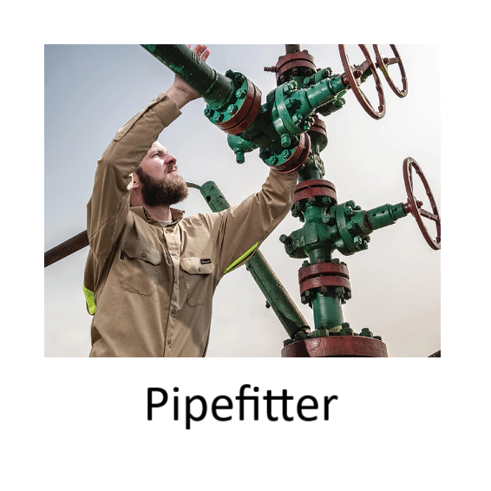
Oil and Gas Career Round Up
My job title requires a high school diploma and an apprenticeship or certification.
I work with a team to plan for a pipe system layout, installation, or repair of pipeline systems that move water, steam, petroleum products, or gases.
I work with plumbers and steamfitters to assemble, install, and repair the pipe system.
I study plans, inspect structures, and test systems using gauges, tests, and other tools.

Slide 4

Oil and Gas Career Round Up
My job title requires a bachelor’s degree
I know how to compile, analyze, interpret, and extract meaning from data on production, transportation, sales, and more.
I use software, tools, statistical formulas, and human thought to look for trends, issues, and needs.
I create reports that will help dictate strategy and logistics in all sectors of the industry.

Slide 5
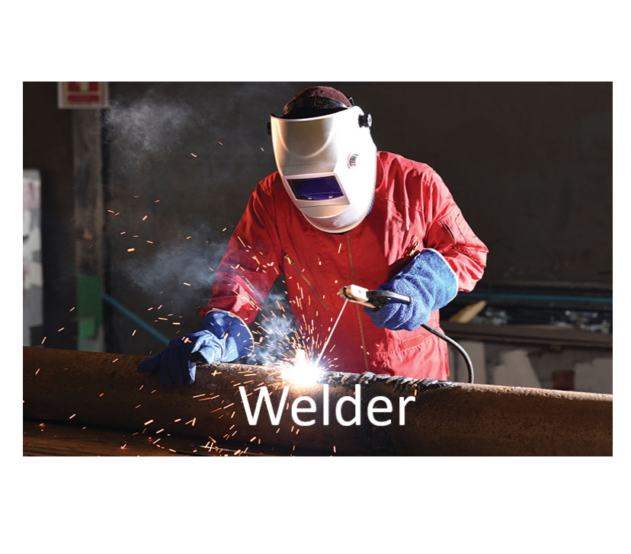
Oil and Gas Career Round Up
My job title requires a high school diploma and an apprenticeship or certification.
I lay out, position, align, and secure metal parts and assemblies that must be joined or sealed.
I use heated irons, gases, torches, or electronic equipment to melt metal and create a seal.
I work in scenarios that require me to be flat on the ground, standing in tight spaces, reaching overhead, or even under water as a diver.

Slide 6
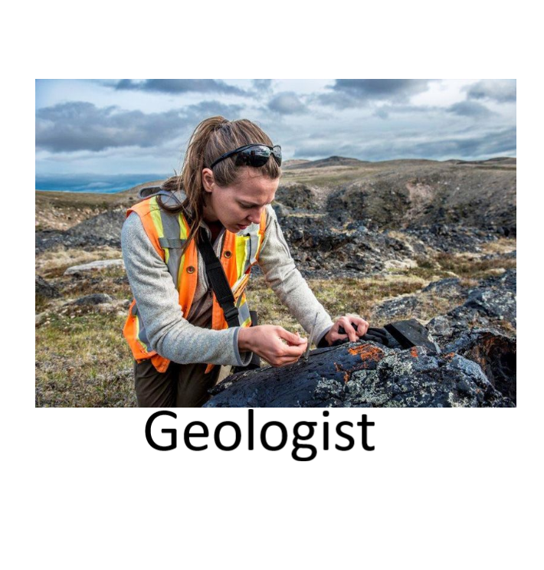
Oil and Gas Career Round Up
My job title requires a bachelor’s degree and often graduate degree programs.
I evaluate seismic, magnetic, and gravitational data to identify good sites for exploration.
I conduct surveys of the sub-surface rock layers to pinpoint the necessary characteristics required for a good drilling site, or to enhance a current site’s development.
I help to determine the processes and equipment needed for safe, economical, and environmentally responsible construction and extraction activities.

Slide 7

Oil and Gas Career Round Up
My job title requires an associate’s degree or bachelor’s degree.
In the field, I conduct tests and collect samples of gases, soil, water, and other materials for testing and corrective action.
I perform laboratory work such as logging numerical and visual observation, preparing and packaging samples, and recording test results.
I receive, set up, test, or decontaminate equipment and assist in the cleanup of hazardous material spills.

Slide 8
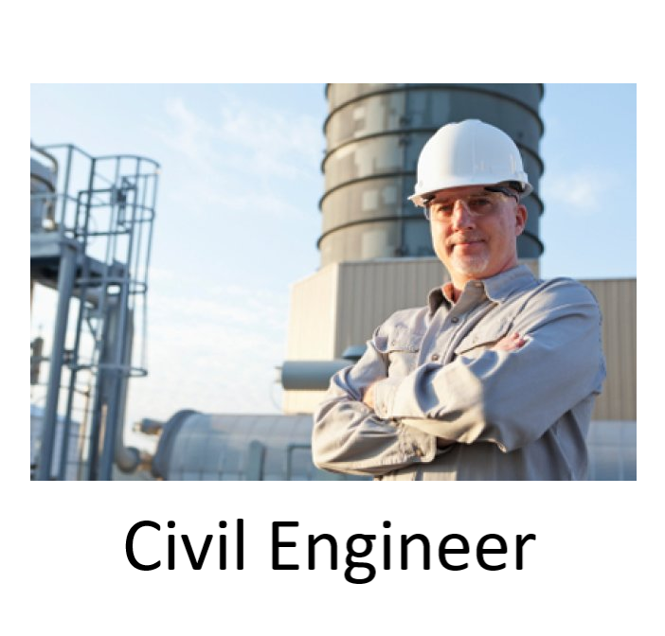
Oil and Gas Career Round Up
My job title requires a bachelor’s degree or higher.
I am responsible for planning, designing, and overseeing construction and maintenance of building structures and facilities such as rigs, pipelines, towers, water lines, etc.
I provide technical advice or program modifications for projects and personnel.
I inspect sites, manage staff members, and provide estimates for cost, labor, and materials.

Slide 9
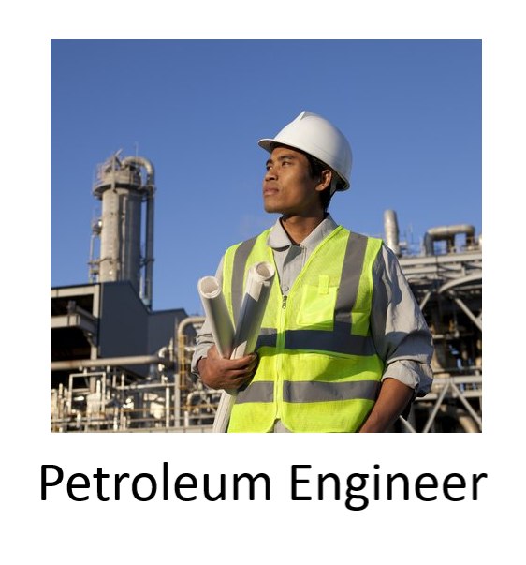
Oil and Gas Career Round Up
My job title requires a bachelor’s degree.
I analyze data to recommend well placement and monitor the completion and evaluation of wells, well testing, or well surveys, providing technical advice and modifications.
I am responsible for devising plans for oil and natural gas drilling and production.
I am constantly assessing costs and estimating the production capabilities of oil and natural gas wells.

Slide 10
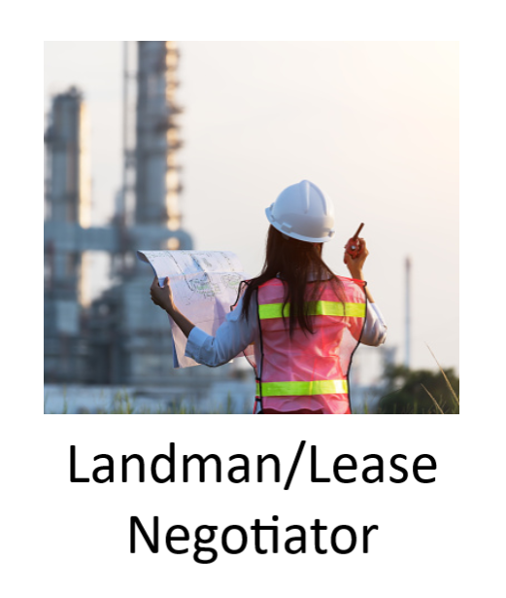
Oil and Gas Career Round Up
My job title requires a bachelor’s degree, and a legal degree is often preferred.
I work with the landowner and/or the government to acquire and maintain access to the land for the removal of natural resources.
I work with a team to negotiate for the ownership or partial ownership (mineral rights) of the resources recovered.
I typically only work in North America, as other countries have different rules and regulations than Canada and the U.S.

Slide 11
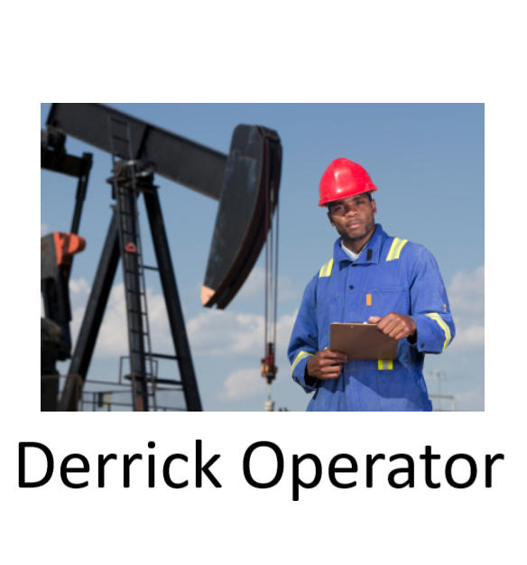
Oil and Gas Career Round Up
My job title usually requires a high school diploma.
I am responsible for rigging drilling equipment and operating pumps to circulate drilling mud through the well’s drill hole.
Often, I must work with others to inspect derricks for flaws and clean the equipment in order to maintain safe and effective work conditions.
I help to control the viscosity and weight of the drilling fluid and repair pumps and equipment that may malfunction.

Slide 12

Oil and Gas Career Round Up
My job title requires at least a high school diploma and significant on-the- job training. Bachelor’s degrees are not required but are often preferred.
I inspect and verify facilities, machinery, and safety equipment to identify and correct potential hazards.
I communicate with employees, promoting worksite or product safety and help to conduct trainings.
I help monitor the use of safety and personal protective equipment and sometimes must evaluate workers for their use of these items.

Slide 13
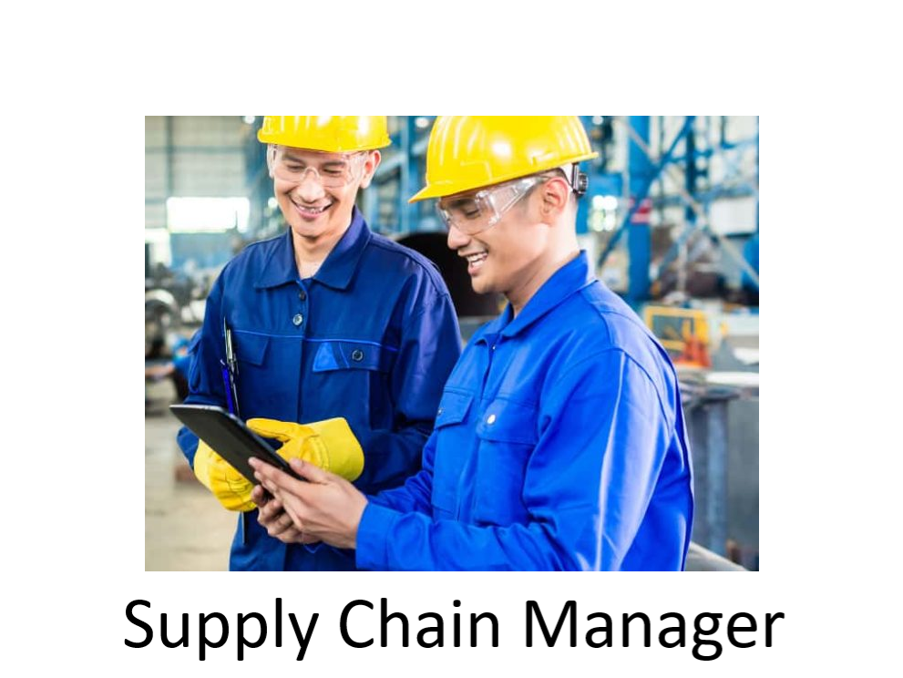
Oil and Gas Career Round Up
My job title requires a bachelor’s degree.
I confer with planners to predict demand for oil and natural gas products or create supply plans that make sure products are available.
I monitor and analyze inventories to increase the sale of products, reduce waste, or improve customer service.
I am in charge of making sure oil and natural gas products are moved, stored, and processed in a way that limits costs and maximizes safety.

Slide 14
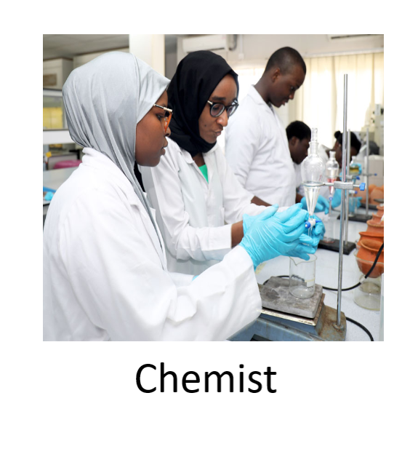
Oil and Gas Career Round Up
My job title requires a bachelor’s degree and often additional graduate coursework.
I work to assess, refine, and create new chemical products to keep proper flow of hydrocarbons from the reservoir to the processing facility and beyond.
I look at data and advise on methods to increase oilfield productivity.
I monitor and manage the use of chemicals on company facilities and insure proper injection.

