Slide 1

Energy Sources
Critical thinking activity that focuses on our nations ten leading sources of energy.
Notes:
Explain that in order to learn more about the 10 sources of energy, we’re now going to do an activity called Energy Enigma. Give a brief overview of the game.

Slide 2
STEP 1
Research
Assign the energy sources that each person in your team will research. Nine sources will be assigned. The tenth source is the one your team is representing.
Examples:
If you have 6 members – 3 members will research 2 sources and 3 members will research 1 source.
If you have 5 members in your group – 4 members will research 2 sources and one member will research 1 source.
If you have 4 members – 3 members will need to research 2 sources and 1 member will research 3 sources.

Slide 3
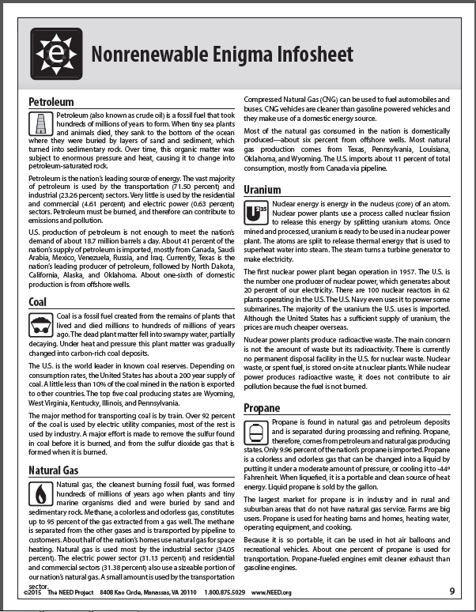
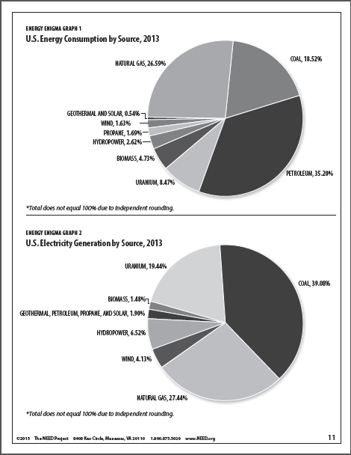
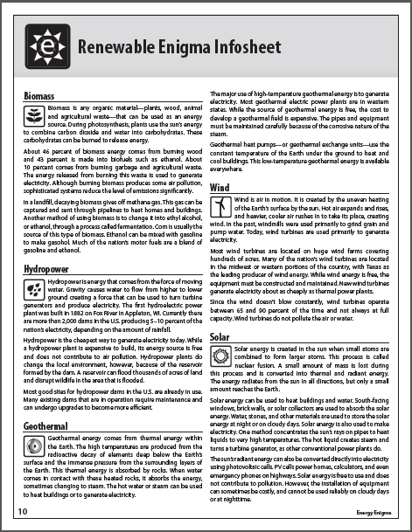
Notes:
Use the Infosheets and graphs to research the information that needs to be filled out on the Data Sheets.
Note: After all of the Data Sheets are filled out, the Infosheets will be picked up. You will only have the notes you take on the Data Sheets to help you figure out the other teams’ sources of energy – so make sure you do a good job taking notes.

Slide 4
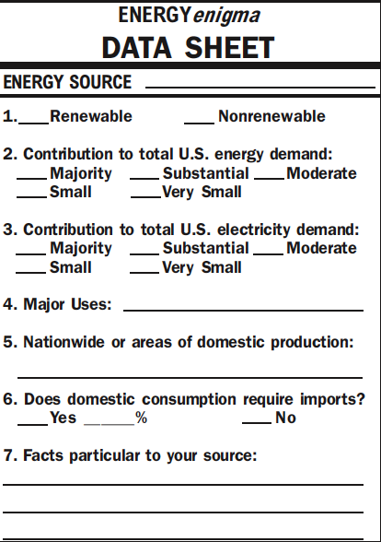
Filling out your Data Sheets
Solar
Label the nine DATA SHEETS with the names of each of the other nine energy sources.
DO NOT label one for your team’s energy
source.
Notes:
Write the name of each energy source you are assigned to research on one of the data sheets. Answer all of the questions about the source on the Data Sheet. You can use the back of the sheet for any additional information you think is important.

Slide 5
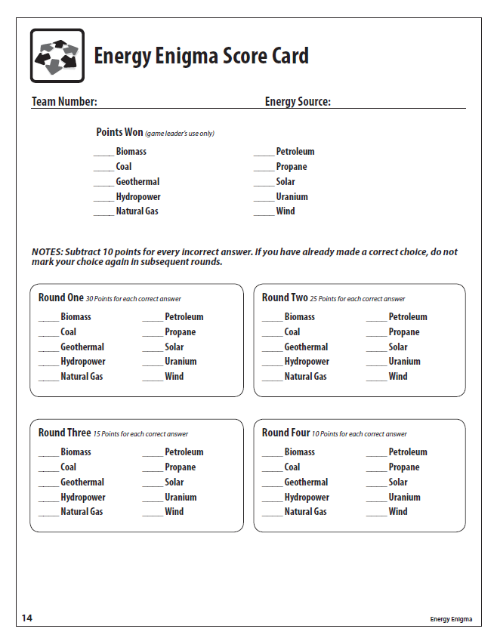
STEP 2
12
Hydrogen
Write your team number and energy source name at the top of your team’s scorecard.

Slide 6
STEP 3
Determine the order of your clues.
Read the eight statements/clues about your source of energy.
Eliminate the four clues you do not want to use.
Number the remaining clues (1 – 4) from least revealing (most general) to most revealing (most specific).
Example
Round 1 Clue – It’s a source of energy.
  Least revealing because all 10 are sources of energy.
Round 2 Clue – It’s nonrenewable.
  More revealing because only 5 of the sources are nonrenewable.
Round 3 Clue – It’s used to produce electricity.
  More revealing because only a few sources are used to produce electricity.
Last Round Clue – It requires fission.
  Most revealing because this clue only applies to one source of energy.
Notes:
The game will be played in 4 rounds. In each round you will see 1 clue for each of the 10 sources of energy and try to guess which source goes with each clue.
Your team now will decide in what order you want the clues to your energy source to be revealed.
Remember, your goal is to try to hide the identity of your source from all of the other groups for as many rounds as possible. Therefore, you want the least revealing clue to be put up in the first round, the next least revealing clue to be shown in the second round.
Since we will only be playing 4 rounds, only the 4 least revealing clues will be used in the game.
Here is an example of how you might rank 4 clues from least revealing to most revealing.

Slide 7
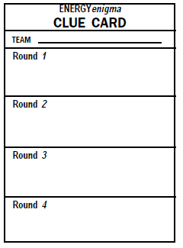
STEP 4
1
2
3
Number the Clue Cards 1 – 10,
EXCEPT for your team’s number.
Notes:
Take out the Clue Cards and number each card from 1to 10 as shown in this slide. Pass out an equal number of Clue Cards to each person in your group – at least as equal as possible since there are 10 Clue Cards (because there are 10 sources of energy) and the 10 may not be divisible by the number of people in your group.

Slide 8
Write the first clue for each team.
Sample Round One
Team 1 It can be used to grill hamburgers. | Team 6 It’s transported by mules.
Team 2 It is not renewable. | Team 7 It smells like gas.
Team 3 It provides 100% of all US energy. | Team 8 Yadda, yadda, yadda…
Team 4 It’s only available at night. | Team 9 Blah, blah, blah.
Team 5 You buy it in Mason jars. | Team 10 It’s found only in Puerto Rico.
5
You buy it in Mason jars.
9
Blah, blah, blah.
Notes:
When I put the First Round clues up on the screen - the person in your group with the corresponding number Clue Card will write the clue in the Round 1 space on their clue card.

Slide 9
STEP 5- Scoring
Your team will receive points for each correct identification.
Number of points depends on the round.
Your team will lose 10 points for each incorrect guess.
Notes:
Now as a team – use the clues from Round One and the information on your Data Sheets to determine whether or not you want to guess what source of energy each clue represents.
If you guess any source correctly in Round One – you will receive 30 points for that correct guess.
However, there is a penalty for guessing incorrectly. For each source you guess that is incorrect, you will loose 10 points.
Any source you choose not to guess does not count for or against you – 0 points for each no guess, but no points taken off your total score.
You may guess as many sources in each round as you would like.

Slide 10
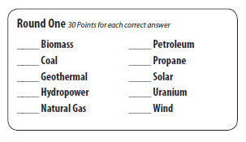
Use the clues to determine whether you can identify any of the energy sources.
10
6
Notes:
Let’s see how the scoring might work if you decided to make two guesses in Round One. Your group has decided that it only wants to make two guesses in Round One.
You are guessing that clue 10 in round one is hydropower so you would write a 10 next to Hydropower.
You are also guessing that clue 6 is wind, so you write a 6 next to Wind.
When you are done guessing, raise you hand and a Scorer will check your answers.
If clue 10 was hydropower you will receive 30 points for the correct guess.
If clue 6 was not wind, we will deduct 10 points for the incorrect guess.
Thus your total score for Round One is 20 points or 30 minus 10.

