Slide 1
Who Am I?
Energy Career Round Up

Slide 2
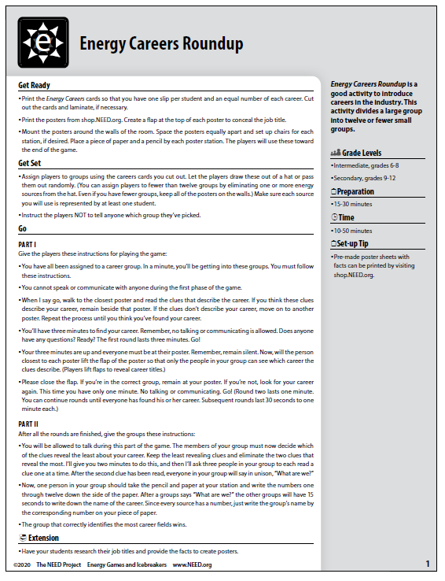
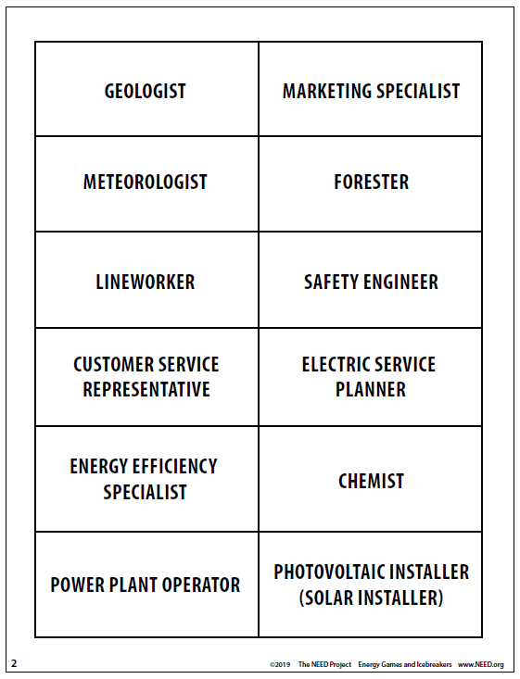

Slide 3
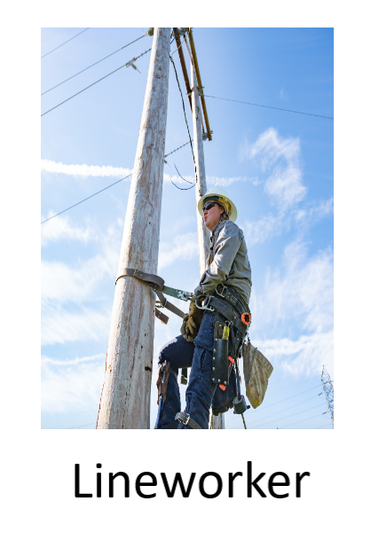
Energy Career Round Up
My job title requires several years of training as an apprentice after graduating high school. My training is often through a local union. Sometimes people seek my job wanting to make a career change later in life.
I use a variety of special personal protection equipment that prevents me from having a shocking day at work.
I might work for utility companies, special contractors in businesses and homes, or in factories.
My workplace is the grid, in winter and summer when the weather safely allows me to.
I keep the world connected and grounded. You could say I have all the power.

Slide 4
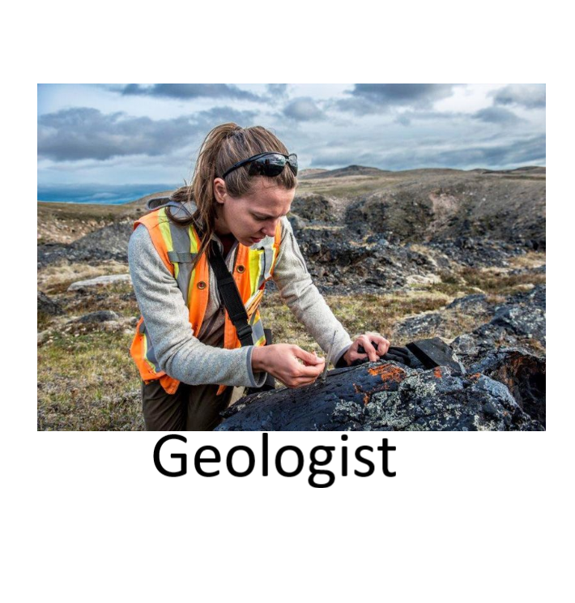
Energy Career Round Up
My job title requires a bachelor’s degree and often a graduate degree.
I am knowledgeable about the Earth, its composition, and what can be found there.
Companies that supply oil, natural gas, coal, uranium ore, and minerals rely on my knowledge to locate these valuable natural resources.
I work with technology that helps me see below ground and know what I will find at which depths.
In my line of work, it’s gneiss to be appreciated and not taken for granite.

Slide 5
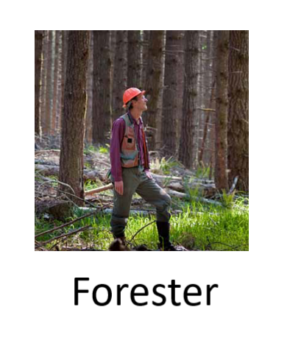
Energy Career Round Up
My job title requires a bachelor’s degree, and if I want to do research in my field, I need a doctorate degree.
Much of my work is done outside, though I also work indoors to analyze data and write reports and recommendations.
I help protect, manage, plant, and care for a wide variety of species. Some of these organisms grow quickly while others have been around hundreds, even thousands, of years.
I need to be able to use a measuring tape, compass, map, and other outdoor equipment to take data and make recommendations. I also need to be able to write reports with my recommendations and instructions.
I cannot always see my entire workspace because trees block the view.

Slide 6
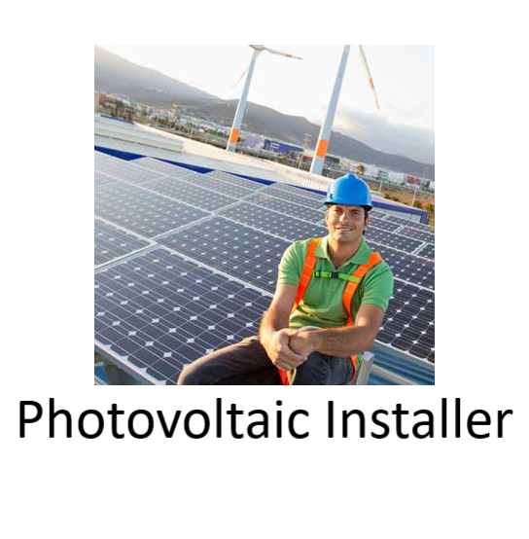
Energy Career Round Up
My job title requires a high school diploma or its equivalent and additional on-the-job training that can last a year or more. Sometimes training takes place at a community college or university or through a local union.
I routinely climb ladders, bringing heavy loads up with me. I also use tape measures and power tools and need to be able to do mental math with fractions quickly and accurately.
I need to have a good understanding of electricity. Some states require that I am a licensed electrician, but others do not. I am always supervised by an electrician if I am not licensed myself.
It is helpful for me to have knowledge of welding and roofing systems to be able to perform my job.
My job’s industry is expected to grow significantly by 2030. How illuminating.

Slide 7
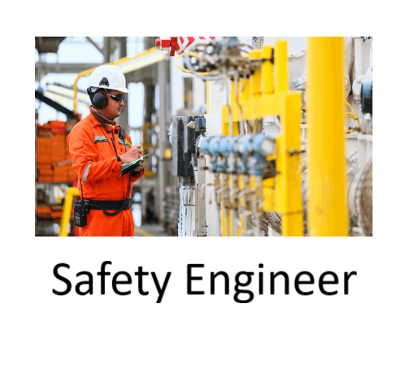
Energy Career Round Up
My job title requires a bachelor’s degree, as well as additional training specific to the area in which I work.
My job requires me to be aware of regulations and codes that keep people from being injured.
It is my job to review and inspect buildings, worksites, and machinery and find problems before someone is injured.
I need to climb ladders, crawl under machines, and be able to move all around my work site to perform my job responsibly.
My favorite song is by the Bee Gees.

Slide 8
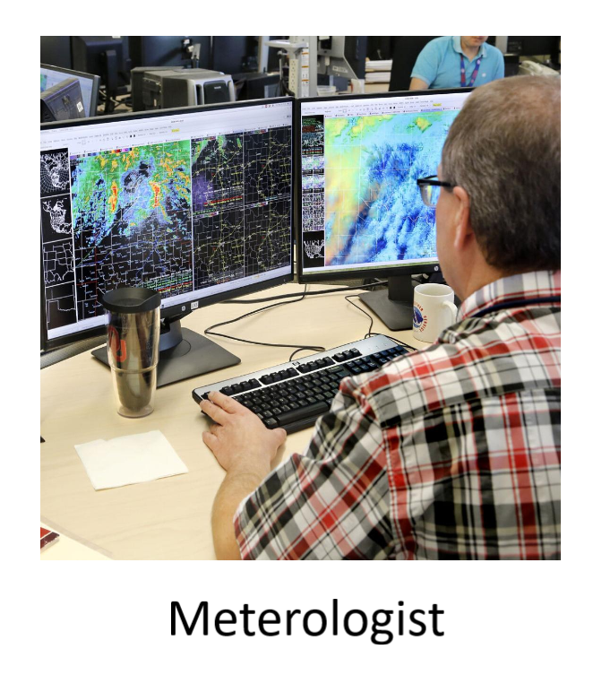
Energy Career Round Up
My job title requires a bachelor’s degree, and many people also earn graduate degrees.
The work I produce is used by many people to schedule projects and plan events.
I use computer models, current measurements, satellite imagery, and past experience to predict the future.
I work for the government, television stations and networks, the military, energy providers, and airlines, to name a few.
My job allows me to be wrong much of the time and still get paid. Cirriusly!

Slide 9
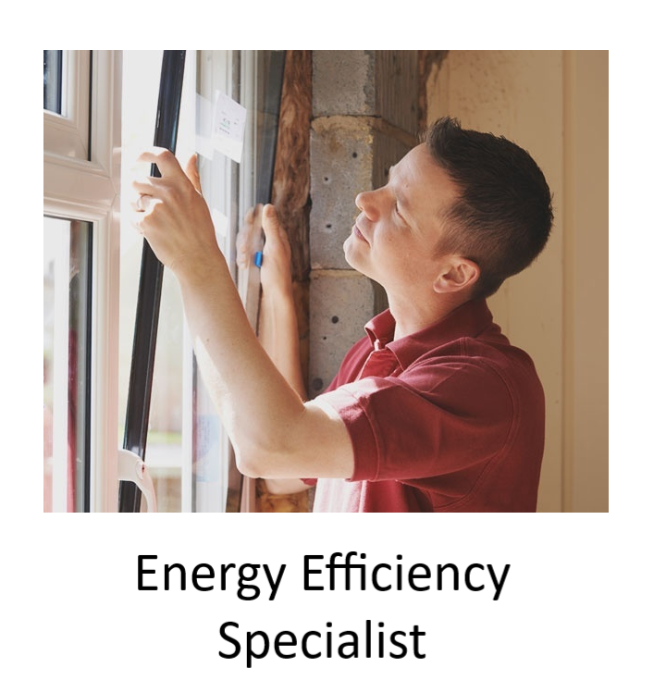
Energy Career Round Up
My job title requires a high school diploma and additional training, but most people in my field have associate’s or bachelor’s degrees. There are specialized certifications I might earn after I complete my degree, too, such as Certified Energy Manager or Certified Demand Side Manager.
Many people who work in my field are in charge of entire buildings or groups of buildings. I know all the energy using systems within my workplace and how to keep them operating at their peak.
I am familiar with helping buildings qualify for LEED certification, Energy Star status, and other indicators of low energy use.
I conduct audits and then make recommendations for using less energy to do the same work. My recommendations are often low- or no-cost fixes that can save money.
I excel at doing more with less.

Slide 10

Energy Career Round Up
My job title requires a bachelor’s degree.
I know a lot about products and how to convince people to buy them.
I know how to get an idea out, whether on TV, radio, or by using social media. I also specialize in knowing who a message is intended to reach.
I excel in creating catchy phrases and slogans.
I can also shop until I drop!

Slide 11
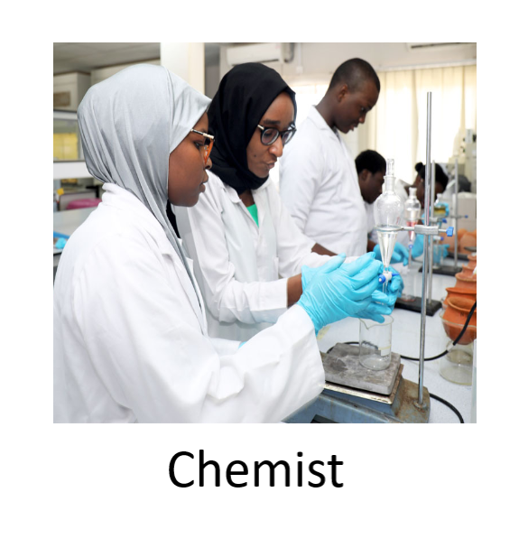
Energy Career Round Up
My job title requires at least a bachelor’s degree; many people doing my job have master’s or doctorate degrees or the equivalent experience.
I look for new ways to manufacture substances or create new substances themselves. Some of the best things to come out of my field are medicines, biofuels, and adhesives.
Besides protective eyewear and clothing, I need to have a properly ventilated workspace to remain safe.
In the energy industry, I might be looking for new formulations of petroleum-based fuels that allow vehicles to operate more efficiently or have fewer polluting emissions.
I don’t know everything, but periodically I come up with some good bonding moments.

Slide 12
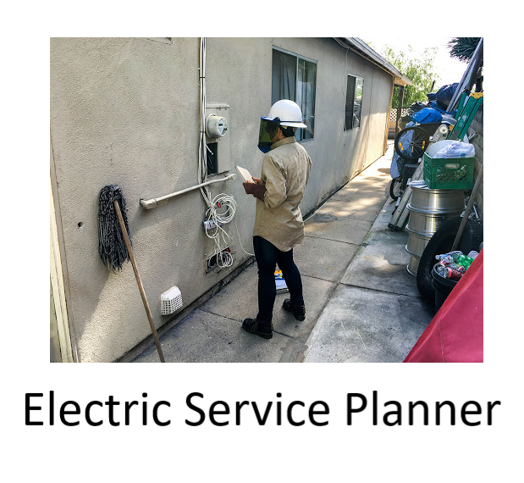
Energy Career Round Up
My job title requires a high school diploma and additional training, which can be from a university or an electric utility.
I can work on small, medium, or large projects for electric utilities. I might bring electricity to a newly built home or lay out the pattern for an entirely new neighborhood.
I coordinate work with a wide variety of other people, including engineers, lineworkers, and local government agencies.
It is important that I stay within budget and make sure new projects follow local building and utility codes and regulations.
As our country’s population increases, I keep everyone plugged in and tuned in.

Slide 13

Energy Career Round Up
My job title requires a high school diploma and often includes additional training from my employer.
I need to be able to listen to people and understand their perspectives in order to find a solution to their problems.
It is my job to review and inspect buildings, worksites, and machinery and find problems before someone is injured.
Even when people are rude to me, it is important that I maintain my composure and be kind in return.
I’m constantly reminded who is always right.

Slide 14
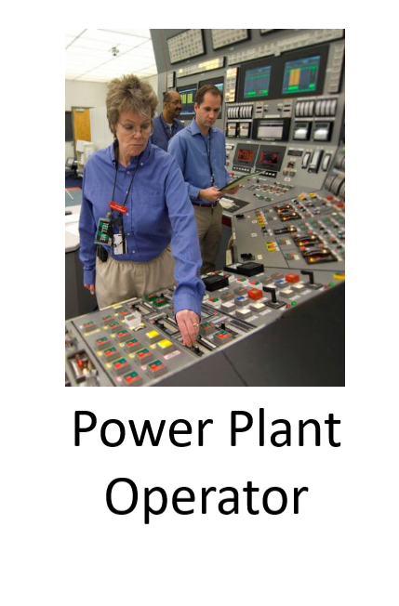
Energy Career Round Up
My job title requires a high school diploma or equivalent. My employer provides on-the-job training that includes a combination of classroom work as well as hands-on experiences. People who work in a specific version of my workplace also need to be licensed.
My job requires a steady supply of an energy source, properly functioning valves and sensors, and continuous monitoring of equipment and systems to ensure they are working the way they should be, and everyone is remaining safe.
I typically read gauges, dials, and other controls to monitor my worksite. I need to be able to record and report data accurately.
As my worksite continues to operate, I often have to analyze the data I have gathered and make adjustments to keep electricity flowing.
Lineworkers think they have all the power, but without me they’re just stringing cable.

