Slide 1
Baseload Balance

Slide 2
Electrical Supply and Demand
GAME GOAL:
Balance electrical demand from consumers with electrical supply from generators.
AVOID the blackout or brownout
Some will act as “loads” with electrical demand
Some will act as “generators” who supply the needed power
Some will act as the Transmission Organization to facilitate the process
Baseload Balance 2021 ©The NEED Project

Slide 3
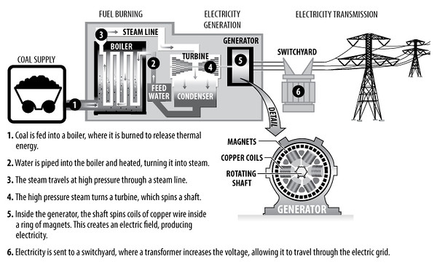
Introduction to Electricity Generation, Supply, and Demand
Key Vocabulary:
Generation - creation of electric power at a power plant
Megawatt – 1x 10⁶ Watts, used to describe amount of power generated by a power plant
Baseload Balance 2021 ©The NEED Project

Slide 4
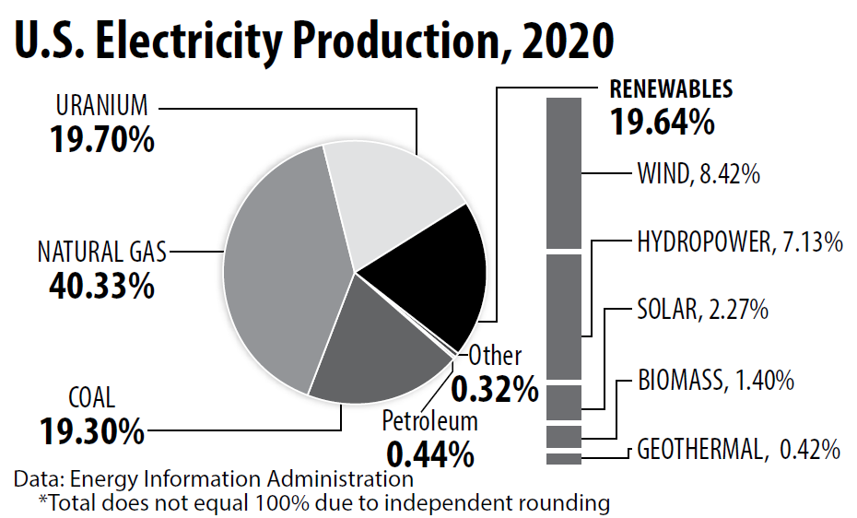
Baseload Balance 2021 ©The NEED Project

Slide 5
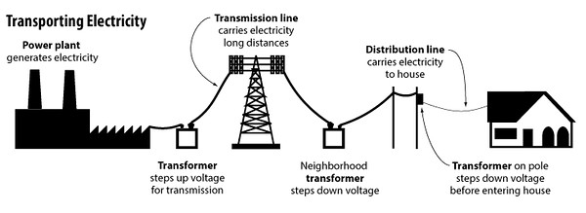
Introduction to Electricity Generation, Supply, and Demand
Key Vocabulary:
Load – an electrical device or group of devices that is plugged in
Transmission – transfer of generated electricity
Baseload Balance 2021 ©The NEED Project

Slide 6
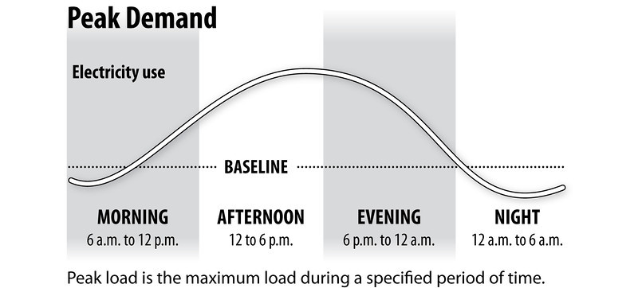
Introduction to Electricity Generation, Supply, and Demand
Key Vocabulary:
Baseload power – minimum amount of electricity that we need all the time, utilities must provide at lowest cost
Peak demand – a period of time when many consumers are using electricity at the same time or in higher quantity, may require additional generation by the utility
Baseload Balance 2021 ©The NEED Project

Slide 7
Game Goal Revisited
Balance electrical demand from consumers with electrical supply from generators.
AVOID the blackout or brownout
Some will act as “loads” with electrical demand
Lists the time you come online/offline and your demand size
Some will act as “generators” who supply the needed power
Lists the generation capacity and cost
Some will act as the Transmission Organization to facilitate the process
Baseload Balance 2021 ©The NEED Project

Slide 8
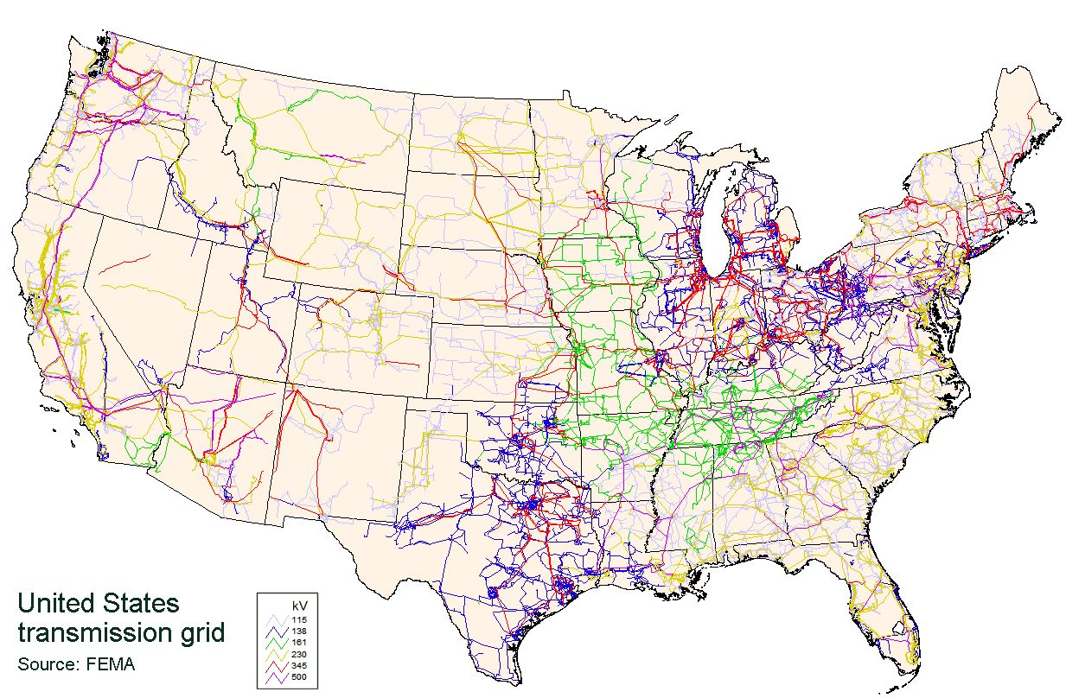
RTO / Transmission
Facilitate the balancing by holding up the lines
Help each side tally their totals
Report to the RTOs what is needed or available from each side
Baseload Balance 2021 ©The NEED Project

Slide 9
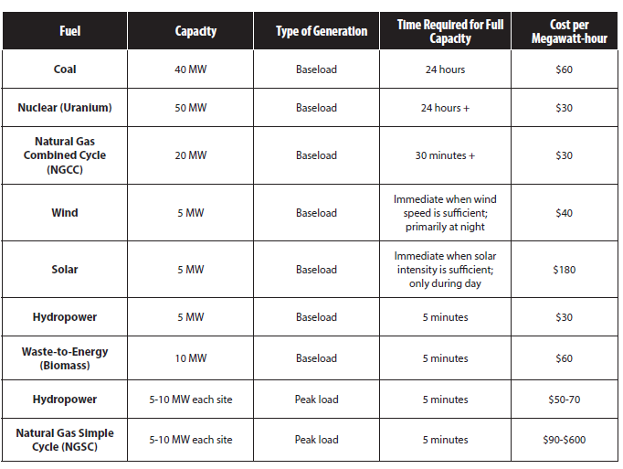
Generation Parameters
Baseload Balance 2021 ©The NEED Project

Slide 10
Key Vocabulary:
Simple Cycle – basic thermal plant, fuel is burned to create high pressure steam that turns a single turbine, about 35% efficient
Combined Cycle – thermal plant that incorporates additional turbine into cycle
gas is brought in at high pressure to turn a turbine
waste heat from the gas is captured to make steam to turn second turbine
Increases efficiency to as much as 60%
Baseload Balance 2021 ©The NEED Project

Slide 11
Let’s Play!
Phase 1 – BALANCE THE DEMAND (loads) with GENERATION
Come online and offline to match demand
Hand off your card to a seated friend
Phase 2 – BALANCE THE DEMAND (loads) with GENERATION
The RTO should require generators supply 15% extra generation above demand
Hand off your card to a seated friend
Phase 3 - BALANCE THE DEMAND (loads) with GENERATION
The RTO should require generators supply 15% extra generation above demand
Make sure consumers have the LOWEST possible cost at all times
Hand off your card to a seated friend
Phase 4 - Balance the demand, Provide 15% Extra @ Lowest Cost AND lookout for an unplanned INCIDENT.
Baseload Balance 2021 ©The NEED Project

Slide 12
BASELOAD BALANCE
Can we Balance?
LOADS
GENERATORS
MW needed :
0 MW
Generating Capacity:
0 MW
Total Cost :
$000
Baseload Balance - 7/13/17 - ©The NEED Project

